Slide 1
New challenges in multi-robot task allocation
Maria Gini
(with work from Ernesto Nunes and James Parker)
Department of Computer Science and Engineering University of Minnesota
March 17, 2015

Slide 2
Outline
Task allocation is ubiquitous in computer science, multi-agent and multi-robot systems.
There are many algorithms for multi-robot task allocation.
We are interested in algorithms, that scale well with the number of robots and tasks, and that are robust to robot failures.
We assume robots are collaborative.

Slide 3
Two specific challenges
Allocation of tasks that have general temporal constraints, which are expressed as time windows within which a task must be executed. We do not pose any restrictions on the time windows.
Allocation of tasks that have a cost that grows over time.

Slide 4
Interaction between time and space
Example problem with 3 robots and 6 tasks
Set of robots.
Set of tasks.
Tasks and task locations are known
Each task requires a single robot.
Robots do 1 task at a time, but can do multiple tasks over time.
Time windows for tasks. Blue boxes in the time windows represent task duration.

Slide 5
Why this is difficult
Temporal and spatial constraints might be in conflict (a task close by in space is distant in time).
Centralized solutions (based on MILP) do not scale well and need to be recomputed if a robot fails or is delayed.
Centralized solutions work when tasks are known up front, but are difficult to use when tasks arrive on-line while the robots work.
Optimizing for makespan (i.e. completion time of last task) and distance traveled is hard even when using heuristics methods.

Slide 6
TeSSI algorithm
Temporal Sequential Single Item Auction – TeSSI.
Uses sequential single item auctions [Lagoudakis et. al., 2006]
Each robot uses a simple temporal network STN [Dechter and Pearl, 1991] to keep its schedule consistent
Objective is to minimize the time to finish all the tasks (makespan) alone [TeSSI] or in combination with the total distance traveled [TessiDuo]
Works both when tasks are known upfront and when they arrive online.
E. Nunes and M.Gini, Multi-robot auctions for allocation of tasks with temporal constraints, AAAI 2015

Slide 7
Sequential single item auction
In a sequential single item auction, all the items are available for bidding, one at a time is allocated to the bidders with the smallest overall bid.
The process continues with new bids for the remaining tasks, until all tasks are allocated.
When a bidder bids, it can take its existing allocation into account by bidding its marginal cost (the cost of adding the new item to its existing items). This enables to take synergies into account.
The algorithm is polynomial and the length of the solution path in the worst case is twice the optimal.

Slide 8
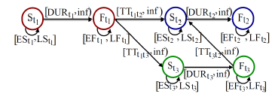
STN representation
Task representation in a simple temporal network. Each task is represented by two time points, start and finish, connected by an arc constrained by the task duration. Travel times to the next task constrain the arc that connects the end of one task and the start of the next one.

Slide 9
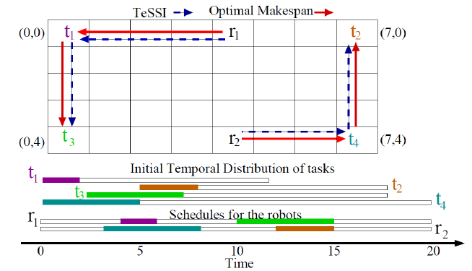
TeSSI on a Small Problem
In this case TeSSI finds the optimal solution that minimizes the makespan, but there is no guarantee it will find the optimal solution.

Slide 10
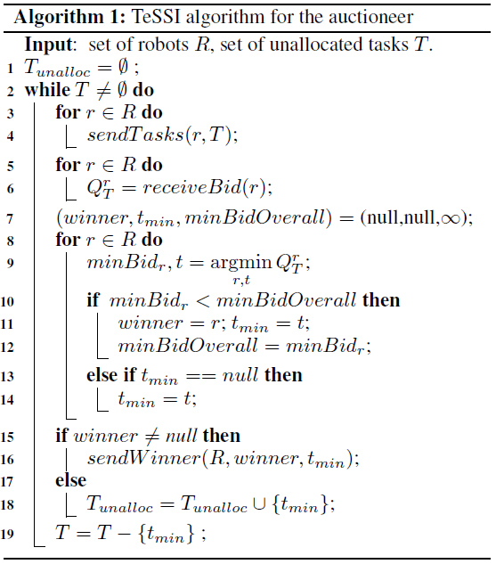
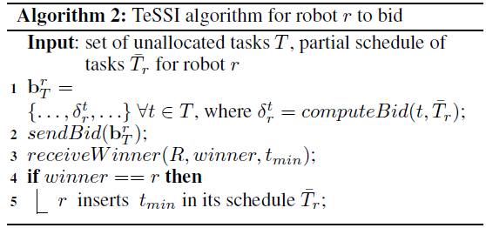
TeSSI algorithm
Bidding
Winner determination

Slide 11
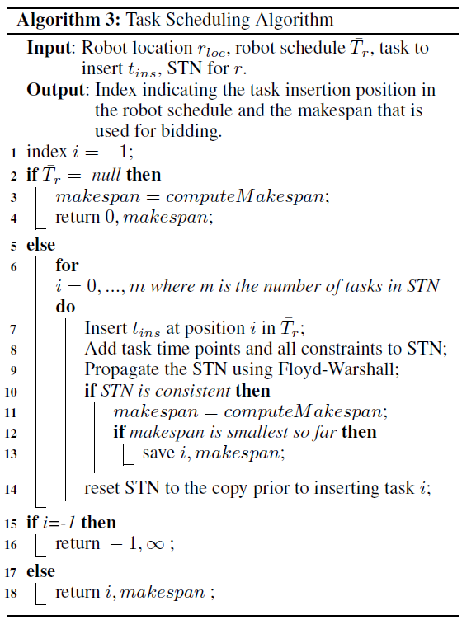
Bid computation algorithm for a robot
Empty schedule, add task in first place.
Find best insertion point for task.
Fail: caused by inconsistency
Succeeded: return insertion index and makespan

Slide 12
Performance comparison with baseline algorithms
Consensus-based bundled auction algorithm [Brunet et al. 2008, Ponda et al., 2010]
Multiple tasks are assigned in each round, instead of a single task.
When a task is inserted the start time of tasks already allocated to the robot does not change.
Greedy assignment algorithm
Assigns a task to each robot in every round, if the task does not cause temporal conflicts.

Slide 13
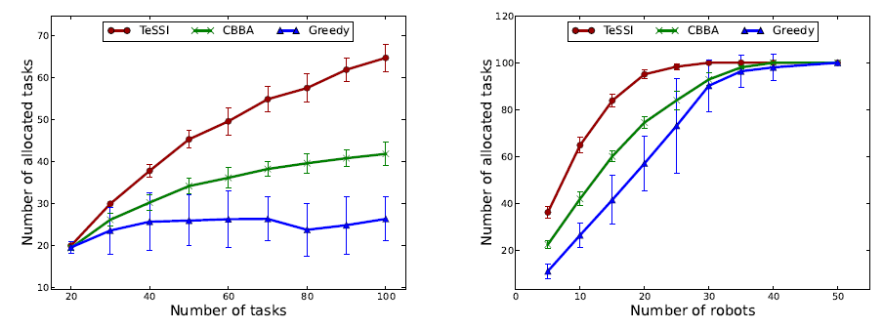
E1: TeSSI completes more tasks than CBBA and Greedy, and it uses fewer robots to complete the same number of tasks
TeSSI allocates more tasks, with makespans competitive with CBBA when both allocate all the tasks
TeSSI needs fewer robots to complete all the tasks.
Dataset 1: 20-100 tasks and 10 robots.
Dataset 2: 100 tasks and 5-50 robots .
Notes:
TRANSITION: IN EXPERIMENT 2

Slide 14
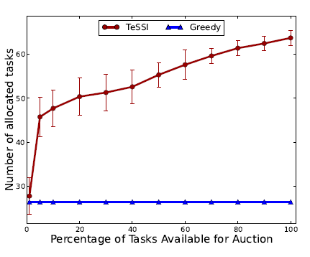
E2: tasks arrive together in batches
100 tasks total.
10 robots.
Tasks arrive in batches of sizes: 1,…,10 - 100.
TeSSI improves allocation even with small numbers of tasks in each batch. More tasks per batch produce better allocations.
.
Notes:
TRANSITION: IN EXPERIMENT 3

Slide 15
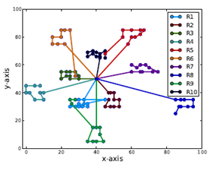
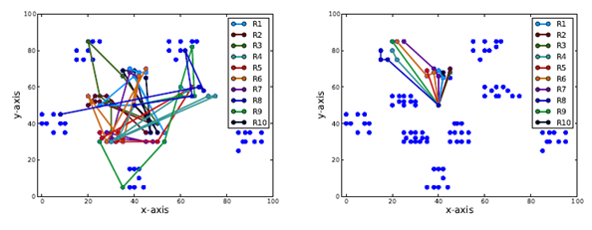
E3: clustered tasks and tight time windows
TeSSI allocates more tasks than the competing algorithms.
Data from the Solomon dataset for vehicle routing with time windows.
TeSSI
CBBA
Greedy
100 tasks and 10 robots

Slide 16
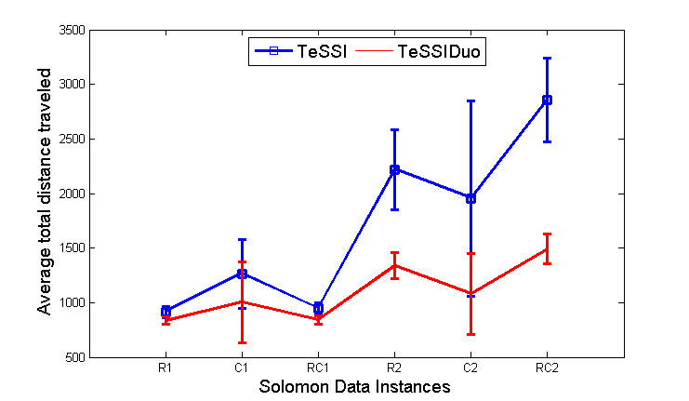
E3: TeSSIDuo produces smaller distances
TeSSI Duo uses an optimization function which is a weighted sum of makespan and travel costs.
Notes:
TYPE 1 HARD TO COMPARE BECAUSE ROBTOS COMPLETE DIFFERENT NUMBER OF TASKS
TYPE 2 CAN COMPARE
TRANSITION: In SUMMARY

Slide 17
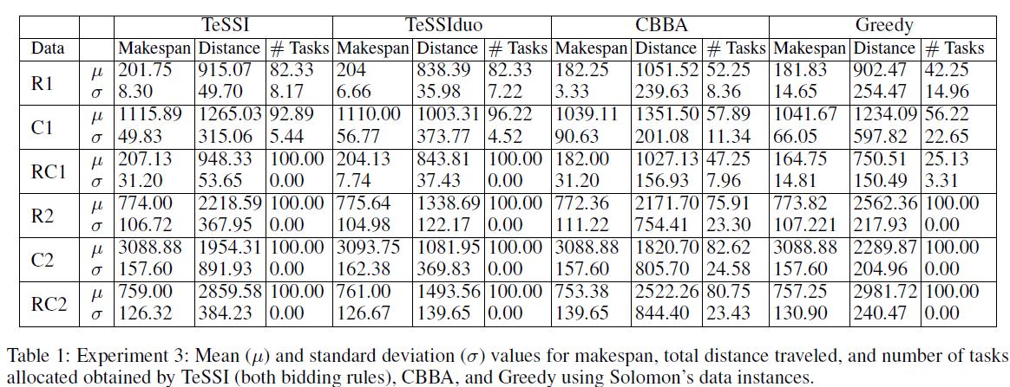
E3: Aggregate data on Solomon datasets
Location : R (randomly ), C(clustered) , RC (mixed randomly and clustered).
Time window tightness/size: type 1 (small), type 2 (large)
6 datasets (R1, C1, RC1, R2, C2, RC2). Each dataset with 8-12 instances.

Slide 18
Summary and outlook
Distributed task allocation with general temporal constraints
Allocate more tasks than baseline methods, with competitive makespans
Suitable for allocation of tasks online
Next steps:
Relax perfect knowledge constraints
Incorporate temporal flexibility to reallocate tasks

Slide 19
RoboCup Rescue Simulator
Many agents
uncontrollable events
lack of information
limited communications
time limits (e.g., people die if not rescued)

Slide 20
Why RoboCup Rescue Simulator?
Complex environments (real maps of real cities)
Lack of information. Agents know the map before the disaster but do not know what roads are impassable, what buildings are collapsed, where are fires, etc
Limited communications. Limited number of channels and number of bytes. A percentage of the messages do not get delivered
Heterogeneous agents (police, ambulances, and fire trucks) with different types of tasks

Slide 21
RoboCup
No coordination
Coordination
Teamwork affects performance.
How to do teamwork when communication is limited?

Slide 22
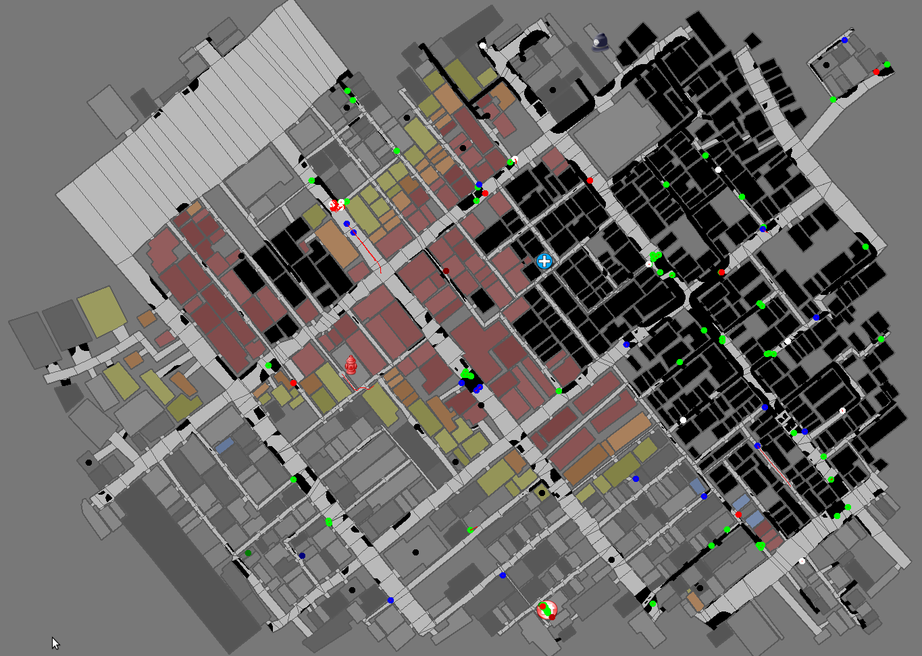
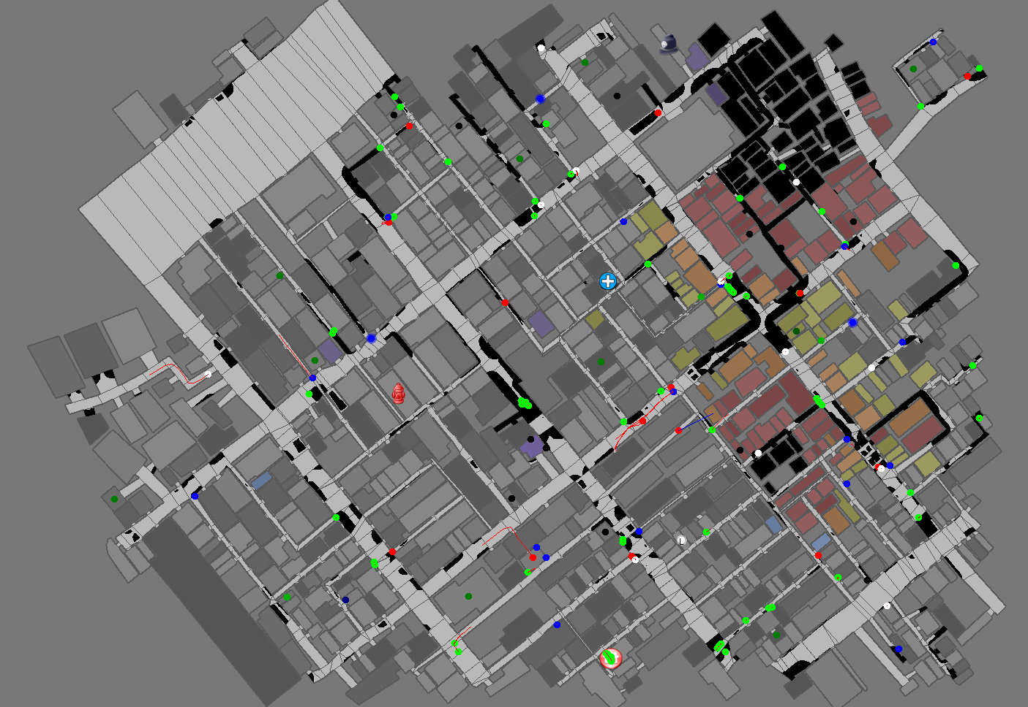
Teamwork affects performance
Example: We form teams based on spatial locality of initial agents positions.
Without teams a large part of the city burns
With teams there is much less fire damage.

Slide 23
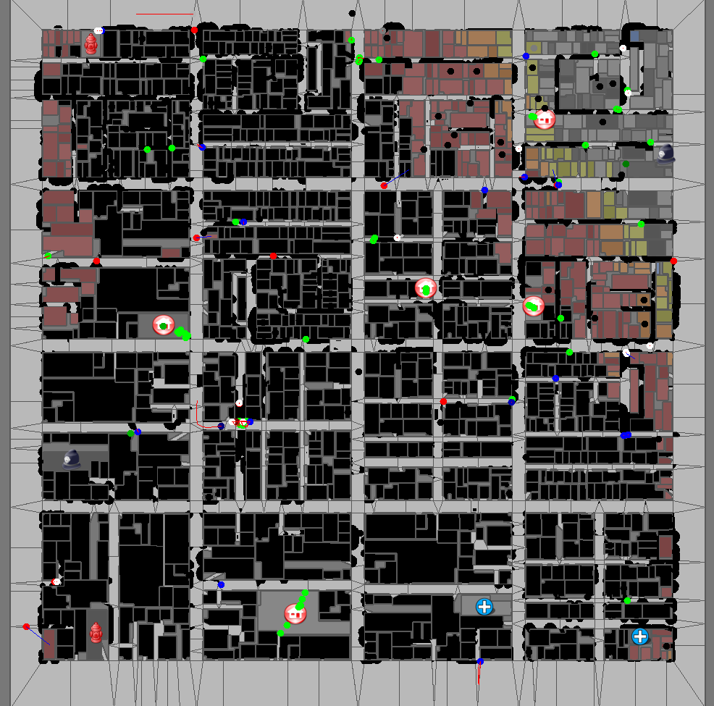
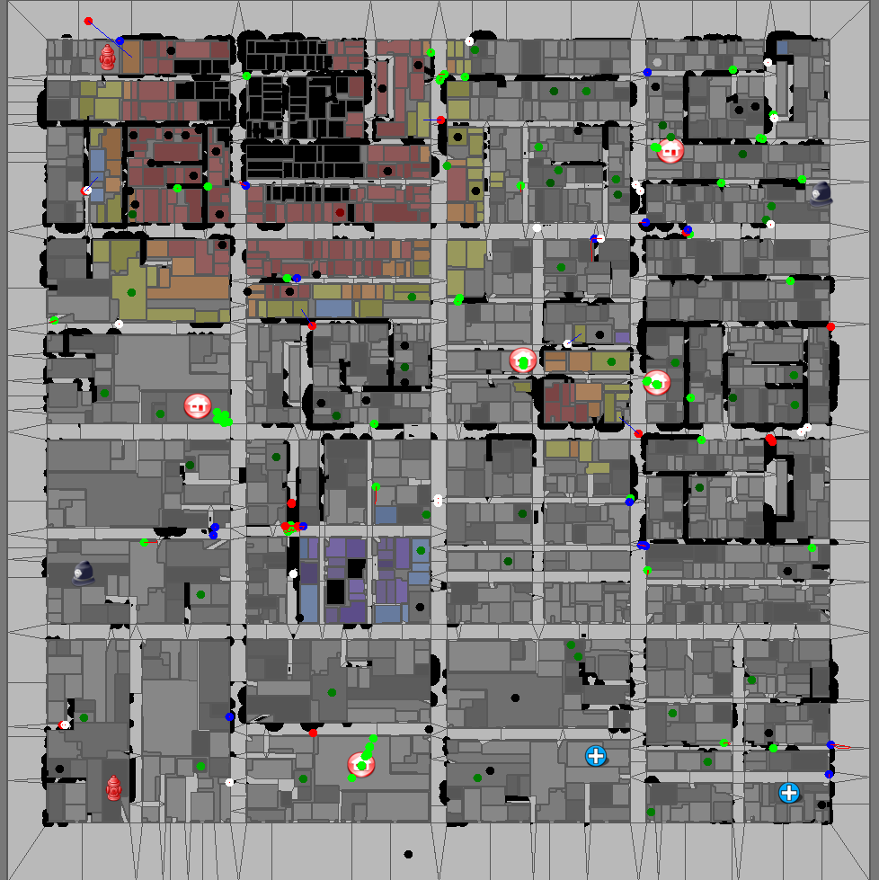
Tasks with cost that grows with time
Fires grow with time and become harder to contain.
The same starting conditions produce very different results depending on how quickly the fires are discovered and attacked.
J. Parker and M.Gini, Tasks with Cost Growing over Time and Agent Reallocation Delays,
AAMAS 2014

Slide 24
Modeling task costs
Task allocation algorithms assume tasks have a fixed cost. Many tasks (such as fire-fighting) have costs that change with time.
We model task costs over time as a recurrence relation, where fi is the cost of task i
where
We assume
We have n agents which have a fixed work rate w
The growth function h(f) is the same for all tasks
The growth function is positive definite convex
Travel time is constant
There are more robots than tasks
We want to reach a time ts when cost of task i is 0,

Slide 25
Example

Slide 26
Optimal allocation of agents to tasks
A solution that extinguishes all the fires exists at time ts if and only if for all tasks bi
We proved that, assuming that travel times are all the same, to minimize the finish time it is sufficient to minimize the regret, i.e.
We showed that Rts can be minimized by greedily minimizing at each time step when h(x) is monotonically accelerating, linear and monotonically decelerating. Hence agents should be assigned to the tasks that have the largest growth.

Slide 27
Latest Finishing First (LFF)
Latest Finishing First (LFF) assigns agents, one by one, to the task which finishes last.
First LFF assigns the tasks that never finish, selecting for them the closest agent still free.
Then it finds the task with the largest finish time and assigns it to the closest agent and continues until all agents are assigned.
Tasks with larger finish times will get more agents.
The algorithm terminates when all the agents are assigned.
If the task growth model is accurate and the travel time is the same the allocation is optimal.

Slide 28
Accelerating growth function
All agents should be assigned to the largest task until there is a tie, and then evenly distributed to the largest tasks.
Two tasks and 60 agents. Initially all agents are allocated to Task2, which is the largest, and slowly reduce it from its initial value. Around time 316, both tasks cost the same and each task is assigned 30 agents. Both tasks end at the same time. If instead agents are assigned only once, 3 will be assigned to task 1 and the rest to task 2 for the whole time

Slide 29
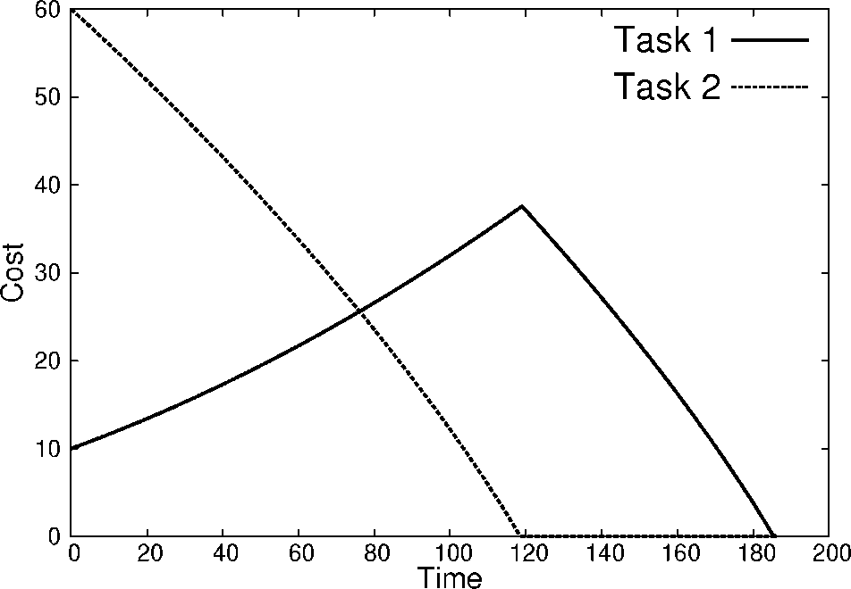
Decelerating growth function
The rate of change in growth is faster in smaller tasks. Larger tasks grow faster than smaller ones, but reducing smaller tasks will shrink their future growth more than for larger tasks.
All the agents are assigned to Task 1 until it is completed. During the 20 time steps it takes to complete 10 units of cost on Task 1 Task 2 only increases about 6 units of work. Task 2 then takes over 130 time steps to remove 66 units of cost.
All the agents are assigned to Task 2 until it is completed. During the 120 time steps it takes to complete Task 2, Task 1 increases. When all the agents are moved to Task 1 they reduce it to 0, but it takes longer to complete the two tasks.

Slide 30
From LFF to RT-LFF
LFF assigns agents to tasks using its estimate of the tasks growth.
If the estimate is not correct, and since travel times are not constant, the results are suboptimal.
RT-LFF applies LFF repeatedly, reallocating agents to tasks when reassigning an agent to a task reduces the overall completion time for all the tasks.

Slide 31
Modeling fires in RoboCup Rescue
Rate of growth of fire, g, is proportional to the number of buildings on fire, x:
Rate of growth is reduced by the number of agents n working on it times the work w each agent does :
Number of buildings on fire is
Solving for x=0 produces the completion time ct when the last fire will be extinguished

Slide 32
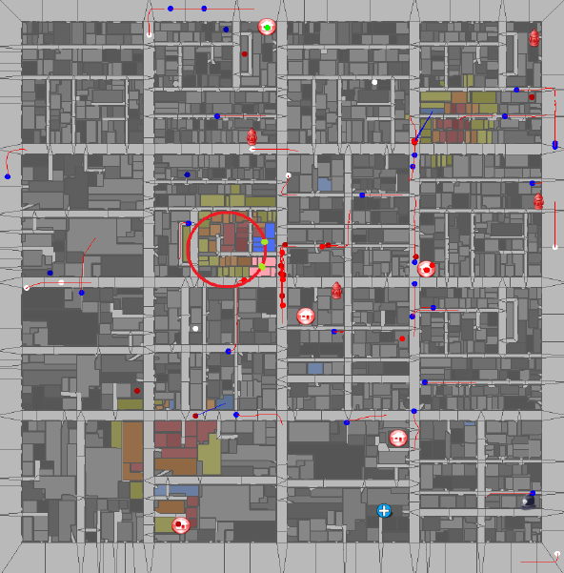
Task clusters

Slide 33
Results in Kobe map
RT-LFF
Assign agent to closest fire

Slide 34
Experimental Results
Comparison of RT-LFF against
Assign an agent to the closest fire in need
Use a uniform distribution of agents to tasks
Assign all agents to one task and when that task is complete move all of them to the next task

Slide 35
Summary and outlook
Model growing tasks as a recurrence relationship
Under our stated assumptions:
Optimal solution when reallocation is impossible or has a very high cost
Optimal solution when there is no travel time
Real-time solution for when new tasks appear or to correct model inaccuracies
Studied allocation of agents to tasks with costs that grow with time and proposed algorithms
Presented preliminary results on performance in RoboCup competition

Slide 36
New challenges in multi-robot task allocation
We addressed two new challenges in task allocation to multi-robots:
Allocation of tasks with scheduling constraints in addition to the spatial constraints
Allocation of task that have a cost that grows with time
Thank you !
For more information go to www.cs.umn.edu/~gini or
email gini@cs.umn.edu
Acknowledgements: NSF Grant IIS-1208413, the I/UCRC center for Safety, Security, and Rescue Robotics at the University of Minnesota, and MnDRIVE

Slide 37
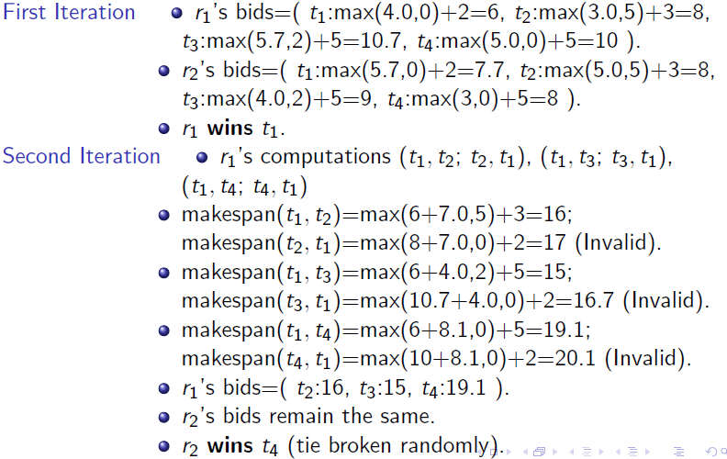
TeSSI at Work in Small Problem (2/2)

Slide 38
Simulated data from a publicly available generator, and datasets from the vehicle routing with time windows literature
For E1 and E2
60 x 60 2D grid
Task locations randomly generated in the grid.
Early start times for tasks randomly drawn from [0,100].
Constant duration for all tasks (15).
Late end times for tasks randomly drawn from [0,early start + duration + slack]. Slack is randomly generated.
For E3
Location distribution: R (randomly ), C(clustered) , RC (mixed randomly and clustered).
Time window tightness/size: Type 1 (small), type 2(large)
6 datasets (R1, C1, RC1, R2, C2, RC2).
Each dataset with 8-12 instances.
For all: 30 runs, report mean and standard deviation.

