Slide 1
Computer Architecture
A Quantitative Approach, Fifth Edition
Chapter 1
Fundamentals of Quantitative Design and Analysis

Slide 2
Computer Technology
Introduction
Performance improvements:
Improvements in semiconductor technology
Feature size, clock speed
Improvements in computer architectures
Enabled by HLL compilers, UNIX
Lead to RISC architectures
Together have enabled:
Lightweight computers
Productivity-based managed/interpreted programming languages
SaaS, Virtualization, Cloud
Applications evolution:
Speech, sound, images, video, “augmented/extended reality”, “big data”

Slide 3
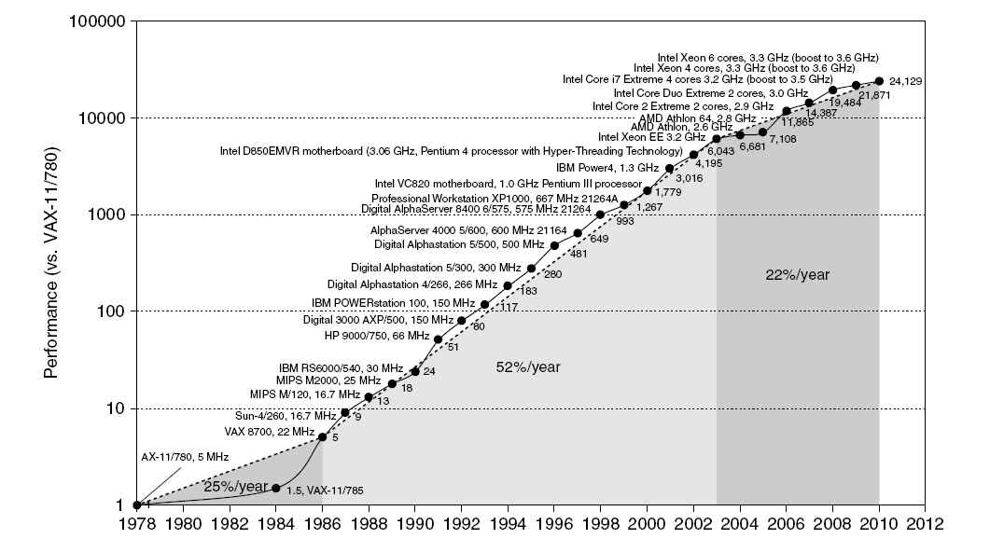
Single Processor Performance
Introduction
Move to multi-processor
RISC

Slide 4
Current Trends in Architecture
Introduction
Cannot continue to leverage Instruction-Level parallelism (ILP)
Single processor performance improvement ended in 2003
New models for performance:
Data-level parallelism (DLP)
Thread-level parallelism (TLP)
Request-level parallelism (RLP)
These require explicit restructuring of the application

Slide 5
Classes of Computers
Personal Mobile Device (PMD)
e.g. smart phones, tablet computers (1.8 billion sold 2010)
Emphasis on energy efficiency and real-time
Desktop Computing
Emphasis on price-performance (0.35 billion)
Servers
Emphasis on availability (very costly downtime!), scalability, throughput (20 million)
Clusters / Warehouse Scale Computers
Used for “Software as a Service (SaaS)”, PaaS, IaaS, etc.
Emphasis on availability ($6M/hour-downtime at Amazon.com!) and price-performance (power=80% of TCO!)
Sub-class: Supercomputers, emphasis: floating-point performance and fast internal networks, and big data analytics
Embedded Computers (19 billion in 2010)
Emphasis: price
Classes of Computers

Slide 6
Parallelism
Classes of parallelism in applications:
Data-Level Parallelism (DLP)
Task-Level Parallelism (TLP)
Classes of architectural parallelism:
Instruction-Level Parallelism (ILP)
Vector architectures/Graphic Processor Units (GPUs)
Thread-Level Parallelism
Request-Level Parallelism
Classes of Computers

Slide 7
Flynn’s Taxonomy
Single instruction stream, single data stream (SISD)
Single instruction stream, multiple data streams (SIMD)
Vector architectures
Multimedia extensions
Graphics processor units
Multiple instruction streams, single data stream (MISD)
No commercial implementation
Multiple instruction streams, multiple data streams (MIMD)
Tightly-coupled MIMD
Loosely-coupled MIMD
Classes of Computers

Slide 8
Defining Computer Architecture
“Old” view of computer architecture:
Instruction Set Architecture (ISA) design
i.e. decisions regarding:
registers, memory addressing, addressing modes, instruction operands, available operations, control flow instructions, instruction encoding
“Real” computer architecture:
Specific requirements of the target machine
Design to maximize performance within constraints: cost, power, and availability
Includes ISA, microarchitecture, hardware
Defining Computer Architecture

Slide 9
Trends in Technology
Integrated circuit technology
Transistor density: 35%/year
Die size: 10-20%/year
Integration overall: 40-55%/year
DRAM capacity: 25-40%/year (slowing)
Flash capacity: 50-60%/year
15-20X cheaper/bit than DRAM
Magnetic disk technology: 40%/year
15-25X cheaper/bit then Flash
300-500X cheaper/bit than DRAM
Trends in Technology

Slide 10
Bandwidth and Latency
Bandwidth or throughput
Total work done in a given time
10,000-25,000X improvement for processors over the 1st milestone
300-1200X improvement for memory and disks over the 1st milestone
Latency or response time
Time between start and completion of an event
30-80X improvement for processors over the 1st milestone
6-8X improvement for memory and disks over the 1st milestone
Trends in Technology

Slide 11
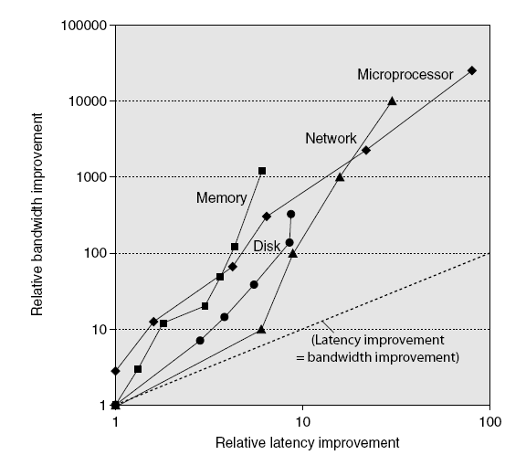
Bandwidth and Latency
Trends in Technology
Log-log plot of bandwidth and latency milestones

Slide 12
Transistors and Wires
Feature size
Minimum size of transistor or wire in x or y dimension
10 microns in 1971 to .032 microns in 2011
Transistor performance scales linearly
Wire delay does not improve with feature size!
Integration density scales quadratically
Linear performance and quadratic density growth present a challenge and opportunity, creating the need for computer architect!
Trends in Technology

Slide 13
Power and Energy
Problem: Get power in, get power out
Thermal Design Power (TDP)
Characterizes sustained power consumption
Used as target for power supply and cooling system
Lower than peak power, higher than average power consumption
Clock rate can be reduced dynamically to limit power consumption
Energy per task is often a better measurement
Trends in Power and Energy

Slide 14
Dynamic Energy and Power
Dynamic energy
Transistor switch from 0 -> 1 or 1 -> 0
½ x Capacitive load x Voltage²
Dynamic power
½ x Capacitive load x Voltage² x Frequency switched
Reducing clock rate reduces power, not energy
Trends in Power and Energy

Slide 15
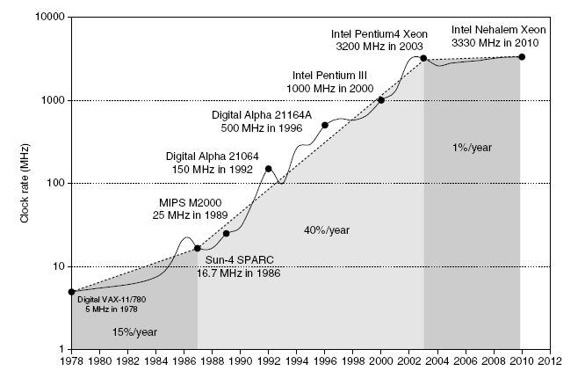
Power
Intel 80386 consumed ~ 2 W
3.3 GHz Intel Core i7 consumes 130 W
Heat must be dissipated from 1.5 x 1.5 cm chip
This is the limit of what can be cooled by air
Trends in Power and Energy

Slide 16
Reducing Power
Techniques for reducing power:
Do nothing well
Dynamic Voltage-Frequency Scaling
Low power state for DRAM, disks
Overclocking, turning off cores
Trends in Power and Energy

Slide 17
Static Power
Static power consumption
Current_{static} x Voltage
Scales with number of transistors
To reduce: power gating
Race-to-halt
The new primary evaluation for design innovation
Tasks per joule
Performance per watt
Trends in Power and Energy

Slide 18
Trends in Cost
Trends in Cost
Cost driven down by learning curve
Yield
DRAM: price closely tracks cost
Microprocessors: price depends on volume
10% less for each doubling of volume

Slide 19



Integrated Circuit Cost
Trends in Cost
Integrated circuit
Bose-Einstein formula:
Defects per unit area = 0.016-0.057 defects per square cm (2010)
N = process-complexity factor = 11.5-15.5 (40 nm, 2010)
The manufacturing process dictates the wafer cost, wafer yield and defects per unit area
The architect’s design affects the die area, which in turn affects the defects and cost per die

Slide 20
Dependability
Dependability
Systems alternate between two states of service with respect to SLA/SLO:
Service accomplishment, where service is delivered as specified by SLA
Service interruption, where the delivered service is different from the SLA
Module reliability: “failure(F)=transition from 1 to 2” and “repair(R)=transition from 2 to 1”
Mean time to failure (MTTF)
Mean time to repair (MTTR)
Mean time between failures (MTBF) = MTTF + MTTR
Availability = MTTF / MTBF

Slide 21
Measuring Performance
Typical performance metrics:
Response time
Throughput
Speedup of X relative to Y
Execution time_{Y} / Execution time_{X}
Execution time
Wall clock time: includes all system overheads
CPU time: only computation time
Benchmarks
Kernels (e.g. matrix multiply)
Toy programs (e.g. sorting)
Synthetic benchmarks (e.g. Dhrystone)
Benchmark suites (e.g. SPEC06fp, TPC-C)
Measuring Performance

Slide 22

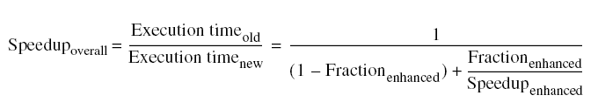
Principles of Computer Design
Principles
Take Advantage of Parallelism
e.g. multiple processors, disks, memory banks, pipelining, multiple functional units
Principle of Locality
Reuse of data and instructions
Focus on the Common Case
Amdahl’s Law

Slide 23



Principles of Computer Design
Principles
The Processor Performance Equation

Slide 24
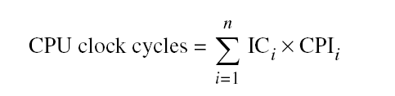
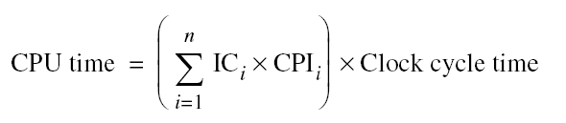
Principles of Computer Design
Principles
Different instruction types having different CPIs

Slide 25
Instruction Set Architecture (ISA)
Serves as an interface between software and hardware.
Provides a mechanism by which the software tells the hardware what should be done.
High level language code : C, C++, Java, Fortran,
compiler
Assembly language code: architecture specific statements
assembler
Machine language code: architecture specific bit patterns
software
instruction set
hardware

Slide 26
Instruction Set Design Issues
Instruction set design issues include:
Where are operands stored?
registers, memory, stack, accumulator
How many explicit operands are there?
0, 1, 2, or 3
How is the operand location specified?
register, immediate, indirect, . . .
What type & size of operands are supported?
byte, int, float, double, string, vector. . .
What operations are supported?
add, sub, mul, move, compare . . .

Slide 27
Classifying ISAs
Accumulator (before 1960, e.g. 68HC11):
1-address add A acc ← acc + mem[A]
Stack (1960s to 1970s):
0-address add tos ← tos + next
Memory-Memory (1970s to 1980s):
2-address add A, B mem[A] ← mem[A] + mem[B]
3-address add A, B, C mem[A] ← mem[B] + mem[C]
Register-Memory (1970s to present, e.g. 80x86):
2-address add R1, A R1 ← R1 + mem[A]
load R1, A R1 ← mem[A]
Register-Register (Load/Store, RISC) (1960s to present, e.g. MIPS):
3-address add R1, R2, R3 R1 ← R2 + R3
load R1, R2 R1 ← mem[R2]
store R1, R2 mem[R1] ← R2

Slide 28
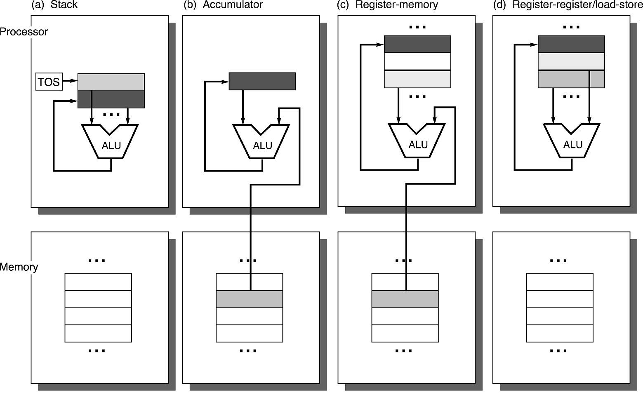
Operand Locations in Four ISA Classes
GPR

Slide 29
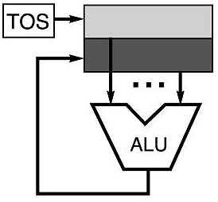
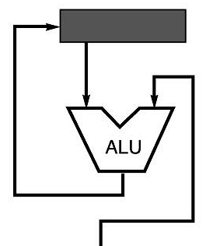
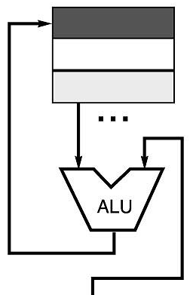
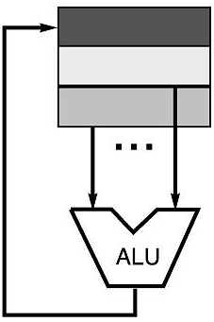
Code Sequence C = A + B for Four Instruction Sets
Stack | Accumulator | Register (register-memory) | Register (load-store)
Push A Push B Add Pop C | Load A Add B Store C | Load R1, A Add R1, B Store C, R1 | Load R1,A Load R2, B Add R3, R1, R2 Store C, R3
memory
memory
acc = acc + mem[C]
R1 = R1 + mem[C]
R3 = R1 + R2

Slide 30
Types of Addressing Modes (VAX)
Addressing Mode Example Action
1. Register direct Add R4, R3 R4 <- R4 + R3
2. Immediate Add R4, #3 R4 <- R4 + 3
3. Displacement Add R4, 100(R1) R4 <- R4 + M[100 + R1]
4. Register indirect Add R4, (R1) R4 <- R4 + M[R1]
5. Indexed Add R4, (R1 + R2) R4 <- R4 + M[R1 + R2]
6. Direct Add R4, (1000) R4 <- R4 + M[1000]
7. Memory Indirect Add R4, @(R3) R4 <- R4 + M[M[R3]]
8. Autoincrement Add R4, (R2)+ R4 <- R4 + M[R2]
R2 <- R2 + d
9. Autodecrement Add R4, (R2)- R4 <- R4 + M[R2]
R2 <- R2 - d
10. Scaled Add R4, 100(R2)[R3] R4 <- R4 +
M[100 + R2 + R3*d]
Studies by [Clark and Emer] indicate that modes 1-4 account for 93% of all operands on the VAX.

Slide 31
Types of Operations
Arithmetic and Logic: AND, ADD
Data Transfer: MOVE, LOAD, STORE
Control BRANCH, JUMP, CALL
System OS CALL, VM
Floating Point ADDF, MULF, DIVF
Decimal ADDD, CONVERT
String MOVE, COMPARE
Graphics (DE)COMPRESS

Slide 32
MIPS Instructions
All instructions exactly 32 bits wide
Different formats for different purposes
Similarities in formats ease implementation
6 bits
5 bits
5 bits
5 bits
5 bits
6 bits
op
rs
rt
rd
shamt
funct
R-Format
31
0
6 bits
5 bits
5 bits
16 bits
op
rs
rt
offset
I-Format
31
0
6 bits
26 bits
J-Format
op
address
31
0

Slide 33
MIPS Instruction Types
Arithmetic & Logical - manipulate data in registers add $s1, $s2, $s3 $s1 = $s2 + $s3 or $s3, $s4, $s5 $s3 = $s4 OR $s5
Data Transfer - move register data to/from memory → load & store lw $s1, 100($s2) $s1 = Memory[$s2 + 100] sw $s1, 100($s2) Memory[$s2 + 100] = $s1
Branch - alter program flow beq $s1, $s2, 25 if ($s1==$s1) PC = PC + 4 + 4*25
else PC = PC + 4

Slide 34
MIPS Arithmetic & Logical Instructions
Instruction usage (assembly) add dest, src1, src2 dest=src1 + src2 sub dest, src1, src2 dest=src1 - src2 and dest, src1, src2 dest=src1 AND src2
Instruction characteristics
Always 3 operands: destination + 2 sources
Operand order is fixed
Operands are always general purpose registers
Design Principles:
Design Principle 1: Simplicity favors regularity
Design Principle 2: Smaller is faster

Slide 35
Arithmetic & Logical Instructions - Binary Representation
6 bits
5 bits
5 bits
5 bits
5 bits
6 bits
op
rs
rt
rd
shamt
funct
31
0
Used for arithmetic, logical, shift instructions
op: Basic operation of the instruction (opcode)
rs: first register source operand
rt: second register source operand
rd: register destination operand
shamt: shift amount (more about this later)
funct: function - specific type of operation
Also called “R-Format” or “R-Type” Instructions

Slide 36
Arithmetic & Logical Instructions - Binary Representation Example
Machine language for add $8, $17, $18
See reference card for op, funct values
6 bits
5 bits
5 bits
5 bits
5 bits
6 bits
op
rs
rt
rd
shamt
funct
31
0
0
17
18
8
0
32
Decimal
000000
10001
10010
01000
00000
100000
Binary

Slide 37
MIPS Data Transfer Instructions
Transfer data between registers and memory
Instruction format (assembly) lw $dest, offset($addr) load word sw $src, offset($addr) store word
Uses:
Accessing a variable in main memory
Accessing an array element

