Slide 1
Is this a triangulated graph?
Why or why not?
Triangulated

Slide 2
Is this a triangulated graph?
Why or why not?
Triangulated

Slide 3
Is this a triangulated graph?
Why or why not?
Triangulated

Slide 4
Is this a triangulated graph?
Why or why not?
Triangulated

Slide 5
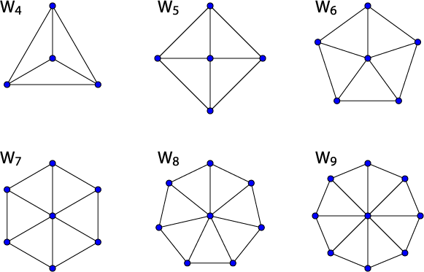
Alert: Wheel Graphs
#vertices: n
#edges:
Chromatic number
4 is n is odd
3 if n is even
Properties
Hamiltonian
Self dual
Planar
2(n-1)

