Slide 1
Structure-Based Methods
An Introduction
Foundations of Constraint Processing
CSCE421/821, Spring 2022
www.cse.unl.edu/~choueiry/S22-421-822/
All questions to Piazza
Berthe Y. Choueiry (Shu-we-ri)
Avery Hall, Room 259
Tel: +1(402)472-5444

Slide 2
Motivation
CSPs are represented by a network
  For binary CSPs, it is a graph
  For general CSPs, it is a hypergraph
Exploit the structure of the network to solve the CSP
  During search
  For inference: adaptive consistency
h1
h8
h1
a
11
1
2
3
h9
h15
h2
c
h10
h3
b
12
13
19
d
h11
16
4
h7
17
7
5
h4
e
h14
18
15
8
9
6
f
14
h12
h13
10

Slide 3
Constraint Networks Dechter §2.1.3
h5
h1
Binary CSPs
  Macrostructure
  Microstructure
  Co-microstructure
Non-Binary CSPs
  Hypergraph
  Dual (a.k.a. intergraph,
  line graph, join graph)
  Primal
14
1
2
3
h6
h7
h2
9
h8
10
11
h3
4
13
12
5
h4
8
7
6
14
1
3
h5
h1
2
h6
h7
h2
h3
9
11
h4
10
4
5
h8
13
12
8
7
6

Slide 4
Outline
Binary CSPs
  Tree-Structured CSP graphs Dechter §5.1.2 [Freuder, 82]
  Cycle-Cutset Method Dechter §10.1.1 [Dechter, 90]
  Dynamic Dangle-Identification [Zheng 07, Geschwender 18]
  DPC Dechter §4.2.2 [Dechter & Pearl, 88]
  Decomp. into bi-connected components [Freuder, 82]
  Tree Clustering Dechter §9.2 [Dechter & Pearl, 89]
Non-Binary CSPs
  Bucket Elimination Dechter §4.4 [Dechter, 97]
  Tree Decomposition Dechter §9.2.2 [DB Theory]

Slide 5
Tree-Structured CSPs Dechter §5.1.2
Tree-structured CSPs can be solved in polynomial time
  Apply Revise(V_{i},V_{j}) for all nodes from leaves to root
  Instantiate variables from root to leaves
Note: later, we will follow the ‘general’ strategy
  Directional consistency from leaves to root
  Solution building from root to leaves
a, b, c, d
Propagation
Elimination
Ordering
a, b, c, d
a, b, c, d
Instantiation
Ordering
a, b, c, d
a, b, c, d
a, b, c, d
a, b, c, d
a, b, c, d
a, b, c, d
a, b, c, d

Slide 6
Cycle-Cutset Method (1) Dechter §10.1.1
Identify a cycle cutset S in the CSP
  Cutset: nodes when removed yield a tree
Decompose the CSP into 2 partitions
  The nodes in S
  The nodes in T, forming a tree
Idea: Iterate until a solution is found
  Solve the nodes in S
  Try to extend the solution to nodes in T

Slide 7
Cycle-Cutset Method (2) Dechter §10.1.1
Find a solution to nodes in S
  |S| is smaller than |V| initial problem
Repeat until you find a solution
  For every solution to S
    Apply DAC from S to T
    If no domain is wiped-out, solve T (quick)
If |S |=c, time is O(d^{c}.(n-c)d²)=O(nd^{c+2})
Finding the smallest cutset is NP-hard ☹

Slide 8
Dynamic Dangle-Identification (GRED)
After each successful var assignment + lookahead
  Check the connectivity of the remaining CSP
  Identify “dangling trees” using Graham’s graph reduction operator
For each dangling tree
  Do DAC from leaf to root
  Domain wipe-out indicates unsolvability
Restrict search to nodes outside the identified dangling trees
Historical
  Unpublished work by Y. Zheng, 2005
  Thesis of Daniel Geschwender, 2018

Slide 9
Outline
Binary CSPs
  Tree-Structured CSP graphs [Freuder, 82]
  Cycle-Cutset Method Dechter §10.1.1 [Dechter, 90]
  Dynamic Dangle-Identification ` [Zheng 07, Geschwender 18]
  DPC Dechter §4.2.2 [Dechter & Pearl, 88]
  Decomp. into bi-connected components [Freuder, 82]
  Tree Clustering Dechter §9.2 [Dechter & Pearl, 89]
Non-Binary CSPs
  Bucket Elimination Dechter §4.4 [Dechter, 97]
  Tree Decomposition Dechter §9.2.2 [DB Theory]

Slide 10
DPC Dechter §4.2.2 [Dechter & Pearl, 88]
DPC
  Binary CSP
  Variable ordering is fixed
  Complexity of DPC O(n.w*²d³)
If w*≤ 2, DPC
  determines consistency
  guarantees BT-free along ordering
V₁
V₂
Instantiation order
V₃
V₄
V₅
Elimination order
V₆
DPC animation courtesy of Chris Reeson

Slide 11
Biconnected components [Freuder 82]
Aka, Decomposition into Separable Graphs
Consider a CSP whose graph has articulation nodes
Assume that the largest biconnected component has size b
Build a tree whose nodes are the biconnected components, considering that the articulation node belongs to the parent (or parent+child)
Build an ordering using a preorder traversal of the tree
The complexity is bound by the size of the largest biconnected component

Slide 12
Tree Clustering
Dechter §9.2
[Dechter & Pearl, 89]
Triangulate the graph
  MinFill, Dechter, Fig 4.4, page 89
Find maximal cliques
  MaxCardinality, Dechter, Fig 4.5, page 90
  MaxCliques, [Golumbic]
Create a tree structure of cliques
  Join tree, Dechter, Fig. 9.4 (Step 3), page 252
Repeat
  Solve a clique (all solutions), at each node in tree
  Apply DAC from leaves to root
  Generate solutions in a BT-free manner
a
b
c
d
e
f
a,b,c
b,c,d
b,d,e
d,f

Slide 13
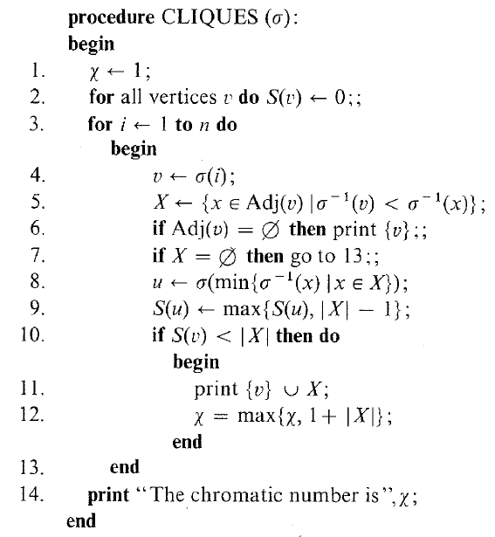
MaxCliques
Figure 4.8, page 99, Algorithmic Graph Theory and Perfect Graphs, by Martin Charles Golumbic, Second edition, Annals of Discrete Mathematics 57, Elsevier, 2004.
a
G=(v,e)
b
c
MinFill
G=(v,e⊆e’)
d
e
MaxCardinality
f
a
σ
a,b,c
b
MaxCliques
c
b,c,d
d
JoinTree
b,d,e
e
f
d,f

Slide 14
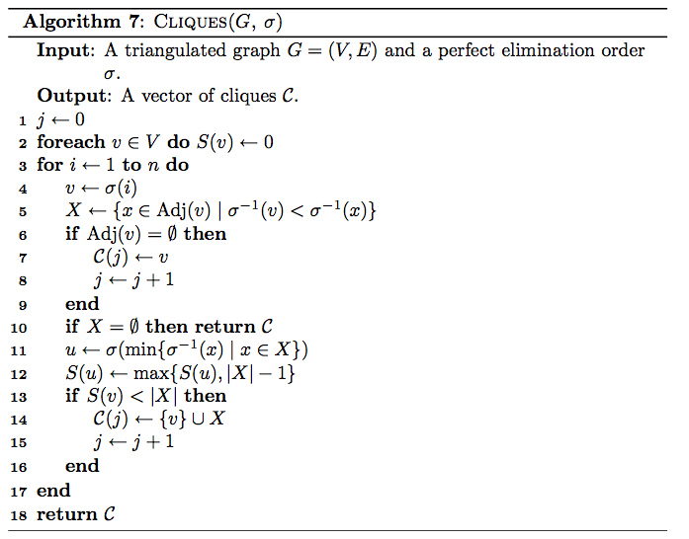
MaxCliques
MaxCliques rewritten by C. Thiel

Slide 15
Tree Clustering
Dechter §9.2
[Dechter & Pearl, 89]
Triangulate the graph
Find maximal cliques
Create a tree structure of cliques
Repeat
  Solve a clique (all solutions), at each node in tree
  Apply DAC from leaves to root
  Generate solutions in a BT-free manner
a
b
c
d
e
f
a,b,c
b,c,d
b,d,e
d,f

Slide 16
Tree Clustering: Complexity
Dechter §9.2
[Dechter & Pearl, 89]
n: number of variables
Triangulation: O(n²)
  MinFill and MaxCardinality: O(n+e)
Finding cliques: linear in n
Solving clusters: O(k^{r}), k is domain size, r is size of largest max clique
Generating a solution O(n t log t)
  t is #tuples in each cluster, (sorted) domain of a ‘super’ variable
  in best case, we have n cliques
Complexity bounded by size of largest clique:
  O(n²)+O(k^{r})+O(n t log t)=O(n k^{r} log k^{r})=O(n r k^{r})
a,b,c
b,c,d
b,d,e
d,f

Slide 17
Outline
Binary CSPs
  Tree-Structured CSP graphs [Freuder, 82]
  Cycle-Cutset Method Dechter §10.1.1 [Dechter, 90]
  Dynamic Dangle-Identification (GRED) [Zheng]
  DPC Dechter §4.2.2 [Dechter & Pearl, 88]
  Decomp. into bi-connected components [Freuder, 82]
  Tree Clustering Dechter §9.2 [Dechter & Pearl, 89]
Non-Binary CSPs
  Bucket Elimination Dechter §4.4 [Dechter, 97]
  Tree Decomposition Dechter §9.2.2, [DB Theory]

Slide 18
Bucket Elimination Dechter §4.4
Choose a variable ordering
Create buckets for each variable
  Place each constraint in the bucket of the deepest variable in its scope
Create a tree node for each bucket
Bottom up to root
  Join relations in bucket
  Project join on deepest bucket with common variables
Top down: create solution BT-free
a
a
a
a | a
b
ba
ba
b | ab
c
ca
cb
c | abc
d
dc
bd
d
d | bdc
e
eb
ed
e | bde
fd
f | fd
f

Slide 19
Tree Clustering versus BE
a | a
a
a
a
a
a,b,c
b
b | ab
ba
ba
b
c
b,c,d
c | abc
c
ca
cb
d
e
b,d,e
d,f
d
dc
bd
d
f
d | bdc
e | bde
e
eb
ed
f | fd
f
fd

Slide 20
Outline
Binary CSPs
Non-Binary CSPs
  Bucket Elimination Dechter §4.4 [Dechter, 97]
  Tree Decomposition Dechter §9.2.2, DB Theory
    Idea
    Definition
    Examples
    Parameters
    Usefulness

Slide 21
Tree Decomposition Dechter §9.2.2
Inspired from Database Theory (join tree, acyclic DBs)
Organize the constraint network in a tree structure called join tree
Label the tree nodes with
  CSP variables (variable labeling)
  CSP constraints (relation labeling)
  Labels must obey rules
Solving the CSP
  Bottom up: joining relations & projecting them on parent
  Top down: Generating the solution
Complexity of solving the CSP is bound by width
  (tree)width: Max number of variables in a tree node - 1
  Hyperwidth: Max number of constraints in a tree node
h1
h8
h1
11
1
2
3
h9
h15
h2
12
h10
13
19
h3
h11
16
4
h7
17
7
5
h4
h14
18
14
15
8
9
6
h12
h13
10
h6
{h8, h15} {1, 11, 17, 19}
{h1, h2} {1, 2, 3, 4, 5, 6}
{h9, h15} {11, 12, 17, 18, 19}
{h2, h3} {3, 4, 5, 6, 7, 8}
{h10, h14} {12, 16, 17, 18, 19}
{h4, h5} {5, 6, 7, 8, 9}
{h9, h13} {12, 15, 16, 18, 19}
{h6} {7, 9, 10}
{h10, h12} {12, 13, 14, 15, 18, 19}

Slide 22
Tree Decomposition: Definition
Dechter §9.2.2
Definition 9.4
Page 257
A tree decomposition (T, χ,ψ) of a CSP P=(X,D,C) where
    T=(V,E)
    χ : chi variable labeling-function: χ(v) ⊆ X
    ψ : psi relation labeling-function: ψ(v) ⊆ C
  Each constraint appears in at least on node in the tree, and all its variables are in that node
  Nodes where any variable appears induce a single connected subtree (connectedness property)
h1
{h8, h15} {1, 11, 17, 19}
h8
h1
11
1
2
3
h9
h15
h2
{h1, h2} {1, 2, 3, 4, 5, 6}
{h9, h15} {11, 12, 17, 18, 19}
12
h10
13
19
h3
{h2, h3} {3, 4, 5, 6, 7, 8}
{h10, h14} {12, 16, 17, 18, 19}
h11
16
4
h7
{h4, h5} {5, 6, 7, 8, 9}
{h9, h13} {12, 15, 16, 18, 19}
17
7
5
h4
h14
18
14
15
8
9
6
{h6} {7, 9, 10}
{h10, h12} {12, 13, 14, 15, 18, 19}
h12
h13
10
h6

Slide 23
Tree Decomposition: Examples
HYPERTREE
Gottlob et al., 2002
HYPERCUTSET
Gottlob et al., 2000
HINGE^{TCLUSTER}
Gyssens et al., 1994
HINGE⁺
CaT
TRAVERSE
TCLUSTER
Dechter & Pearl,
1989
HINGE
Gyssens et al.,
1994
CUT
CUTSET
Dechter, 1987
BICOMP
Freuder, 1985
Heuristics proposed by
Yaling Zheng in 2005

Slide 24
Tree Decomposition: Parameters
For a given decomposition
  Treewidth (tw)
    Maximum number of variables in any node in tree - 1
  Hyperwidth (hw)
    Maximum number of constraints in any node in tree
For a given hypergraph
  Treewidth (tw)
    Minimum tw of all possible decompositions
  Hyperwidth (hw)
    Minimum hw of all possible decompositions

Slide 25
Tree Decompostion: Usefulness
Theory: Characterize tractable CSPs
  Complexity is bounded tree/hyper width
  Fixed parameter complexity: independent of number of variables
Practice: Use structure to solve CSPs
  Bottom up: join relations & project on parents
  Top down: generating solution BT-free

Slide 26
Summary
Constraint networks
  Hypergraph, dual graph, primal graph
Binary CSPs
  Tree-Structured CSP graphs [Freuder, 82]
  Cycle-Cutset Method Dechter §10.1.1 [Dechter, 90]
  Dynamic Dangle-Identification (GRED) [Zheng 07, Geschwender 18]
  DPC Dechter §4.2.2 [Dechter & Pearl, 88]
  Decomp. into bi-connected components [Freuder, 82]
  Tree Clustering Dechter §9.2 [Dechter & Pearl, 89]
Non-Binary CSPs
  Bucket Elimination Dechter §4.4 [Dechter, 97]
  Tree Decomposition Dechter §9.2.2 [DB Theory]

