Slide 1
Sets
Sections 2.1 and 2.2 of Rosen
Spring 2023
CSCE 235H Introduction to Discrete Structures (Honors)
Course web-page: cse.unl.edu/~cse235h
Questions: Piazza

Slide 2
Notation and LaTeX
A set is a collection of objects.
For example:
  S = {s₁,s₂,s₃,…,s_{n}} is a finite set of n elements
  S = {s₁,s₂,s₃,…} is a infinite set of elements.
s₁ ∈ S denotes that the object s₁ is an element of the set S
s₁ ∉ S denotes that the object s₁ is not an element of the set S
LaTex
  $S=\{s_1,s_2,s_3, \ldots,s_n\}$
  $s_i \in S$
  $si \notin S$

Slide 3
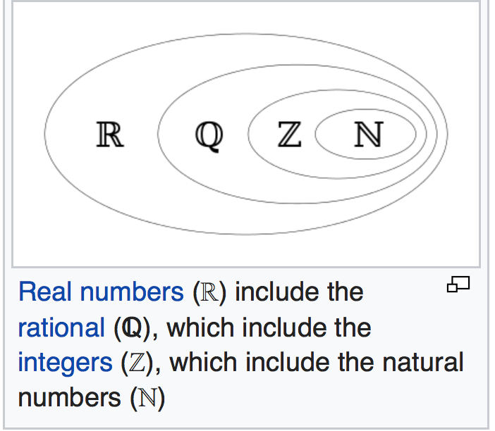
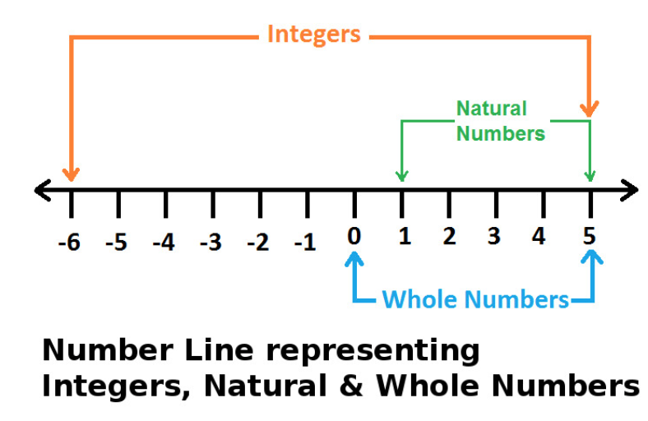
Sets of Numbers
Using the package: \usepackage{amssymb}
  Set of natural numbers: $\mathbb{N}$: may or may not include 0 (by default, it does)
  Set of integer numbers: $\mathbb{Z}$
  Set of rational numbers: $\mathbb{Q}$
  Set of real numbers: $\mathbb{R}$
  Set of complex numbers: $\mathbb{C}$

Slide 4
Outline
Definitions: set, element
Terminology and notation
  Set equal, multi-set, bag, set builder, intension, extension, Venn Diagram (representation), empty set, singleton set, subset, proper subset, finite/infinite set, cardinality
Proving equivalences
Power set
Tuples (ordered pair)
Cartesian Product (a.k.a. Cross product), relation
Quantifiers
Set Operations (union, intersection, complement, difference), Disjoint sets
Set equivalences (cheat sheet or Table 1, page 130)
  Inclusion in both directions
  Using membership tables
Generalized Unions and Intersection
Computer Representation of Sets

Slide 5
Introduction (1)
We have already implicitly dealt with sets
  Integers (Z), rationals (Q), naturals (N), reals (R), etc.
We will develop more fully
  The definitions of sets
  The properties of sets
  The operations on sets
Definition: A set is an unordered collection of (unique) objects
Sets are fundamental discrete structures and for the basis of more complex discrete structures like graphs

Slide 6
Introduction (2)
Definition: The objects in a set are called elements or members of a set. A set is said to contain its elements
Notation, for a set A:
  x ∈ A: x is an element of A $\in$
  x ∉ A: x is not an element of A $\notin$

Slide 7
Terminology (1)
Definition: Two sets, A and B, are equal is they contain the same elements. We write A=B.
Example:
  {2,3,5,7}={3,2,7,5}, because a set is unordered
  Also, {2,3,5,7}={2,2,3,5,3,7} because a set contains unique elements
  However, {2,3,5,7} ≠{2,3} $\neq$

Slide 8
Terminology (2)
A multi-set is a set where you specify the number of occurrences of each element: {m₁⋅a₁,m₂⋅a₂,…,m_{r}⋅a_{r}} is a set where
  m₁ occurs a₁ times
  m₂ occurs a₂ times
  …
  m_{r} occurs a_{r} times
In Databases, we distinguish
  A set: elements cannot be repeated
  A bag: elements can be repeated

Slide 9
Terminology (3)
The set-builder notation
S={ x | (x∈Z) ∧ (x=2k) for some k∈Z}
reads: S is the set that contains all x such that x is an integer and x is even
A set is defined in intension when you give its set-builder notation
S={ x | (x∈Z) ∧ (0≤x≤8) ∧ (x=2k) for some k ∈ Z }
A set is defined in extension when you enumerate all the elements:
S={0,2,4,6,8}

Slide 10
Venn Diagram: Example
A set can be represented graphically using a Venn Diagram
U
x
y
B
A
z
a
C

Slide 11
More Terminology and Notation (1)
A set that has no elements is called the empty set or null set and is denoted ∅ $\emptyset$
A set that has one element is called a singleton set.
  For example: {a}, with brackets, is a singleton set
  a, without brackets, is an element of the set {a}
Note the subtlety in ∅ ≠ {∅}
  The left-hand side is the empty set
  The right hand-side is a singleton set, and a set containing a set

Slide 12
More Terminology and Notation (2)
Definition: A is said to be a subset of B, and we write A ⊆ B, if and only if every element of A is also an element of B $\subseteq$
That is, we have the equivalence:
A ⊆ B ⇔ ∀ x (x ∈ A ⇒ x ∈ B)

Slide 13
More Terminology and Notation (3)
Theorem: For any set S Theorem 1, page 120
  ∅ ⊆ S and
  S ⊆ S
The proof is in the book, an excellent example of a vacuous proof

Slide 14
More Terminology and Notation (4)
Definition: A set A that is a subset of a set B is called a proper subset if A ≠ B.
That is there is an element x∈B such that x∉A
We write: A ⊂ B, A ⊂ B
In LaTex: $\subset$, $\subsetneq$

Slide 15
More Terminology and Notation (5)
Sets can be elements of other sets
Examples
  S₁ = {∅,{a},{b},{a,b},c}
  S₂={{1},{2,4,8},{3},{6},4,5,6}

Slide 16
More Terminology and Notation (6)
Definition: If there are exactly n distinct elements in a set S, with n a nonnegative integer, we say that:
  S is a finite set, and
  The cardinality of S is n. Notation: |S| = n.
Definition: A set that is not finite is said to be infinite

Slide 17
More Terminology and Notation (7)
Examples
  Let B = {x | (x≤100) ∧ (x is prime)}, the cardinality of B is |B|=25 because there are 25 primes less than or equal to 100.
  The cardinality of the empty set is |∅|=0
  The sets N, Z, Q, R are all infinite

Slide 18
Proving Equivalence (1)
You may be asked to show that a set is
  a subset of,
  proper subset of, or
  equal to another set.
To prove that A is a subset of B, use the equivalence discussed earlier A ⊆ B ⇔ ∀x(x∈A ⇒ x∈B)
  To prove that A ⊆ B it is enough to show that for an arbitrary (nonspecific) element x, x∈A implies that x is also in B.
  Any proof method can be used.
To prove that A is a proper subset of B, you must prove
  A is a subset of B and
  ∃x (x∈B) ∧ (x∉A)

Slide 19
Proving Equivalence (2)
Finally to show that two sets are equal, it is sufficient to show independently (much like a biconditional) that
  A ⊆ B and
  B ⊆ A
Logically speaking, you must show the following quantified statements:
(∀x (x∈A ⇒ x∈B)) ∧ (∀x (x∈B ⇒ x∈A))
we will see an example later..

Slide 20
Power Set (1)
Definition: The power set of a set S, denoted P(S), is the set of all subsets of S.
Examples
  Let A={a,b,c}, P(A)={∅,{a},{b},{c},{a,b},{b,c},{a,c},{a,b,c}}
  Let A={{a,b},c}, P(A)={∅,{{a,b}},{c},{{a,b},c}}
Note: the empty set ∅ and the set itself are always elements of the power set. This fact follows from Theorem 1 (Rosen, page 120).

Slide 21
Power Set (2)
The power set is a fundamental combinatorial object useful when considering all possible combinations of elements of a set
Fact: Let S be a set such that |S|=n, then
|P(S)| = 2^{n}

Slide 22
Outline
Definitions: set, element
Terminology and notation
  Set equal, multi-set, bag, set builder, intension, extension, Venn Diagram (representation), empty set, singleton set, subset, proper subset, finite/infinite set, cardinality
Proving equivalences
Power set
Tuples (ordered pair)
Cartesian Product (a.k.a. Cross product), relation
Quantifiers
Set Operations (union, intersection, complement, difference), Disjoint sets
Set equivalences (cheat sheet or Table 1, page 130)
  Inclusion in both directions
  Using membership tables
Generalized Unions and Intersection
Computer Representation of Sets

Slide 23
Tuples (1)
Sometimes we need to consider ordered collections of objects
Definition: The ordered n-tuple (a₁,a₂,…,a_{n}) is the ordered collection with the element a_{i} being the i-th element for i=1,2,…,n
Two ordered n-tuples (a₁,a₂,…,a_{n}) and (b₁,b₂,…,b_{n}) are equal iff for every i=1,2,…,n we have a_{i}=b_{i} (a₁,a₂,…,a_{n})
A 2-tuple (n=2) is called an ordered pair

Slide 24
Cartesian Product (1)
Definition: Let A and B be two sets. The Cartesian product of A and B, denoted AxB, is the set of all ordered pairs (a,b) where a∈A and b∈B
AxB = { (a,b) | (a∈A) ∧ (b ∈ B) }
The Cartesian product is also known as the cross product
Definition: A subset of a Cartesian product, R ⊆ AxB is called a relation. We will talk more about relations in the next set of slides
Note: AxB ≠ BxA unless A=∅ or B=∅ or A=B. Find a counter example to prove this.

Slide 25
Cartesian Product (2)
Cartesian Products can be generalized for any n-tuple
Definition: The Cartesian product of n sets, A₁,A₂, …, A_{n}, denoted A₁×A₂×… ×A_{n}, is
A₁×A₂×… ×A_{n} ={ (a₁,a₂,…,a_{n}) | a_{i} ∈ A_{i} for i=1,2,…,n}
\prod\limits_{i=1}^n A_i = A_1 \times A_2 \times \ldots \times A_n

Slide 26
Notation with Quantifiers
Whenever we wrote ∃xP(x) or ∀xP(x), we specified the universe of discourse using explicit English language
Now we can simplify things using set notation!
Example
  ∀ x ∈ R (x²≥0)
  ∃ x ∈ Z (x²=1)
  Also mixing quantifiers:
  ∀a,b,c ∈ R ∃ x ∈ C (ax²+bx+c=0)

Slide 27
Outline
Definitions: set, element
Terminology and notation
  Set equal, multi-set, bag, set builder, intension, extension, Venn Diagram (representation), empty set, singleton set, subset, proper subset, finite/infinite set, cardinality
Proving equivalences
Power set
Tuples (ordered pair)
Cartesian Product (a.k.a. Cross product), relation
Quantifiers
Set Operations (union, intersection, complement, difference), Disjoint sets
Set equivalences (cheat sheet or Table 1, page 130)
  Inclusion in both directions
  Using membership tables
Generalized Unions and Intersection
Computer Representation of Sets

Slide 28
Set Operations
Arithmetic operators (+,-, × ,÷) can be used on pairs of numbers to give us new numbers
Similarly, set operators exist and act on two sets to give us new sets
  Union $\cup$
  Intersection $\cap$
  Set difference $\setminus$
  Set complement $\overline{S}$
  Generalized union $\bigcup$
  Generalized intersection $\bigcap$

Slide 29
Set Operators: Union
Definition: The union of two sets A and B is the set that contains all elements in A, B, or both. We write:
A∪B = { x | (x ∈ A) ∨ (x ∈ B) }
U
A
B

Slide 30
Set Operators: Intersection
Definition: The intersection of two sets A and B is the set that contains all elements that are element of both A and B. We write:
A ∩ B = { x | (x ∈ A) ∧ (x ∈ B) }
U
A
B

Slide 31
Disjoint Sets
Definition: Two sets are said to be disjoint if their intersection is the empty set: A ∩ B = ∅
U
A
B

Slide 32
Set Difference
Definition: The difference of two sets A and B, denoted A\B ($\setminus$) or A−B, is the set containing those elements that are in A but not in B
U
A
B

Slide 33
Set Complement
Definition: The complement of a set A, denoted Ā ($\bar$), consists of all elements not in A. That is the difference of the universal set and U: U\A
Ā = A^{C} = {x | x ∉ A }
U
A
A

Slide 34
Set Complement: Absolute & Relative
Given the Universe U, and A,B ⊂ U.
The (absolute) complement of A is A=U\A
The (relative) complement of A in B is B\A
U
U
A
A
B
A

Slide 35
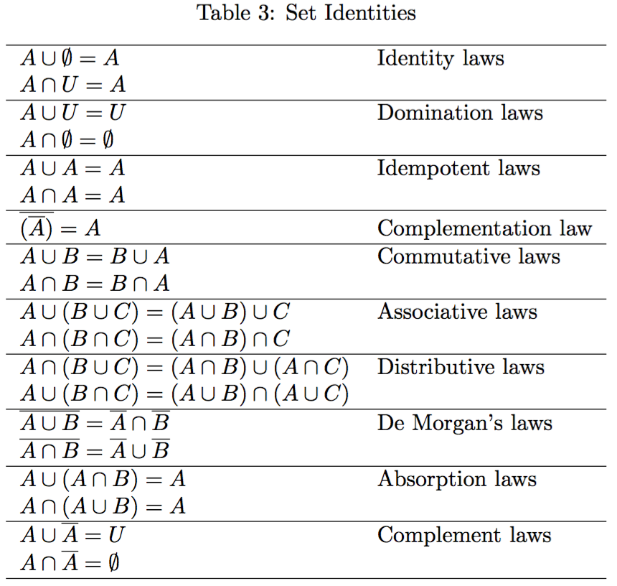
Set Idendities
Let’s take a quick look at this Cheat Sheet or at Table 1 on page 136 in your textbook

Slide 36
Proving Set Equivalences
Recall that to prove such identity, we must show that:
  The left-hand side is a subset of the right-hand side
  The right-hand side is a subset of the left-hand side
  Then conclude that the two sides are thus equal
The book proves several of the standard set identities
We will give a couple of different examples here

Slide 37
Proving Set Equivalences: Example A (1)
Let
  A={x|x is even}
  B={x|x is a multiple of 3}
  C={x|x is a multiple of 6}
Show that A∩B=C

Slide 38
Proving Set Equivalences: Example A (2)
A∩B ⊆ C: ∀ x ∈ A∩B
  x is a multiple of 2 and x is a multiple of 3
  we can write x=2.3.k for some integer k
  x=6k for some integer k ⇒ x is a multiple of 6
  x ∈ C
C ⊆A∩B: ∀ x∈ C
  x is a multiple of 6 ⇒ x=6k for some integer k
  x=2(3k)=3(2k) ⇒ x is a multiple of 2 and of 3
  x ∈ A∩B

Slide 39
Proving Set Equivalences: Example B (1)
An alternative prove is to use membership tables where an entry is
  1 if a chosen (but fixed) element is in the set
  0 otherwise
Example: Show that
A ∩ B ∩ C = A ∪ B ∪ C

Slide 40
Proving Set Equivalences: Example B (2)
A | B | C | A∩B∩C | A∩B∩C | A | B | C | A∪B∪C
0 | 0 | 0 | 0 | 1 | 1 | 1 | 1 | 1
0 | 0 | 1 | 0 | 1 | 1 | 1 | 0 | 1
0 | 1 | 0 | 0 | 1 | 1 | 0 | 1 | 1
0 | 1 | 1 | 0 | 1 | 1 | 0 | 0 | 1
1 | 0 | 0 | 0 | 1 | 0 | 1 | 1 | 1
1 | 0 | 1 | 0 | 1 | 0 | 1 | 0 | 1
1 | 1 | 0 | 0 | 1 | 0 | 0 | 1 | 1
1 | 1 | 1 | 1 | 0 | 0 | 0 | 0 | 0
1 under a set indicates that “an element is in the set”
If the columns are equivalent, we can conclude that indeed the two sets are equal

Slide 41
Generalizing Set Operations: Union and Intersection
In the previous example, we showed De Morgan’s Law generalized to unions involving 3 sets
In fact, De Morgan’s Laws hold for any finite set of sets
Moreover, we can generalize set operations union and intersection in a straightforward manner to any finite number of sets

Slide 42
Generalized Union
Definition: The union of a collection of sets is the set that contains those elements that are members of at least one set in the collection
$\bigcup_{i=1}^{n}A_i=A_1\cup A_2 \cup\ldots\cup A_n$

Slide 43
Generalized Intersection
Definition: The intersection of a collection of sets is the set that contains those elements that are members of every set in the collection
LaTex: $\bigcap_{i=1}^{n}A_i=A_1\cap A_2 \cap\ldots\cap A_n$

Slide 44
Typical Pattern for Proofs on Sets
In order to prove ∀ x (p ⇒ q), where p, q are statements about sets
Start from the hypothesis (p)
Use definitions for ‘things’ in p
Use sequence of IR, ER, SER, math, etc.
Refer to definitions of ‘things’ in q
Conclude with q
Pattern
  x, [p ⇔ Use definitions for ‘things’ in p
  ⇒ …(IR | ER | SER | basic math) ⇒ ... ⇒ … ⇒ …
  ⇒ Refer to definitions of ‘things’ in q
  ⇔ q]

Slide 45
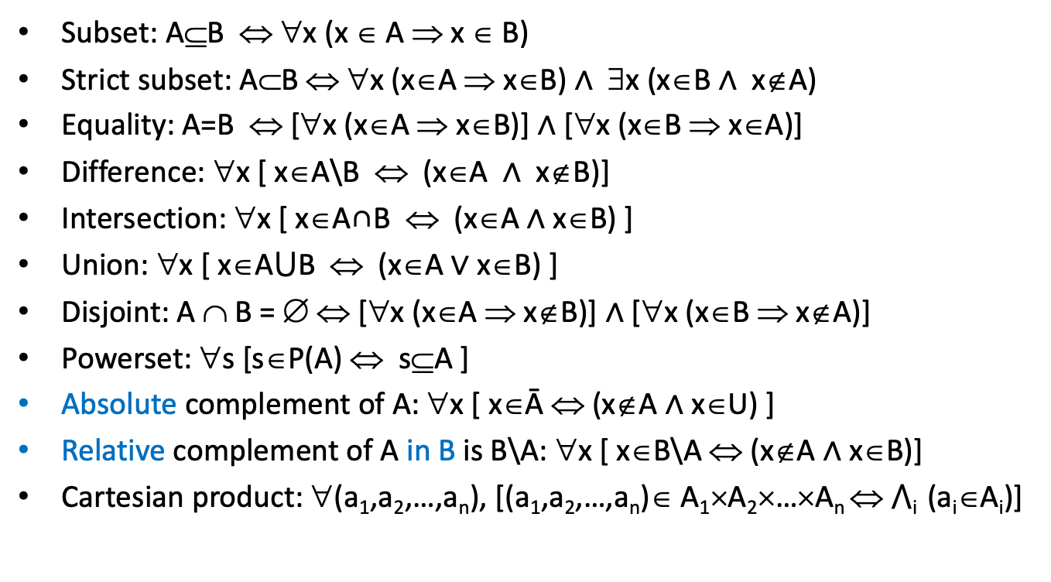
Useful Expressions
Subset: A⊆B ⇔ ∀x (x ∈ A ⇒ x ∈ B)
Strict subset: A⊂B ⇔ ∀x (x∈A ⇒ x∈B) ∧ ∃x (x∈B ∧ x∉A)
Equality: A=B ⇔ [∀x (x∈A ⇒ x∈B)] ∧ [∀x (x∈B ⇒ x∈A)]
Difference: ∀x [ x∈A\B ⇔ (x∈A ∧ x∉B)]
Intersection: ∀x [ x∈A∩B ⇔ (x∈A ∧ x∈B) ]
Union: ∀x [ x∈A⋃B ⇔ (x∈A $∨$ x∈B) ]
Disjoint: A ∩ B = ∅ ⇔ [∀x (x∈A ⇒ x∉B)] ∧ [∀x (x∈B ⇒ x∉A)]
Powerset: ∀s [s∈P(A) ⇔ s⊆A ]
Absolute complement of A: ∀x [ x∈Ā ⇔ (x∉A ∧ x∈U) ]
Relative complement of A in B is B\A: ∀x [ x∈B\A ⇔ (x∉A ∧ x∈B)]
Cartesian product: ∀(a₁,a₂,…,a_{n}), [(a₁,a₂,…,a_{n})∈ A₁×A₂×…×A_{n} ⇔ ⋀_{i} (a_{i}∈A_{i})]

Slide 46
Computer Representation of Sets (1)
There really aren’t ways to represent infinite sets by a computer since a computer has a finite amount of memory
If we assume that the universal set U is finite, then we can easily and effectively represent sets by bit vectors
Specifically, we force an ordering on the objects, say:
U={a₁, a₂,…,a_{n}}
For a set A⊆U, a bit vector can be defined as, for i=1,2,…,n
  b_{i}=0 if a_{i} ∉ A
  b_{i}=1 if a_{i} ∈ A

Slide 47
Computer Representation of Sets (2)
Examples
  Let U={0,1,2,3,4,5,6,7} and A={0,1,6,7}
  The bit vector representing A is: 1100 0011
  How is the empty set represented?
  How is U represented?
Set operations become trivial when sets are represented by bit vectors
  Union is obtained by making the bit-wise OR
  Intersection is obtained by making the bit-wise AND

Slide 48
Computer Representation of Sets (3)
  Let U={0,1,2,3,4,5,6,7}, A={0,1,6,7}, B={0,4,5}
What is the bit-vector representation of B?
Compute, bit-wise, the bit-vector representation of A∩B
Compute, bit-wise, the bit-vector representation of A∪B

Slide 49
Programming Question
Using bit vector, we can represent sets of cardinality equal to the size of the vector
What if we want to represent an arbitrary sized set in a computer (i.e., that we do not know a priori the size of the set)?
What data structure could we use?

