Slide 1
Clause Learning and Intelligent Backtracking in MiniSAT
CSCE 235H Introduction to Discrete Structures (Honors)
Spring 2019
URL: cse.unl.edu/~cse235h
All questions: Piazza

Slide 2
Clause Learning
At every conflict, determine the cause of the conflict
Create a new clause to prevent the conflict from being reached in the future
Tools
Implication graph to determine cause of conflicts
Added clause is a “learnt” no-good

Slide 3
Implication Graph (1)
Nodes correspond to assignments
Nodes with no incoming edges are decision variables (assignments)
Nodes with incoming edges were assigned through propagation
x₁ = 0
x₇ = 0
x₄= 0
x₂ = 1
x₈ = 0
x₅ = 1
x₃ = 0
x₆ = 0

Slide 4
Implication Graph (2)
A node and its immediate predecessors correspond to the propagating clause
x₁ = 0
x₇ = 0
x₄= 0
x₂ = 1
x₈ = 0
Note: transitive links are required to show which clause caused propagation
x₅ = 1
x₃ = 0
x₆ = 0

Slide 5
Trail
Series of assignments made up to current point in search
Broken up by ‘decision levels’
Each decision level includes propagations
Decision level | Assignment
1 | x₁ = 0
2 | x₂ = 1
 | x₄ = 0
 | x₅ = 1
 | x₇ = 0
 | x₈ = 0
3 | x₃ = 0
 | x₆ = 0

Slide 6
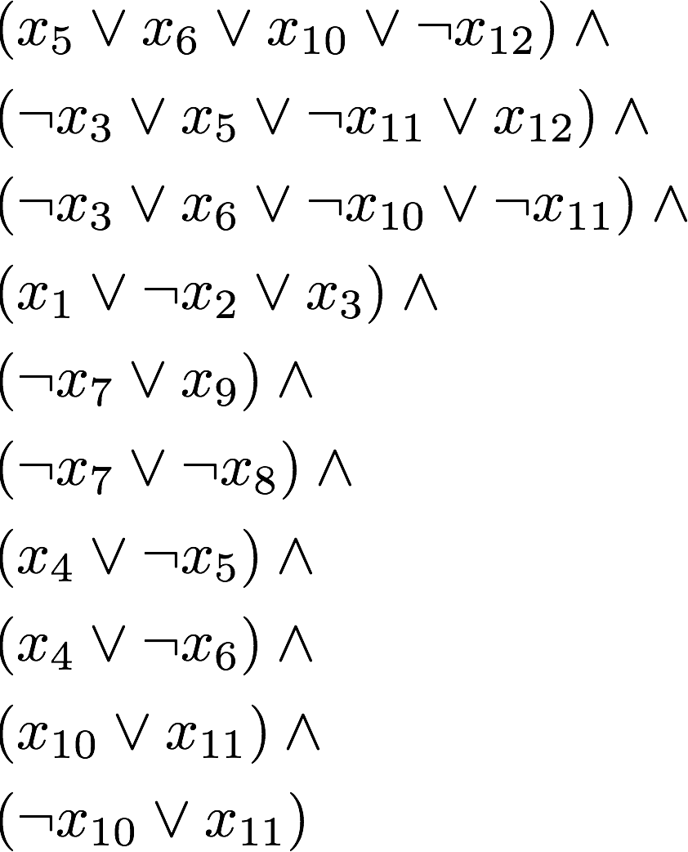
Clause Learning Example (1)
DL | Assignment
1 | x₁ = 0
2 | x₂ = 1
 | x₃ = 1
3 | x₄ = 0
 | x₅ = 0
 | x₆ = 0
4 | x₇ = 1
 | x₈ = 0
 | x₉ = 1
5 | x₁₀ = 0
 | x₁₁ = 1
 | x₁₂ = 0
Notes:
\begin{eqnarray*}
&&(x_5 \vee x_6 \vee x_{10} \vee \neg x_{12}) \wedge \\
&&(\neg x_3 \vee x_5 \vee \neg x_{11} \vee x_{12}) \wedge \\
&&(\neg x_3 \vee x_6 \vee \neg x_{10} \vee \neg x_{11}) \wedge \\
&&(x_1 \vee \neg x_2 \vee x_3) \wedge \\
&&(\neg x_7 \vee x_9) \wedge \\
&&(\neg x_7 \vee \neg x_8) \wedge \\
&&(x_4 \vee \neg x_5) \wedge \\
&&(x_4 \vee \neg x_6) \wedge \\
&&(x_{10} \vee x_{11}) \wedge \\
&&(\neg x_{10} \vee x_{11})
\end{eqnarray*}

Slide 7
Clause Learning Example (2)
DL | Assignment
1 | x₁ = 0
2 | x₂ = 1
 | x₃ = 1
3 | x₄ = 0
 | x₅ = 0
 | x₆ = 0
4 | x₇ = 1
 | x₈ = 0
 | x₉ = 1
5 | x₁₀ = 0
 | x₁₁ = 1
 | x₁₂ = 0
x₉ = 1
x₇ =1
x₈ = 0
x₁ = 0
x₃ = 1
Conflict
x₂ = 1
x₅ = 0
x₄ = 0
x₆ = 0
x₁₀ = 0
x₁₂ = 0
x₁₁ = 1

Slide 8

Clause Learning Example (3)
x₉ = 1
Decision variables
Conflict discovered in clause
x₇ =1
x₈ = 0
Conflict caused by assignment
So, we negate it
.. and add the clause
to the formula to prevent
this conflict in the future
x₁ = 0
x₃ = 1
Conflict
x₂ = 1
x₅ = 0
x₄ = 0
x₆ = 0
x₁₀ = 0
x₁₂ = 0
x₁₁ = 1

Slide 9
Intelligent Backtracking
When reaching a conflict, we
Consider conflicted clauses
Draw the implication graph
Identify the decision variables
Generate the learnt no-good
Add learned clause to the formula
Undo assignments until the learned clause becomes a unit clause

Slide 10
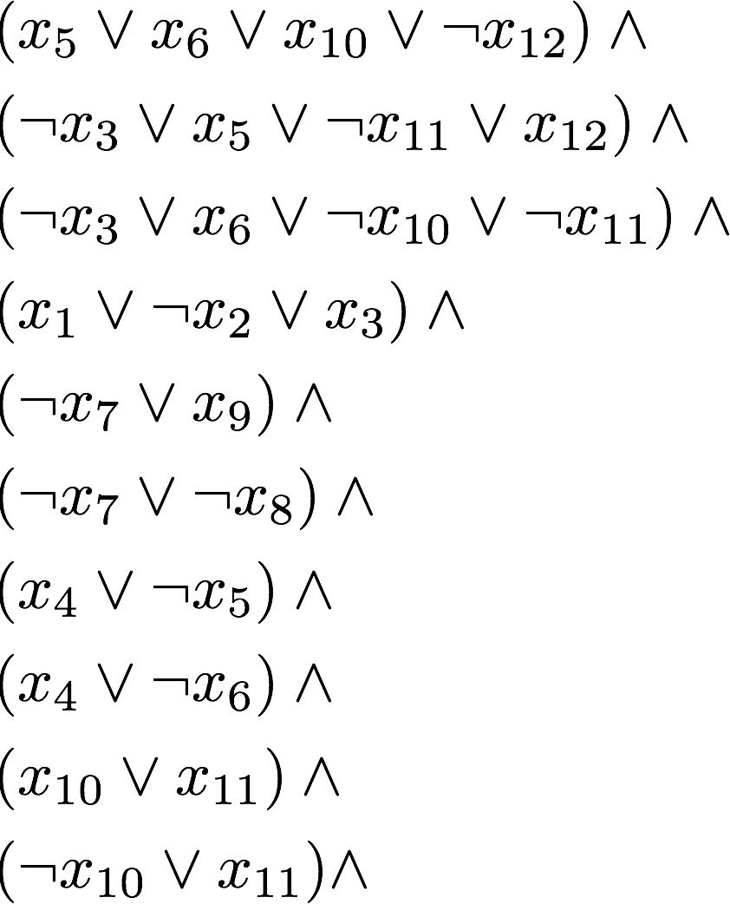
Intelligent Backtracking Example (1)
DL | Assignment
1 | x₁ = 0
2 | x₂ = 1
 | x₃ = 1
3 | x₄ = 0
 | x₅ = 0
 | x₆ = 0
4 | x₇ = 1
 | x₈ = 0
 | x₉ = 1
5 | x₁₀ = 0
 | x₁₁ = 1
 | x₁₂ = 0
x₁₀ deepest decision variable

Slide 11
Intelligent Backtracking Example (2)
DL | Assgn
1 | x₁ = 0
2 | x₂ = 1
 | x₃ = 1
3 | x₄ = 0
 | x₅ = 0
 | x₆ = 0
4 | x₇ = 1
 | x₈ = 0
 | x₉ = 1
5 | x₁₀ = 0
 | x₁₁ = 1
 | x₁₂ = 0
DL | Assgn
1 | x₁ = 0
2 | x₂ = 1
 | x₃ = 1
3 | x₄ = 0
 | x₅ = 0
 | x₆ = 0
4 | x₇ = 1
 | x₈ = 0
 | x₉ = 1
 | x₁₀ = 1
x₉ = 1
x₇ =1
x₈ = 0
x₁ = 0
x₃ = 1
x₂ = 1
x₅ = 0
x₄ = 0
x₆ = 0
x₁₀ = 1

Slide 12
Intelligent Backtracking Example (3)
x₉ = 1
Conflict caused by these decision variables
x₇ =1
Conflict discovered in clause
x₈ = 0
x₁ = 0
x₃ = 1
Conflict
x₂ = 1
.. and add the clause
to the formula to prevent
this conflict in the future
x₅ = 0
x₄ = 0
x₆ = 0
x₁₀ = 1
x₁₁ = 1

Slide 13
Intelligent Backtracking Example (4)
DL | Assgn
1 | x₁ = 0
2 | x₂ = 1
 | x₃ = 1
3 | x₄ = 0
 | x₅ = 0
 | x₆ = 0
4 | x₇ = 1
 | x₈ = 0
 | x₉ = 1
 | x₁₀ = 1

Slide 14
Intelligent Backtracking Example (5)
DL | Assgn
1 | x₁ = 0
2 | x₂ = 1
 | x₃ = 1
3 | x₄ = 0
 | x₅ = 0
 | x₆ = 0
4 | x₇ = 1
 | x₈ = 0
 | x₉ = 1
 | x₁₀ = 1
DL | Assgn
1 | x₁ = 0
2 | x₂ = 1
 | x₃ = 1
3 | x₄ =1

Slide 15
Summary
Search
Assign variable, Propagate
Detect conflict? Intelligent backtracking
Intelligent backtracking
Identify decision variables source of conflict
Add no-good clause so conflict cannot arise in the future
Backtrack the deepest variables in the learnt clause
Flip assignment of deepest variable in learnt clause
Proceed
Do you see any problem in this strategy?
Notes:
Problem: too many learned clauses, blows memory. There are strategies for reducing learned clauses (subsumption) and forgetting unused learned clauses

