Slide 1
Unit Propagation and Variable Ordering in MiniSAT
CSCE 235H Introduction to Discrete Structures
Spring 2023
URL: cse.unl.edu/~cse235h
All questions: Piazza

Slide 2
Outline
Unit propagation
Unit resolution
Thrashing calls for a good variable ordering
Variable ordering by
Activity
Decay

Slide 3
When a literal is assigned a value..
A satisfied clause can be removed
If , remove all clauses where it is positive (positive occurences)
If , remove all clauses where it is negative (negative occurences)
A clause can be simplified
If , remove it from all clauses where it is positive
If , remove all clauses where it is negative

Slide 4
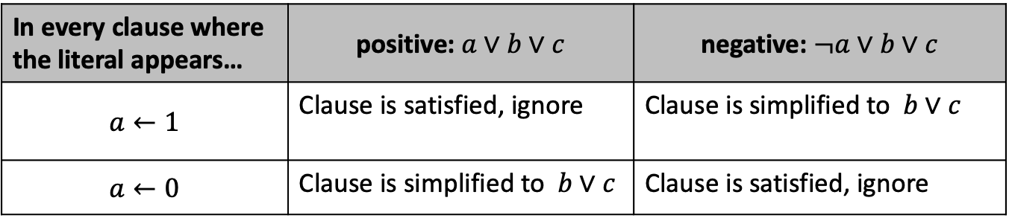
When a literal is assigned a value..
In every clause where the literal appears… | positive: $a∨b∨c$ | negative: $¬a∨b∨c$
$$a←1$$ | Clause is satisfied, ignore | Clause is simplified to $b∨c$
$$a←0$$ | Clause is simplified to $b∨c$ | Clause is satisfied, ignore
Special case: when the simplified clause has one literal, it is called unit clause

Slide 5
Unit Propagation (1)
Assignments may result in unit clauses
Unit clauses immediately force an assignment
This can lead to a chain reaction as new assignments ‘propagate’ throughout the clauses

Slide 6
Unit Propagation: Example
SAT formula with 1,000 variables
Cycle of implications
A single assignment results in unit propagation to solve the entire problem

Slide 7
Outline
Unit propagation
Unit resolution
Thrashing calls for a good variable ordering
Variable ordering by
Activity
Decay

Slide 8
Unit Resolution
Unit resolution or disjunctive syllogism
Unit propagation has similarities to unit resolution
Assignments add unit clauses to the formula
When a new unit clause is added, it can be resolved with other clauses in the formula and the result added to the formula

Slide 9
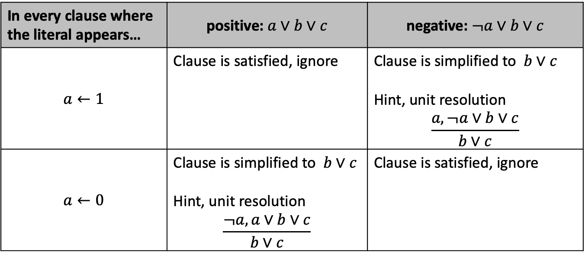
When a literal is assigned a value..
In every clause where the literal appears… | positive: $a∨b∨c$ | negative: $¬a∨b∨c$
$$a←1$$ | Clause is satisfied, ignore | Clause is simplified to $b∨c$ Hint, unit resolution $$\frac{a,¬a∨b∨c}{b∨c}$$
$$a←0$$ | Clause is simplified to $b∨c$ Hint, unit resolution $$\frac{¬a,a∨b∨c}{b∨c}$$ | Clause is satisfied, ignore

Slide 10
Outline
Unit propagation
Unit resolution
Thrashing calls for a good variable ordering
Variable ordering by
Activity
Decay

Slide 11
Thrashing in Search
Repeatedly hitting conflict within a subtree of the search tree
Thrashing is costly

Slide 12
Fail-First Principle (FFP)
It is better to fail early than to waste time exploring a subtree with no solutions
Want to handle potential conflicts earlier

Slide 13
Outline
Unit propagation
Unit resolution
Thrashing calls for a good variable ordering
Variable ordering by
Activity
Decay

Slide 14
Variable Ordering Heuristics
The order in which variables are assigned
Heuristic: good performance in general, not guaranteed to be optimal
Static versus dynamic
Static: Assignment order is decided before search and maintained fixed throughout search
Dynamic: Variable ordering is adjusted during the course of the search

Slide 15
Activity-Based Heuristics
Variables are assigned an ‘activity’ value
Variables involved in a conflict have their activities increased
Activities exponentially decay
Select most ‘active’ variable

Slide 16
Activity-Based Heuristics Example
UNSAT formula with 1000 variables
Conflict occurs between v₉₉₉ and v₁₀₀₀
Lexicographic ordering
Activity-based ordering

