Slide 1
Introduction to MiniSAT
Spring 2023
CSCE 235H Introduction to Discrete Structures
URL: cse.unl.edu/~cse235h
All questions: Piazza

Slide 2
The MiniSAT Solver
‘Minimalistic,’ open-source SAT solver
Designed to be easy to learn and modify
Highly performant: has won SAT competitions
Used as the backend for many projects

Slide 3
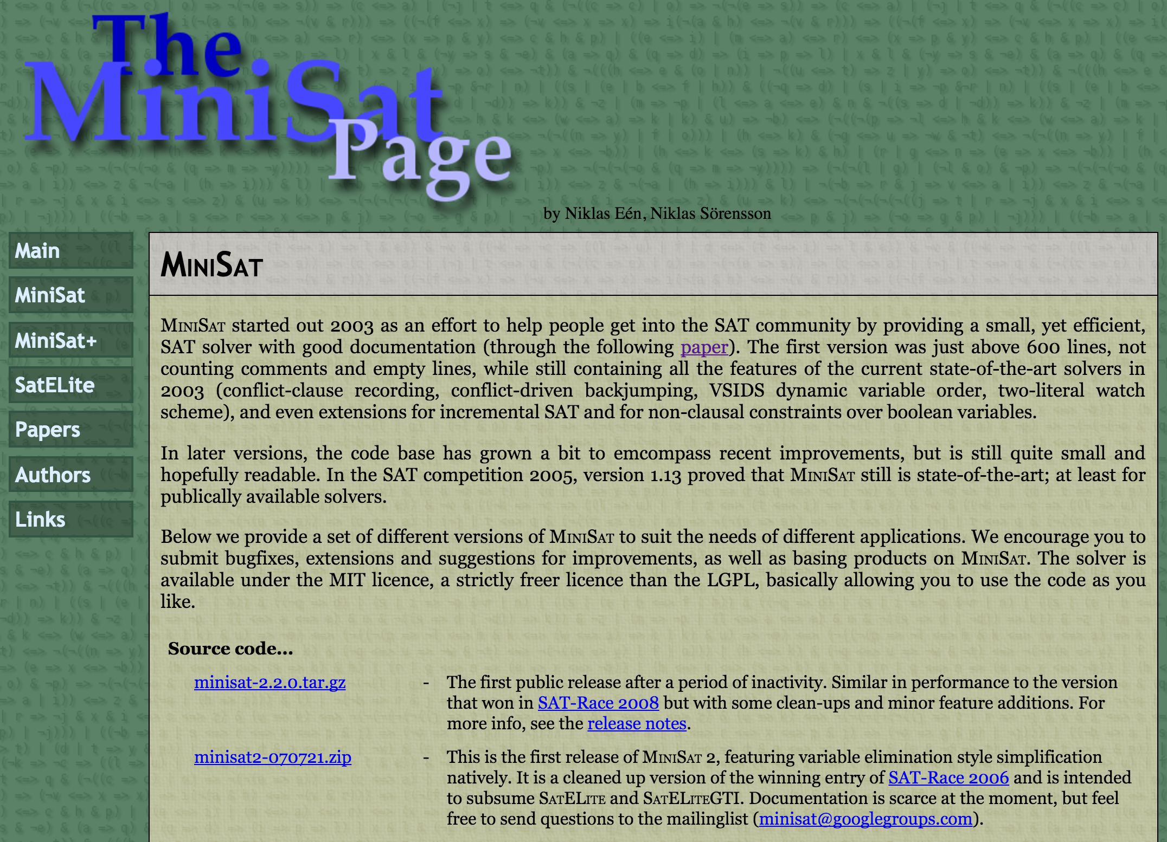
Setting up MiniSAT (1)
Access the MiniSAT webpage at
http://minisat.se/MiniSat.html

Slide 4
Setting up MiniSAT (2)
Download the file minisat-2.2.0.tar.gz
Copy the file to the CSE server
OR
Login to the CSE server
Download the file directly
wget http://minisat.se/downloads/minisat-2.2.0.tar.gz

Slide 5
Setting up MiniSAT (3)
Untar the MiniSAT files
tar -zxvf minisat-2.2.0.tar.gz
Enter the minisat directory
cd minisat
Set the MROOT environment variable to the full path to the minisat directory (only required for compilation)
setenv MROOT <full path to minisat> or
export MROOT <full path to minisat>

Slide 6
Setting up MiniSAT (4)
Enter the core directory
cd core
Compile the program using make
make
The minisat executable is now located in the core directory

Slide 7
Using MiniSAT
Command usage
./minisat [options] <input-file> <result-output-file>
See full listing of options
./minisat --help

Slide 8
DIMACS CNF format (1)
Created by the Center for Discrete Mathematics and Theoretical Computer Science (DIMACS)
Standard format for expressing CNF formulas
Human-readable text file

Slide 9
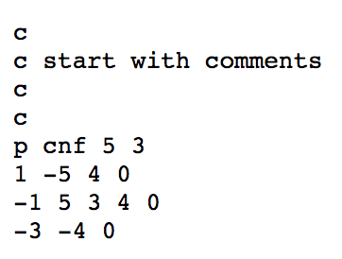
DIMACS CNF format (2)
Comments start with a ‘c’
Each line expresses one clause and must end with a ‘0’
Parameters line starts with a ‘p’ and indicates cnf format, 5 variables, 3 clauses
Variables must be non-zero numbers.
Negated variables have a minus sign

Slide 10
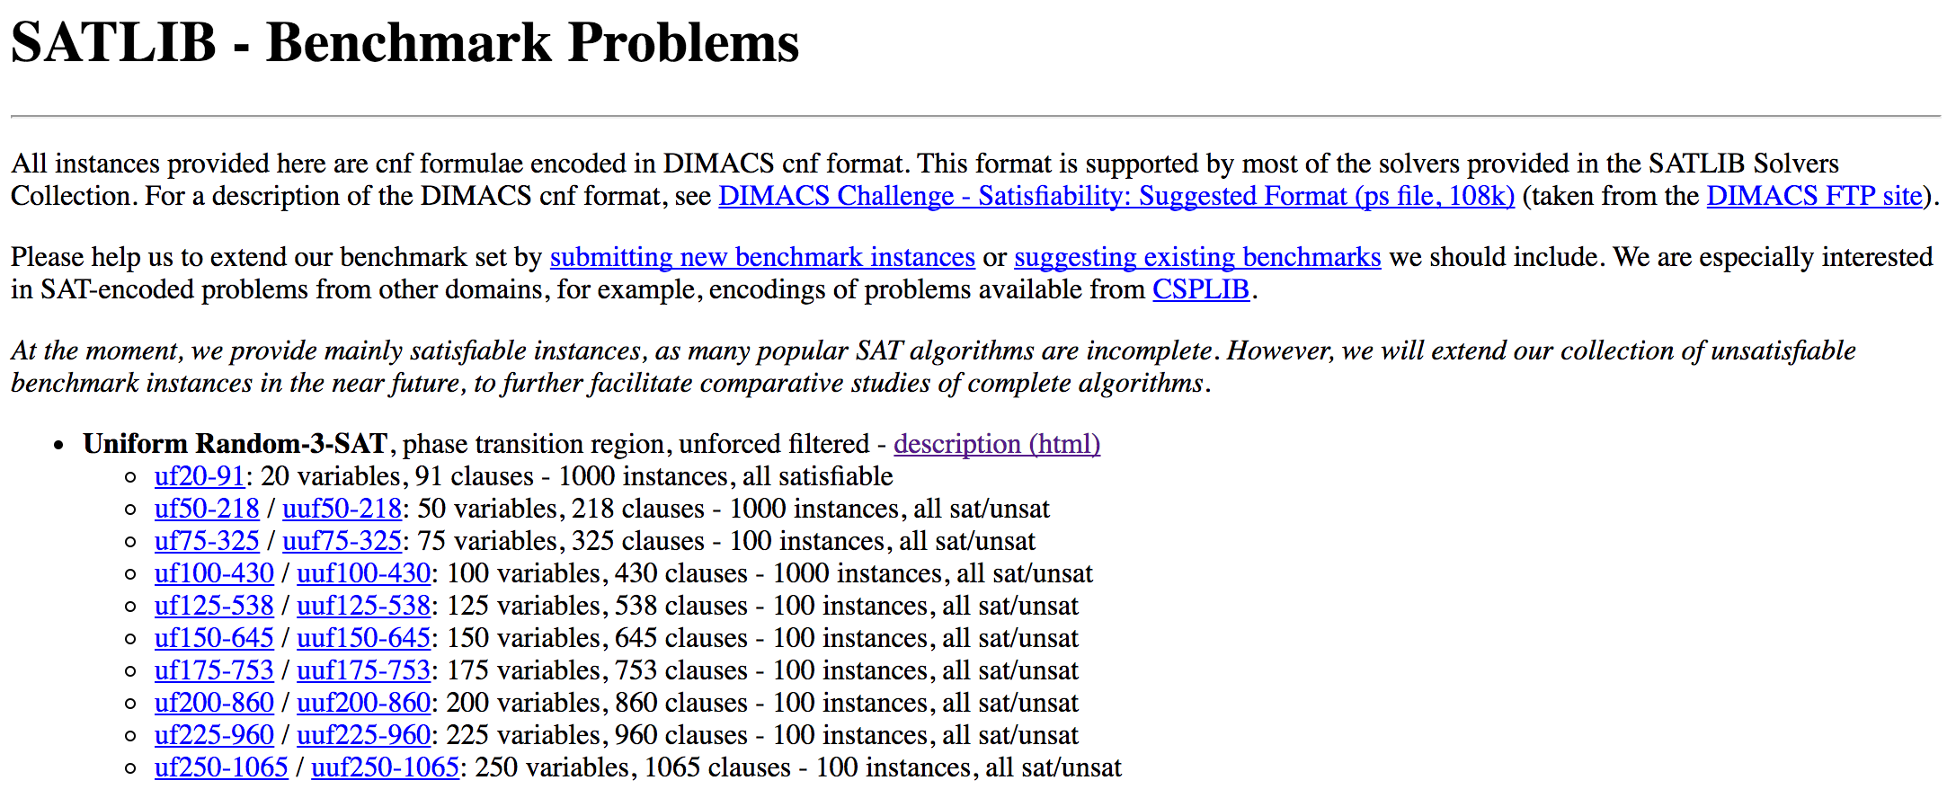
SATLIB benchmark problems (1)
Access the SATLIB webpage at
http://www.cs.ubc.ca/~hoos/SATLIB/benchm.html

Slide 11
SATLIB benchmark problems (2)
Repository of SAT benchmark problems
Used the evaluate and compare solvers
Taken from a variety of domains
E.g., randomly generated, puzzles, coloring graph, planning, etc.
Descriptions of the benchmarks are included

Slide 12
SATLIB benchmark problems (3)
ALERT
Some instances may have extra lines that cannot be parsed by MiniSAT.
Delete any line starting with ‘%’ and all following lines.

