Slide 1
Constraint Satisfaction 101
CSCE421/821, Spring 2022
www.cse.unl.edu/~choueiry/S22-421-821
Questions: Piazza
Berthe Y. Choueiry (Shu-we-ri)
AVH 259

Slide 2
Take Away Message
CP = Modeling + Inference + Search
Variables
Domains
Constraints
Query
Enforcing consistency (filtering) and
Propagation
(E.g., AC, PC, etc.)
Systematic (chronological backtracking, with/without intelligence, etc.) or
Non-systematic (hill climbing, taboo, etc.)

Slide 3
Outline
Motivating example, application areas
CSP: Definition, representation
Some simple modeling examples
More on definition and formal characterization
Basic solving techniques
(Implementing backtrack search)
Advanced solving techniques
Issues & research directions

Slide 4
Motivating example
Context: You are a senior in college
Problem: You need to register in 4 courses for the Spring semester
Possibilities: Many courses offered in Math, CSE, EE, CBA, etc.
Constraints: restrict the choices you can make
  Unary: Courses have prerequisites you have/don't have Courses/instructors you like/dislike
  Binary: Courses are scheduled at the same time
  n-ary: In CE: 4 courses from 5 tracks such as at least 3 tracks are covered
You have choices, but are restricted by constraints
  Make the right decisions!!

Slide 5
Motivating example (cont’d)
Given
  A set of variables: 4 courses at UNL
  For each variable, a set of choices (values)
  A set of constraints that restrict the combinations of values the variables can take at the same time
Questions
  Does a solution exist? (classical decision problem)
  How two or more solutions differ? How to change specific choices without perturbing the solution?
  If there is no solution, what are the sources of conflicts? Which constraints should be retracted?
  etc.

Slide 6
Practical applications
Adapted from E.C. Freuder
Radio resource management (RRM)
Databases (computing joins, view updates)
Temporal and spatial reasoning
Planning, scheduling, resource allocation
Design and configuration
Graphics, visualization, interfaces
Hardware verification and software engineering
HC Interaction and decision support
Molecular biology
Robotics, machine vision and computational linguistics
Transportation
Qualitative and diagnostic reasoning

Slide 7
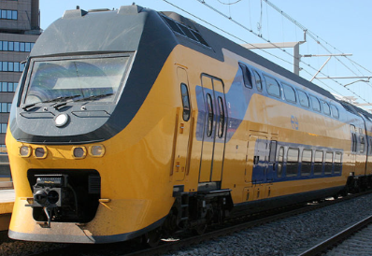
Real Practical Application (I)
Borrowed from Milano&Lombardi
Netherlands have one of most dense railroad networks in the world, with 5,500 trains per day
In 2009, the entire timetable has been redesigned from scratch (via OR techniques and Constraint Programming)
More robust schedule
More effective
Profit increase: ~$75M

Slide 8

Real Practical Application (II)
Borrowed from Milano&Lombardi
The port of Singapore is one of the world’s largest container hubs
200 shipping lines with connections to 600 ports in 123 countries
Yard locations and loading plans must be assigned under a large number of operational and safety requirements
The Yard planning system, based on CP is assisting the job

Slide 9
Constraint Processing
is about ...
  Solving a decision problem…
  … While allowing the user to state arbitrary constraints in an expressive way and
  Providing concise and high-level feedback about alternatives and conflicts
  CP = Model + Constraint Reasoning + Search
    We will learn what these are
Related areas:
  AI, OR, Algorithmic, DB, TCS, Prog. Languages, etc.

Slide 10
Power of Constraints Processing
Flexibility & expressiveness of representations
Interactivity
users can constraints
relax
reinforce

Slide 11
Outline
Motivating example, application areas
CSP: Definition, representation
Some simple modeling examples
More on definition and formal characterization
Basic solving techniques

Slide 12
Defining a problem
General template of any computational problem
  Given:
    Example: a set of objects, their relations, etc.
  Query/Question:
    Example: Find x such that the condition y is satisfied
How about the Constraint Satisfaction Problem?

Slide 13
Definition of a CSP
Given
  A set of variables
  A set of variable domains (values)
  A set of constraints
  A solution where all constraints are satisfied
Query:
  Does a solution exist?
  What is the number of solutions?
  Etc.
Notes:
C_i: \langle \mathit{scope},\mathit{rel}\rangle
\mathit{scope}(C_i) =\{{V_i}, {V_j},\ldots, V_k\} \subseteq \mathcal{V}
\mathit{rel}(C_i) =\{(x,y,\ldots,z\} \subseteq D_{V_i}\times D_{V_k}\times \ldots\times D_{V_k}
\mathit{rel}(C_i) =\{(x,y,\ldots,z\} \subseteq D_{V_i}\times D_{V_j}\times \ldots\times D_{V_k}
\mathit{scope}(C_i) =\{{V_i}\times {V_j}\times \ldots\times {V_k}\} \subseteq \mathcal{V}
\forall\; V_i \in \mathcal{V}, V_i \gets a_i \in D_{V_i}
C_i: \langle \mathit{scope},\mathit{rel}\rangle
\forall\; V_i \in \mathcal{V}, V_i \gets a_i \in D_{V_i}

Slide 14
Query
Different queries yield different problems
Decide if a solution exists decision problem
Find a solution exemplification problem
Find a minimum set of constraints that can be removed so that a solution exists optimization (mini) problem
Find number of/all solutions counting problem
Etc.

Slide 15
Domain Types
x
Domains:
  Restricted to {0,1}: Boolean CSPs
  Finite (discrete), enumeration works
  Continuous, sophisticated algebraic techniques are needed
    Consistency techniques on domain bounds

Slide 16
CSP Representation (I)
Given
Find a consistent assignment for variables
Constraint Network (graph, hypergraph)
Variable → node (vertex)
Domain → node label
Constraint → arc (edge) between nodes

Slide 17
CSP Representation (II)
Graph
Vertices: variables
Edges: binary constraints
V₁
V₁ < V₂
{1, 2, 3, 4}
{ 3, 6, 7 }
V₂
V₁+V₃ < 9
V₂ < V₃
V₂ > V₄
V₃
{ 3, 4, 9 }
{ 3, 5, 7 }
V₄
Hypergraph
Vertices: variables
Hyperedges: constraints

Slide 18
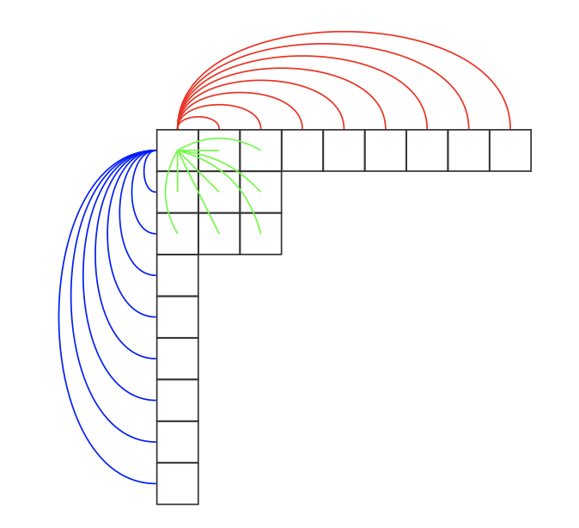
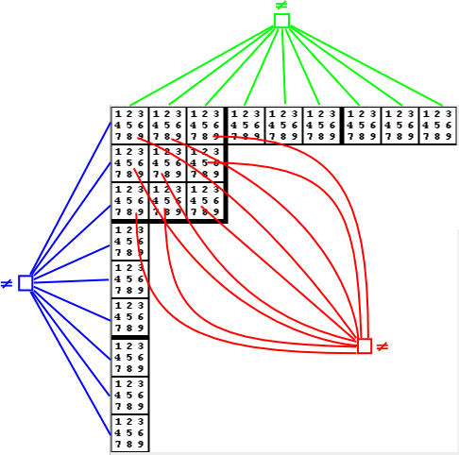
Example I: Sudoku
Binary constraint model
Non-binary constraint model

Slide 19
Constraint Definition
A constraint C is defined by a
  Scope, the set of variables on which the constraint applies
  Notation: Scope(C), scope(C), scp(C)
  Relation, a subset of the Cartesian product of the domains of the variables in the scope of the constraint
  Notation: Relation(C), rel(C)
Arity of constraint: cardinality of the constraint’s scope
  Unary, binary, ternary, …, non-binary
  Global constraints: rel(C) is defined, scp(C) is a parameter
  Example: AllDiff (Sudoku), Balance, Atmost
  See: Global Constraints Catalog (https://sofdem.github.io/gccat/)
  Universal constraint

Slide 20
Relation Definition
Extension, all tuples are enumerated
  As a list of allowed tuples (supports, positive table)
  As a list of forbidden tuples (conflicts, no-goods)
Intension, given by a set builder
  When it is not practical or possible to list all tuples
  Define types/templates of common constraints to be used repeatedly
  Example: Global constraints
    rel(C) is defined
    scp(C) is a parameter
    Examples: linear constraints, AllDiff (mutex), Atmost, TSP-constraint, cycle-constraint, etc.

Slide 21
Constraint Implementation
Predicate function
Set of tuples (list or table)
Binary matrix (bit-matrix)
Constrained Decision Diagrams ([Cheng & Yap, AAAI 05])
etc.

Slide 22
Outline
Motivating example, application areas
CSP: Definition, representation
Some simple modeling examples
More on definition and formal characterization
Basic solving techniques

Slide 23
Example II: Temporal reasoning
A < B
A
B
[1,10]
[5,18]
2 < C – A < 5
[4,15]
B < C
C
Give one solution: …….
Satisfaction, yes/no: decision problem
Note: bounded differences, gap constraints

Slide 24
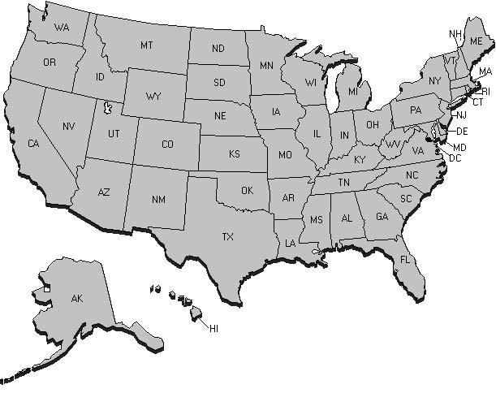
Example III: Map coloring
Using 3 colors (R, G, & B), color the US map such that no two adjacent states have the same color
Variables?
Domains?
Constraints?

Slide 25
Example III: Map coloring (cont’d)
Using 3 colors (R, G, & B), color the US map such that no two adjacent states have the same color

Slide 26
Example IV: Resource Allocation
What is the CSP formulation?
{ a, b, c }
{ a, b } { a, c, d }
{ b, c, d }

Slide 27
Example IV: RA (cont’d)
{ a, b, c }
{ a, b } { a, c, d }
{ b, c, d }
Constraint Graph
T1
Interval Order
{ R1, R3 }
≠
T4
≠
≠
{ R1, R2, R3 }
≠
T6
T1
{ R1, R3 }
≠
{ R2, R4 }
{ R1, R3 }
≠
≠
≠
≠
≠
T2
{ R1, R3 }
{ R1, R3, R4 }
{ R1, R3 }
T3
T4
T2
≠
T5
{ R1, R2, R3 }
≠
{ R1, R2, R3 }
≠
{ R2, R4 }
T6
{ R2, R4 }
T3
T7
{ R2, R4 }
{ R1, R3 }
T5
T7

Slide 28
Example V: Cryptarithmetic puzzles
D_{X1} = D_{X2} = D_{X3} = {0,1}
D_{F}=D_{T}=D_{U}=D_{W}=D_{R}=D_{O}=[0,9]
O+O = R+10X1
X1+W+W = U+10X2
X2+ T+T = O + 10X3
X3=F
Alldiff({F,T,U,W,R,O})

Slide 29
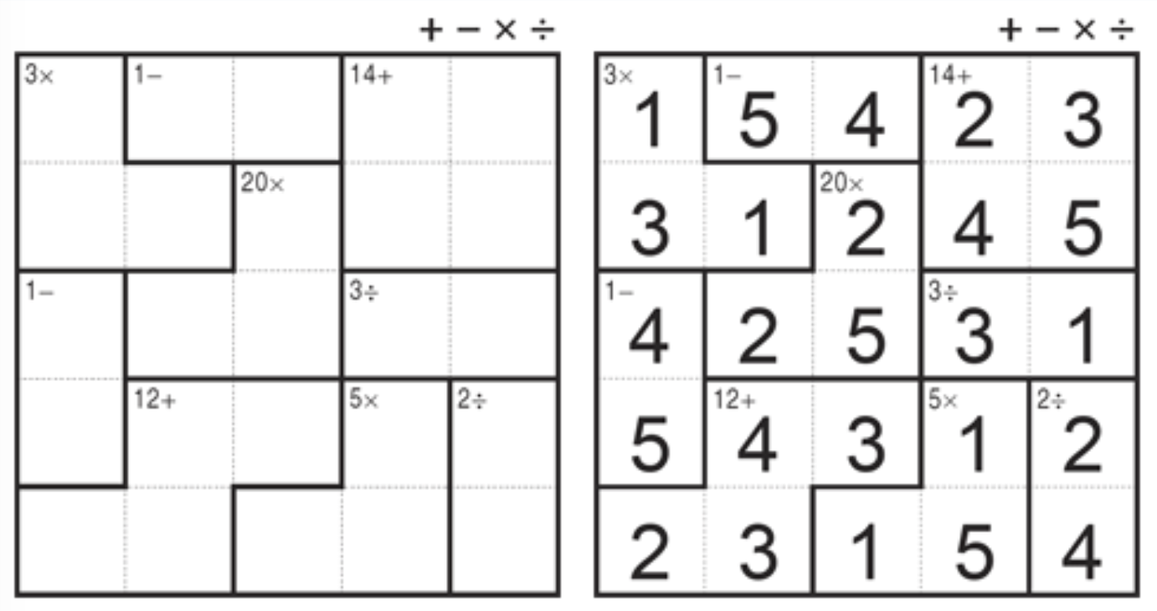
Example VI: Kendoku

Slide 30
Example VII: Product Configuration
Train, elevator, car, etc.
Given:
  Components and their attributes (variables)
  Domain covered by each characteristic (values)
  Relations among the components (constraints)
  A set of required functionalities (more constraints)
Find: a product configuration
i.e., an acceptable combination of components
that realizes the required functionalities

Slide 31
Example VIII: Puzzle
Given:
Four musicians: Fred, Ike, Mike, and Sal, play bass, drums, guitar and keyboard, not necessarily in that order.
They have 4 successful songs, ‘Blue Sky,’ ‘Happy Song,’ ‘Gentle Rhythm,’ and ‘Nice Melody.’
Ike and Mike are, in one order or the other, the composer of ‘Nice Melody’ and the keyboardist.
etc ...
Query: Who plays which instrument and who composed which song?

Slide 32
Example VIII: Puzzle (cont’d)
Formulation 1:
Variables: Bass, Drums, Guitar, Keyboard, Blue Sky, Happy Song
Gentle Rhythm and Nice Melody.
Domains: Fred, Ike, Mike, Sal
Constraints: …
Formulation 2:
Variables: Fred's-instrument, Ike's-instrument, …,
Fred's-song, Ikes's-song, Mike’s-song, …, etc.
Domains:
  { bass, drums, guitar, keyboard }
{ Blue Sky, Happy Song, Gentle Rhythm, Nice Melody}
Constraints: …

Slide 33
Constraint types: examples
Algebraic constraints
  Linear, nonlinear inequalities
Example: constraints
of bounded difference
Coloring (mutual exclusion, difference constraints)
AllDiff constraints, arbitrary constraints
V1
{1, 2, 3, 4}
v1 < v2
{ 3, 6, 7 }
V2
v1+v3 < 9
v2 < v3
v2 > v4
V3
{ 3, 4, 9 }
{ 3, 5, 7 }
V4
T1
Constraint Graph
{ R1, R3 }
≠
T4
≠
≠
{ R1, R2, R3 }
≠
T6
≠
≠
{ R2, R4 }
{ R1, R3 }
≠
≠
≠
≠
≠
≠
{ R1, R2, R3 }
≠
{ R2, R4 }
T3
{ R1, R3 }
T5
T7

Slide 34
More examples
Databases
  Join operation in relational DB is a CSP
  View materialization is a CSP
Interactive systems
  Data-flow constraints
  Spreadsheets
  Graphical layout systems and animation
  Graphical user interfaces
Molecular biology (bioinformatics)
  Threading, etc.

Slide 35
Outline
Motivating example, application areas
CSP: Definition, representation
Some simple modeling examples
More on definition and formal characterization
Basic solving techniques

Slide 36
Representation (again)
Macrostructure G(P):
- constraint graph for
binary constraints
- constraint network for
non-binary constraints
Micro-structure μ (P):
Co-microstructure co-μ(P):
V1
a, b
≠
≠
V2
V3
a, c
≠
b, c
(V1, a ) (V1, b)
(V2, a ) (V2, c)
(V3, b ) (V3, c)
(V1, a ) (V1, b)
no goods
(V2, a ) (V2, c)
(V3, b ) (V3, c)

Slide 37
Complexity of CSP
Characterization
  Decision problem
  In general, NP-complete by reduction from 3SAT

Slide 38
Proving NP-completeness
Show that Π₁ is in NP
Given a problem Π₁ in NP, show that an known NP-complete problem Π₂ can be efficiently reduced to Π₁
  Select a known NP-complete problem Π₂ (e.g., SAT)
  Construct a transformation f from Π₂ to Π₁
  Prove that f is a polynomial transformation
(Check Chapter 3 of Garey & Johnson)

Slide 39
What is SAT?
Given a sentence:
  Sentence: conjunction of clauses
  Clause: disjunction of literals
  Literal: a term or its negation
  Term: Boolean variable
Question: Find an assignment of truth values to the Boolean variables such the sentence is satisfied.

Slide 40
CSP is NP-Complete
Verifying that an assignment for all variables is a solution
  Provided constraints can be checked in polynomial time
Reduction from 3SAT to CSP
  Many such reductions exist in the literature (perhaps 7 of them)

Slide 41
Problem Reduction
Example: CSP into SAT (proves nothing, just an exercise)
Notation: variable-value pair = vvp
vvp → term
  V₁ = {a,b,c,d} yields x₁ = (V₁,a), x₂ = (V₁,b), x₃ = (V₁,c), x₄ = (V₁,d),
  V₂ = {a,b,c} yields x₅ = (V₂,a), x₆ = (V_{2,}b), x₇ = (V₂,c).
The vvp’s of a variable → disjunction of terms
  V₁ = {a, b, c, d} yields
(Optional) At most one VVP per variable
  Way 1:
  Way 2:

Slide 42
CSP into SAT (cont.)
Constraint:
Way 1: Each no-good/inconsistent tuple → one disjunctive clause
  For example: how many?
Way 2:
  Consistent tuple → conjunction of terms
  Each constraint → disjunction of these conjunctions
→ transform into conjunctive normal form (CNF)
Question: find a truth assignment of the Boolean variables such that the sentence is satisfied

Slide 43
Outline
Motivating example, application areas
CSP: Definition, representation
Some simple modeling examples
More on definition and formal characterization
Basic solving techniques
  Modeling and consistency checking
  Constructive, systematic search
  Iterative improvement, local search

Slide 44
How to solve a CSP?
Search
1. Constructive, systematic
2. Iterative repair, local search

Slide 45
Before starting search!
Consider:
Importance of modeling/formulation:
  To control the size of the search space
Preprocessing
  A.k.a. constraint filtering/propagation, consistency checking
  reduces size of search space

Slide 46
Importance of Modeling
N-queen: formulation 1
  Variables?
  Domains?
  Size of CSP?
N-queens: formulation 2
  Variables?
  Domains?
  Size of CSP?
1 2 3 4
V₁
V₂
V₃
V₄
4 Rows
4 Column positions
V₁₁ V₁₂ V₁₃ V₁₄
16 Cells
V₂₁ V₂₂ V₂₃ V₂₄
{0,1}
V₃₁ V₃₂ V₃₃ V₃₄
V₄₁ V₄₂ V₄₃ V₄₄

Slide 47
Constraint Checking
Arc-consistency
B
A < B
13
1- B: [ 5 .. 14 ]
14
A
[ 5.... 18]
C: [ 6 .. 15 ]
2
B < C
2- A: [ 2 .. 10 ]
[ 1.... 10 ]
C: [ 6 .. 14 ]
2 < C - A < 5
3- B: [ 5 .. 13 ]
6
14
[ 4.... 15]
C

Slide 48
Constraint Checking
Arc-consistency: every combination of two adjacent variables
3-consistency, k-consistency (k ≤ n)
Constraint filtering, constraint checking, etc..
Eliminate non-acceptable tuples prior to search
Warning: arc-consistency does not solve the problem
still is not a solution!

Slide 49
Systematic Search
Starting from a root node
Consider all values for a variable V₁
For every value for V₁, consider all values for V₂
etc..
For n variables, each of domain size d
Maximum depth fixed!
Maximum number of paths? size of search space
root
V₁
a
b
e
V₂
a
b
e
a
b
e
V_{n}
a
b
e
a
b
e

Slide 50
Systematic search: Ordering heuristics
Which variable to expand first?
Which value to assign first?
3
3
0
Heuristics:
  most constrained variable first (reduce branching factor)
  most promising value first (find quickly first solution)

Slide 51
Systematic search: Back-checking
Systematic search generates d^{n} possibilities
Are all possibilities acceptable?
Expand a partial solution only when it is consistent
This yields early pruning of inconsistent paths

Slide 52
Back-checking
Rationale
  Maintain the consistency of current path
Mechanism
  When instantiating V_{i}, (back)check consistency with each previous assignment
    If consistent, move to V_{i+1}
    If inconsistent, try another value
    If no other value exists, backtrack chronologically
root
V₁
V₂
V_{i}

Slide 53
Lookahead
Rationale
  Maintain the consistency of future subproblem after each assignment
Mechanism
  When instantiating V_{i}, enforce consistency of future subproblem
    Forward checking revises the domain of the future variables that are adjacent to current variable V_{c}
    Maintaining Arc Consistency enforces AC on the current assignment and the entire future subproblem
Advantage: domain-wipe out in the future
Question
  Is back-checking needed with lookahead?
root
root
V_{c}
V_{c}
FC
MAC

Slide 54
Example: Back-checking
Search tree with only backtrack search?
Root node
Q
Q
1
2
Q
Q
1
2
3
4
Q
1
2
3
4
Q
Q
1
2
3
4
1
2
3
4
1
Q
1
2
3
4
1
2
3
Solution!
26 nodes visited.

Slide 55
Example: Forward checking
Search Tree with domains filter by Forward Check
Root node
Q
Q
1
2
Q
Q
4
Q
3
4
Domain Wipe Out V₃
Q
Q
2
1
Q
Domain Wipe Out V₄
3
Solution!
8 nodes visited.

Slide 56
Systematic search: Chronological backtracking
What if only one solution is needed?
Depth-first search & Chronological backtracking
DFS: Soundness? Completeness?

Slide 57
Systematic search: Intelligent backtracking
What if the reason for failure was higher up in the tree?
Backtrack to source of conflict !!
Backjumping, conflict-directed backjumping, etc.

Slide 58
Improving BT search
General purpose methods for
  Variable, value ordering
  Improving backtracking: intelligent backtracking avoids repeating failure
  Look-ahead techniques: propagate constraints as variables are instantiated

Slide 59
Search-tree branching
K-way branching
  One branch for every value in the domain
Binary branching
  One branch for the first value
  One branch for all remaining values in domain
  Used in commercial solvers: ILOG, Eclipse
root
root
V₁
V₁
a
b
e
a
D₁-{a}
V₂
a
b
e
b
D₁-{a,b}
a
b
e
V_{n}
.
D₁-{a,b,.}
a
b
e
a
b
e
Have different behaviors (e.g., WRT value ordering heuristics [Smith, IJCAI 95])

Slide 60
Summary of backtrack search
Constructive, systematic, exhaustive
  In general sound and complete
Back-checking: expands nodes consistent with past
Backtracking: Chronological vs. intelligent
Ordering heuristics:
  Static
  Dynamic variable
  Dynamic variable-value pairs
Looking ahead:
  Partial look-ahead
    Forward checking (FC)
    Directional arc-consistency (DAC)
  Full (a.k.a. Maintaining Arc-consistency or MAC)

Slide 61
CSP: a decision problem (NP-complete)
Modeling: abstraction and reformulation
Preprocessing techniques:
  eliminate non-acceptable tuples prior to search
Systematic search:
  potentially d^{n} paths of fixed lengths
  chronological backtracking
  intelligent backtracking
  variable/value ordering heuristics
Search ‘hybrids:’
  Mixing consistency checking with search: look-ahead strategies

Slide 62
Non-Systematic Search
Iterative repair, local search: modifies a global but inconsistent solution to decrease the number of violated constraints
Examples: Hill climbing, taboo search, simulated annealing, GSAT, WalkSAT, Genetic Algorithms, Swarm intelligence, etc.
Features: Incomplete & not sound
  Advantage: anytime algorithm
  Shortcoming: cannot tell that no solution exists

Slide 63
Outline of CSP 101
We have seen
  Motivating example, application areas
  CSP: Definition, representation
  Some simple modeling examples
  More on definition and formal characterization
  Basic solving techniques
We will move to
  Arc consistency
  Backtrack search
Advanced solving techniques
Issues & research directions

Slide 64
Take-Away Message
CP = Modeling + Inference + Search
Variables
Domains
Constraints
Query
Enforcing consistency (filtering) and
Propagation
(E.g., AC, PC, etc.)
Systematic (chronological backtracking, with/without intelligence, etc.) or
Non-systematic (hill climbing, taboo, etc.)

