Slide 1
Search Orders in CSPs
Foundations of Constraint Processing
CSCE421/821, Spring 2022
www.cse.unl.edu/~choueiry/S22-421-821/
Berthe Y. Choueiry (Shu-we-ri)
Avery Hall, Room 259
Tel: +1(402)472-5444

Slide 2
Assumptions
Finite domains
Binary constraints
Required reading
Chapter 6 of Tsang’s book (web accessible)
Recommended reading
Dual viewpoint heuristics for binary Constraint Satisfaction Problems [Geelen, ECAI 92]
In my experience the most powerful, but also the most costly (require lots of constraint checks)
a quite

Slide 3
Context
In BT, there are fewer backtracks
under some orderings than others
In look-ahead,
failure can be detected earlier under some orderings than others
When searching for one solution,
value ordering may speed up search as branches that have a better chance to reach a solution are explored first
When using some kind of lookahead (e.g., FC)
dynamic ordering often reduce (remove?) the need for intelligent backtracking (personal experience)

Slide 4
Goal of variable/value ordering
Avoid constraint violation
Select values that do not cause constraint violation
Most promising value first (general principal)
Discover constraint violation quickly
Select variables that do not delay the discovery of constraint violation
Most constrained variable first (general principal)

Slide 5
Value ordering: quickly get to a solution
Min-conflict heuristic: orders values according to the conflicts in which they are involved with the future variables (most popular) [Minton]
Cruciality [Keng & Yu ’89]
Promise (most powerful) [Geelen ’92]
Etc.

Slide 6
Notation Geelen ECAI 92
For a given future variable V_{i}, the assignment V_{i}←x partitions the domain of a future variable V_{j}
A set of values consistent with V_{i}←x of size Left(V_{j} | V_{i}←x)
A set of values inconsistent with V_{i}←x of size Lost(V_{j} | V_{i}←x)

Slide 7
Value selection in terms of Lost, Left
V_{i}, V_{j}: future variables
Minimize min-conflict Cost(V_{i}←x)=∑_{Vj≠i} Lost(V_{j} | V_{i}←x)
Minimize [Keng & Yun 89] Cruciality(V_{i}←x)=∑_{Vj≠i} Lost(V_{j} | V_{i}←x) / |D_{Vj}|
Maximize [Geelen ECAI 92] Promise(V_{i}←x)=∏_{Vj≠i} Left(V_{j} | V_{i}←x) number of assignments that can be done such that no constraint on V_{i} is broken

Slide 8
Advantages of Promise for value selection
Advantages that are unique to Promise:
Product recognizes domain wipe-out, sum does not
Compare 6+0 and 6x0
Product discriminates better than sum:
6+0, 5+1, 4+2, 3+3 are all equivalent However (6x0) < (5x1) < (4x2) < (3x3)
Semantics of Promise (i.e., physical interpretation)
Upper bound on number of solutions

Slide 9
Value selection: example
Minimize cost
Cost(V_{i} ← x)=∑_{Vj≠i} Lost(Vj | Vi ← x)
Maximize Promise
Promise(Vi ← x)=∏_{Vj≠i} Left(Vj | Vi ← x)
Q1 | 6 | 6 | 6 | 6
Q2 | 6 | 8 | 8 | 6
Q3 | 6 | 8 | 8 | 6
Q4 | 6 | 6 | 6 | 6
Q1 | 8 | 6 | 6 | 8
Q2 | 8 | 2 | 2 | 8
Q3 | 8 | 2 | 2 | 8
Q4 | 8 | 6 | 6 | 8

Slide 10
Variable Ordering: Fail-first principle
Recognize dead-ends ASAP to save search effort
Terminology (FFP) is historic, currently contested
If you are on
a correct path, stay on it
an incorrect path, ‘fail’ on it
Problem:
How to guess whether a path is correct?
Advice:
choose the ordering that reduces the branching factor, the enemy of search..

Slide 11
Variable ordering heuristics
Least domain (LD), a.k.a. smallest domain
Maximal (future/forward) degree (deg, fdeg, ddeg)
Minimal ratio domain size over degree (ddr, dom/deg, dom/ddeg)
Promise for variables
Brélaz heuristic (originally for graph coloring)
Weighted degree (wdeg) [Boussemart et al, ECAI 04]
Graph-based heuristics
Minimal width ordering (MWO)
Induced with ordering w*
Maximal cardinality ordering (MCO)
Minimal bandwidth ordering (BBO)
Alert: Always exploit domino effect (domain has 1 value), especially under dynamic variable ordering
Always state how you are breaking ties (e.g., lexicographically)
In general:
Cheap and effective
In most cases, suitable for both static and dynamic ordering

Slide 12
Promise for variable selection
Minimize Promise(V_{i})= ∑_{x∈Dvi} Promise(Vi ← x)
Interpretation:
minimize the number of assignments that can be done such that no constraint on V_{i} is broken
Upper bound on the number of solutions
Q1 | 8 | 6 | 6 | 8 | 28
Q2 | 8 | 2 | 2 | 8 | 20
Q3 | 8 | 2 | 2 | 8 | 20
Q4 | 8 | 6 | 6 | 8 | 28
Q1, Q4 promise 28 solutions
Q2, Q3 promise 20 solutions
Start with Q2 or Q3 (more constraining) choosing Col1 or 4 (more promising)

Slide 13
Brélaz CACM, 79
Originally designed for coloring.
Assigns the most constrained nodes first (i.e., those with the most distinctly colored neighbors)
breaking ties by choosing nodes with the most uncolored neighbors.
Arrange the variables in decreasing order of degrees
Color a vertex with maximal degree with color 1.
Choose a vertex with a maximal saturation degree (number of different colors to which is it adjacent).
If there is equality (tie), choose any vertex of maximal degree in the uncolored graph
Color the chosen vertex (with the lowest numbered color)
If all vertices are colored, stop. Otherwise, return to 3.

Slide 14
wdeg [Boussemart et al, ECAI 04]
All constraints are assigned a weight, first set to 1
Every time a constraint is broken during propagation with look-ahead (constraint causing domain wipe-out), its weight is increased
The weight of an un-assigned variable is defined as the sum of the weights of the constraints that apply to the variable
The variable with largest weight is chosen for instantiation
Weights are not reinitialized upon backtracking
Refinement: dom/wdeg
Historically: inspired by breakout heuristic of [Morris, AAAI 93], commonly used in local search

Slide 15
Variable ordering heuristics
Least domain (LD), a.k.a. smallest domain
Maximal (future/forward) degree (deg, fdeg, ddeg)
Minimal ratio domain size over degree (ddr, dom/deg, dom/ddeg)
Promise for variables
Brélaz heuristic (originally for graph coloring)
Weighted degree (wdeg) [Boussemart et al, ECAI 04]
Graph-based heuristics
Minimal width ordering (MWO)
Induced width ordering w*
Maximal cardinality ordering (MCO)
Minimal bandwidth ordering (BBO)
Alert: Always exploit domino effect (domain has 1 value), especially under dynamic variable ordering
Always state how you are breaking ties (e.g., lexicographically)
In general:
Cheap and effective
In most cases, suitable for both static and dynamic ordering

Slide 16
Graph-based heuristics
Ordering
Elimination ordering
Instantiation ordering
Minimal width ordering (MWO)
Induced with ordering w*
Maximal cardinality ordering (MCO)
Minimal bandwidth ordering (BBO)

Slide 17
Node/Vertex Ordering
Elimination ordering
Order under which we eliminate the vertices from the graph
Instantiation ordering
Variable instantiation order
Usually the reverse of elimination order

Slide 18
Width of a graph
A graph-theoretic criterion
Constraint graph
Ordering of nodes how many possible orderings?
Width of an ordering
Width of the graph (independent of the ordering)

Slide 19
Minimal width ordering (MWO)
A
F
Compute width of A, B, C, D, E, F, G
Compute width of G, F, E, D, C, B, A
B
G
E
D
C
Reduces the chance of backtracking:
Variables at the front of the ordering are in general more constrained
Variables that have more variables depending on them are instantiated ealier
Finding minimum width ordering: O(n²)

Slide 20
Procedure: Width or a graph G
Remove from the graph all nodes not connected to any others
Set k ← 0
Do while there are nodes left in the graph
Set k ← (k+1)
While there are nodes not connected to more than k others
Remove such nodes from the graph, along with any edges connected to them
Return k
The minimal width ordering of the nodes is obtained by taking the nodes in the reverse order than they were removed

Slide 21
Graph-based heuristics
Ordering
Elimination ordering
Instantiation ordering
Minimal width ordering (MWO)
Induced width ordering w*
Maximal cardinality ordering (MCO)
Goal: minimize induced width w*
Minimal bandwidth ordering (BBO)

Slide 22
Induced width w*
Induced width of an ordering
Given an ordering
Moralize the graph (i.e., marry the parents)
Induced width of the ordering is the width of the moralized graph
Induced width of a graph w*
Is the minimum induced width of all possible orderings
Given a graph
Finding w* (and the corresponding ordering)
Is NP-hard
Solution: heuristically approximated

Slide 23
Min Fill Dechter Figure 4.3
When removing a node
add a fill-in edge between every two nodes connected to the node but not connected between themselves
Remove the node that, after removal, yields the smallest number of fill-in edges

Slide 24
Graph-based heuristics
Ordering
Elimination ordering
Instantiation ordering
Minimal width ordering (MWO)
Induced with ordering w*
Maximal cardinality ordering (MCO)
Goal: minimize induced width w*
Minimal bandwidth ordering (BBO)

Slide 25
Maximal cardinality ordering (1)
Tsang 6.2.4
Dechter Fig 4.5
Choose a node arbitrarily
Among the remaining nodes
choose the one connected to the maximum number of already chosen nodes
break ties arbitrarily
Repeat…
Obtained ordering: instantiation ordering
Reverse ordering yields σ, a PEO

Slide 26
Maximal cardinality ordering (2)
Tsang 6.2.4
Dechter Fig 4.5
Choose a node arbitrarily
Among the remaining nodes, choose the one connected to the maximum number of already chosen nodes, break ties arbitrarily
Repeat Step 2 until all nodes have been selected
Reverse the order of nodes
After Step 3: Instantiation order
After Step 4: if graph is triangulated, σ (PEO)
Use of Max Cardinality Ordering
A decent ordering heuristic (a good approximation of induced width)
Recognition of a triangulated graph: when every vertex after Step 4 simplicial
Simplicial: a vertex whose neighbors are all connected

Slide 27
Summary: w*, triangulation MaxCard
Moralized graph
Is a triangulated or chordal graph
Is a graph where ∀cycle of length ≥ 4 has a chord (chord = an edge between 2 non-consecutive vertices)
A triangulated has a perfect elimination ordering σ
Triangulating a graph
May require adding edges, fill-ins e⊆e’
Minimizing e’ is NP-hard
MinFill = good heuristic for reducing |e’|
MaxCardinality
Recognizes triangulated graphs
If graph is triangulated, gives PE ordering σ
G=(v,e)
MinFill
G=(v,e⊆e’)
MaxCardinality
σ

Slide 28
Graph-based heuristics
Ordering
Elimination ordering
Instantiation ordering
Minimal width ordering (MWO)
Induced with ordering w*
Maximal cardinality ordering (MCO)
Goal: minimize induced width w*
Minimal bandwidth ordering (BBO)

Slide 29
Minimal Bandwidth Ordering Tsang 6.2.2
Definitions: The bandwidth of…
A node is the largest distance between the node and its neighbors
An ordering is the largest bandwidth of the nodes in the ordering
A graph is the smallest bandwidth across all its possible orderings
Localizes/confines backtracking
The smaller the bandwidth, the sooner one could backtrack to relevant decisions
Finding minimum bandwidth ordering is NP-hard ☹
Is there an ordering of a given bandwidth k?
O(n^{k+1}), i.e. polynomial

Slide 30
Ordering heuristics: how, when?
How
Static variable, value ordering
Dynamic variable (static value)
Dynamic variable, dynamic value (dynamic vvp)
When
Finding one solution
Finding all solutions

Slide 31
Computing the orders
Static
Sort all variables, at pre-processing
Based on:
Initial domain (for LD, dom/deg, etc.)
All or remaining neighbors of a variable (for deg, dom/deg, etc.)
Dynamic
Select one variable, during search
Based on:
Current domain (for LD, ddr, etc.)
All un-instantiated neighbors of a variable (for deg, ddr, etc.)
Exploit the domino effect
When the domain of any future variable has a single value, instantiate this variable first.

Slide 32
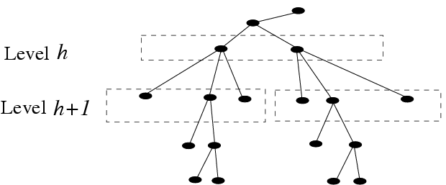
Search & ordering heuristics
At a given level h of the search tree, we encounter:

Slide 33
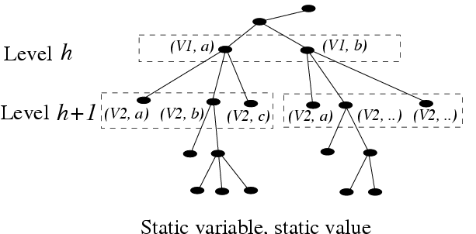
Static variable, static value
vvps pertaining to the same variable across a given level

Slide 34
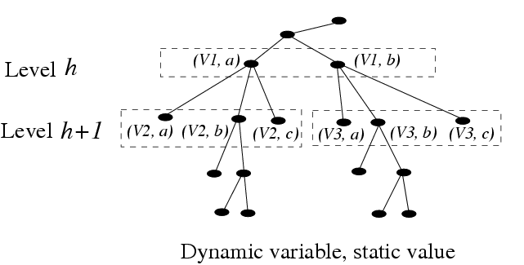
Dynamic variable, static value
vvps pertaining to the same variable for nodes with a common parent, but possibly to different variables for nodes with different parents

Slide 35
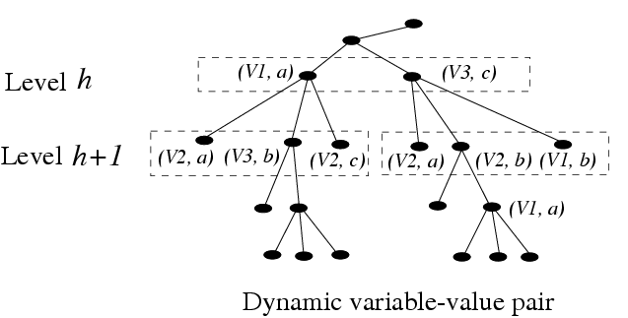
Dynamic vvp
vvps pertaining to different variables

Slide 36
Side comment
Common wisdom
When looking for all solutions, value ordering does not matter
Above ‘wisdom’ holds for k-way branching
[Smith, IJCAI 05] showed that this is not true for 2-way branching, which, apparently, is used in commercial products such as ECLiPSe and Ilog
The benefits (if any) and implications of 2-way branching versus k-way branching are not fully studied yet

