Slide 1
Predicate Logic and Quantifies
Sections 1.4 and 1.5 of Rosen
Spring 2022
CSCE 235H Introduction to Discrete Structures (Honors)
Course web-page: cse.unl.edu/~cse235h
All questions: Piazza

Slide 2
Outline
Introduction
Terminology:
Propositional functions; arguments; arity; universe of discourse
Quantifiers
Definition; using, mixing, negating them
Logic Programming (Prolog)
Transcribing English to Logic
More exercises

Slide 3
Introduction
Consider the statements:
x>3, x=y+3, x+y=z
The symbols >, +, = denote relations between x and 3, x, y, and 4, and x,y, and z, respectively
These relations may hold or not hold depending on the values that x, y, and z may take.
A predicate is a property that is affirmed or denied about the subject (in logic, we say ‘variable’ or ‘argument’) of a statement
Consider the statement : ‘x is greater than 3’
‘x’ is the subject
‘is greater than 3’ is the predicate

Slide 4
Propositional Functions (1)
To write in Predicate Logic ‘x is greater than 3’
We introduce a functional symbol for the predicate and
Put the subject as an argument (to the functional symbol): P(x)
Terminology
P(x) is a statement
P is a predicate or propositional function
x as an argument
P(Bob) is a proposition

Slide 5
Propositional Functions (2)
Examples:
Father(x): unary predicate
Brother(x,y): binary predicate
Sum(x,y,z): ternary predicate
P(x,y,z,t): n-ary predicate

Slide 6
Propositional Functions (3)
Definition: A statement of the form P(x₁,x₂,…, x_{n}) is the value of the propositional symbol P.
Here: (x₁,x₂,…, x_{n}) is an n-tuple and P is a predicate
We can think of a propositional function as a function that
Evaluates to true or false
Takes one or more arguments
Expresses a predicate involving the argument(s)
Becomes a proposition when values are assigned to the arguments

Slide 7
Propositional Functions: Example
Let Q(x,y,z) denote the statement ‘x²+y²=z²’
What is the truth value of Q(3,4,5)?
What is the truth value of Q(2,2,3)?
How many values of (x,y,z) make the predicate true?
Q(3,4,5) is true
Q(2,3,3) is false
There are infinitely many values that make the proposition true, how many right triangles are there?

Slide 8
Universe of Discourse
Consider the statement ‘x>3’, does it make sense to assign to x the value ‘blue’?
Intuitively, the universe of discourse is the set of all things we wish to talk about; that is the set of all objects that we can sensibly assign to a variable in a propositional function.
What would be the universe of discourse for the propositional function below be:
EnrolledCSE235(x)=‘x is enrolled in CSE235’

Slide 9
Universe of Discourse: Multivariate functions
Each variable in an n-tuple (i.e., each argument) may have a different universe of discourse
Consider an n-ary predicate P:
P(r,g,b,c)= ‘The rgb-values of the color c is (r,g,b)’
Example, what is the truth value of
P(255,0,0,red)
P(0,0,255,green)
What are the universes of discourse of (r,g,b,c)?

Slide 10
Alert
Propositional Logic (PL)
Sentential logic
Boolean logic
Zero order logic
First Order Logic (FOL)
Predicate logic (PL)

Slide 11
Outline
Introduction
Terminology:
Propositional functions; arguments; arity; universe of discourse
Quantifiers
Definition; using, mixing, negating them
Logic Programming (Prolog)
Transcribing English to Logic
More exercises

Slide 12
Quantifiers: Introduction
The statement ‘x>3’ is not a proposition
It becomes a proposition
When we assign values to the argument: ‘4>3’ is true, ‘2<3’ is false, or
When we quantify the statement
Two quantifiers
Universal quantifier ∀ $\forall$
the proposition is true for all possible values in the universe of discourse
Existential quantifier ∃ $\exists$
the proposition is true for some value(s) in the universe of discourse

Slide 13
Universal Quantifier: Definition
Definition: The universal quantification of a predicate P(x) is the proposition ‘P(x) is true for all values of x in the universe of discourse.’ We use the notation: ∀ x P(x), which is read ‘for all x’.
If the universe of discourse is finite, say {n₁,n₂,…,n_{k}}, then the universal quantifier is simply the conjunction of the propositions over all the elements
∀ x P(x) ⇔ P(n₁) ∧ P(n₂) ∧ … ∧ P(n_{k})

Slide 14
Universal Quantifier: Example 1
Let
P(x): ‘x must take a discrete mathematics course’ and
Q(x): ‘x is a CS student.’
The universe of discourse for both P(x) and Q(x) is all UNL students.
Express the statements:
“Every CS student must take a discrete mathematics course.”
“Everybody must take a discrete mathematics course or be a CS student.”
“Everybody must take a discrete mathematics course and be a CS student.”
∀ x Q(x) → P(x)
∀ x ( P(x) ∨ Q(x) )
∀ x ( P(x) ∧ Q(x) )
Are these statements true or false at UNL?

Slide 15
Universal Quantifier: Example 2
Express in FOL the statement
‘for every x and every y, x+y>10’
Answer:
Let P(x,y) be the statement x+y>10
Where the universe of discourse for x, y is the set of integers
The statement is: ∀x ∀y P(x,y)
Shorthand: ∀x,y P(x,y)

Slide 16
Existential Quantifier: Definition
Definition: The existential quantification of a predicate P(x) is the proposition ‘There exists a value x in the universe of discourse such that P(x) is true’
Notation: ∃ x P(x)
Reads: ‘there exists x’
If the universe of discourse is finite, say {n₁,n₂,…,n_{k}}, then the existential quantifier is simply the disjunction of the propositions over all the elements
∃ x P(x) ⇔ P(n₁) ∨ P(n₂) ∨ … ∨ P(n_{k})

Slide 17
Existential Quantifier: Example 1
Let P(x,y) denote the statement ‘x+y=5’
What does the expression ∃x ∃y P(x,y) mean?
Which universe(s) of discourse make it true?

Slide 18
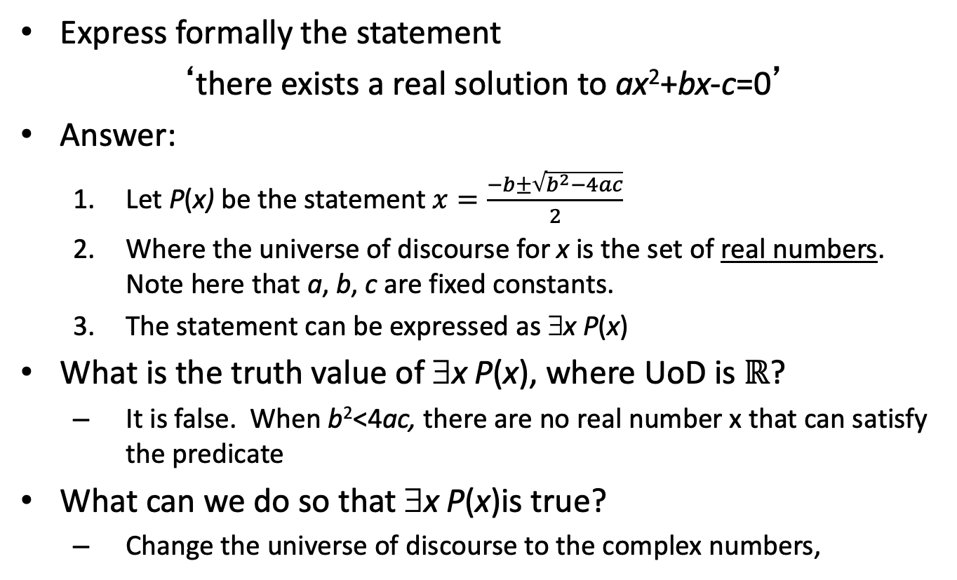
Existential Quantifier: Example 2
Express formally the statement
‘there exists a real solution to ax²+bx-c=0’
Answer:
Let P(x) be the statement $x=\frac{−b±\sqrt{b^{2}−4ac}}{2}$
Where the universe of discourse for x is the set of real numbers. Note here that a, b, c are fixed constants.
The statement can be expressed as ∃x P(x)
What is the truth value of ∃x P(x), where UoD is $ℝ$?
It is false. When b²<4ac, there are no real number x that can satisfy the predicate
What can we do so that ∃x P(x)is true?
Change the universe of discourse to the complex numbers,

Slide 19
Quantifiers: Truth values
In general, when are quantified statements true or false?
Statement | True when… | False when...
∀x P(x) | P(x) is true for every x | There is an x for which P(x) is false
∃x P(x) | There is an x for which P(x) is true | P(x) is false for every x

Slide 20
Mixing quantifiers (1)
Existential and universal quantifiers can be used together to quantify a propositional predicate. For example:
∀x ∃y P(x,y)
is perfectly valid
Alert:
The quantifiers must be read from left to right
The order of the quantifiers is important
∀x ∃y P(x,y) is not equivalent to ∃y ∀x P(x,y)

Slide 21
Mixing quantifiers (2)
Consider
∀x ∃y Loves (x,y): Everybody loves somebody
∃y ∀x Loves(x,y): There is someone loved by everyone
The two expressions do not mean the same thing
(∃y ∀x Loves(x,y)) → (∀x ∃y Loves (x,y))
but the converse does not hold
However, you can commute similar quantifiers
∀x ∀y P(x,y) is equivalent to ∀y ∀x P(x,y) (thus, ∀x,y P(x,y))
∃x ∃y P(x,y) is equivalent to ∃y ∃x P(x,y) (thus ∃x,y P(x,y))

Slide 22
Mixing Quantifiers: Truth values
Statement | True when... | False when...
∀x∀y P(x,y) | P(x,y) is true for every pair x,y | There is at least one pair x,y for which P(x,y) is false
∀x∃y P(x,y) | For every x, there is a y for which P(x,y) is true | There is an x for which P(x,y) is false for every y
∃x∀y P(x,y) | There is an x for which P(x,y) is true for every y | For every x, there is a y for which P(x,y) is false
∃x∃yP(x,y) | There is at least one pair x,y for which P(x,y) is true | P(x,y) is false for every pair x,y

Slide 23
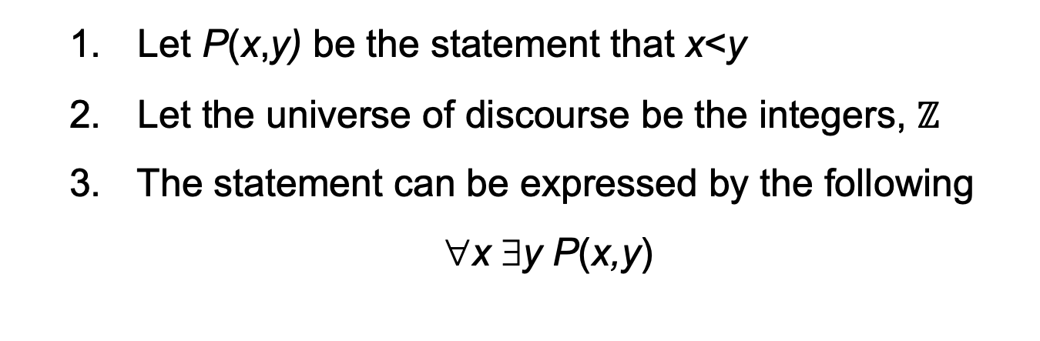
Mixing Quantifiers: Example (1)
Express, in predicate logic, the statement that there is an infinite number of integers
Answer:
Let P(x,y) be the statement that x<y
Let the universe of discourse be the integers, $ℤ$
The statement can be expressed by the following
∀x ∃y P(x,y)

Slide 24

Mixing Quantifiers: Example (2)
Express the commutative law of addition for R
We want to express that for every pair of reals, x,y, the following holds: x+y=y+x
Answer:
Let P(x,y) be the statement that x+y
Let the universe of discourse be the reals, $ℝ$
The statement can be expressed by the following
∀x ∀y (P(x,y) ⇔ P(y,x))
Alternatively, ∀x ∀y (x+y = y+x)

Slide 25
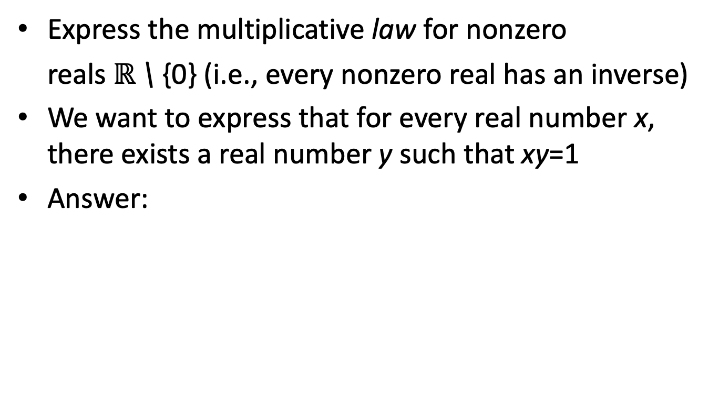
Mixing Quantifiers: Example (3)
Express the multiplicative law for nonzero
reals $ℝ$ \ {0} (i.e., every nonzero real has an inverse)
We want to express that for every real number x, there exists a real number y such that xy=1
Answer:
∀x ∃y (xy = 1)

Slide 26
Mixing Quantifiers: Example (4) false mathematical statement
Does commutativity for subtraction hold over the reals?
That is: does x-y=y-x for all pairs x,y in R?
Express using quantifiers
∀x ∀y (x-y = y-x)

Slide 27
Mixing Quantifiers: Example (5)
Express the statement as a logical expression:
“There is a number x such that
when it is added to any number, the result is that number and
if it is multiplied by any number, the result is x”
Answer:
Let P(x,y) be the expression “x+y=y”
Let Q(x,y) be the expression “xy=x”
The universe of discourse is N,Z,R,Q (but not Z⁺)
Then the expression is:
∃x ∀y P(x,y) ∧ Q(x,y)
Alternatively: ∃x ∀y (x+y=y) ∧ (xy = x)

Slide 28
Outline
Introduction
Terminology:
Propositional functions; arguments; arity; universe of discourse
Quantifiers
Definition; using, mixing, biding, negating them
Logic Programming (Prolog)
Transcribing English to Logic
More exercises

Slide 29
Binding Variables
When a quantifier is used on a variable x, we say that x is bound
If no quantifier is used on a variable in a predicate statement, the variable is called free
Examples
In ∃x∀yP(x,y), both x and y are bound
In ∀xP(x,y), x is bound but y is free
A statement is called a well-formed formula, when all variables are properly quantified

Slide 30
Binding Variables: Scope
The set of all variables bound by a common quantifier is called the scope of the quantifier
For example, in the expression ∃x,y∀zP(x,y,z,c)
What is the scope of existential quantifier?
What is the scope of universal quantifier?
What are the bound variables?
What are the free variables?
Is the expression a well-formed formula?

Slide 31
Negation
We can use negation with quantified expressions as we used them with propositions
Lemma: Let P(x) be a predicate. Then the followings hold:
¬(∀x P(x)) ≡ ∃x ¬P(x)
(∃x P(x)) ≡ ∀x ¬P(x)
This is essentially the quantified version of De Morgan’s Law (when the universe of discourse is finite, this is exactly De Morgan’s Law)

Slide 32
Negation: Truth
Truth Values of Negated Quantifiers
Statement | True when… | False when...
¬∃x P(x) ≡ ∀x ¬P(x) | P(x) is false for every x | There is an x for which P(x) is true
¬∀x P(x) ≡ ∃x ¬P(x) | There is an x for which P(x) is false | P(x) is true for every x

Slide 33
Negation: Example
Rewrite the following expression, pushing negation inward:
¬ ∀x (∃ y ∀z P(x,y,z) ∧ ∃ z ∀y P(x,y,z))
Answer:
∃x (∀y ∃z ¬P(x,y,z) ∨ ∀z ∃y ¬P(x,y,z))

Slide 34
Outline
Introduction
Terminology:
Propositional functions; arguments; arity; universe of discourse
Quantifiers
Definition; using, mixing, negating them
Logic Programming (Prolog)
Transcribing English to Logic
More exercises

Slide 35
Prolog (1)
Prolog (Programming in Logic)
is a programming language
based on (a restricted form of) Predicate Logic (a.k.a. Predicate Calculus and FOL)
It was developed
by the logicians of the Artificial Intelligence community
for symbolic reasoning

Slide 36
Prolog (2)
Prolog allows the users to express facts and rules
Facts are propositional functions:
student(mia),
enrolled(mia,cse235),
instructor(patel,cse235), etc.
Rules are implications with conjunctions:
teaches(X,Y) :- instructor(X,Z), enrolled(Y,Z)
Prolog answers queries such as:
?enrolled(mia,cse235)
?enrolled(X,cse476)
?teaches(X,mia)
by binding variables and doing theorem proving (i.e., applying inference rules) as we will see in Section 1.5

Slide 37
English into Logic
Logic is more precise than English
Transcribing English into Logic and vice versa can be tricky
When writing statements with quantifiers, usually the correct meaning is conveyed with the following combinations:
Use ∀ with ⇒
∀x Lion(x) ⇒ Fierce(x): Every lion is fierce
∀x Lion(x) ∧ Fierce(x): Everyone is a lion and everyone is fierce
Use ∃ with ∧
∃ x Lion(x) ∧ Vegan(x): Holds when you have at least one vegan lion
∃ x Lion(x) ⇒ Vegan(x): Holds when you have vegan people in the universe of discourse (even though there is no vegan lion in the universe of discourse )

Slide 38
More Exercises (1)
Let P(x,y) denote ‘x is a factor of y’ where
x ∈ {1,2,3,…} and y ∈ {2,3,4,…}
Let Q(x,y) denote:
∀x,y [P(x,y) → (x=y) ∨ (x=1)]
Question: When is Q(x,y) true?

Slide 39
Alert…
Some students wonder if:
∀x,y P(x,y) ≡ (∀x P(x,y)) ∧ (∀y P(x,y))
This is certainly not true.
In the left-hand side, both x,y are bound.
In the right-hand side,
In the first predicate, x is bound and y is free
In the second predicate, y is bound and x is free
Thus, the left-hand side is a proposition, but the right-hand side is not. They cannot be equivalent
All variables that occur in a propositional function must be bound to turn it into a proposition

