Slide 1
Combinatorics
Section 6.1—6.6 8.5—8.6 of Rosen
Spring 2022
CSCE 235H Introduction to Discrete Structures (Honors)
Course web-page: cse.unl.edu/~cse235h
Questions: Piazza

Slide 2
Motivation
Combinatorics is the study of collections of objects. Specifically, counting objects, arrangement, derangement, etc. along with their mathematical properties
Counting objects is important in order to analyze algorithms and compute discrete probabilities
Originally, combinatorics was motivated by gambling: counting configurations is essential to elementary probability
  A simple example: How many arrangements are there of a deck of 52 cards?
In addition, combinatorics can be used as a proof technique
  A combinatorial proof is a proof method that uses counting arguments to prove a statement

Slide 3
Outline
Introduction
Counting:
  Product rule, sum rule, Principal of Inclusion Exclusion (PIE)
  Application of PIE: Number of onto functions
Pigeonhole principle
  Generalized, probabilistic forms
Permutations
Combinations
Binomial Coefficients
Generalizations
  Combinations with repetitions, permutations with indistinguishable objects
Algorithms
  Generating combinations (1), permutations (2)
More Examples

Slide 4
Product Rule
If two events are not mutually exclusive (that is we do them separately), then we apply the product rule
Theorem: Product Rule
Suppose a procedure can be accomplished with two disjoint subtasks. If there are
  n₁ ways of doing the first task and
  n₂ ways of doing the second task,
  then there are n₁.n₂ ways of doing the overall procedure

Slide 5
Sum Rule (1)
If two events are mutually exclusive, that is, they cannot be done at the same time, then we must apply the sum rule
Theorem: Sum Rule. If
  an event e₁ can be done in n₁ ways,
  an event e₂ can be done in n₂ ways, and
  e₁ and e₂ are mutually exclusive
  then the number of ways of both events occurring is n₁+ n₂
Notes:
The quick and cheap lunch menu of a Chinese restaurant has 2 selections for Fish, 5 selections for chicken, 3 sections for beef and 2 for ducks. How many choices do you have for lunch?

Slide 6
Sum Rule (2)
There is a natural generalization to any sequence of m tasks; namely the number of ways m mutually exclusive events can occur
n₁ + n₂ + … + n_{m-1} + n_{m}
We can give another formulation in terms of sets. Let A₁, A₂, …, A_{m} be pairwise disjoint sets. Then
|A₁ ∪ A₂ ∪ … ∪ A_{m} | = |A₁| + |A₂| + … + |A_{m}|
  In fact, this is a special case of the general Principal of Inclusion-Exclusion (PIE)

Slide 7
Principle of Inclusion-Exclusion (PIE)
Say there are two events, e₁ and e₂,
  For which there are n₁ and n₂ possible outcomes respectively.
  But, some outcome n_{i} could result from e₁ and also from e₂
Now, say that only one event can occur, not both
In this situation, we cannot apply the sum rule. Why?
… because we would be over counting the number of possible outcomes.
Instead we have to count the number of possible outcomes of e₁ and e₂ minus the number of possible outcomes in common to both; i.e., the number of ways to do both tasks
If again we think of them as sets, we have
|A₁ ∪ A₂| =|A₁| + |A₂| - |A₁∩ A₂|

Slide 8
PIE (2)
More generally, we have the following
Lemma: Let A, B, be subsets of a finite set U. Then
  |A∪B| = |A| + |B| - |A∩B|
  |A ∩ B| ≤ min {|A|, |B|}
  |A\B| = |A| - |A∩B| ≥ |A|-|B|
  |A| = |U| - |A|
  |A⊕B| = |A∪B|-|A∩B|
  = |A|+|B|-2|A∩B|= |A\B|+ |B\A|
  |A × B| = |A|×|B|

Slide 9
PIE: Theorem
Theorem: Let A₁,A₂, …,A_{n} be finite sets, then
|A₁∪ A₂ ∪...∪A_{n}|= Σ_{i}|A_{i}|
- Σ_{i<j}|A_{i} ∩ A_{j}|
+ Σ_{i<j<k}|A_{i} ∩ A_{j} ∩ A_{k}|
- …
+(-1)^{n+1} |A₁∩A₂∩...∩A_{n}|
  Each summation is over
    all i,
    pairs i,j with i<j,
    triples with i<j<k, etc.

Slide 10
PIE Theorem: Example 1
To illustrate, when n=3, we have
|A₁∪ A₂ ∪A₃|= |A₁|+ |A₂| +|A₃|
- (|A₁∩A₂|+|A₁∩A₃|+|A₂∩A₃|)
+|A₁ ∩ A₂ ∩ A₃|

Slide 11
PIE Theorem: Example 2
To illustrate, when n=4, we have
|A₁∪A₂∪A₃∪A₄|= |A₁|+|A₂|+|A₃|+|A₄|
- (|A₁∩A₂|+|A₁∩A₃|+|A₁∩A₄|
+|A₂∩A₃|+|A₂∩A₄|+|A₃∩A₄|)
+ (|A₁∩A₂∩A₃|+|A₁∩A₂∩A₄|
+|A₁∩A₃∩A₄|+|A₂∩A₃∩A₄|)
- |A₁ ∩A₂ ∩A₃ ∩A₄|

Slide 12
Application of PIE: Example A (1)
How many integers between 1 and 300 (inclusive) are
  Divisible by at least one of 3,5,7?
  Divisible by 3 and by 5 but not by 7?
  Divisible by 5 but by neither 3 or 7?
Let
A = {n∈Z | (1 ≤ n ≤ 300)∧ (3|n)}
B = {n∈Z | (1 ≤ n ≤ 300)∧ (5|n)}
C = {n∈Z | (1 ≤ n ≤ 300)∧ (7|n)}
How big are these sets? We use the floor function
|A| = ⎣300/3⎦ = 100
|B| = ⎣300/5⎦ = 60
|C| = ⎣300/7⎦ = 42

Slide 13
Application of PIE: Example A (2)
How many integers between 1 and 300 (inclusive) are divisible by at least one of 3,5,7?
Answer: |A∪B ∪C|
By the principle of inclusion-exclusion
|A∪B ∪C|= |A|+|B|+|C|-[|A∩B|+|A∩C|+|B∩C|]+|A∩B∩C|
How big are these sets? We use the floor function
|A| = ⎣300/3⎦ = 100 |A∩B| = ⎣300/15⎦ = 20
|B| = ⎣300/5⎦ = 60 |A∩C| = ⎣300/21⎦ = 14
|C| = ⎣300/7⎦ = 42 |B∩C| = ⎣300/35⎦ = 8
|A∩B∩C| = ⎣300/105⎦ = 2
Therefore:
|A∪B ∪C| = 100 + 60 + 42 - (20+14+8) + 2 = 162

Slide 14
Application of PIE: Example A (3)
How many integers between 1 and 300 (inclusive) are divisible by 3 and by 5 but not by 7?
Answer: |(A ∩ B)\C|
By the definition of set-minus
|(A ∩ B)\C| = |A ∩ B| - |A ∩ B ∩ C| = 20 – 2 = 18
Knowing that
|A| = ⎣300/3⎦ = 100 |A∩B| = ⎣300/15⎦ = 20
|B| = ⎣300/5⎦ = 60 |A∩C| = ⎣300/21⎦ = 100
|C| = ⎣300/7⎦ = 42 |B∩C| = ⎣300/35⎦ = 8
|A∩B∩C| = ⎣300/105⎦ = 2

Slide 15
Application of PIE: Example A (4)
  How many integers between 1 and 300 (inclusive) are divisible by 5 but by neither 3 or 7?
Answer: |B\(A ∪C)| = |B| - |B ∩ (A ∪C)|
Distributing B over the intersection
|B ∩ (A ∪ C)| = |(B ∩ A) ∪ (B ∩ C)|
= |B ∩ A| + |B ∩ C| - | (B ∩ A) ∩ (B ∩ C) |
= |B ∩ A| + |B ∩ C| - | B ∩ A ∩ C |
= 20 + 8 – 2 = 26
Knowing that
|A| = ⎣300/3⎦ = 100 |A∩B| = ⎣300/15⎦ = 20
|B| = ⎣300/5⎦ = 60 |A∩C| = ⎣300/21⎦ = 14
|C| = ⎣300/7⎦ = 42 |B∩C| = ⎣300/35⎦ = 8
|A∩B∩C| = ⎣300/105⎦ = 2

Slide 16
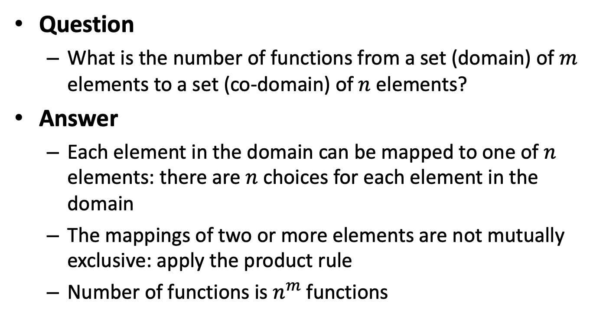
Product Rule: Example 1
Question
  What is the number of functions from a set (domain) of $m$ elements to a set (co-domain) of $n$ elements?
Answer
  Each element in the domain can be mapped to one of $n$ elements: there are $n$ choices for each element in the domain
  The mappings of two or more elements are not mutually exclusive: apply the product rule
  Number of functions is $n^{m}$functions

Slide 17
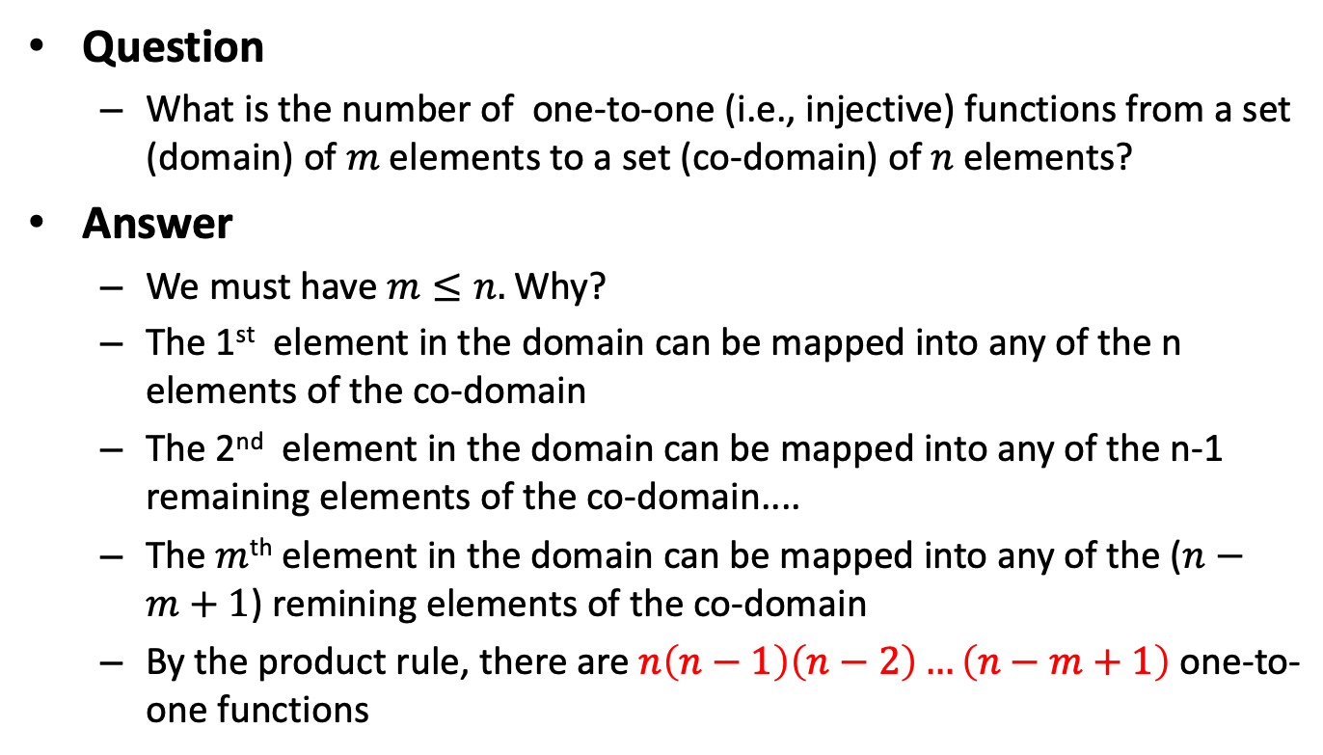
Product Rule: Example 2
Question
  What is the number of one-to-one (i.e., injective) functions from a set (domain) of $m$ elements to a set (co-domain) of $n$ elements?
Answer
  We must have $m≤n.$Why?
  The 1st element in the domain can be mapped into any of the n elements of the co-domain
  The 2nd element in the domain can be mapped into any of the n-1 remaining elements of the co-domain....
  The $m$^{th} element in the domain can be mapped into any of the ($n−m+1$) remining elements of the co-domain
  By the product rule, there are $n\left(n−1\right)\left(n−2\right)…\left(n−m+1\right)$ one-to-one functions

Slide 18
Product and Sum Rules: Example 3
Question: Number of strings of length 6 with uppercase letters?
Answer: 26⁶
Question: Number of strings of length 6 with letters with no digits?
Answer: 52⁶
Question: Number of strings of length 6 with letters or digits?
Answer: (26+26+10)⁶= 62⁶
Question: Number of strings of length 6 with letters and at least one digit?
Answer: 62⁶ -52⁶
Question: Number of strings of length 6, 7, or 8 with letters and a least one digit?
Answer: (62⁶ -52⁶)+ (62⁷ -52⁷)+ (62⁸ -52⁸)

Slide 19


PIE: Example
Question: What is the number of onto (i.e., surjection) functions from a set $A$ (domain), $|A=6$|, to a set $B=\{b_{1},b_{2},b_{3}\}$(co-domain)?
Answer
  $P_{1}$: property that $b_{1}$ is not in the range of the function
  $P_{2}$: property that $b_{2}$ is not in the range of the function
  $P_{3}$: property that $b_{3}$ is not in the range of the function
Set of all functions
Functions have $P_{i}$
Notes:
N(P'_1,P’_2,P’_3)= N\\
-[N(P_1)+N(P_2)+N(P_3)]\\
+[N(P_1P_2)+N(P_2P_3)+N(P_1P_3)]\\
-N(P_1P_2P_3)

Slide 20
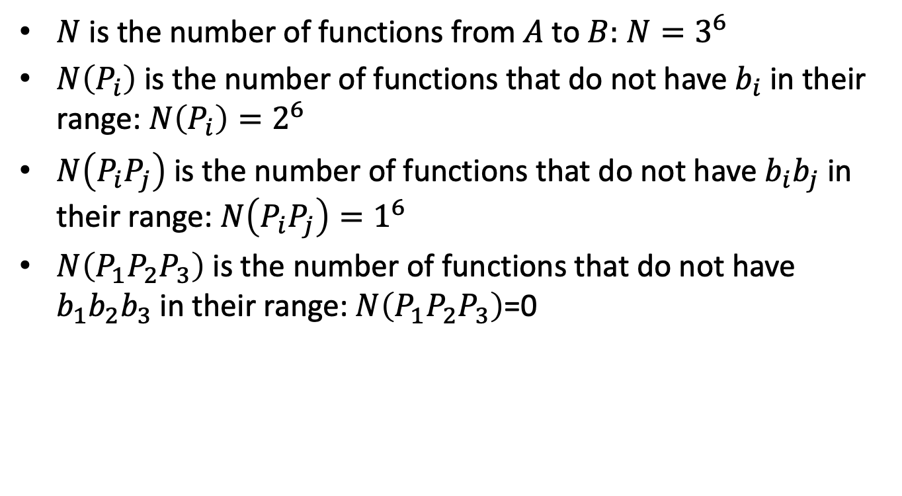
PIE: Example (cont’d)
$N$ is the number of functions from $A$ to $B:$ $N=3^{6}$
$N\left(P_{i}\right)$ is the number of functions that do not have $b_{i}$in their range: $N\left(P_{i}\right)=2^{6}$
$N\left(P_{i}P_{j}\right)$ is the number of functions that do not have $b_{i}b_{j}$ in their range: $N\left(P_{i}P_{j}\right)=1^{6}$
$N\left(P_{1}P_{2}P_{3}\right)$ is the number of functions that do not have $b_{1}b_{2}b_{3}$ in their range:$N\left(P_{1}P_{2}P_{3}\right)$=0
Notes:
N(P'_1P’_2P’_3)= N\\
-[N(P_1)+N(P_2)+N(P_3)]\\
+[N(P_1P_2)+N(P_2P_3)+N(P_1P_3)]\\
-N(P_1P_2P_3)
= 3^6 -{3 \choose 1}N(P_i)+ {3 \choose 2}N(P_iP_j)- N(P_1P_2P_3)
= 3^6 -{3 \choose 1}N(P_i)+ {3 \choose 2}N(P_iP_j)- N(P_1P_2P_3)
= 3^6 -{3 \choose 1}2^6+ {3 \choose 2}1^6

Slide 21
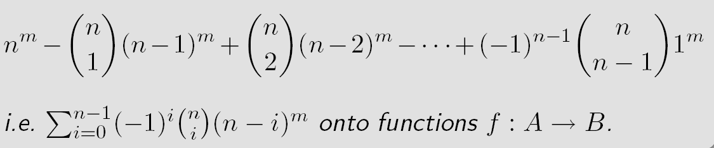
Application of PIE: #Surjections (Section 8.6)
The principle of inclusion-exclusion can be used to count the number of onto (surjective) functions
Theorem: Let A, B be non-empty sets of cardinality m,n with m≥n. Then there are
${n \choose i}$
See textbook, Section 8.6 page 561

Slide 22
PIE: Example
How many ways of giving out 6 pieces of candy to 3 children if each child must receive at least one piece?
This problem can be modeled as follows:
  Let A be the set of candies, |A|=6
  Let B be the set of children, |B|=3
  The problem becomes “find the number of surjective mappings from A to B” (because each child must receive at least one candy)
Thus the number of ways is thus (m=6, n=3)

Slide 23
Outline
Introduction
Counting:
  Product rule, sum rule, Principal of Inclusion Exclusion (PIE)
  Application of PIE: Number of onto functions
Pigeonhole principle
  Generalized, probabilistic forms
Permutations
Combinations
Binomial Coefficients
Generalizations
  Combinations with repetitions, permutations with indistinguishable objects
Algorithms
  Generating combinations (1), permutations (2)
More Examples

Slide 24
Pigeonhole Principle (1)
If there are more pigeons than there are roots (pigeonholes), for at least one pigeonhole, more than one pigeon must be in it
Theorem: If k+1 or more objects are placed in k boxes, then there is at least one box containing two or more objects
This principal is a fundamental tool of elementary discrete mathematics.
It is also known as the Dirichlet Drawer Principle or Dirichlet Box Pinciple

Slide 25
Pigeonhole Principle (2)
It is seemingly simple but very powerful
The difficulty comes in where and how to apply it
Some simple applications in Computer Science
  Calculating the probability of hash functions having a collision
  Proving that there can be no lossless compression algorithm compressing all files to within a certain ratio
Lemma: For two finite sets A,B there exists a bijection f:A→B if and only if |A|=|B|

Slide 26
Generalized Pigeonhole Principle (1)
Theorem: If N objects are placed into k boxes then there is at least one box containing at least
Example: In any group of 367 or more people, at least two of them must have been born on the same date.

Slide 27
Generalized Pigeonhole Principle (2)
A probabilistic generalization states that
  if n objects are randomly put into m boxes
  with uniform probability
  (i.e., each object is place in a given box with probability 1/m)
  then at least one box will hold more than one object with probability

Slide 28
Generalized Pigeonhole Principle: Example
Among 10 people, what is the probability that two or more will have the same birthday?
  Here n=10 and m=365 (ignoring leap years)
  Thus, the probability that two will have the same birthday is
  So, less than 12% probability

Slide 29
Pigeonhole Principle: Example A (1)
Show that
  in a room of n people with certain acquaintances,
  some pair must have the same number of acquaintances
Note that this is equivalent to showing that any symmetric, irreflexive relation on n elements must have two elements with the same number of relations
Proof: by contradiction using the pigeonhole principle
Assume, to the contrary, that every person has a different number of acquaintances: 0, 1, 2, …, n-1
Note: no one can have n acquaintances because the relation is irreflexive.
There are n possibilities, we have n people, we are not done ☹

Slide 30
Pigeonhole Principle: Example A (2)
There are n possibilities, we have n people, we are not done ☹
Remember: acquaintanceship is a symmetric, irreflexive relation
In particular
  Some person knows 0 people
  While another knows n-1 people, meaning knows the person who knows 0 people
This situation is impossible. Contradiction! ☺
So we do not have n possibilities (0, 1, 2, …, n-1 acquaintances), but fewer possibilities
Thus by the pigeonhole principle (10 people and 9 possibilities) at least two people have to the same number of acquaintances

Slide 31
Pigeonhole Principle: Example B
Example: Say, 30 buses are to transport 2000 Cornhusker fans to Colorado. Each bus has 80 seats.
Show that
  One of the buses will have 14 empty seats
  One of the buses will carry at least 67 passengers
One of the buses will have 14 empty seats
  Total number of seats is 80.30=2400
  Total number of empty seats is 2400-2000=400
  By the pigeonhole principle: 400 empty seats in 30 buses, one must have ⎡400/30 ⎤ = 14 empty seats
One of the buses will carry at least 67 passengers
  By the pigeonhole principle: 2000 passengers in 30 buses, one must have ⎡2000/30 ⎤ = 67 passengers

Slide 32
Review
Product rule
Sum rule
Principle of Inclusion Exclusion
Application to counting
  Number of functions, surjections, injections
Pigeonhole principle

Slide 33
Outline
Introduction
Counting:
  Product rule, sum rule, Principal of Inclusion Exclusion (PIE)
  Application of PIE: Number of onto functions
Pigeonhole principle
  Generalized, probabilistic forms
Permutations
Combinations
Binomial Coefficients
Generalizations
  Combinations with repetitions, permutations with indistinguishable objects
Algorithms
  Generating combinations (1), permutations (2)
More Examples

Slide 34
Permutations
A permutation of a set of distinct objects is an ordered arrangement of these objects.
An ordered arrangement of r elements of a set of n elements is called an r-permutation
Theorem: The number of r permutations of a set of n distinct elements is
It follows that
In particular
Note here that the order is important. It is necessary to distinguish when the order matters and it does not

Slide 35
Application of PIE and Permutations: Derangements (I)
(Section 8.6)
Consider the hat-check problem
  Given
    An employee checks hats from n customers
    However, s/he forgets to tag them
    When customers check out their hats, they are given one at random
  Question
    What is the probability that no one will get their hat back?

Slide 36
Application of PIE and Permutations: Derangements (II)
The hat-check problem can be modeled using derangements: permutations of objects such that no element is in its original position
- Example: 21453 is a derangement of 12345 but 21543 is not
The number of derangements of a set with n elements is
Thus, the answer to the hatcheck problem is
Note that
Thus, the probability of the hatcheck problem converges
See textbook, Section 8.6 page 562

Slide 37
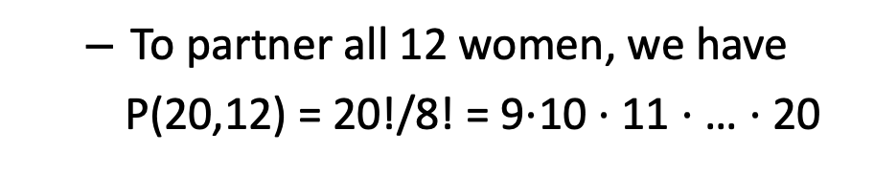
Permutations: Example A
How many pairs of dance partners can be selected from a group of 12 women and 20 men?
  The first woman can partner with any of the 20 men, the second with any of the remaining 19, etc.
  To partner all 12 women, we have
  P(20,12) = 20!/8! = 9$⋅$10 $⋅$11 $⋅$… $⋅$20

Slide 38
Permutations: Example B
In how many ways can the English letters be arranged so that there are exactly 10 letters between a and z?
z
  The number of ways is P(24,10)
a
10 letters
  Since we can choose either a or z to come first, then there are 2P(24,10) arrangements of the 12-letter block
  For the remaining 14 letters, there are P(15,15)=15! possible arrangements
a
10 letters
z
  In all there are 2P(24,10) $⋅$15! arrangements

Slide 39
Permutations: Example C (1)
How many permutations of the letters a, b, c, d, e, f, g contain neither the pattern bge nor eaf?
  The total number of permutations is P(7,7)=7!
  If we fix the pattern bge, then we consider it as a single block. Thus, the number of permutations with this pattern is P(5,5)=5!
…
bge
…
  Fixing the patter eaf, we have the same number: 5!
…
eaf
…
  Thus, we have (7! – 2.5!). Is this correct?
  No! we have subtracted too many permutations: ones containing both eaf and bfe.

Slide 40
Permutations: Example C (2)
  There are two cases: (1) eaf comes first, (2) bge comes first
  Are there any cases where eaf comes before bge?
  No! The letter e cannot be used twice
…
eafbge
…
  If bge comes first, then the pattern must be bgeaf, so we have 3 blocks or 3! arrangements
…
bgeaf
…
  Altogether, we have
  7! – 2.(5!) + 3! = 4806

Slide 41
Outline
Introduction
Counting:
  Product rule, sum rule, Principal of Inclusion Exclusion (PIE)
  Application of PIE: Number of onto functions
Pigeonhole principle
  Generalized, probabilistic forms
Permutations
Combinations
Binomial Coefficients
Generalizations
  Combinations with repetitions, permutations with indistinguishable objects
Algorithms
  Generating combinations (1), permutations (2)
More Examples

Slide 42
Combinations (1)
Whereas permutations consider order, combinations are used when order does not matter
Definition: A k-combination of elements of a set is an unordered selection of k elements from the set.
  (A combination is imply a subset of cardinality k)

Slide 43
Combinations (2)
Theorem: The number of k-combinations of a set of cardinality n with 0 ≤ k ≤ n is
is read ‘n choose k’. ${n \choose k}$

Slide 44
Combinations (3)
A useful fact about combinations is that they are symmetric
Corollary: Let n, k be nonnegative integers with k ≤ n, then

Slide 45
Combinations: Example A
In the Powerball lottery, you pick
  Five numbers between 1 and 55 and
  A single ‘powerball’ number between 1 and 42
  How many possible plays are there?
Here order does not matter
  The number of ways of choosing 5 numbers is
  There are 42 possible ways to choose the powerball
  The two events are not mutually exclusive:
  The odds of winning are

Slide 46
Combinations: Example B
In a sequence of 10 coin tosses, how many ways can 3 heads and 7 tails come up?
  The number of ways of choosing 3 heads out of 10 coin tosses is
  It is the same as choosing 7 tails out of 10 coin tosses
  … which illustrates the corollary

Slide 47
Combinations: Example C
How many committees of 5 people can be chosen from 20 men and 12 women
  If exactly 3 men must be on each committee?
  If at least 4 women must be on each committee?
  If exactly three men must be on each committee?
  We must choose 3 men and 2 women. The choices are not mutually exclusive, we use the product rule
  If at least 4 women must be on each committee?
  We consider 2 cases: 4 women are chosen and 5 women are chosen. Theses choices are mutually exclusive, we use the addition rule:

Slide 48
Outline
Introduction
Counting:
  Product rule, sum rule, Principal of Inclusion Exclusion (PIE)
  Application of PIE: Number of onto functions
Pigeonhole principle
  Generalized, probabilistic forms
Permutations
Combinations
Binomial Coefficients
Generalizations
  Combinations with repetitions, permutations with indistinguishable objects
Algorithms
  Generating combinations (1), permutations (2)
More Examples

Slide 49
Binomial Coefficients (1)
The number of r-combinations is also called the binomial coefficient
The binomial coefficients are the coefficients in the expansion of the expression, (multivariate polynomial),
(x+y)^{n}
A binomial is a sum of two terms

Slide 50
Binomial Coefficients (2)
Theorem: Binomial Theorem
Let x, y, be variables and let n be a nonnegative integer. Then
Expanding the summation we have
Example

Slide 51
Binomial Coefficients: Example
What is the coefficient of the term x⁸y¹² in the expansion of (3x+4y)²⁰?
  By the binomial theorem, we have
  When j=12, we have
  The coefficient is

Slide 52
Binomial Coefficients (3)
Many useful identities and facts come from the Binomial Theorem
Corollary:
Equalities are based on (1+1)^{n}=2^{n}, ((-1)+1)^{n}=0^{n}, (1+2)^{n}=3^{n}

Slide 53
Binomial Coefficients (4)
Theorem: Vandermonde’s Identity
Let m,n,r be nonnegative integers with r not exceeding either m or n. Then
Corollary: If n is a nonnegative integer then
Corollary: Let n,r be nonnegative integers, r≤n, then

Slide 54
Binomial Coefficients: Pascal’s Identity & Triangle
The following is known as Pascal’s identity which gives a useful identity for efficiently computing binomial coefficients
Theorem: Pascal’s Identity
Let n,k ∈Z⁺ with n≥k, then
Pascal’s Identity forms the basis of a geometric object known as Pascal’s Triangle

Slide 55
Pascal’s Triangle

Slide 56
Outline
Introduction
Counting:
  Product rule, sum rule, Principal of Inclusion Exclusion (PIE)
  Application of PIE: Number of onto functions
Pigeonhole principle
  Generalized, probabilistic forms
Permutations
Combinations
Binomial Coefficients
Generalizations
  Combinations with repetitions, permutations with indistinguishable objects
Algorithms
  Generating combinations (1), permutations (2)
More Examples

Slide 57
Generalized Combinations & Permutations (1)
Sometimes, we are interested in permutations and combinations in which repetitions are allowed
Theorem: The number of r-permutations of a set of n objects with repetition allowed is n^{r}
…which is easily obtained by the product rule
Theorem: There are
r-combinations from a set with n elements when repetition of elements is allowed

Slide 58
Generalized Combinations & Permutations: Example
There are 30 varieties of donuts from which we wish to buy a dozen. How many possible ways to place your order are there?
Here, n=30 and we wish to choose r=12.
Order does not matter and repetitions are possible
We apply the previous theorem
The number of possible orders is

Slide 59
Generalized Combinations & Permutations (2)
Theorem: The number of different permutations of n objects where there are n₁ indistinguishable objects of type 1, n₂ of type 2, and n_{k} of type k is
An equivalent ways of interpreting this theorem is the number of ways to
  distribute n distinguishable objects
  into k distinguishable boxes
  so that n_{i} objects are place into box i for i=1,2,3,…,k

Slide 60
Example
How many permutations of the word Mississipi are there?
‘Mississipi’ has
  4 distinct letters: m,i,s,p
  with 1,4,4,2 occurrences respectively
  Therefore, the number of permutations is

Slide 61
Outline
Introduction
Counting:
  Product rule, sum rule, Principal of Inclusion Exclusion (PIE)
  Application of PIE: Number of onto functions
Pigeonhole principle
  Generalized, probabilistic forms
Permutations
Combinations
Binomial Coefficients
Generalizations
  Combinations with repetitions, permutations with indistinguishable objects
Algorithms
  Generating combinations (1), permutations (2)
More Examples

Slide 62
Algorithms
In general, it is inefficient to solve a problem by considering all permutation or combinations since there are exponential (worst, factorial!) numbers of such arrangements
Nevertheless, for many problems, no better approach is known.
When exact solutions are needed, backtracking algorithms are used to exhaustively enumerate all arrangements

Slide 63
Algorithms: Example
Traveling Salesperson Problem (TSP)
Consider a salesman that must visit n different cities. He wishes to visit them in an order such that his overall distance travelled is minimized
This problem is one of hundreds of NP-complete problems for which no known efficient algorithms exist. Indeed, it is believed that no efficient algorithms exist. (Actually, Euclidean TSP is not even known to be in NP.)
The only way of solving this problem exactly is to try all possible n! routes
We give several algorithms for generating these combinatorial objects

Slide 64
Generating Combinations (1)
Recall that combinations are simply all possible subsets of size r. For our purposes, we will consider generating subsets of
{1,2,3,…,n}
The algorithm works as follows
  Start with {1,…,r}
  Assume that we have a₁a₂…a_{r}, we want the next combination
  Locate the last element ai such that a_{i} ≠ n-r-I
  Replace a_{i} with a_{i}+1
  Replace a_{j} with a_{i}+j-I for j=i+1, i+2,…,r

Slide 65
Generating Combinations (2)
Next r-Combinations
Input: A set of n elements and an r-combination a₁,a₂,…,a_{r}
Output: The next r-combination
i ← r
While a_{i} =n-r+i Do
i ← i-1
End
a_{i} ← a_{i} +1
For j ← (i+1) to r Do
a_{j} ← a_{i} + j - i
End

Slide 66
Generating Combinations: Example
Find the next 3-combination of the set {1,2,3,4,5} after {1,4,5}
Here a₁=1, a₂=4, a₃=5, n=5, r=3
The last i such that a_{i} ≠5-3+i is 1
Thus, we set
a₁ = a₁ + 1 = 2
a₂ = a₁ + 2 -1 = 3
a₃ = a₁ + 3 -1 = 4
Thus, the next r-combinations is {2,3,4}

Slide 67
Generating Permutations
The textbook gives an algorithm to generate permutations in lexicographic order. Essentially, the algorithm works as follows. Given a permutation
  Choose the left-most pair a_{j},a_{j+1} where a_{j}<a_{j+1}
  Choose the least items to the right of a_{j} greater than a_{j}
  Swap this item and a_{j}
  Arrange the remaining (to the right) items in order

Slide 68
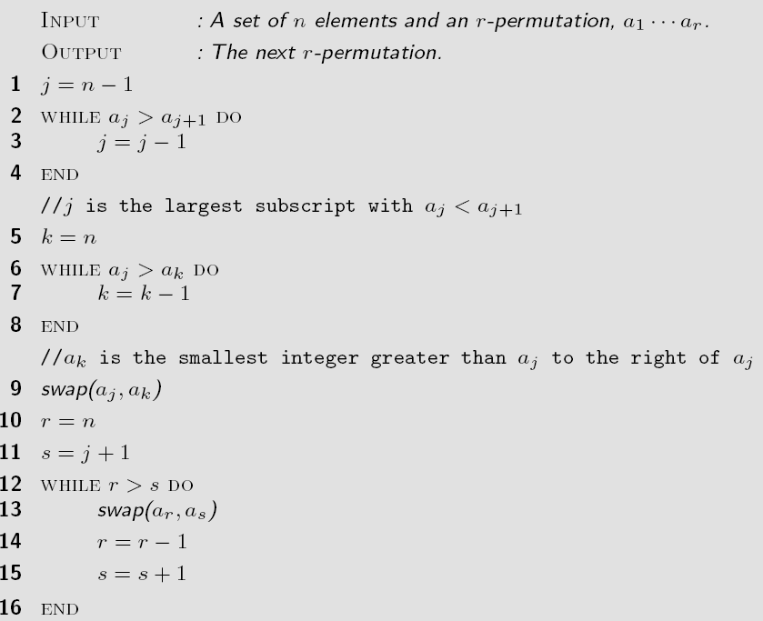
Next Permutation (lexicographic order)

Slide 69
Generating Permutations (2)
Often there is no reason to generate permutations in lexicographic order. Moreover even though generating permutations is inefficient in itself, lexicographic order induces even more work
An alternate method is to fix an element, then recursively permute the n-1 remaining elements
The Johnson-Trotter algorithm has the following attractive properties. Not in your textbook, not on the exam, just for your reference/culture
  It is bottom up (non-recursive)
  It induces a minimal-change between each permutation

Slide 70
Johnson-Trotter Algorithm
We associate a direction to each element, for example
A component is mobile if its direction points to an adjacent component that is smaller than itself.
Here 3 and 4 are mobile, 1 and 2 are not

Slide 71
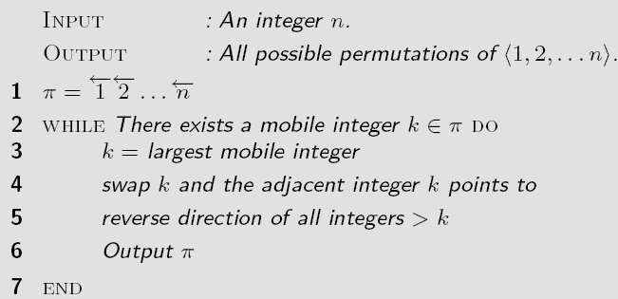
Algorithm: Johnson Trotter

Slide 72
Outline
Introduction
Counting:
  Product rule, sum rule, Principal of Inclusion Exclusion (PIE)
  Application of PIE: Number of onto functions
Pigeonhole principle
  Generalized, probabilistic forms
Permutations
Combinations
Binomial Coefficients
Generalizations
  Combinations with repetitions, permutations with indistinguishable objects
Algorithms
  Generating combinations (1), permutations (2)
More Examples

Slide 73
Example A
How many bit strings of length 4 are there such that 11 never appear as a substring
We can represent the set of strings graphically using a diagram tree (see textbook pages 395)
1
0
0
1010
1
1001
1
0
0
0010
0
1
0101
1
0
0
0100
0
1
1000
0
1
0001
0
0
0000

Slide 74
Example: Counting Functions (1)
Let S,T be sets such that |S|=n, |T|=m.
  How many function are there mapping f:S→T?
  How many of these functions are one-to-one (injective)?
A function simply maps each s_{i} to one t_{j}, thus for each n we can choose to send it to any of the elements in T
Each of these is an independent event, so we apply the multiplication rule:
If we wish f to be injective, we must have n≤m, otherwise the answer is obviously 0

Slide 75
Example: Counting Functions (2)
Now each s_{i} must be mapped to a unique element in T.
  For s₁, we have m choices
  However, once we have made a mapping, say s_{j}, we cannot map subsequent elements to t_{j} again
  In particular, for the second element, s₂, we now have m-1 choices, for s₃, m-2 choices, etc.
An alternative way of thinking is using the choose operator: we need to choose n element from a set of size m for our mapping
Once we have chosen this set, we now consider all permutations of the mapping, that is n! different mappings for this set. Thus, the number of such mapping is

Slide 76
Another Example: Counting Functions
Let S={1,2,3}, T={a,b}.
  How many onto (surjective) mappings are there from S→T?
  How many onto-to-one injective functionsare there from T→S?
See Theorem 1, page 561

Slide 77
Example: Sets
How many k integers 1≤k≤100 are divisible by 2 or 3?
Let
  A = {n∈Z | (1 ≤ n ≤ 100)∧ (2|n)}
  B = {n∈Z | (1 ≤ n ≤ 100)∧ (3|n)}
Clearly, |A| = ⎣100/2⎦ = 50, |B| = ⎣100/3⎦ = 33
Do we have |A∪B| = 83? No!
We have over counted the integers divisible by 6
  Let C = {n∈Z | (1 ≤ n ≤ 100)∧ (6|n)}, |C| = ⎣100/6⎦ = 16
So |A∪B| = (50+33) – 16 = 67

Slide 78
Summary
Introduction
Counting:
  Product rule, sum rule, Principal of Inclusion Exclusion (PIE)
  Application of PIE: Number of onto functions
Pigeonhole principle
  Generalized, probabilistic forms
Permutations, Derangements
Combinations
Binomial Coefficients
Generalizations
  Combinations with repetitions, permutations with indistinguishable objects
Algorithms
  Generating combinations (1), permutations (2)
More Examples

