Slide 1
Local Search
Foundations of Constraint Processing
CSCE421/821, Spring 2019
www.cse.unl.edu/~choueiry/S19-421-821/
Berthe Y. Choueiry (Shu-we-ri)
Avery Hall, Room 360
Tel: +1(402)472-5444

Slide 2
Lecture sources
Required reading
Dechter: Chapter 7, Section 7.1 and 7.2
Recommended
R. Bartak’s online guide:
http://kti.ms.mff.cuni.cz/~bartak/constraints/stochastic.html
AIMA:
Section 4.4 (1st edition) Section 4.3 (2nd edition)
Paul Morris 93:
The Breakout Method for Escaping From Local Minima
AAAI 1993, pages 40—45

Slide 3
Solving CSPs
CSPs are typically solved with a combination of
Constraint propagation (inference)
Search (conditioning)
  Backtrack search
  Local search
We focus on local search

Slide 4
Outline
General principle
Main types: greedy & stochastic
When nothing works…
Evaluation methods

Slide 5
Backtrack search
Properties
  Systematic and exhaustive
  Deterministic or heuristic
  Sound and complete
Shortcomings
  worst-case time complexity prohibitive
  often unable to solve large problems. Thus, theoretical soundness and completeness do not mean much in practice
Idea
  Use approximations: sacrifice soundness and/or completeness
  Can quickly solve very large problems (that have many solutions)

Slide 6
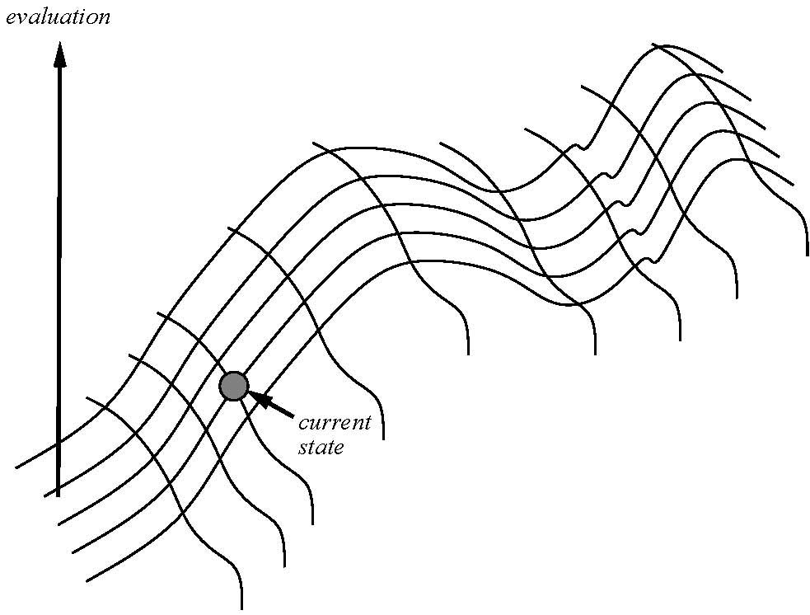
Local search: the picture
States are laid up on a surface
State quality/cost is its height
State space forms a landscape
Optimum state:
  maximizes solution quality
  minimizes solution cost
Move around from state to state and try to reach the optimum state
Exploration restricted to neighboring states, thus ‘local’ search (ref. Holger & Hoos)

Slide 7
Components of a local search
State
  is a complete assignment of values to variables, a possibly inconsistent solution
Possible moves
  are modifications to the current state, typically by changing the value of a single variable. Thus, ‘local’ repair (ref. Dechter)
  Examples:
    SAT: Flipping the value of a Boolean variable (GSAT),
    CSPs: Min-conflict heuristic (variations)
Evaluation (cost) function
  rates the quality of a state, typically in the number of violated constraints

Slide 8
Generic Mechanism
Cost function: number of broken constraints
General principle
  Start with a full but arbitrary assignment of values to variables
  Reduce inconsistencies by local repairs (heuristic)
  Repeat until
    A solution is found (global minimum)
    The solution cannot be repaired (local minimum)
    … You run out of patience (max-tries)
A.k.a.
  Iterative repair (decision problems)
  Iterative improvement (optimization problems)

Slide 9
Outline
General principle
Main types: greedy & stochastic
  Greedy: hill climbing, local beam
  Stochastic:
    RandomWalk (stochastic noise), Tabu Search
    Simulated AnnealingGeneric algorithms, Breakout method (constraint weighting), ERA (multi-agent search)
When nothing works…
Evaluation methods

Slide 10
Main types of local search
Greedy:
  Use a heuristic to determine the best move
Stochastic (improvement)
  Sometimes (randomly) disobey the heuristic

Slide 11
Greedy local search
At any given point,
  make the best decision you can given the information you have and proceed.
  Typically, move to the state that minimizes the number of broken constraints
Example:
  hill climbing (a.k.a. gradient descent/ascent)
  Local beam search: keep track of k states

Slide 12
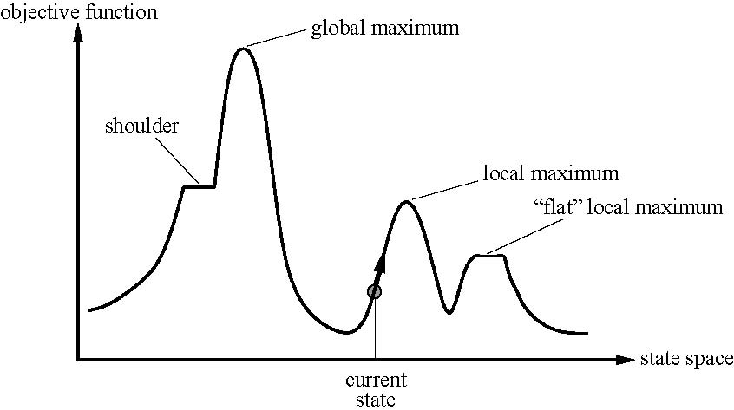
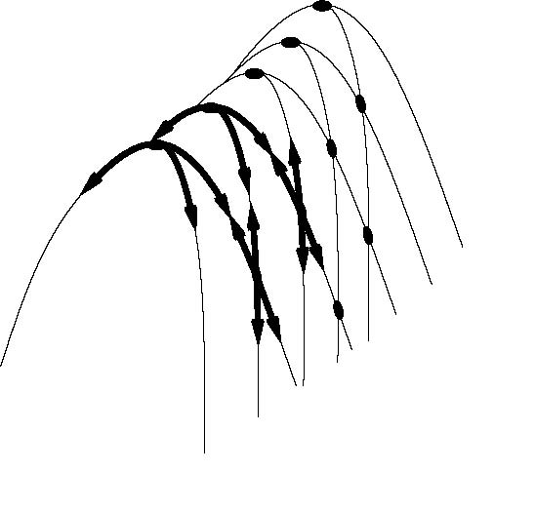
Greedy local search
Problems:
  local optima (stuck),
  plateau (errant),
  ridge (oscillates from side to side, slow progress)

Slide 13
Stochastic Local Search
Sometimes (randomly) move to a state that is not the best: use randomization to escape local optimum
Examples:
    RandomWalk (stochastic noise)
    Tabu Search
    Simulated Annealing
    Generic algorithms
    Breakout method (constraint weighting)
    ERA (multi-agent search)

Slide 14
Simulated Annealing: idea
Analogy to physics:
  Process of gradually cooling a liquid until it freezes
  If temperature is lowered sufficiently slowly, material will attain lowest-energy configuration (perfect order)
Basic idea:
  When stuck in a local optimum, allow few steps towards less good neighbors to escape the local maximum

Slide 15
Simulated Annealing: Mechanism
Start from any state at random, start countdown and loop until time is over:
  Pick up a neighbor at random
  Set d = quality of neighbor – quality of current state
  If d>0 (there is improvement)
    Then move to neighbor & restart countdown
    Else, move to neighbor with a transition probability p<1
Transition probability proportional to e^{d/t}
  d is negative, and t is time countdown
  As times passes, less and less likely to make the move towards unattractive neighbors
Under some very restrictive assumptions, guaranteed to find optimum

Slide 16
Properties
Non-systematic and non-exhaustive
Liable to getting stuck in local optima (optima/minima)
Non-deterministic:
  outcome may depend on where you start
Typically, heavy tailed:
  probability of improving solution as time goes by quickly becomes small but does not die out

Slide 17
Genetic Algorithms
Basic step: Combinations two complete assignments (parents) to generate offsprings
Mechanism
  Starts from an initial population
  Encodes assignments in a compact manner (a string)
  Combines partial solutions to generate new solutions (next generation)

Slide 18
Genetic Algorithm (2)
Fitness Function ranks a state’s quality, assigns probability for selection
Selection randomly chooses pairs for combination depending on fitness
Crossover point randomly chosen for two individuals, offsprings are generated
Mutation randomly changes a state

Slide 19
Outline
General principle
Main types: greedy & stochastic
  Greedy: hill climbing, local beam
  Stochastic:
    RandomWalk (stochastic noise), Tabu Search
    Simulated AnnealingGeneric algorithms, Breakout method (constraint weighting), ERA (multi-agent search)
When nothing works…
Evaluation methods

Slide 20
Breakout strategies [Bresina]
Increase the weights of the broken constraints so that they are less likely to be broken in subsequent iterations
Quite effective for recovering from local optima

Slide 21
ERA: Environment, Rules, Agents [Liu et al, AIJ 02]
Environment is an n × a board
Each variable is an agent
Each position on board is a value of a domain
Agent moves in a row on board
Each position records the number of violations caused by the fact that agents are occupying other positions
Agents try to occupy positions where no constraints are broken (zero position)
Agents move according to reactive rules

Slide 22
Reactive rules [Liu et al, AIJ 02]
Reactive rules:
Least-move: choose a position with the min. violation value
Better-move: choose a position with a smaller violation value
Random-move: randomly choose a position
Combinations of these basic rules form different behaviors.

Slide 23
Big picture
Agents do not communicate but share a common context
Agents keep kicking each other out of their comfortable positions until every one is happy
Charecterization: [Hui Zou, 2003]
  Amazingly effective in solving very tight but solvable instances
  Unstable in over-constrained cases
    Agents keep kicking each other out (livelock)
    Livelocks may be exploited to identify bottlenecks

Slide 24
ERA performance
Observation:
Solvable vs. unsolvable instances:
stable on solvable instances
oscillates on unsolvable cases
ERA performance on solvable instances
ERA performance on unsolvable instances

Slide 25
Agent’s movement
Motion of agents
    variable
    stable
    constant
Observations:
 | Solvable | Unsolvable
Variable | None | Most
Stable | A few | A few
Constant | Most | None

Slide 26
Outline
General principle
Main types: greedy & stochastic
When nothing works…
Evaluation methods

Slide 27
Random restart
Principle
  When no progress is made, restart from a new randomly selected state
  Save best results found so far (anytime algorithm)
Repeat random restart
  For a fixed number of iterations
  Until best results have not been improved on for a certain number of iterations. E.g., Geometric law

Slide 28
Outline
General principle
Main types: greedy & stochastic
When nothing works…
Evaluation methods

Slide 29
Evaluation: empirical
Test on
  a given problem instance
  an ensemble of problem instances (representative of a population)
Experiment
  Run the algorithm thousands of times
  Measure some metric as a random variable (e.g., the time needed to find a solution)

Slide 30
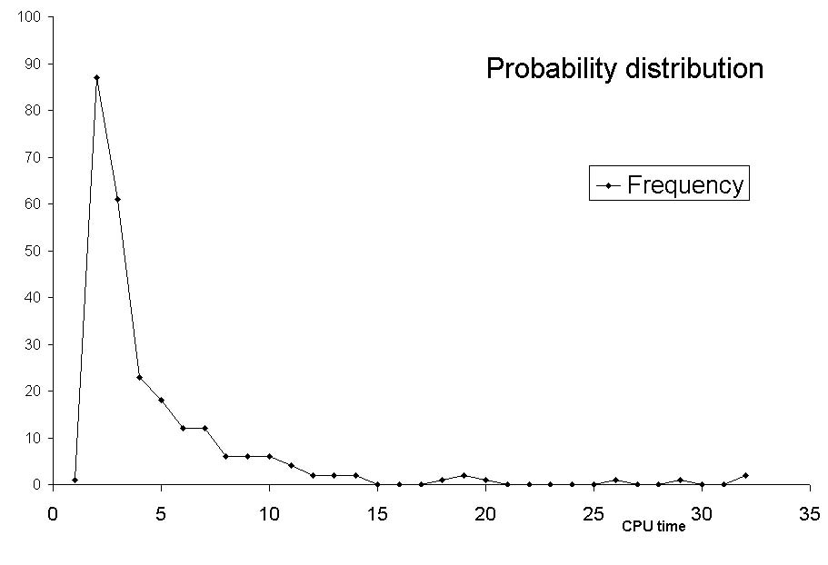
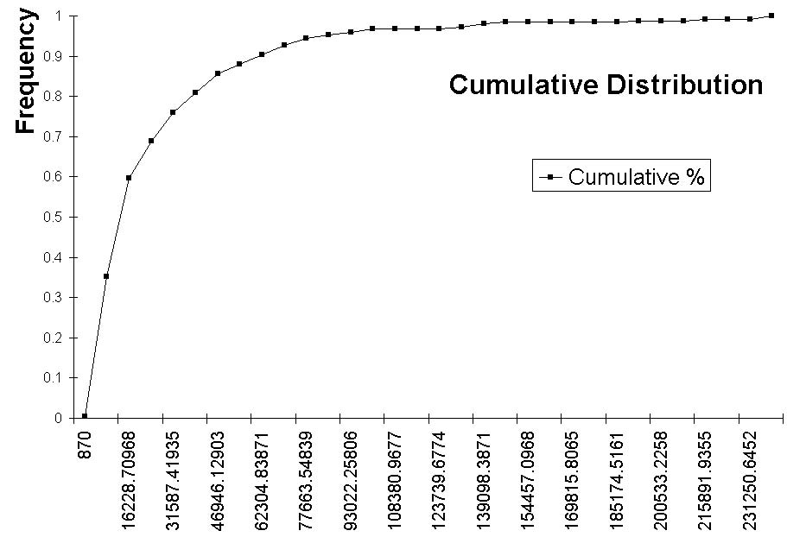
Comparing techniques
Provide
  The probability distribution function (approximated by the number of runs that took a given time to find a solution)
  The cumulative distribution function (approximated by the number of runs that found a solution within a given time)

Slide 31
Comparing techniques
Compare algorithms’ performance using statistical tests (for confidence levels)
  t-test: assumes normal distribution of the measured metrics
  Nonparametric tests do not. Some match pairs, some do not.
Consult/work with a statistician

