Slide 1
Partial Orders
Section 9.6 of Rosen
Spring 2021
CSCE 235H Introduction to Discrete Structures (Honors)
Course web-page: cse.unl.edu/~cse235h
Questions: Piazza

Slide 2
Special Relations on a Set
Equivalence Relations
  Reflexive
  Symmetric
  Transitive
Partial Orders
  Reflexive
  Antisymmetric
  Transitive

Slide 3
Outline
Motivating example
Definitions
  Partial ordering, comparability, total ordering, well ordering
Principle of well-ordered induction
Lexicographic orderings
Hasse Diagrams
Extremal elements
Lattices
Topological Sorting

Slide 4
Motivating Example (1)
Consider the renovation of Avery Hall. In this process several tasks were undertaken
  Remove Asbestos
  Replace windows
  Paint walls
  Refinish floors
  Assign offices
  Buy office furniture
  Move in office furniture
Replace windows
Move furniture
Remove Asbestos
Buy
furniture
Paint walls
Refinish floors
Assign offices

Slide 5
Motivating Example (2)
Clearly, some things must be done before others can begin
  Asbestos has to be removed before construction can start
  Replacing the windows has to be done before painting the walls or refinishing the floors
However, several things can be done concurrently:
  Painting could be done while working on the floor
  Assigning offices could be done at anytime before moving in office furniture
This scenario nicely illustrates a partial ordering relation between the tasks
Move furniture
Paint walls
Refinish floors
Replace windows
Buy
furniture
Remove Asbestos
Assign offices

Slide 6
Partial Orderings: Definition
Definitions:
  A relation R on a set S is called a partial order if it is
    Reflexive
    Antisymmetric
    Transitive
  A set S together with a partial ordering R is called a partially ordered set (poset, for short) and is denote (S,R)
Partial orderings are used to give an order to sets that may not have a natural one
In our renovation example, we could define an ordering such that (a,b)∈R if ‘a must be done before b can be done’
Notes:
\forall a,b \in S, (a R b) \wedge (b R a) \rightarrow a = b

Slide 7
Partial Orderings: Notation
We use the notation
  $\preccurlyeq$
  $\prec$
Careful:
The notation p is used to denote any partial ordering
Example:
Notes:
\begin{array}{ccl}
a\preccurlyeq b &\equiv & (a,b) \in R \\
a\prec b & \equiv & ((a,b) \in R) \wedge (a\neq b)
\end{array}
(\preccurlyeq \mathrm{versus}\; \leq,
\prec \mathrm{versus}\; <)
(\mathbb{Z}, \mid)
R=\{(a,b)| (a,b \in \mathbb{Z}) \wedge (a\;\mathrm{divides}\;b)\}
x \preccurlyeq x, 2 \preccurlyeq 6, 6 \not\preccurlyeq 2

Slide 8
Comparability: Definition
Definition
  The elements a and b of a poset (S, p) are called comparable if either a p b or b p a
  When for a,b∈S, we have neither apb nor bpa, we say that a,b are incomparable
Consider again
Notes:
2 \preccurlyeq 4, 2 \prec 4
(5 \not\prec 8) \wedge (8 \not\prec 5)

Slide 9
Total Orders: Definition
Definition:
  If (S,p) is a poset and every two elements of S are comparable, S is called a totally ordered set
  The relation p is said to be a total order
Example
  The relation “less than or equal to” over the set of integers (Z, ≤) since for every a,b∈Z, it must be the case that a≤b or b≤a
  What happens if we replace ≤ with <?
The relation < is not reflexive, and (Z,<) is not a poset

Slide 10
Well Orderings: Definition
Definition: (S,p) is a well-ordered set if
  It is a poset
  Such that p is a total ordering and
  Such that every non-empty subset of S has a least element
Example
  The natural numbers along with ≤, (N ,≤), is a well-ordered set since any nonempty subset of N has a least element and ≤ is a total ordering on N
1 2 3 4 5….

Slide 11
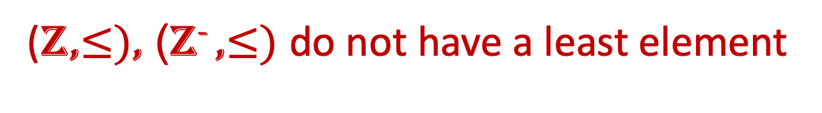
Well Ordering: Examples
0
(Z,$≤)$, (Z⁻ ,$≤)$ do not have a least element
Notes:
(\mathbb{Z^+},\leq)?\\
(2\mathbb{Z^+},\leq)?\\
(2\mathbb{Z^+}+1,\leq)?\\
(\mathbb{Z^-},\leq)?\\
(\mathbb{Z},\leq)?\\
-\infty

Slide 12
Review
(S,R):
  R on S
  R is reflexive, antisymmetric, transitive
Types of Partial Ordering
  Partially ordered Set (poset)
  Totally ordering
  Well ordering

Slide 13
Outline
Motivating example
Definitions
  Partial ordering, comparability, total ordering, well ordering
Principle of well-ordered induction
Lexicographic orderings
Hasse Diagrams
Extremal elements
Lattices
Topological Sorting

Slide 14
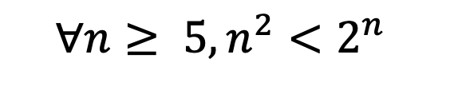
Principle of Well-Ordered Induction
Well-ordered sets are the basis of the proof technique known as induction (more when we cover Chapter 3)
$$∀n≥ 5, n^{2}<2^{n}$$
Theorem: Principle of Well-Ordered Induction
  Basis Step:
  Inductive Step:
Notes:
\mathrm{Given}\; (S,\preccurlyeq), \forall x\in S, P(x)
\forall y \in S [\forall x \in S, x\prec y \rightarrow P(x)]\rightarrow P(y)

Slide 15
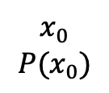




Principle of Well-Ordered Induction: Proof
Proof: (S well ordered) ∧(Basis Step) ∧ (Induction Step) ⇒ ∀x∈S, P(x)
Suppose that it is not the case the P(x) holds for all x∈S
⇒ ∃y P(y) is false
⇒ A={ x∈S | P(x) is false } is not empty
S is well ordered ⇒ A has a least element a
Since P(x₀) is true and P(a) is false ⇒ a≠x₀
P(x) holds for all x∈S and xpa, then P(a) holds by the induction step
This yields a contradiction QED
S
$$P\left(x\right)$$
$x$
$$P(a)$$
A
$$x_{0}$$
$$P(x_{0})$$
$$y$$
$$¬P(y)$$
$$a$$
$$¬P(a)$$

Slide 16
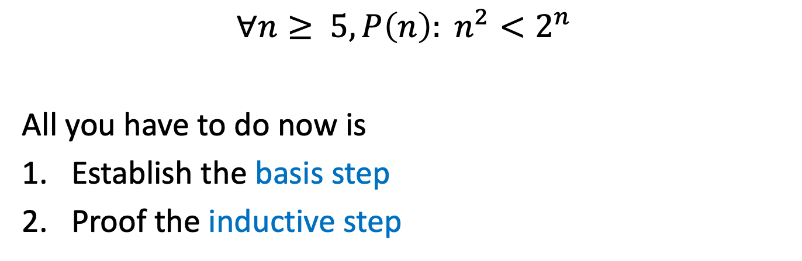
Inductive Proof: Example
$$∀n≥ 5, {P\left(n\right): n}^{2}<2^{n}$$
All you have to do now is
Establish the basis step
Proof the inductive step

Slide 17
Outline
Motivating example
Definitions
  Partial ordering, comparability, total ordering, well ordering
Principle of well-ordered induction
Lexicographic orderings
  Idea, on A₁×A₂, A₁×A₂×…×A_{n}, S^{t} (strings)
Hasse Diagrams
Extremal elements
Lattices
Topological Sorting

Slide 18
Lexicographic Orderings: Idea
Lexigraphic ordering is the same as any dictionary or phone-book ordering:
  We use alphabetic ordering
    Starting with the first character in the string
    Then the next character, if the first was equal, etc.
  If a word is shorter than the other, than we consider that the ‘no character’ of the shorter word to be less than ‘a’

Slide 19





Lexicographic Orderings on A₁×A₂
Formally, lexicographic ordering is defined by two other orderings
Definition: Let and be two posets. The lexicographic ordering p on the Cartesian product A₁×A₂ is defined by
If we add equality to the lexicographic ordering p on A₁×A₂, we obtain a partial ordering
$$(A_{1},≼_{1})$$
$$(A_{2},≼_{2})$$
$$\left(a_{1},a_{2}\right)≺\left(b_{1},b_{2}\right) if \left(a_{1}≺_{1}b_{1}\right) or (a_{1}=b_{1} and a_{2}≺_{2}b_{2})$$
$$≺_{1}$$
$$\left(a_{1},a_{2}\right)≺\left(b_{1},b_{2}\right)$$
$$≺_{2}$$

Slide 20
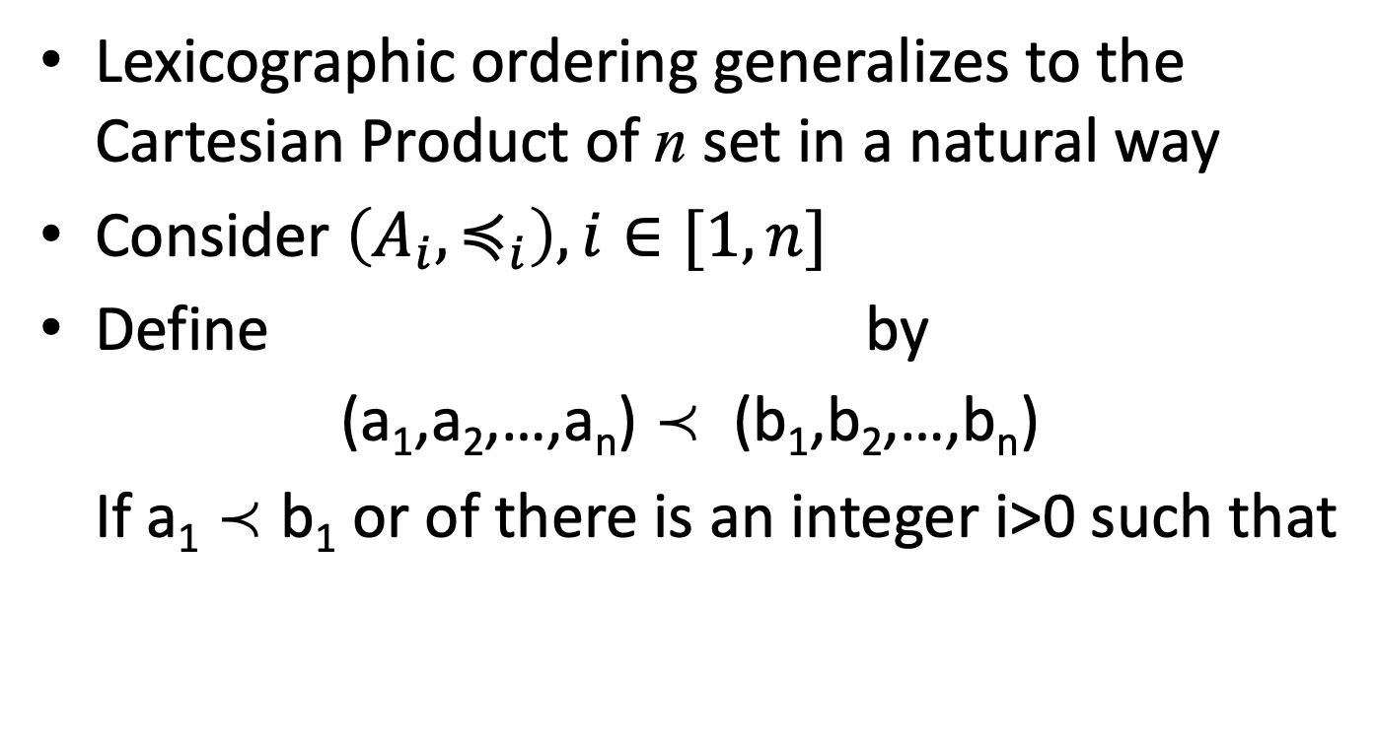
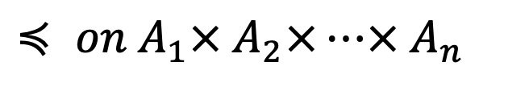
Lexicographic Ordering on A₁×A₂×… ×A_{n}
Lexicographic ordering generalizes to the Cartesian Product of n set in a natural way
Consider $\left(A_{i},≼_{i}\right), i∈[1,n]$
Define by
(a₁,a₂,…,a_{n}) p (b₁,b₂,…,b_{n})
If a₁ p b₁ or of there is an integer i>0 such that
$≼ on A_{1}× A_{2}×…× A_{n}$
Notes:
a_1=b_1,\ldots, a_i=b_i, \mathrm{and}\; a_{i+1}\prec_{i+1}b_{i+1}

Slide 21
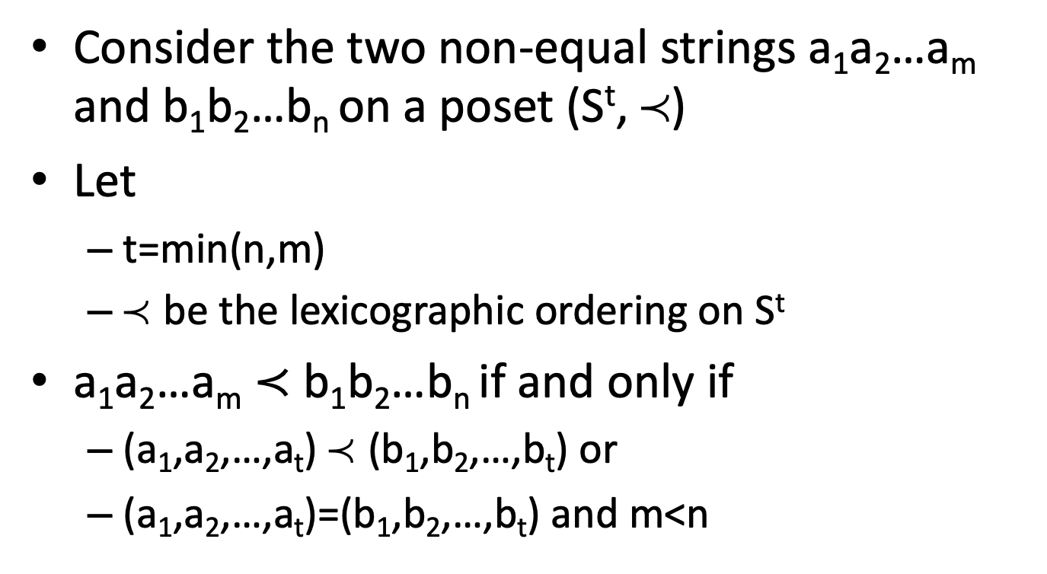
Lexicographic Ordering on Strings
Consider the two non-equal strings a₁a₂…a_{m} and b₁b₂…b_{n} on a poset (S^{t}, p)
Let
  t=min(n,m)
  p be the lexicographic ordering on S^{t}
a₁a₂…a_{m} $≺$ b₁b₂…b_{n} if and only if
  (a₁,a₂,…,a_{t}) p (b₁,b₂,…,b_{t}) or
  (a₁,a₂,…,a_{t})=(b₁,b₂,…,b_{t}) and m<n

Slide 22
Outline
Motivating example
Definitions
  Partial ordering, comparability, total ordering, well ordering
Principle of well-ordered induction
Lexicographic orderings
Hasse Diagrams
Extremal elements
Lattices
Topological Sorting

Slide 23
Hasse Diagrams
Like relations, partial orders have a convenient graphical representation: Hasse Diagrams
Consider the digraph representation of a partial order
Because we are dealing with a partial order, we know that the relation must be reflexive and transitive
a₄
a₅
a₂
a₃
a₁

Slide 24
Hasse Diagram: Example
Thus, we can simplify the graph as follows
  Remove all self loops
  Remove all transitive edges
  Remove directions on edges assuming that they are oriented upwards
The resulting diagram is far simpler
a₄
a₅
a₄
a₅
a₂
a₂
a₃
a₃
a₁
a₁

Slide 25
Hasse Diagrams: Example (1)
Of course, you need not always start with the complete relation in the partial order and then trim everything.
Rather, you can build a Hasse Diagram directly from the partial order
Example: Draw the Hasse Diagram
  for the following partial ordering: {(a,b) | a|b }
  on the set {1, 2, 3, 4, 5, 6, 10, 12, 15, 20, 30, 60}
  (these are the divisors of 60 which form the basis of the ancient Babylonian base-60 numeral system)

Slide 26
Hasse Diagram: Example (2)
R= {(a,b) | a|b }
A= {1,2,3,4,5,6,10,12,15,20,30,60}
60
12
20
30
4
6
10
15
2
3
5
1

Slide 27
Outline
Motivating example
Definitions
  Partial ordering, comparability, total ordering, well ordering
Principle of well-ordered induction
Lexicographic orderings
Hasse Diagrams
Extremal elements
Lattices
Topological Sorting

Slide 28
Extremal Elements: Summary
We will define the following terms:
A maximal/minimal element in a poset (S, p)
The maximum (greatest)/minimum (least) element of a poset (S, p)
An upper/lower bound element of a subset A of a poset (S, p)
The greatest lower/least upper bound element of a subset A of a poset (S, p)

Slide 29
Extremal Elements: Maximal
Definition: An element a in a poset (S, p) is called maximal if it is not less than any other element in S. That is: ¬(∃b∈S (apb))
If there is one unique maximal element a, we call it the maximum element (or the greatest element)
c
d
a
b
e
c
d
a
b

Slide 30
Extremal Elements: Minimal
Definition: An element a in a poset (S, p) is called minimal if it is not greater than any other element in S. That is: ¬(∃b∈S (bpa))
If there is one unique minimal element a, we call it the minimum element (or the least element)
c
d
a
b
c
d
a
b
e

Slide 31
Extremal Elements: Upper Bound
Definition: Let (S,p) be a poset and let A⊆S. If u is an element of S such that a p u for all a∈A then u is an upper bound of A
An element x that is an upper bound on a subset A and is less than all other upper bounds on A is called the least upper bound on A. We abbreviate it as lub.
f
e
g
c
d
a
b

Slide 32
Extremal Elements: Lower Bound
Definition: Let (S,p) be a poset and let A⊆S. If l is an element of S such that l p a for all a∈A then l is an lower bound of A
An element x that is a lower bound on a subset A and is greater than all other lower bounds on A is called the greatest lower bound on A. We abbreviate it glb.
f
e
g
c
d
a
b

Slide 33
Extremal Elements: Example 1
c
d
a
b
What are the minimal, maximal, minimum, maximum elements?
Minimal: {a,b}
Maximal: {c,d}
There are no unique minimal or maximal elements, thus no minimum or maximum

Slide 34
Extremal Elements: Example 2
Give lower/upper bounds & glb/lub of the sets:
{d,e,f}, {a,c} and {b,d}
{d,e,f}
Lower bounds: ∅, glb: DNE
Upper bounds: ∅, lub: DNE
{a,c}
g
h
i
Lower bounds: ∅, glb: DNE
Upper bounds: {h}, lub: h
d
e
f
{b,d}
Lower bounds: {b}, glb: b
a
b
c
Upper bounds: {d,g}, lub: d because dpg

Slide 35
Extremal Elements: Example 3
Minimal/Maximal elements?
i
j
  Minimal & Minimum element: a
  Maximal elements: b,d,i,j
f
g
h
Bounds, glb, lub of {c,e}?
  Lower bounds: {a,c}, thus glb is c
  Upper bounds: {e,f,g,h,i,j}, thus lub is e
e
b
c
d
Bounds, glb, lub of {b,i}?
  Lower bounds: {a}, thus glb is a
  Upper bounds: ∅, thus lub DNE
a

Slide 36
Outline
Motivating example
Definitions
  Partial ordering, comparability, total ordering, well ordering
Principle of well-ordered induction
Lexicographic orderings
Hasse Diagrams
Extremal elements
Lattices
Topological Sorting

Slide 37
Lattices
A special structure arises when every pair of elements in a poset has an lub and a glb
Definition: A lattice is a partially ordered set in which every pair of elements has both
  a least upper bound and
  a greatest lower bound

Slide 38
Lattices: Example 1
Is the example from before a lattice?
i
j
f
g
h
No, because the pair {b,c} does not have a least upper bound
e
b
c
d
a

Slide 39
Lattices: Example 2
What if we modified it as shown here?
j
i
f
g
h
Yes, because for any pair, there is an lub & a glb
e
b
c
d
a

Slide 40
Lattices: Example 3
Is this example a lattice?
g
No!
  The lower bound of A={e,f} is {a,b,c}
  However, A has no glb
Similarly, B={b,c} has no ulb
f
e
h
b
c
d
a

Slide 41
A Lattice Or Not a Lattice?
To show that a partial order is not a lattice, it suffices to find a pair that does not have an lub or a glb (i.e., a counter-example)
For a pair not to have an lub/glb, the elements of the pair must first be incomparable (Why?)
You can then view the upper/lower bounds on a pair as a sub-Hasse diagram: If there is no maximum/minimum element in this sub-diagram, then it is not a lattice
g
f
e
h
b
c
d
a

Slide 42
Outline
Motivating example
Definitions
  Partial ordering, comparability, total ordering, well ordering
Principle of well-ordered induction
Lexicographic orderings
Hasse Diagrams
Extremal elements
Lattices
Topological Sorting

Slide 43
Topological Sorting
Let us return to the introductory example of Avery Hall renovation. Now that we have got a partial order model, it would be nice to actually create a concrete schedule
That is, given a partial order, we would like to transform it into a total order that is compatible with the partial order
A total order is compatible if it does not violate any of the original relations in the partial order
Essentially, we are simply imposing an order on incomparable elements in the partial order
Move furniture
Move furniture
Refinish floors
Refinish floors
Paint walls
Paint walls
Replace windows
Replace windows
Buy
furniture
Replace windows
Remove Asbestos
Assign offices
Assign offices
Remove Asbestos

Slide 44
Topological Sorting: Preliminaries (1)
Before we give the algorithm, we need some tools to justify its correctness
Fact: Every finite, nonempty poset (S,p) has a minimal element
We will prove the above fact by a form of reductio ad absurdum

Slide 45



Topological Sorting: Preliminaries (2)
Proof:
  Assume, to the contrary, that a nonempty finite poset (S,p) has no minimal element. In particular, assume that a₁ is not a minimal element.
  Assume, w/o loss of generality, that |S|=n
  If a₁ is not minimal, then there exists a₂ such that a₂p a₁
  But a₂ is also not minimal because of the above assumption
  Therefore, there exists a₃ such that a₃p a₂. This process proceeds until we have the last element a_{n}. Thus, a_{n} p a_{n-1} p … p a₂ p a₁
  Finally, by definition a_{n} is the minimal element QED
$$a_{2}$$
$$a_{1}$$
$$a_{n}$$

Slide 46
Topological Sorting: Intuition
The idea of topological sorting is
  We start with a poset (S, p)
  We remove a minimal element, choosing arbitrarily if there is more than one. Such an element is guaranteed to exist by the previous fact
  As we remove each minimal element, one at a time, the set S shrinks
  Thus we are guaranteed that the algorithm will terminate in a finite number of steps
  Furthermore, the order in which the elements are removed is a total order: a₁ p a₂ p … p a_{n-1}p a_{n}
Now, we can give the algorithm itself

Slide 47
Topological Sorting: Algorithm
Input: (S, p) a poset with |S|=n
Output: A total ordering (a₁,a₂,…, a_{n})
k ← 1
While S Do
a_{k} ← a minimal element in S
S ← S \ {a_{k}}
k ← k+1
End
Return (a₁, a₂, …, a_{n})

Slide 48
Topological Sorting: Example
Find a compatible ordering (topological ordering) of the poset represented by the Hasse diagrams below
i
j
j
i
f
g
h
f
g
h
e
e
b
c
d
b
c
d
a
a

Slide 49
Summary
Definitions
  Partial ordering, comparability, total ordering, well ordering
Principle of well-ordered induction
Lexicographic orderings
  Idea, on A₁×A₂, A₁×A₂×…×A_{n}, S^{t} (strings)
Hasse Diagrams
Extremal elements
  Minimal/minimum, maximal/maximum, glb, lub
Lattices
Topological Sorting

