Slide 1
Algorithms Analysis
Section 3.3 of Rosen
Spring 2021
CSCE 235H Introduction to Discrete Structures (Honors)
Course web-page: cse.unl.edu/~cse235h
Questions: Piazza

Slide 2
Outline
Introduction
Input Size
Order of Growth
Intractability
Worst, Best, and Average Cases
Mathematical Analysis of Algorithms
  3 Examples
Summation tools

Slide 3
Introduction
How can we say that one algorithm performs better than another one?
Quantify the resources needed to run it:
  Time
  Memory
  I/O, disk access
  Circuit, power, etc.
We want to study algorithms independent of
  Implementations
  Platforms
  Hardware
We need an objective point of reference
  For that we measure time by the number of operations as a function of the size of the input to the algorithm
  Time is not merely CPU clock cycle

Slide 4
Input Size
For a given problem, we characterize the input size n appropriately
  Sorting: The number of items to be sorted
  Graphs: The number of vertices and/or edges
  Matrix manipulation: The number of rows and colums
  Numerical operations: the number of bits needed to represent a number
The choice of an input size greatly depends on the elementary operation: the most relevant or important operation of an algorithm
  Comparisons
  Additions
  Multiplications

Slide 5
Outline
Introduction
Input Size
Order of Growth
Intractability
Worst, Best, and Average Cases
Mathematical Analysis of Algorithms
  3 Examples
Summation tools

Slide 6
Order of Growth (of Algorithms)
Small input sizes can usually be computed instantaneously, thus we are most interested in how an algorithms performs as n→∞
Indeed, for small values of n, most such functions will be very similar in running time.
Only for sufficiently large n do differences in running time become apparent:
As n→∞ the differences become more and more stark

Slide 7
Intractability (of Problems)
Problems that we can solve (today) only with exponential or super-exponential time algorithms are said to be (likely) intractable. That is, though they may be solved in a reasonable amount of time for small n, for large n, there is (likely) no hope for efficient execution. It may take millions or billions of years.
Tractable problems are problems that have efficient (read: polynomial) algorithms to solve them.
Polynomial order of magnitude usually means that there exists a polynomial p(n)=n^{k} for some constant k that always bounds the order of growth. More on asymptotics in the next lecture
(Likely) Intractable problems (may) need to be solved using approximation or randomized algorithms (except for small size of input)

Slide 8
Worst, Best, and Average Case (of Algorithms)
Some algorithms perform differently on various input of similar size. It is sometimes helpful to consider
  The worst-case
  The best-case
  The average-case
  Performance of the algorithm.
Example: Search an array A of size n for a given value k
  Worst-case: k ∈ A, then we must check every item. Cost = n comparisons
  Best-case: k is the first item in the array. Cost = 1 comparison
  Average-case: Probabilistic analysis

Slide 9
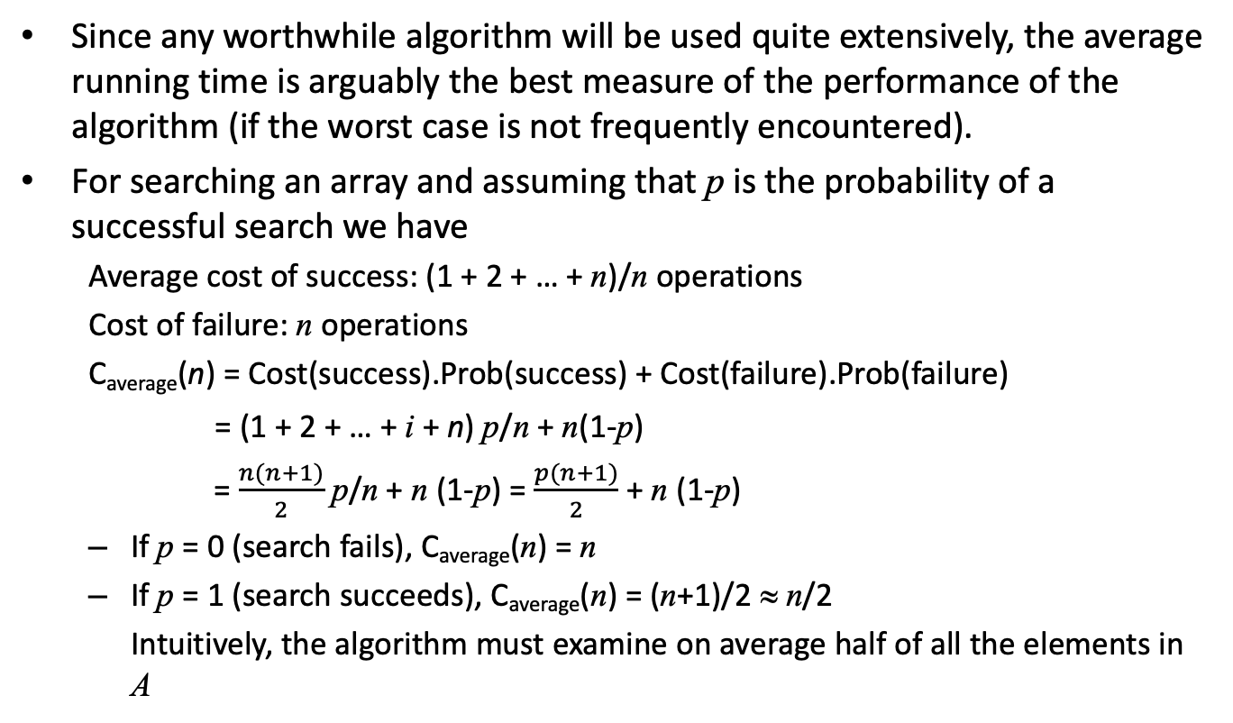
Average-Case: Example
Since any worthwhile algorithm will be used quite extensively, the average running time is arguably the best measure of the performance of the algorithm (if the worst case is not frequently encountered).
For searching an array and assuming that p is the probability of a successful search we have
  Average cost of success: (1 + 2 + … + n)/n operations
  Cost of failure: n operations
  C_{average}(n) = Cost(success).Prob(success) + Cost(failure).Prob(failure)
  = (1 + 2 + … + i + n) p/n + n(1-p)
  = $\frac{n(n+1)}{2}$ p/n + n (1-p) = $\frac{p(n+1)}{2}$ + n (1-p)
  If p = 0 (search fails), C_{average}(n) = n
  If p = 1 (search succeeds), C_{average}(n) = (n+1)/2 ≈ n/2
  Intuitively, the algorithm must examine on average half of all the elements in A

Slide 10
Average-Case: Importance
Average-case analysis of algorithms is important in a practical sense
Often C_{avg} and C_{worst} have the same order of magnitude and thus from a theoretical point of view, are no different from each other
Practical implementations, however, require a real-world examination and empirical analysis

Slide 11
Outline
Introduction
Input Size
Order of Growth
Intractability
Worst, Best, and Average Cases
Mathematical Analysis of Algorithms
  3 Examples
Summation tools

Slide 12
Mathematical Analysis of Algorithms
After developing a pseudo-code for an algorithm, we wish to analyze its performance
  as a function of the size of the input, n,
  in terms of how many times the elementary operation is performed.
Here is a general strategy
  Decide on a parameter(s) for the input, n
  Identify the basic operation
  Evaluate if the elementary operation depends only on n
  Set up a summation corresponding to the number of elementary operations
  Simplify the equation to get as simple of a function f(n) as possible

Slide 13




Algorithm Analysis: Example 1 (1)
UniqueElements
Input: Integer array A of size n
Output: True if all elements a ∈ A are distinct
For $i←1 to n−1$ Do
For $j←i+1 to n$ Do
If $ai=aj$
Then Return false
End
End
End
Return true
$$i$$
1 | 2 | … |  |  | $$n−1$$ | $$n$$
$$j$$

Slide 14
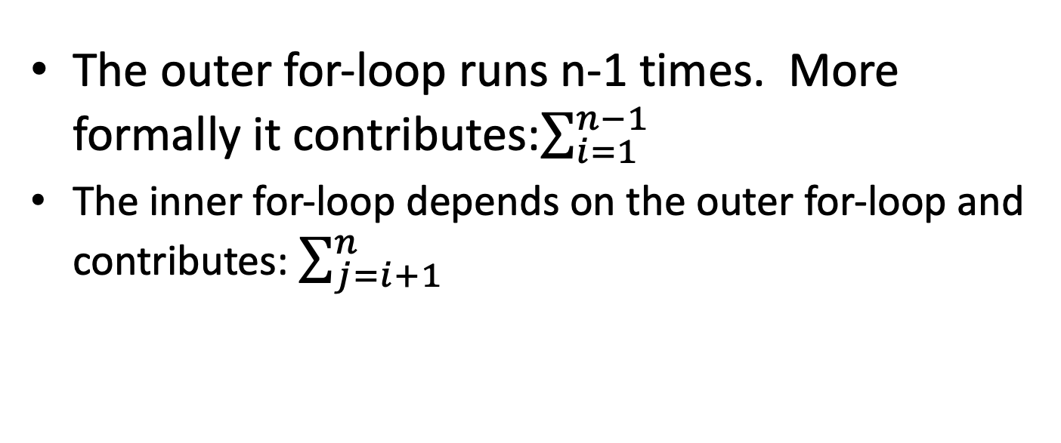
Algorithm Analysis: Example 1 (2)
For this algorithm, what is
  The elementary operation?
  Input size?
  Does the elementary operation depend only on n?
  Comparing a_{i} and a_{j}
  n, size of A
The outer for-loop runs n-1 times. More formally it contributes:$\sum_{i=1}^{n−1}{ }$
The inner for-loop depends on the outer for-loop and contributes: $\sum_{j=i+1}^{n}{ }$

Slide 15

Algorithm Analysis: Example 1 (3)
We observe that the elementary operation is executes once in each iteration, thus we have
C_{worst}(n) = $\sum_{i=1}^{n−1}{\sum_{j=i+1}^{n}{1}}$ = $\frac{\left(n×n\right)−n}{2}$= $\frac{n(n−1)}{2}$
1
 |  |  |  |  | n-1

Slide 16
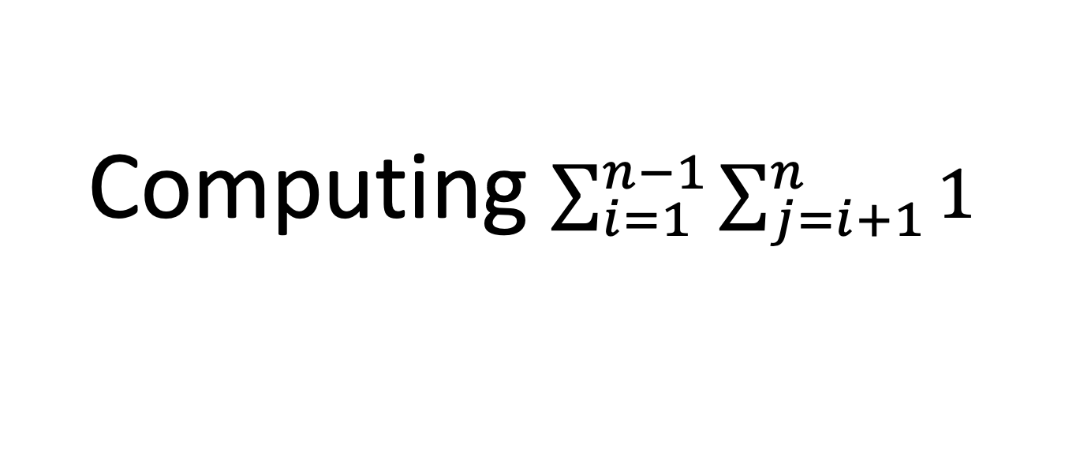
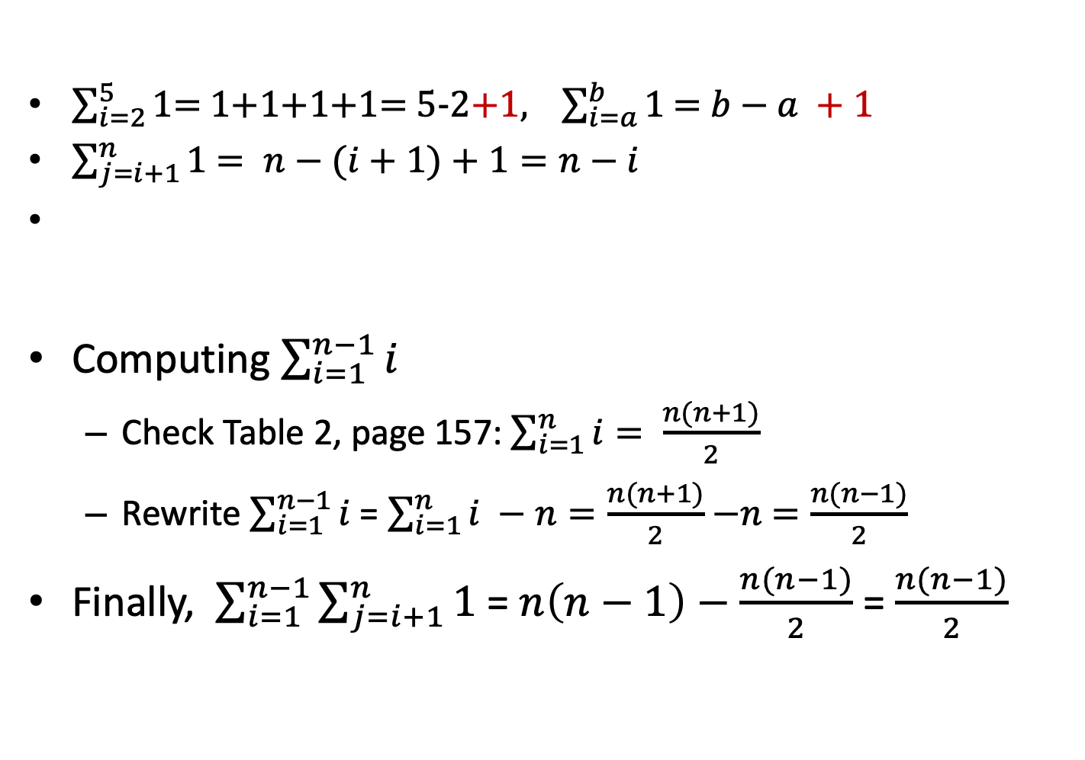
Computing $\sum_{i=1}^{n−1}{\sum_{j=i+1}^{n}{1}}$
$\sum_{i=2}^{5}{1}$= 1+1+1+1= 5-2+1, $\sum_{i=a}^{b}{1}$ = $b−a +1$
$\sum_{j=i+1}^{n}{1}$ $= n−(i+1)+1=n−i$
Computing $\sum_{i=1}^{n−1}{i}$
  Check Table 2, page 157: $\sum_{i=1}^{n}{i}= \frac{n(n+1)}{2}$
  Rewrite $\sum_{i=1}^{n−1}{i}$= $\sum_{i=1}^{n}{i} −n=\frac{n(n+1)}{2}$ $−n$ $=\frac{n(n−1)}{2}$
Finally, $\sum_{i=1}^{n−1}{\sum_{j=i+1}^{n}{1}}$= $n\left(n−1\right)−$ $\frac{n(n−1)}{2}$ = $\frac{n(n−1)}{2}$
Notes:
\sum_{i=1}^{n-1}(n-i) = \sum_{i=1}^{n-1}n- \sum_{i=1}^{n-1}i\\
= n\sum_{i=1}^{n-1} 1 - \sum_{i=1}^{n-1}i\\
=n (n-1-1+1) - \sum_{i=1}^{n-1}i\\
= n(n-1)-\sum_{i=1}^{n-1}I
\sum_{i=1}^{n-1}(n-i) = \sum_{i=1}^{n-1}n- \sum_{i=1}^{n-1}i =\\ n\sum_{i=1}^{n-1} 1 - \sum_{i=1}^{n-1}i= n(n-1)-\sum_{i=1}^{n-1}i

Slide 17
Algorithm Analysis: Example 2 (1)
The parity of a bit string determines whether or not the number of 1s in it is even or odd.
It is used as a simple form of error correction over communication networks

Slide 18
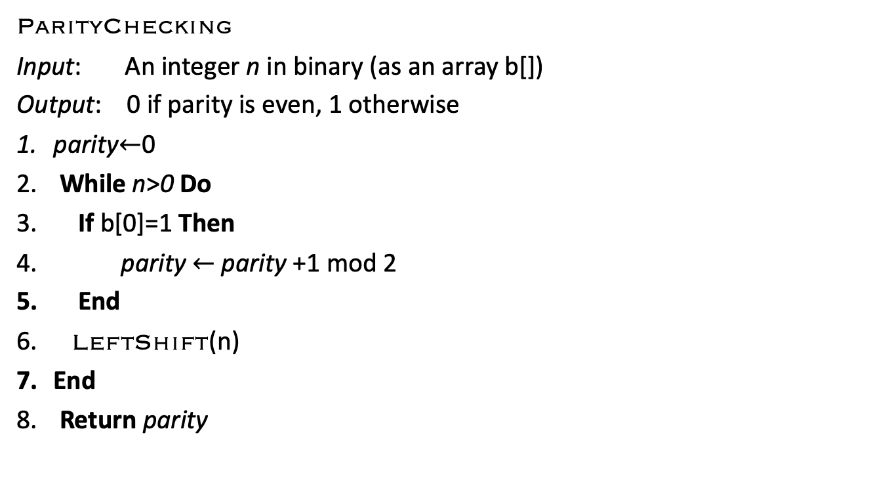
Algorithm Analysis: ParityChecking
ParityChecking
Input: An integer n in binary (as an array b[])
Output: 0 if parity is even, 1 otherwise
parity$←$0
While n>0 Do
If b[0]=1 Then
parity $←$ parity +1 mod 2
End
LeftShift(n)
End
Return parity

Slide 19
Algorithm Analysis: Example 2 (2)
For this algorithm, what is
  The elementary operation?
  Input size, n?
  Does the elementary operation depend only on n?
The number of bits required to represent an integer n is ⎡log n⎤
The while-loop will be executed as many times as there are 1-bits in the binary representation.
In the worst case we have a bit string of all 1s
So the running time is simply log n

Slide 20

Algorithm Analysis: Example 3 (1)
MyFunction
Input: Integers n,m,p such that n>m>p
Output: Some function f(n,m,p)
$x←1$
For $i←1 to 10$Do
For $j←0 to n$ Do
For $k←m to 2m$Do
$x←x  p$
End
End
End
Return $x$

Slide 21
Algorithm Analysis: Example 3 (2)
Outer for-loop: executes 11 times, but does not depend on input size
2nd for-loop: executes n+1 times
3rd for-loop: executes m+1 times
Thus, the cost is C(n,m,p)=11(n+1)(m+1)
And we do NOT need to consider p

Slide 22
Outline
Introduction
Input Size
Order of Growth
Intractability
Worst, Best, and Average Cases
Mathematical Analysis of Algorithms
  3 Examples
Summation tools

Slide 23
Summation Tools
Table 2, Section 2.4 (page 166) has more summation rules, which will be
You can always use Maple to evaluate and simplify complex expressions
  But you should know how to do them by hand!
To use Maple on cse you can use the command-line interface by typing maple
Under Unix (gnome of KDE) or via xwindows interface, you can use the graphical version via xmaple

Slide 24
Summation Tools: Maple
> simplify(sum(i,i=0..n));
½ n²+ ½ n
> Sum(Sum(j,j=i..n),i=0..n);
Σ_{i=0}^{n} (Σ_{j=i}^{n} j)

Slide 25
Summary
Introduction
Input Size
Order of Growth
Intractability
Worst, Best, and Average Cases
Mathematical Analysis of Algorithms
  3 Examples
Summation tools

