Slide 1
Sequences & Summations
Section 2.4 of Rosen
Spring 2020
CSCE 235H Introduction to Discrete Structures (Honors)
Course web-page: cse.unl.edu/~cse235h
Questions: Piazza
Notes:
\sum_{i=0}^n(ar^i)=\left\{\begin{array}{rr}\frac{a(r^{n+1}-1)}{r-1}& \mathrm{if\;} r\neq 1\\(n+1)a & \mathrm{if\;}r=1\end{array}\right.

Slide 2
Outline
Although you are (more or less) familiar with sequences and summations, we give a quick review
Sequences
Definition, 2 examples
Progressions: Special sequences
Geometric, arithmetic
Summations
Careful when changing lower/upper limits
Series: Sum of the elements of a sequence
Examples, infinite series, convergence of a geometric series

Slide 3
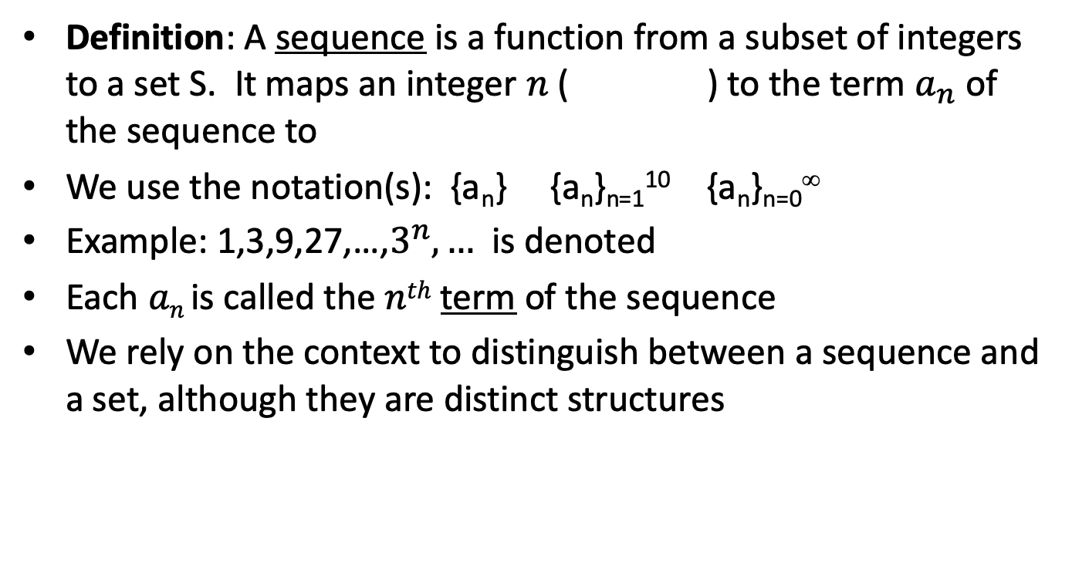
Sequences
Definition: A sequence is a function from a subset of integers to a set S. It maps an integer $n$ ( ) to the term $a_{n}$of the sequence to
We use the notation(s): {a_{n}} {a_{n}}_{n=1}¹⁰ {a_{n}}_{n=0}∞
Example: 1,3,9,27,…,$3^{n},…$ is denoted
Each $an$ is called the $nth$ term of the sequence
We rely on the context to distinguish between a sequence and a set, although they are distinct structures
Notes:
\in \mathbb{N}, \in \mathbb{Z^+}
\{a_n\}_{n=0}^\infty \mathrm{\;with\;} a_n=3^n

Slide 4
Sequences: Example 1
Consider the sequence
{(1 + 1/n)^{n}}_{n=1} ∞
The terms of the sequence are:
a₁ = (1 + 1/1)¹ = 2.00000
a₂ = (1 + 1/2)² = 2.25000
a₃ = (1 + 1/3)³ = 2.37037
a₄ = (1 + 1/4)⁴ = 2.44140
a₅ = (1 + 1/5)⁵ = 2.48832
What is this sequence?
The sequence corresponds to Euler number, Napier number
lim_{n→∞}{(1 + 1/n)^{n}}_{n=1} ∞ = e = 2.71828..

Slide 5
Sequences: Example 2
The sequence: {h_{n}}_{n=1}∞ with h_{n} = 1/n
is known as the harmonic sequence
The sequence is simply:
1, 1/2, 1/3, 1/4, 1/5, …
This sequence is particularly interesting because its summation is divergent:
Σ _{n=1}∞ (1/n) = ∞

Slide 6
Progressions: Geometric
Definition: A geometric progression is a sequence of the form
a, ar, ar², ar³, …, ar^{n}, …
Where:
a∈R is called the initial term
r∈R is called the common ratio
A geometric progression is a discrete analogue of the exponential function
f(x) = ar^{x}

Slide 7
Geometric Progressions: Examples
A common geometric progression in Computer Science is:
{a_{n}}= 1/2^{n}
with a=1 and r=1/2
Give the initial term and the common ratio of
{b_{n}} with b_{n}= (-1)^{n}
{c_{n}} with c_{n}= 2(5)^{n}
{d_{n}} with d_{n}= 6(1/3)^{n}

Slide 8
Progressions: Arithmetic
Definition: An arithmetric progression is a sequence of the form
a, a+d, a+2d, a+3d, …, a+nd, …
Where:
a ∈ R is called the initial term
d ∈ R is called the common difference
An arithmetic progression is a discrete analogue of the linear function
f(x) = dx+a

Slide 9
Arithmetic Progressions: Examples
Give the initial term and the common difference of
{s_{n}} with s_{n}= -1 + 4n
{t_{n}} with t_{n}= 7 – 3n

Slide 10
More Examples
Table 1 on Page 162 (Rosen) has some useful sequences:
{n²}_{n=1}∞, {n³} _{n=1}∞, {n⁴} _{n=1}∞, {2^{n}} _{n=1}∞, {3^{n}} _{n=1}∞, {n!} _{n=1}∞

Slide 11
Outline
Although you are (more or less) familiar with sequences and summations, we give a quick review
Sequences
Definition, 2 examples
Progressions: Special sequences
Geometric, arithmetic
Summations
Careful when changing lower/upper limits
Series: Sum of the elements of a sequence
Examples, infinite series, convergence of a geometric series

Slide 12
Summations (1)
You should be by now familiar with the summation notation:
Σ_{j=m}^{n} (a_{j}) = a_{m} + a_{m+1} + … + a_{n-1} + a_{n}
Here
j is the index of the summation
m is the lower limit
n is the upper limit
Often times, it is useful to change the lower/upper limits, which can be done in a straightforward manner (although we must be very careful):
Σ_{j=1}^{n} (a_{j}) = Σ_{i=o}^{n-1} (a_{i+1})
When j=1, i=0, so j=i+1 and i=j-1
j=n becomes i=n-1 (because j=i+1))
a_{j} becomes a_{i+1} (because j=i+1)

Slide 13
Summations (2)
Sometimes we can express a summation in closed form, as for geometric series
Theorem: For a, r∈R, r≠0
Closed form = analytical expression using a bounded number of well-known functions, does not involved an infinite series or use of recursion
Notes:
\sum_{i=0}^n(ar^i)=\left\{\begin{array}{rr}\frac{a(r^{n+1}-1)}{r-1}& \mathrm{if\;} r\neq 1\\(n+1)a & \mathrm{if\;}r=1\end{array}\right.

Slide 14
Summations (3)
Double summations often arise when analyzing an algorithm
Σ_{i=1}^{n} Σ_{j=1}^{i}(a_{j}) = a₁+
a₁+a₂+
a₁+a₂+a₃+
…
a₁+a₂+a₃+…+a_{n}
Summations can also be indexed over elements in a set:
Σ_{x∈S} f(x)
Table 2 on Page 166 (Rosen) has very useful summations. Exercises 2.4.30—34 (edition 7th) are great material to practice on.

Slide 15
Outline
Although you are (more or less) familiar with sequences and summations, we give a quick review
Sequences
Definition, 2 examples
Progressions: Special sequences
Geometric, arithmetic
Summations
Careful when changing lower/upper limits
Series: Sum of the elements of a sequence
Examples, infinite series, convergence of a geometric series

Slide 16
Series
When we take the sum of a sequence, we get a series
We have already seen a closed form for geometric series
Some other useful closed forms include the following:
Σ_{i=l}^{u} 1 = u-k+1, for k≤u
Σ_{i=0}^{n} i = n(n+1)/2
Σ_{i=0}^{n} (i²) = n(n+1)(2n+1)/6
Σ_{i=0}^{n} (i^{k}) ≈ n^{k+1}/(k+1)

Slide 17
Infinite Series
Although we will mostly deal with finite series (i.e., an upper limit of n for fixed integer), inifinite series are also useful
Consider the following geometric series:
Σ_{n=0}∞ (1/2^{n}) = 1 + 1/2 + 1/4 + 1/8 + … converges to 2
Σ_{n=0}∞ (2^{n}) = 1 + 2 + 4 + 8 + … does not converge
However note: Σ_{n=0}^{n} (2^{n}) = 2^{n+1} – 1 (a=1,r=2)

Slide 18
Infinite Series: Geometric Series
In fact, we can generalize that fact as follows
Lemma: A geometric series converges if and only if the absolute value of the common ratio is less than 1
When |r|<1,

