Slide 1
Modeling Sudoku as a CNF Formula
Spring 2020
CSCE 235H Introduction to Discrete Structures
URL: cse.unl.edu/~cse235h
All questions: Piazza

Slide 2
Compact CNF Notation
Iterated conjunction operator:
Iterated disjunction operator:

Slide 3
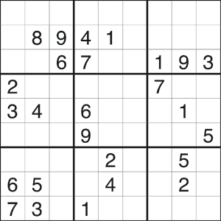
Sudoku
Rules
Each cell filled with a number 1…9
All nine numbers appear in each
    row,
    column, and
    3x3 block
(i.e., no duplicates)

Slide 4
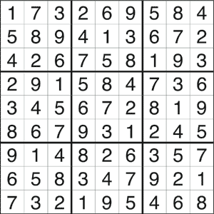
Sudoku
Rules
Each cell filled with a number 1…9
All nine numbers appear in each
    row,
    column, and
    3x3 block
(i.e., no duplicates)

Slide 5

Defining the Variables
asserts that
  the cell in row
  column
  is assigned value

Slide 6
Rules of the Game as Clauses
Putting numbers in cells
  Put a number in a given cell / Put a number in every cell
  A given cell cannot take two numbers / No cell can take two numbers
Constraining rows
  Every number must appear in every row
Constraining columns
  Every number must appear in every column
Constraining 3x3 blocks
  Every number must appear in every 3x3 block

Slide 7
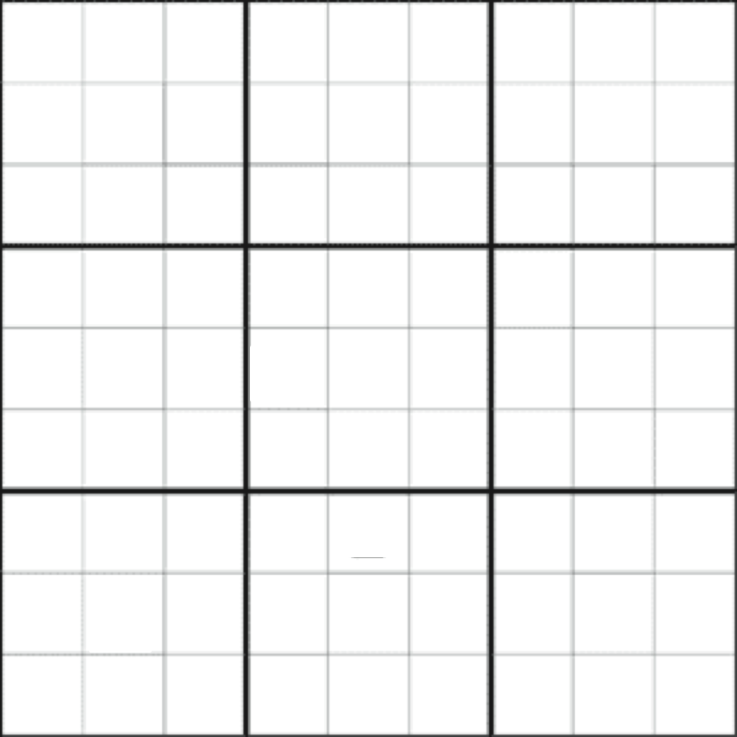
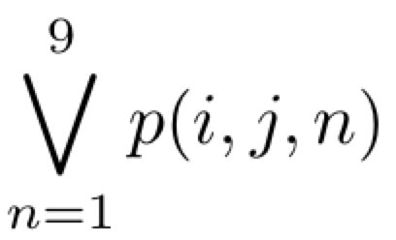
Putting Numbers in Cells (1)
1
2
3
4
5
6
7
8
9
Put at least one number in [1,9] in cell

Slide 8
Putting Numbers in Cells (2)
Put a number in cell
Put a number in every cell

Slide 9
Putting Numbers in Cells (3)
&
Cell cannot take two numbers
Notes:
\neg{(p(i,j,1)\wedge(p,i,j,2))} \wedge \neg{(p(i,j,1)\wedge(p,i,j,3))} \wedge \ldots \wedge \neg{(p(i,j,1)\wedge(p,i,j,9))} \wedge
\neg{(p(i,j,2)\wedge(p,i,j,3))} \wedge \neg{(p(i,j,2)\wedge(p,i,j,4))} \wedge \ldots \wedge \neg{(p(i,j,2)\wedge(p,i,j,9))} \wedge
\neg{(p(i,j,3)\wedge(p,i,j,4))} \wedge \neg{(p(i,j,3)\wedge(p,i,j,5))} \wedge \ldots \wedge \neg{(p(i,j,3)\wedge(p,i,j,9))} \wedge
\neg{(p(i,j,3)\wedge(p,i,j,4))} \wedge \neg{(p(i,j,3)\wedge(p,i,j,5))} \wedge \ldots \wedge \neg{(p(i,j,3)\wedge(p,i,j,9))} \wedge \ldots

Slide 10


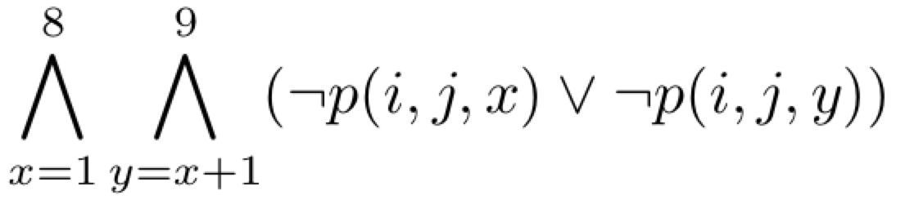
Putting Numbers in Cells (4)
Order of the literals does not matter so
becomes

Slide 11
Putting Numbers in cells (5)
Every cell takes at most one number

Slide 12



Constraining Rows (1)
For every
  Row
  Number
  Select some column
1
2
3
4
5
6
7
8
9
1
2
3
4
5
6
7
8
9

Slide 13
Constraining Rows (2)
Every number must appear in every row

Slide 14
Constraining Columns (1)
For every
  Column
  Number
  Select some row
1
2
3
4
5
6
7
8
9
1
2
3
4
5
6
7
8
9

Slide 15
Constraining Columns (2)
Every number must appear in every column

Slide 16
Constraining 3x3 Blocks (1)
For every
  Block
  Number
  Select some cell in block
0
1
2
0
1
2
3
1
1
2
3
2

Slide 17
Constraining 3x3 Blocks (2)
Every number must appear in every 3x3 block

Slide 18
Sudoku CNF Formula
729 variables
324 clauses with 9 literals
2916 clauses with 2 literals
3240 total clauses (+ clauses for initial setup)

Slide 19
Redundant Clauses
We can model a Sudoku as a SAT sentence in many ways
Some models may have redundant clauses
  Removing redundant clauses does not change the problem and yields an equivalent formula
  Example: we can generate redundant clauses by applying inference rules on some clauses in the model
Redundant clauses
  Do not change the model
  May speed the solving process.. Useful!

Slide 20
Declaring the Hints/Clues
We add propositions as unary clauses corresponding to hints/clues (filled cells)

Slide 21
Solving Sudoku
Total number of possible assignments
Testing one billion assignments a second
SAT solvers solve a Sudoku in milliseconds by aggressively pruning the search tree

