Slide 1
Relations (Additional)
Section 9.1, 9.3—9.5 of Rosen
Spring 2020
CSCE 235H Introduction to Discrete Structures (Honors)
Course web-page: cse.unl.edu/~cse235h
Questions: Piazza

Slide 2
Review: Relation
A (binary) relation between elements of two sets is a subset of their Cartesian products (set of all ordered pairs)
R ⊆ A×B ={ (a,b) | a ∈ A, b ∈ B }
A
0
a
B
1
b
2
Notes:
M_R = \left(\begin{array}{cc}
1 & 1\\
1 & 0 \\
0 & 1
\end{array} \right)

Slide 3
Review: Relation on a Set
Relation on a set: R ⊆ A×A = A²
Reflexive
Irreflexive
Symmetric
Antisymmetric
Transitive
Asymmetric
A
1
0
2
Notes:
M_R = \left(\begin{array}{ccc}
1 & 0 & 1\\
0 & 0 & 0\\
1 & 0 & 0
\end{array} \right)

Slide 4
Review: Representations
A
A
0
a
B
1
0
1
b
2
2
Bipartite directed graph
Directed graph
Bit matrix

Slide 5
Review: Operations on Relations (1)
Intersection, union, difference
Notes:
R_1 \subseteq A\times B, R_2 \subseteq A\times B
\begin{array}{cc}
R_1 \cap R_2 & M_{R_1 \cap R_2} = M_{R_1} \wedge M_{R_2}\\
R_1 \cup R_2 & M_{R_1 \cup R_2} = M_{R_1} \vee M_{R_2}\\
R_1 \setminus R_2 & M_{R_1 \setminus R_2} = M_{R_1} - M_{R_2}
\end{array}

Slide 6
Review: Operations on Relations (2)
Composition
Notes:
R_1 \subseteq A\times B, R_2 \subseteq A\times B
\begin{array}{ll}
R_2 \circ R_1 & M_{R_2 \circ R_1} = M_{R_1} \cdot M_{R_2}\\
R \circ R & M_{R^2} = M_{R} \cdot M_{R}
\end{array}

Slide 7
Composition
A
B
C
0
a
x
1
y
2
b
A
A
A
0
0
0
1
1
1
2
2
2
Notes:
R^2 = R \circ R = \{(0,2)\}
R_2 \circ R_1 = \{(0,y),(2,y)\}

Slide 8
Powers of Relations & Transitivity
The powers of relations give us a nice characterization of transitivity
Theorem: A relation R is transitive if and only if R^{n} ⊆ R for n=1,2,3,…

Slide 9
Computing the Transitive Closure
Given a relation on a set:
Cost
Product of two square matrices:
compositions
Notes:
R\subseteq A\times A
\begin{array}{l}
R_T = R \cup R^2 \cup R^3 \cup \cdots \cup R^n\\
\\
R_T = \bigcup_{i=2}^n R^n
\end{array}
\mathrm{where~} |A| =n

Slide 10
Transitive Closure
To compute the transitive closure we use the theorem
Theorem: A relation R is transitive if and only if R^{n} ⊆ R for n=1,2,3,…
Cost is
The Warshall’s Algorithm allows us to do this efficiently
Note: Your textbook gives much greater details in terms of graphs and connectivity relations. It is good to read this material, but it is based on material that we have not yet seen.

Slide 11
Warshall’s Algorithm: Key Ideas
In any set A with |A|=n, any transitive relation will be built from a sequence of relations that has a length of at most n. Why?
Consider the case where the relation R on A has the ordered pairs (a₁,a₂),(a₂,a₃),…,(a_{n-1},a_{n}). Then, (a₁,a_{n}) must be in R for R to be transitive
Thus, by the previous theorem, it suffices to compute (at most) R^{n}
Recall that R^{k}=R^{ο}R^{k-1} is computed using a bit-matrix product
The above gives us a natural algorithm for computing the transitive closure: the Warshall’s Algorithm

Slide 12
Warshall’s Algorithm
Input: An (n×n) 0-1 matrix M_{R} representing a relation R on A, |A|=n
Output: An (n×n) 0-1 matrix W representing the transitive closure of R on A
1. W← M_{R}
2. FOR k ← 1,…, n DO
FOR i ← 1,…, n DO
FOR j ← 1,…, n DO
w_{i,j} ← w_{i.j} ∨ (w_{i,k} ∧ w_{k,j})
END
END
END
RETURN W
Three nested loops. Cost
k, the middle point, is in the outer loop
k
j
i

Slide 13
Warshall’s Algorithm: Example
Compute the transitive closure of
R={(1,1),(1,2),(1,4),(2,2),(2,3),(3,1),(3,4),(4,1),(4,4)}
On the set A={1,2,3,4}
Notes:
M_R = W_0 = \left[\begin{array}{cccc}
1 & 1 & 0 & 1\\
0 & 1 & 1 & 0\\
1 & 0 & 0 & 1\\
1& 0 & 0 & 1
\end{array} \right]

Slide 14
Mechanical Execution
k=1
Notes:
W_0 = \left[\begin{array}{cccc}
1 & 1 & 0 & 1\\
0 & 1 & 1 & 0\\
1 & 0 & 0 & 1\\
1& 0 & 0 & 1
\end{array} \right]
W_1 = \left[\begin{array}{cccc}
1 & & & \\
0 & & & \\
1 & & & \\
1& & &
\end{array} \right]
W_1 = \left[\begin{array}{cccc}
1 & 1 & 0 & \\
0 & 1 & 1 & \\
1 & 1 & 0 & \\
1& 1 & 0 &
\end{array} \right]
W_1 = \left[\begin{array}{cccc}
1 & 1 & & \\
0 & 1 & & \\
1 & 1 & & \\
1& 1 & &
\end{array} \right]
W_1 = \left[\begin{array}{cccc}
1 & 1 & 0 & 1\\
0 & 1 & 1 & 0\\
1 & 1 & 0 & 1\\
1& 1 & 0 & 1
\end{array} \right]

Slide 15
k=2
Notes:
W_2 = \left[\begin{array}{cccc}
1 & 1 & 1 & 1\\
0 & 1 & 1 & 0\\
1 & 1 & 1 & 1\\
1& 1 & 1 & 1
\end{array} \right]

Slide 16
k=3
Notes:
W_3 = \left[\begin{array}{cccc}
1 & 1 & 1 & 1\\
1 & 1 & 1 & 1\\
1 & 1 & 1 & 1\\
1& 1 & 1 & 1
\end{array} \right]

Slide 17
Warshall Algorithm: Mechanically
0 | 1 | 1 | 1 | 1
0 | 1 | 1 | 1 | 1
Notes:
\mathrm{For}\; col_i, \mathrm{if}\; m_{ik} = 0, col_i\; \mathrm{stays\; the\; same}\\
\mathrm{if}\; m_{ik} = 1, col_i \gets (col_i \vee col_k)\\

Slide 18
Outline
Relation:
Definition, representation, relation on a set
Properties
Reflexivity, symmetry, antisymmetric, irreflexive, asymmetric
Combining relations
∩, ∪, \, composite of relations
Representing relations
0-1 matrices, directed graphs
Closure of relations
Reflexive closure, diagonal relation, Warshall’s Algorithm
Equivalence relations:
Equivalence class, partitions,

Slide 19
Equivalence Relation (1)
Consider the set of every person in the world
Now consider a R relation such that (a,b)∈R if a and b are full siblings
Clearly this relation is
Reflexive
Symmetric, and
Transitive
Such as relation is called an equivalence relation

Slide 20
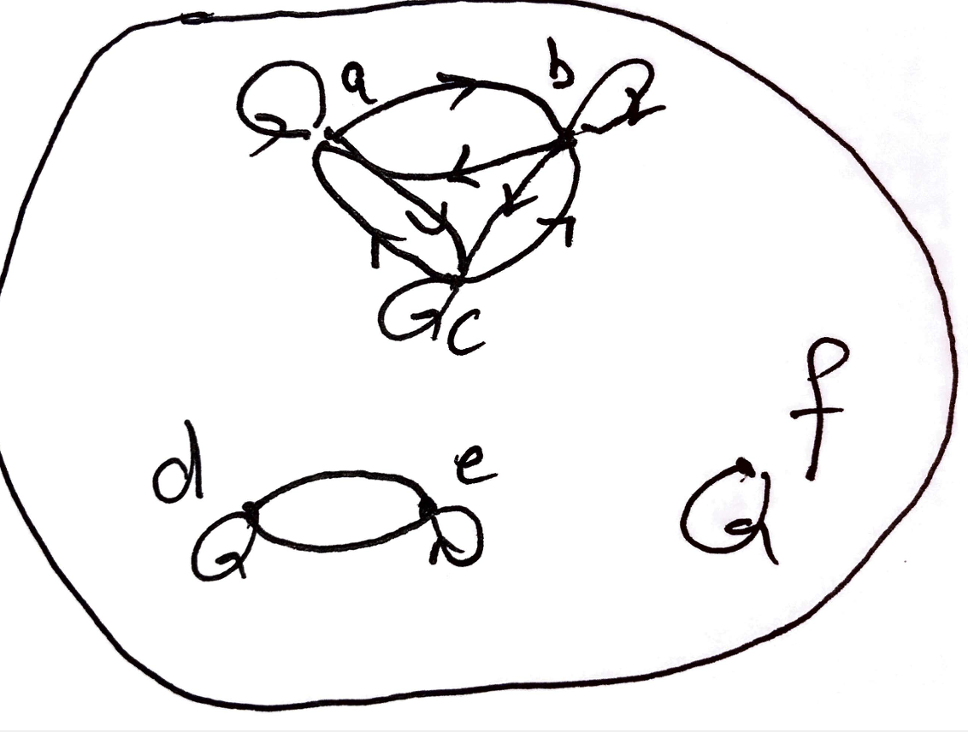
Equivalence Relation (2)
Definition: A relation on a set A is an equivalence relation if it is
reflexive,
symmetric, and
transitive

Slide 21
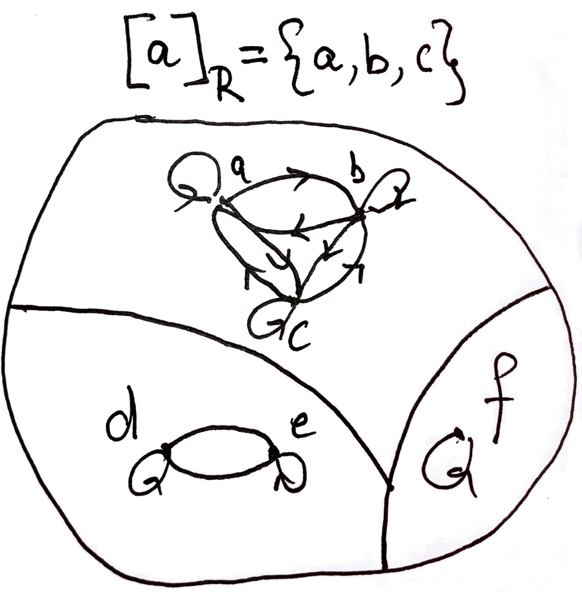
Equivalence Class (1)
Definition: Let R be an equivalence relation on a set A and let a ∈A. The set of all elements in A that are related to a is called the equivalence class of a. We denote this set [a]_{R}. We omit R when there is not ambiguity as to the relation.
[a]_{R} = { s | (a,s)∈R, s∈A}

Slide 22
Equivalence Class (2)
Although a relation R on a set A may not be an equivalence relation, we can define a subset of A such that R does become an equivalence relation (on the subset)

Slide 23
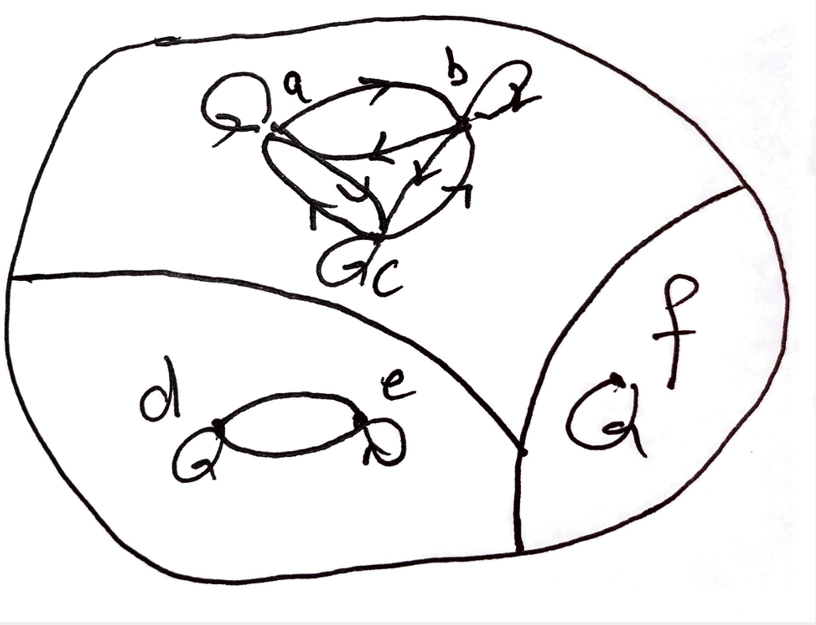
Equivalence Class (2)
The elements in [a]_{R} are called representatives of the equivalence class
Theorem: Let R be an equivalence class on a set A. The following statements are equivalent
aRb
[a]=[b]
[a] ∩ [b] ≠∅
The proof in the book is a circular proof

Slide 24
Partitions Partitions (1)
Equivalence classes partition the set A into disjoint, non-empty subsets A₁, A₂, …, A_{k}
A partition of a set A satisfies the properties
Notes:
\bigcup_{i=1}^k A_i = A
\begin{array}{cl}
1. & \bigcup_{i=1}^k A_i = A\\
2. & i\neq j \rightarrow A_i \cap A_j = \emptyset\\
3. & \forall i A_i \neq \emptyset
\end{array}

Slide 25
Partitions (2)
Example: Let R be a relation such that (a,b)∈R if a and b live in the same state, then R is an equivalence relation that partitions the set of people who live in the US into 50 equivalence classes

Slide 26
Partitions (3)
Theorem
Let R be an equivalence relation on a set S. Then the equivalence classes of R form a partition of S.
Conversely, given a partition A_{i} of the set S, there is a equivalence relation R that has the set A_{i} as its equivalence classes

Slide 27
Partitions: Visual Interpretation (1)
In a diargh, equivalence classes form a collections of disjoint complete graphs
Example: Let A={1,2,3,4,5,6,7} and R be an equivalence relation that partitions A into A₁={1,2}, A₂={3,4,5,6} and A₃={7}. Draw the directed graph.

Slide 28
Partitions: Visual Interpretation (2)
In a 0-1 matrix, if the elements are ordered into their equivalence classes, equivalence classes/partitions form perfect squares of 1s (with 0s everywhere else)
Notes:
\left[\begin{array}{cccccc}
1 & 1 & 1 & 0 & 0 & 0\\
1 & 1 & 1 & 0 & 0 & 0\\
1 & 1 & 1 & 0 & 0 & 0\\
0 & 0 &0 &1 & 1& 0\\
0 & 0 &0 &1 & 1& 0\\
0 & 0 &0 &0 & 0& 1
\end{array}\right]

Slide 29
Equivalence Relations: Example 1
Example: Let R={ (a,b) | a,b∈R and a≤b}
Is R reflexive?
Is it transitive?
Is it symmetric?
No, it is not. 4 is related to 5 (4 ≤ 5) but 5 is not related to 4
Thus R is not an equivalence relation

Slide 30
Equivalence Relations: Example 2
Example: Let R={ (a,b) | a,b∈Z and a=b}
Is R reflexive?
Is it transitive?
Is it symmetric?
What are the equivalence classes that partition Z?

Slide 31
Equivalence Relations: Example 3
Example: For (x,y),(u,v) ∈R², we define
R={ ((x,y),(u,v)) | x²+y²=u²+v²}
Show that R is an equivalence relation.
What are the equivalence classes that R defines (i.e., what are the partitions of R²)?

Slide 32
Equivalence Relations: Example 4
Example: Given n,r∈N, define the set
nZ + r = { na + r | a ∈Z }
For n=2, r=0, 2Z represents the equivalence class of all even integers
What n, r give the class of all odd integers?
For n=3, r=0, 3Z represents the equivalence class of all integers divisible by 3
For n=3, r=1, 3Z +1 represents the equivalence class of all integers divisible by 3 with a remainder of 1
In general, this relation defines equivalence classes that are, in fact, congruence classes (See Section 3.4)

