Slide 1
Asymptotics
Section 3.2 of Rosen
Spring 2020
CSCE 235H Introduction to Discrete Structures (Honors)
Course web-page: cse.unl.edu/~cse235h
Questions: Piazza

Slide 2
Outline
Introduction
Asymptotic
Definitions (Big O, Omega, Theta), properties
Proof techniques
3 examples, trick for polynomials of degree 2,
Limit method (l’Hôpital Rule), 2 examples
Limit Properties
Complexity of algorithms
Conclusions

Slide 3
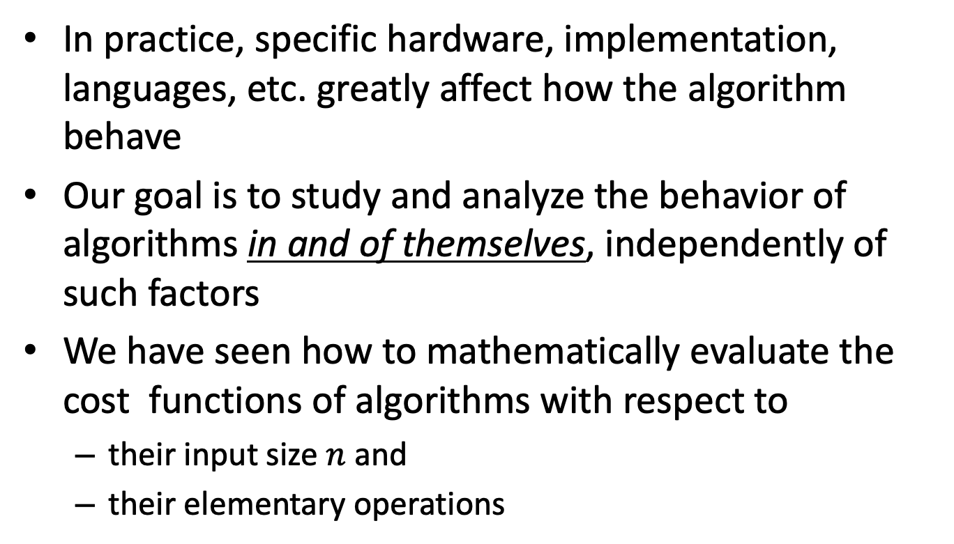
Introduction (1)
In practice, specific hardware, implementation, languages, etc. greatly affect how the algorithm behave
Our goal is to study and analyze the behavior of algorithms in and of themselves, independently of such factors
We have seen how to mathematically evaluate the cost functions of algorithms with respect to
their input size $n$ and
their elementary operations

Slide 4
Introduction (2)
However, it suffices to simply measure a cost function’s asymptotic behavior
We are interested only in the Order of Growth of an algorithm’s complexity
How well does the algorithm perform as the size of the input grows: n → ∞
For example
An algorithm that executes its elementary operation 10000n times is better than one that executes it 5n² times
Also, algorithms that have running time n² and 2000n² are considered asymptotically equivalent

Slide 5
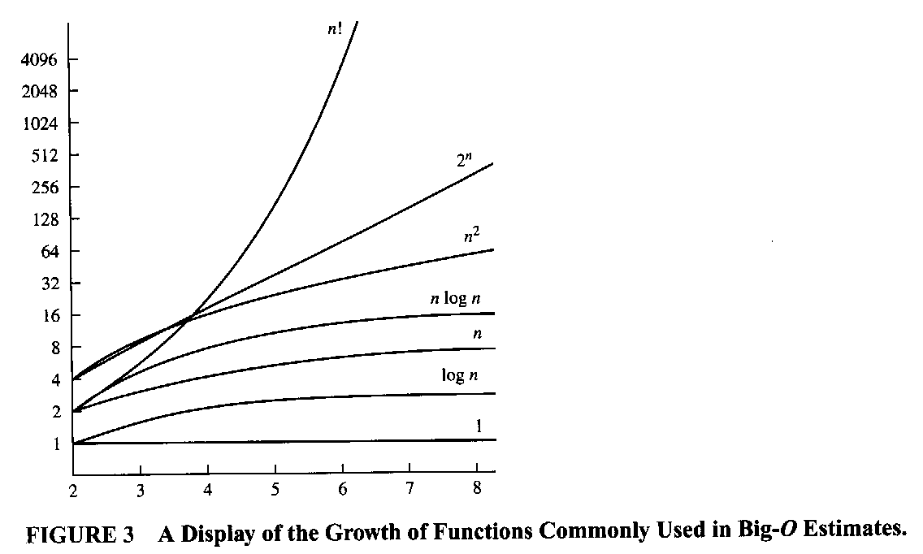
Introduction (3): Magnitude Graph

Slide 6
Outline
Introduction
Asymptotic
Definitions (Big-O, Omega, Theta), properties
Proof techniques
Limit Properties
Efficiency classes
Conclusions

Slide 7
Big-O Definition
Definition: Let f and g be two functions f,g:N→R⁺. We say that
f(n) ∈ O(g(n))
(read: f is Big-O of g) if there exists a constant c ∈ R⁺ and an n_{o}∈N such that for every integer n ≥ n₀ we have
f(n) ≤ cg(n)
Big-O is actually Omicron, but it suffices to write “O” Intuition: f is asymptotically less than or equal to g
Big-O gives an asymptotic upper bound \mathcal{O}

Slide 8
Big-Omega Definition
Definition: Let f and g be two functions f,g: N→R⁺. We say that
f(n) ∈ Ω(g(n))
(read: f is Big-Omega of g) if there exists a constant c ∈ R⁺ and an n_{o}∈N such that for every integer n ≥ n₀ we have
f(n) ≥ cg(n)
Intuition: f is asymptotically greater than or equal to g
Big-Omega gives an asymptotic lower bound \Omega()

Slide 9
Big-Theta Definition
Definition: Let f and g be two functions f,g: N→R⁺. We say that
f(n) ∈ Θ(g(n))
(read: f is Big-Theta of g) if there exists a constant c₁, c₂ ∈ R⁺ and an n_{o}∈N such that for every integer n ≥ n₀ we have
c₁g(n) ≤ f(n) ≤ c₂g(n)
Intuition: f is asymptotically equal to g
f is bounded above and below by g
Big-Theta gives an asymptotic equivalence \Theta ()

Slide 10
Asymptotic Properties (1)
Theorem: For f₁(n) ∈ O(g₁(n)) and f₂(n) ∈ O(g₂(n)), we have
f₁(n) + f₂(n) ∈ O( max{g₁(n), g₂(n)} )
This property implies that we can ignore lower order terms. In particular, for any polynomial with degree k such as p(n)=an^{k} + bn^{k-1} + cn^{k-2} + …,
p(n) ∈ O(n^{k})
More accurately, p(n) ∈ Θ(n^{k})
In addition, this theorem gives us a justification for ignoring constant coefficients. That is for any function f(n) and a positive constant c
cf(n) ∈ Θ(f(n))

Slide 11
Asymptotic Properties (2)
Some obvious properties also follow from the definitions
Corollary: For positive functions f(n) and g(n) the following hold:
f(n) ∈ Θ(g(n)) ⇔ f(n) ∈ O(g(n)) ⋀ f(n) ∈ Ω(g(n))
f(n) ∈ O(g(n)) ⇔ g(n) ∈ Ω(f(n))
The proof is obvious and left as an exercise

Slide 12
Outline
Introduction
Asymptotic
Definitions (big O, Omega, Theta), properties
Proof techniques
3 examples, trick for polynomials of degree 2
Limit method (l’Hôpital Rule), 2 examples
Limit Properties
Efficiency classes
Conclusions

Slide 13
Asymptotic Proof Techniques
Proving an asymptotic relationship between two given function f(n) and g(n) can be done intuitively for most of the functions you will encounter; all polynomials for example
However, this does not suffice as a formal proof
To prove a relationship of the form f(n)∈Δ(g(n)), where Δ is Ο, Ω, or Θ, can be done using the definitions, that is
Find a value for c (or c₁ and c₂)
Find a value for n₀
(But the above is not the only way.)

Slide 14
Asymptotic Proof Techniques: Example A
Example: Let f(n)=21n²+n and g(n)=n³
Our intuition should tell us that f(n) ∈ O(g(n))
Simply using the definition confirms this:
21n²+n ≤ cn³
holds for say c=3 and for all n≥n₀=8
So we found a pair c=3 and n₀=8 that satisfy the conditions required by the definition QED
In fact, an infinite number of pairs can satisfy this equation

Slide 15
Asymptotic Proof Techniques: Example B (1)
Example: Let f(n)=n²+n and g(n)=n³. Find a tight bound of the form
f(n) ∈ Δ(g(n))
Our intuition tells us that f(n)∈O(g(n))
Let’s prove it formally

Slide 16
Example B: Proof
If n≥1 it is clear that
n ≤ n³ and
n² ≤ n³
Therefore, we have, as 1. and 2.:
n²+n ≤ n³ + n³ = 2n³
Thus, for n₀=1 and c=2, by the definition of Big-O we have that f(n)=n²+n ∈ O(g(n³))

Slide 17
Asymptotic Proof Techniques: Example C (1)
Example: Let f(n)=n³+4n² and g(n)=n². Find a tight bound of the form
f(n) ∈ Δ(g(n))
Here, 0ur intuition tells us that f(n)∈Ω(g(n))
Let’s prove it formally

Slide 18
Example C: Proof
For n≥1, we have n² ≤ n³
For n≥0, we have n³ ≤ n³ + 4n²
Thus n≥1, we have n² ≤ n³ ≤ n³ + 4n²
Thus, by the definition of Big-Ω , for n₀=1 and c=1 we have that f(n)=n³+4n² ∈ Ω(g(n²))

Slide 19
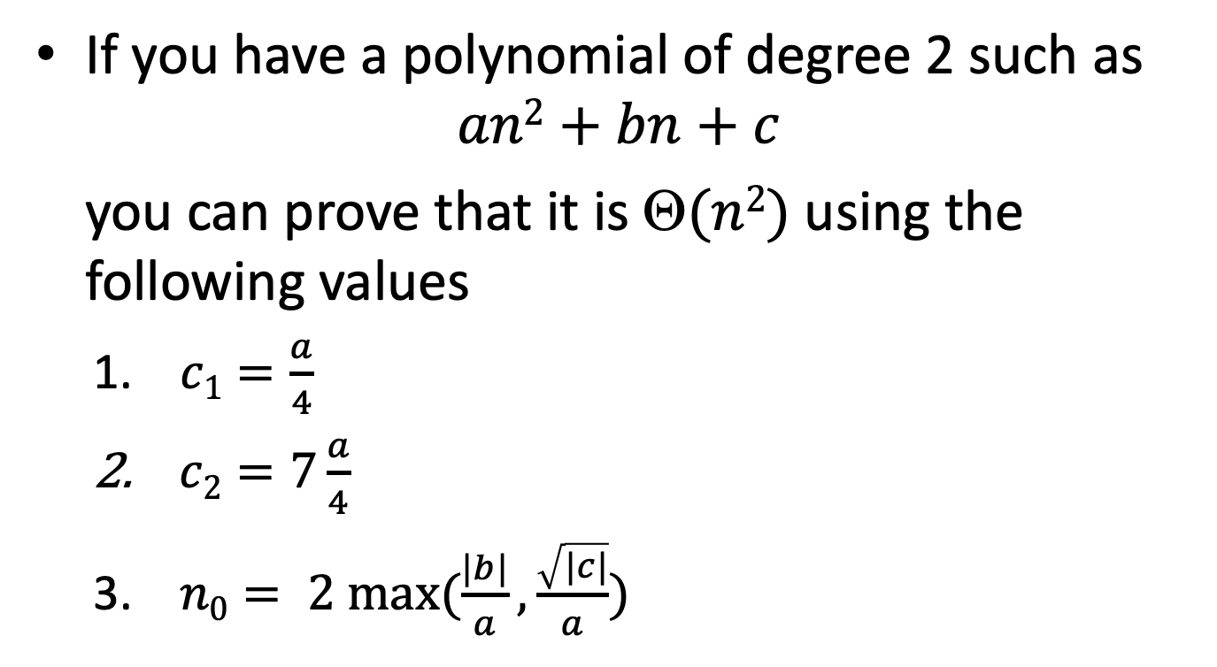
Asymptotic Proof Techniques: Trick for polynomials of degree 2
If you have a polynomial of degree 2 such as
$$an2+bn+c$$
you can prove that it is $(n2)$using the following values
$c1=\frac{a}{4}$
$c2=7\frac{a}{4}$
$n0= 2 max⁡(\frac{|b|}{a}, \frac{\sqrt{|c|}}{a})$

Slide 20
Outline
Introduction
Asymptotic
Definitions (big O, Omega, Theta), properties
Proof techniques
3 examples, trick for polynomials of degree 2,
Limit method (l’Hôpital Rule), 2 examples
Limit Properties
Efficiency classes
Conclusions

Slide 21
Limit Method: Motivation
Now try this one:
f(n)= n⁵⁰+12n³log⁴n –1243n¹²
+ 245n⁶logn + 12log³n – logn
g(n)= 12 n⁵⁰ + 24 log¹⁴ n⁴³ – logn/n⁵ +12
Using the formal definitions can be very tedious especially one has very complex functions
It is much better to use the Limit Method, which uses concepts from Calculus

Slide 22
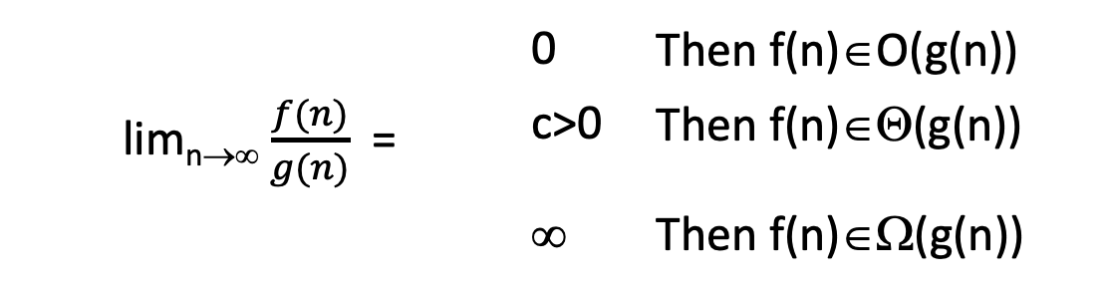
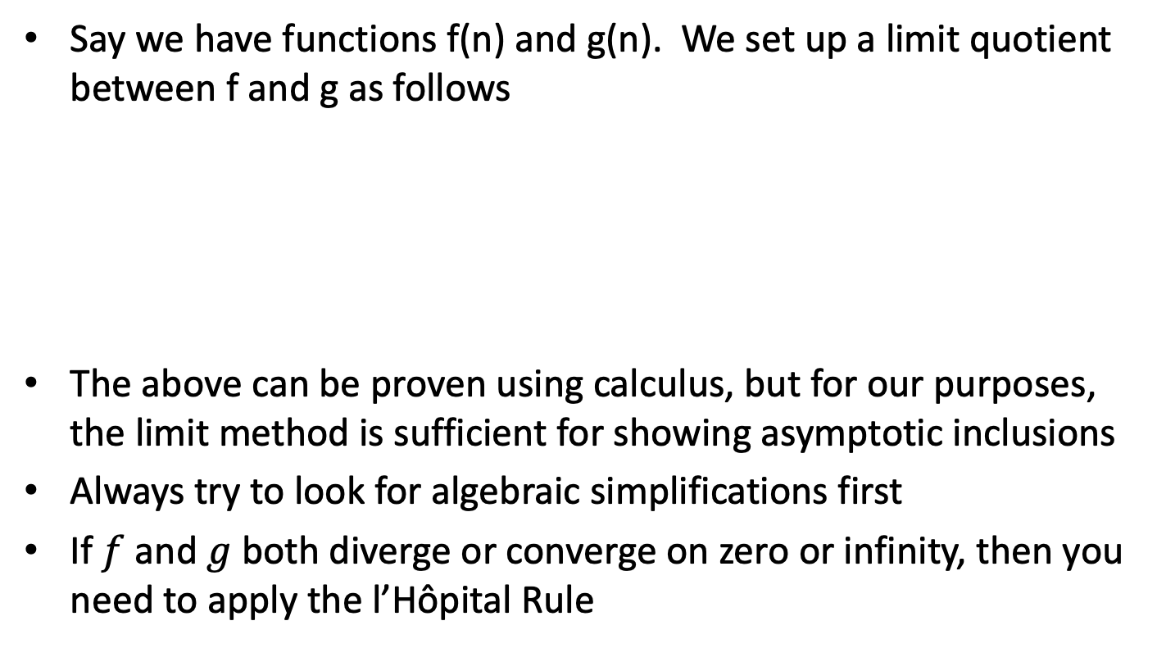
Limit Method: The Process
Say we have functions f(n) and g(n). We set up a limit quotient between f and g as follows
The above can be proven using calculus, but for our purposes, the limit method is sufficient for showing asymptotic inclusions
Always try to look for algebraic simplifications first
If $f$and $g$ both diverge or converge on zero or infinity, then you need to apply the l’Hôpital Rule
 | 0 | Then f(n)∈O(g(n))
lim_{n→∞} $\frac{f(n)}{g(n)}$ = | c>0 | Then f(n)∈Θ(g(n))
 | ∞ | Then f(n)∈Ω(g(n))

Slide 23
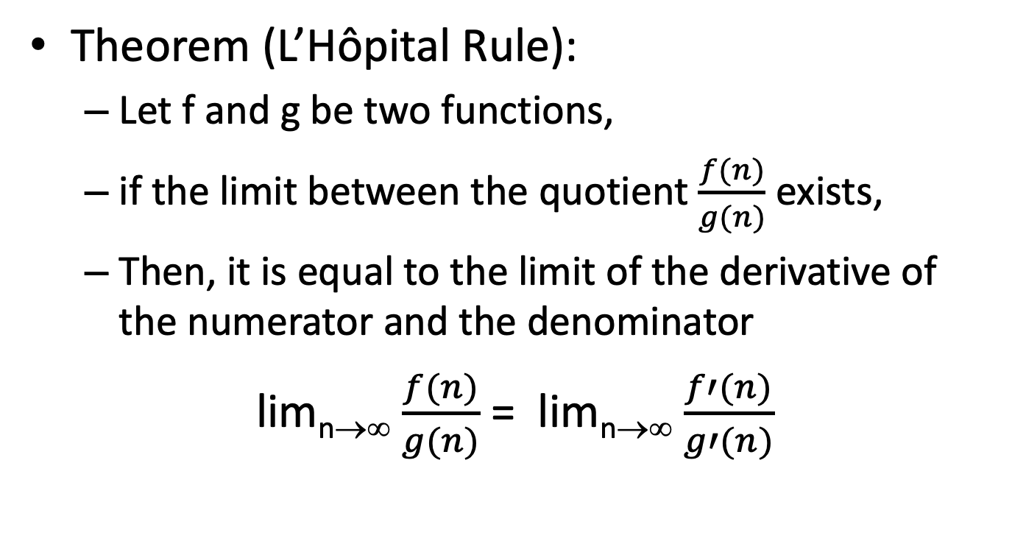
(Guillaume de) L’Hôpital Rule
Theorem (L’Hôpital Rule):
Let f and g be two functions,
if the limit between the quotient $\frac{f(n)}{g(n)}$ exists,
Then, it is equal to the limit of the derivative of the numerator and the denominator
lim_{n→∞} $\frac{f(n)}{g(n)}$ = lim_{n→∞} $\frac{f′(n)}{g′(n)}$

Slide 24
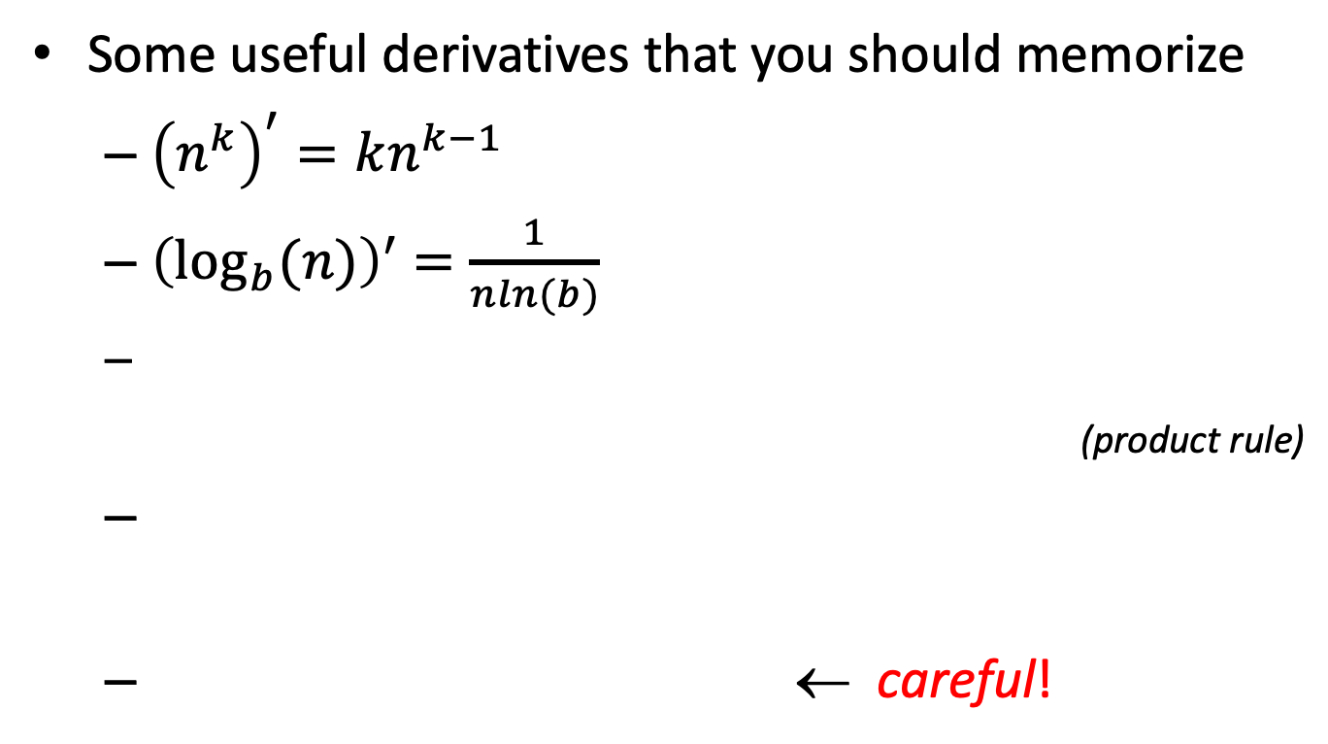
Useful Derivatives
Some useful derivatives that you should memorize
${\left(n^{k}\right)}^{′}=kn^{k−1}$
${\left(\log_{b}(n)\right)}^{′}$ $=\frac{1}{nln(b)}$
(product rule)
← careful!
Notes:
(f_1(n)f_2(n))' =f_1'(n)f_2(n)+f_1(n)f_2'(n)
(\log_b(f(n))'= \frac{f'(n)}{f(n)\ln(b)}
(c^n)'= \ln(c)c^n

Slide 25
Useful log Identities
Change of base formula:
Notes:
\log_b(n)= \frac{\log_c(n)}{\log_c(b)}
\log(n^k)=k\log(n)
\log(ab)=\log(a)+\log(b)

Slide 26
L’Hôpital Rule: Justification (1)
Why do we have to use L’Hôpital’s Rule?
Consider the following function
Clearly sin 0=0. So you may say that when x→0, f(x) → 0
However, the denominator is also → 0, so you may say that f(x) → ∞
Both are wrong
Notes:
f(x)= \frac{sin x}{x}

Slide 27
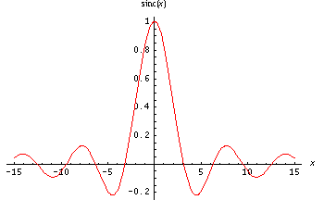
L’Hôpital Rule: Justification (2)
Observe the graph of f(x)= (sin x)/x = sinc x

Slide 28
L’Hôpital Rule: Justification (3)
Clearly, though f(x) is undefined at x=0, the limit still exists
Applying the L’Hôpital Rule gives us the correct answer
lim x→0 ((sin x )/x) = lim x→0 (sin x )’/x’ = cos x/1 = 1

Slide 29
Limit Method: Example 1
Example: Let f(n) =2^{n}, g(n)=3^{n}. Determine a tight inclusion of the form f(n) ∈ Δ(g(n))
What is your intuition in this case? Which function grows quicker?

Slide 30

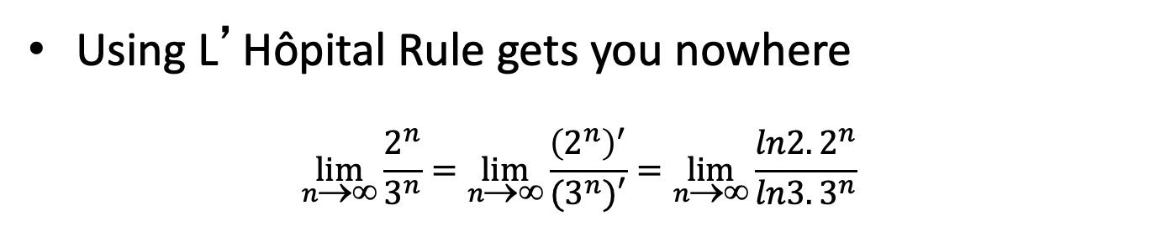
Limit Method: Example 1—Proof A
Proof using limits
We set up our limit: $\lim_{n\text{→∞}}{\frac{f(n)}{g(n)}}$ = $\lim_{n\text{→∞}}{\frac{2^{n}}{3^{n}}}$
Using L’Hôpital Rule gets you nowhere
$$\lim_{n\text{→∞}}{\frac{2^{n}}{3^{n}}}=\lim_{n\text{→∞}}{\frac{{\left(2^{n}\right)}^{′}}{(3^{n})′}=\lim_{n\text{→∞}}{\frac{{ln2. 2}^{n}}{{ln3. 3}^{n}} }}$$
Both the numerator and denominator still diverge. We’ll have to use an algebraic simplification

Slide 31

Limit Method: Example 1—Proof B
Using algebra $\lim_{n\text{→∞}}{\frac{2^{n}}{3^{n}}}$= lim_{n→∞} (2/3)^{n}
Now we use the following Theorem w/o proof
 | 0 | if α < 1
lim_{n→∞} α^{n} = | 1 | if α = 1
 | ∞ | if α > 1
Therefore we conclude that the lim_{n→∞} (2/3)^{n} converges to zero thus 2^{n} ∈ O(3^{n})

Slide 32
Limit Method: Example 2 (1)
Example: Let f(n) =log₂n, g(n)=log₃n². Determine a tight inclusion of the form
f(n) ∈ Δ(g(n))
What is your intuition in this case?

Slide 33
Limit Method: Example 2 (2)
We prove using limits
We set up out limit
lim_{n→∞} f(n)/g(n) = lim_{n→∞} log₂n/log₃n²
= lim_{n→∞} log₂n/(2log₃n)
Here we use the change of base formula for logarithms: log_{x}n = log_{y} n/log_{y} x
Thus: log₃n = log₂n / log₂3

Slide 34
Limit Method: Example 2 (3)
Computing our limit:
lim_{n→∞} log₂n/(2log₃n) = lim_{n→∞} log₂n log₂3 /(2log₂n)
= lim_{n→∞} (log₂3)/2
= (log₂3) /2
≈ 0.7924, which is a positive constant
So we conclude that f(n)∈Θ(g(n))

Slide 35
Outline
Introduction
Asymptotic
Definitions (big O, Omega, Theta), properties
Proof techniques
3 examples, trick for polynomials of degree 2,
Limit method (l’Hôpital Rule), 2 examples
Limit Properties
Efficiency classes
Conclusions

Slide 36
Limit Properties
A useful property of limits is that the composition of functions is preserved
Lemma: For the composition ° of addition, subtraction, multiplication and division, if the limits exist (that is, they converge), then
lim_{n→∞} f₁(n) ° lim_{n→∞} f₂(n) = lim_{n→∞} (f₁(n) ° f₂(n))

Slide 37
Complexity of Algorithms—Table 1, page 226
Constant O(1)
Logarithmic O(log (n))
Linear O(n)
Polylogarithmic O(log^{k} (n))
Quadratic O(n²)
Cubic O(n³)
Polynominal O(n^{k}) for any k>0
Exponential O(k^{n}), where k>1
Factorial O(n!)

Slide 38
Conclusions
Evaluating asymptotics is easy, but remember:
Always look for algebraic simplifications
You must always give a rigorous proof
Using the limit method is (almost) always the best
Use L’Hôpital Rule if need be
Give as simple and tight expressions as possible

Slide 39
Summary
Introduction
Asymptotic
Definitions (big O, Omega, Theta), properties
Proof techniques
3 examples, trick for polynomials of degree 2,
Limit method (l’Hôpital Rule), 2 examples
Limit Properties
Efficiency classes
Conclusions

