Slide 1
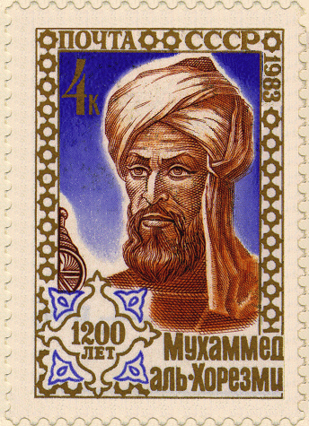
Algorithms: An Introduction
‘Algorithm’ is a distortion of Al-Khawarizmi,
a Persian mathematician
Section 3.1 of Rosen
Spring 2020 CSCE 235 Introduction to Discrete Structures (Honors)
Course web-page: cse.unl.edu/~cse235h
Questions: Piazza

Slide 2
Outline
Introduction & definition
Algorithms categories & types
Pseudo-code
Designing an algorithm
Example: Max
Greedy Algorithms
Change

Slide 3
Computer Science is About Problem Solving
A Problem is specified by
The givens (a formulation)
A set of objects
Relations between them
The query
The information one wants to extract from the formulation, the question to answer
An algorithm is a method or procedure that solves instances of a problem
Real World | ↔ | Computing World
Objects | represented by… | data Structures, ADTs, Classes
Relations | implemented with… | relations & functions (e.g., predicates)
Actions | Implemented with… | algorithms: a sequence of instructions

Slide 4
Algorithms: Formal Definition
Definition: An algorithm is a sequence of unambiguous instructions for solving a problem.
Properties of an algorithm
Finite: the algorithm must eventually terminate
Complete: Always give a solution when one exists
Correct (sound): Always give a correct solution
For an algorithm to be an acceptable solution to a problem, it must also be effective. That is, it must give a solution in a ‘reasonable’ amount of time
Efficient= runs in polynomial time. Thus, effective≠ efficient
There can be many algorithms to solve the same problem

Slide 5
Outline
Introduction & definition
Algorithms categories & types
Pseudo-code
Designing an algorithm
Example: Max
Greedy Algorithms
Change

Slide 6
Algorithms: General Techniques
There are many broad categories of algorithms
Deterministic versus Randomized (e.g., Monte Carlo)
Exact versus Approximation
Sequential/serial versus Parallel, etc.
Some general styles of algorithms include
Brute force (enumerative techniques, exhaustive search)
Divide & Conquer
Transform & Conquer (reformulation)
Greedy Techniques

Slide 7
Outline
Introduction & definition
Algorithms categories & types
Pseudo-code
Designing an algorithm
Example: Max
Greedy Algorithms
Change

Slide 8
Good Pseudo-Code: Example
Intersection
Input: Two finite sets A, B
Output: A finite set C such that C = A ∩ B
C←∅
If |A|>|B| Then Swap(A,B)
For every x ∈ A Do
If x ∈ B Then C ← C ∪ {x} Union(C,{x})
End
Return C

Slide 9
Algorithms: Pseudo-Code
Algorithms are usually presented using pseudo-code
Bad pseudo-code
Gives too many details or
Is too implementation specific (i.e., actual C++ or Java code or giving every step of a sub-process such as set union)
Good pseudo-code
Is a balance between clarity and detail
Abstracts the algorithm
Makes good use of mathematical notation
Is easy to read and
Facilitates implementation (reproducible, does not hide away important information)

Slide 10
Writing Pseudo-Code: Advice
Input/output must properly defined
All your variables must be properly initialized, introduced
Variables are instantiated, assigned using ←
All ‘commands’ (while, if, repeat, begin, end) boldface \bf
For i ← 1 to n Do
All functions in small caps Union(s,t) \sc
All constants in courier: pi ← 3.14 \tt
All variables in italic: temperature ← 78 \mathit{}
LaTeX: Several algorithm formatting packages exist on WWW

Slide 11
Outline
Introduction & definition
Algorithms categories & types
Pseudo-code
Designing an algorithm
Example: Max
Greedy Algorithms
Change

Slide 12
Designing an Algorithm
A general approach to designing algorithms is as follows
Understanding the problem, assess its difficulty
Choose an approach (e.g., exact/approximate, deterministic/ probabilistic)
(Choose appropriate data structures)
Choose a strategy
Prove
Termination
Completeness
Correctness/soundness
Evaluate complexity
Implement and test it
Compare to other known approach and algorithms

Slide 13
Algorithm Example: Max
When designing an algorithm, we usually give a formal statement about the problem to solve
Problem
Given: a set A={a₁,a₂,…,a_{n}} of integers
Question: find the index i of the maximum integer a_{i}
A straightforward idea is
Simply store an initial maximum, say a₁
Compare the stored maximum to every other integer in A
Update the stored maximum if a new maximum is ever encountered

Slide 14
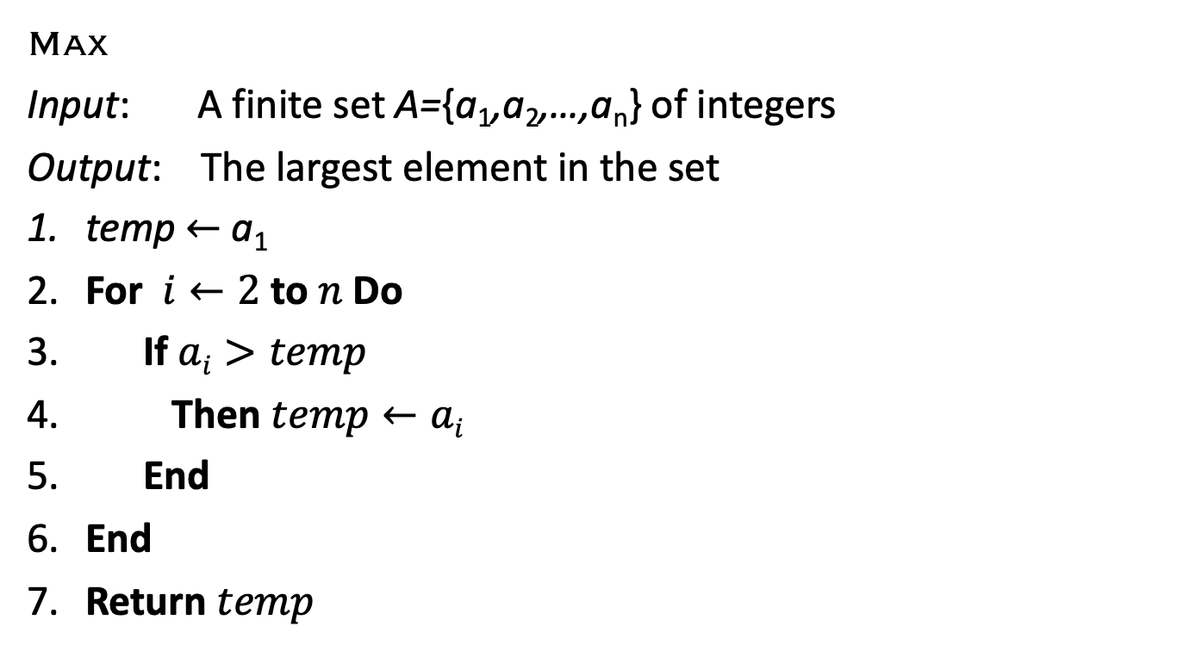
Pseudo-code of Max
Max
Input: A finite set A={a₁,a₂,…,a_{n}} of integers
Output: The largest element in the set
temp $←$ a₁
For $i←2$ to $n$Do
If $ai>temp$
Then $temp←ai$
End
End
Return $temp$

Slide 15
Algorithms: Other Examples
Check Bubble Sort and Insertion Sort in your textbooks
… which you should have seen ad nauseum in CSE 155 and CSE 156
And which you will see again in CSE 310
Let us know if you have any questions

Slide 16
Outline
Introduction & definition
Algorithms categories & types
Pseudo-code
Designing an algorithm
Example: Max
Greedy Algorithms
Change

Slide 17
Greedy Algorithms
In many problems, we wish to not only find a solution, but to find the best or optimal solution
A simple technique that works for some optimization problems is called the greedy technique
As the name suggests, we solve a problem by being greedy
Choose what appears now to be the best choice
Choose the most immediate best solution (i.e., think locally)
Greedy algorithms
Work well on some (simple) problems
Usually they are not guaranteed to produce the best globally optimal solution

Slide 18
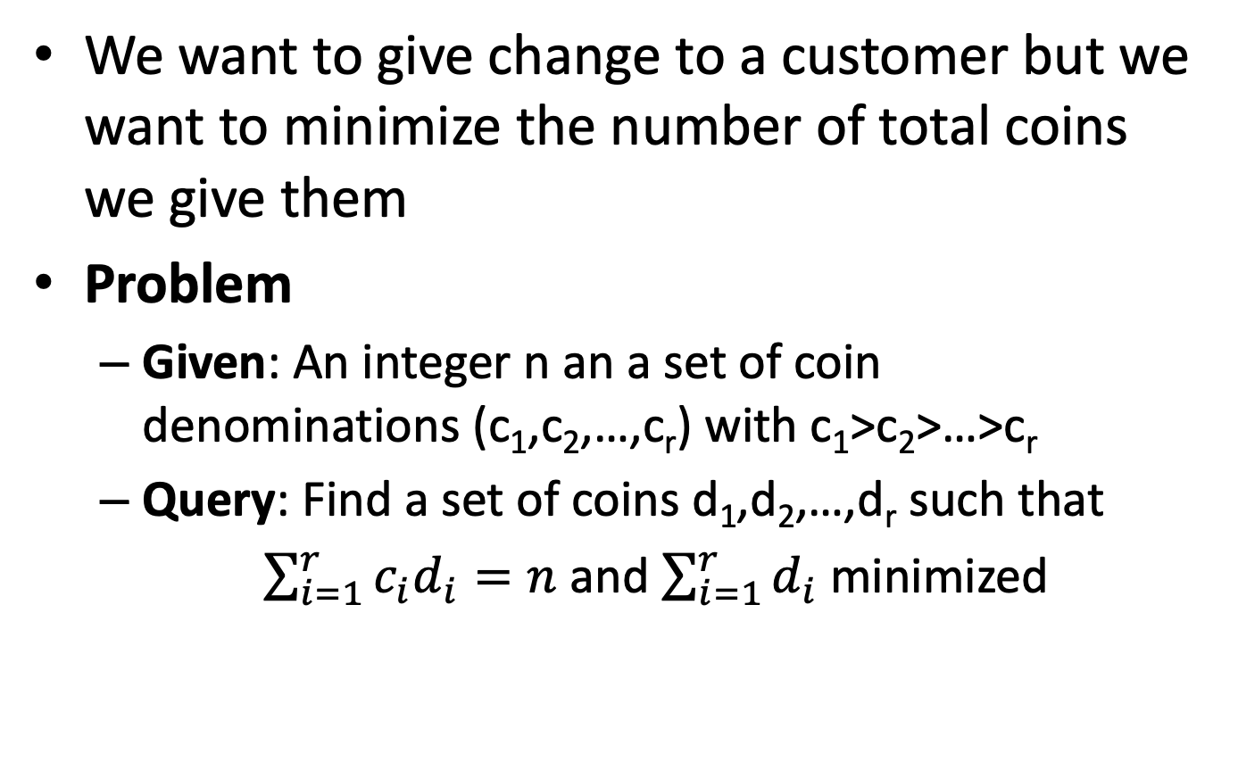
Change-Making Problem
We want to give change to a customer but we want to minimize the number of total coins we give them
Problem
Given: An integer n an a set of coin denominations (c₁,c₂,…,c_{r}) with c₁>c₂>…>c_{r}
Query: Find a set of coins d₁,d₂,…,d_{r} such that
$\sum_{i=1}^{r}{c_{i}d_{i}=n}$ and $\sum_{i=1}^{r}{d_{i}}$ minimized

Slide 19
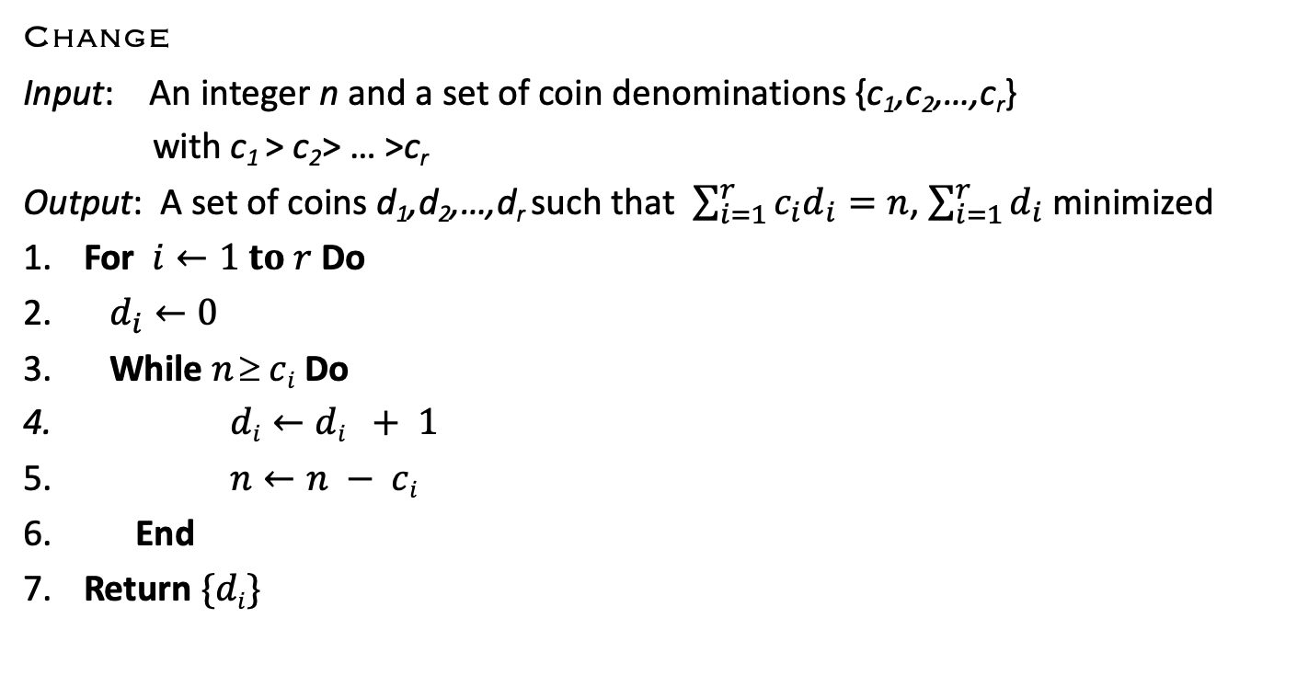
Greedy Algorithm: Change
Change
Input: An integer n and a set of coin denominations {c₁,c₂,…,c_{r}}
with c₁ > c₂> … >c_{r}
Output: A set of coins d₁,d₂,…,d_{r} such that $\sum_{i=1}^{r}{c_{i}d_{i}=n}$, $\sum_{i=1}^{r}{d_{i}}$ minimized
For $i←1 to r$Do
$d_{i}←0$
While $n  ci$Do
$di←di + 1$
$n←n − ci$
End
Return $\{di\}$

Slide 20
Change: Analysis (1)
Will the algorithm always produce an optimal answer?
Example
Consider a coinage system where c₁=20, c₂=15, c₃=7, c₄=1
We want to give 22 ‘cents’ in change
What is the output of the algorithm?
Is it optimal?
It is not optimal because it would give us two c₄ and one c₁ (3 coins). The optimal change is one c₂ and one c₃ (2 coins)

Slide 21
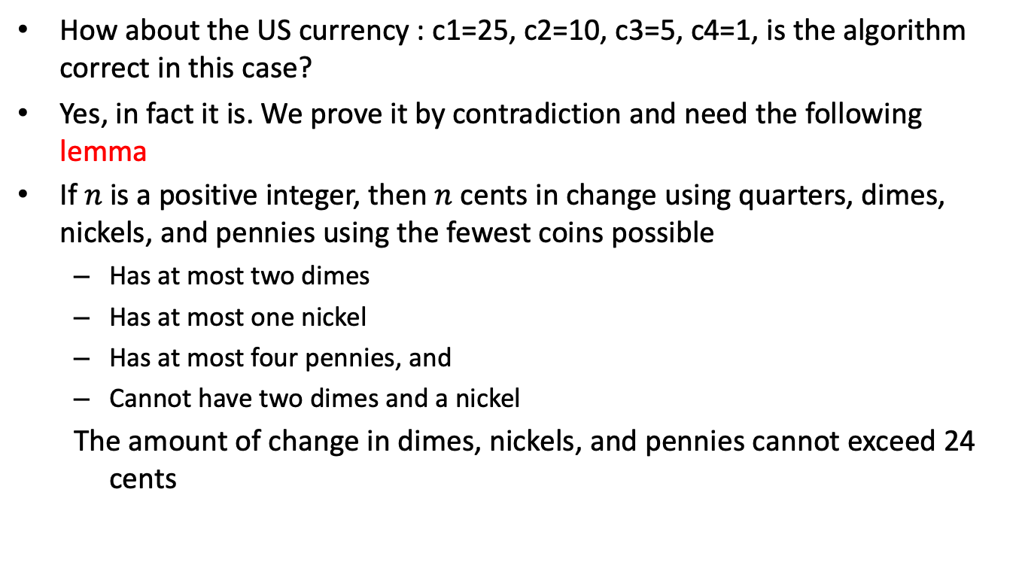
Optimality of Change (1)
How about the US currency : c1=25, c2=10, c3=5, c4=1, is the algorithm correct in this case?
Yes, in fact it is. We prove it by contradiction and need the following lemma
If $n$ is a positive integer, then $n$ cents in change using quarters, dimes, nickels, and pennies using the fewest coins possible
Has at most two dimes
Has at most one nickel
Has at most four pennies, and
Cannot have two dimes and a nickel
The amount of change in dimes, nickels, and pennies cannot exceed 24 cents

Slide 22
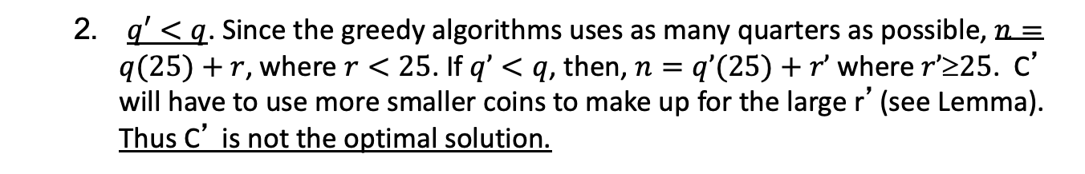

Optimality of Change (2)
Assume:
q is the number of quarters returned by the greedy algorithm
q’ is the number of quarters returned by the optimal solution
Three cases:
$q’>q$. The greedy algorithm chooses the largest number of quarters possible, by construction. Thus, it is impossible to q’>q.
$q′<q$. Since the greedy algorithms uses as many quarters as possible, $n=q(25)+r$, where $r<25$. If $q’<q$, then, $n=q’(25)+r’$where $r’25$. C’ will have to use more smaller coins to make up for the large r’(see Lemma). Thus C’ is not the optimal solution.
$q=q’.$then we continue the argument on the smaller denomination (e.g., dimes). Eventually, we reach a contradiction.
Thus, the greedy algorithm gives the optimal solution

Slide 23
Greedy Algorithm: Another Example
Check the problem of Scenario I, page 25 in the slides IntroductiontoCSE235.ppt
We discussed then (remember?) a greedy algorithm for accommodating the maximum number of customers. The algorithm
terminates, is complete, sound, and satisfies the maximum number of customers (finds an optimal solution)
runs in time linear in the number of customers

Slide 24
Summary
Introduction & definition
Algorithms categories & types
Pseudo-code
Designing an algorithm
Example: Max
Greedy Algorithms
Example: Change

