Slide 1
Introduction
CSCE 235H Introduction to Discrete Structures
Spring 2019
Web page http://cse.unl.edu/~cse235h/
http://cse.unl.edu/~choueiry/S19-235h/
All questions Piazza http://piazza.com/unl/spring2019/csce235h

Slide 2
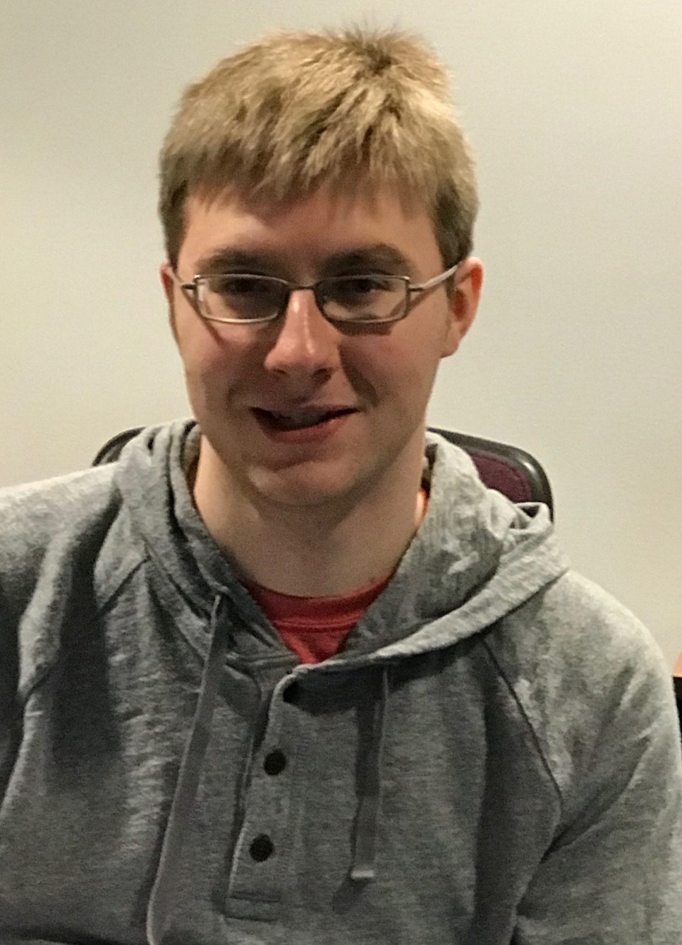
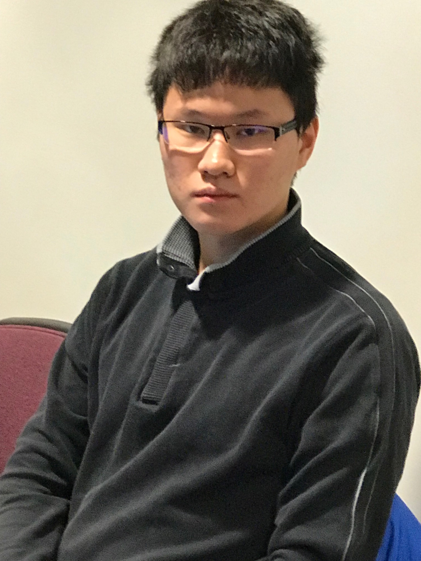
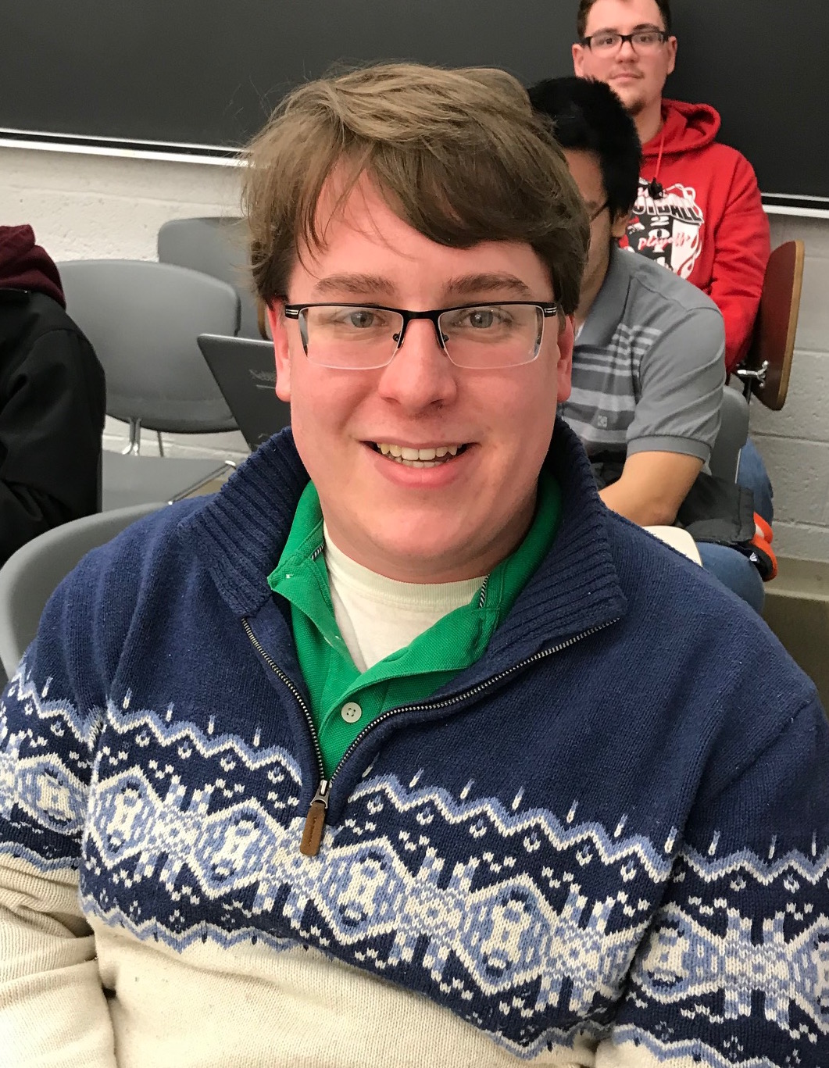
Teaching Assistants
Tyler Paul
(Homework)
Daniel Guo
(Quizzes)
Colin Richards
(SAT Study)

Slide 3
Roles & Office Hours
Instructor gives the lectures
Instructor and Colin give recitations in AvH 119
Tyler grades homework
Daniel grades the quizzes
Office hours
  Instructor: Mon/Fri, 4:30—5:30 pm (Avery 360)
  Colin: Thu, 2:30—3:30 pm (SRC)
  Tyler: Wed, 1:30—2:30 pm (SRC)
  Daniel: Fri, 11:00 am—12:00 pm (SRC)
  Online help on Piazza (9:00 am-5:00 pm)
Allow 24 hours for appointments, 12 hours for reply

Slide 4
Online Information
Grades on Canvas http://canvas.unl.edu
  Check regularly, errors happen no matter how hard we try
  Seven (7) calendar days to report errors in grading & claim missing points
Course materiel on http://cse.unl.edu/~cse235h
  Office hours, Slides, Homework, Schedule, Required readings, all major dates & announcements. Check regularly
Help
  Office hours
  Email & appointments: Piazza, please do not email us directly

Slide 5
Outline
Introduction
  Rules
  Topics covered
  Syllabus
Why Discrete Mathematics?
Basic preliminaries

Slide 6
Introduction
Must
  have a cse account
  use cse handin
Questions
  All questions to Piazza for a quick reply
  Questions about homework will not be discussed in class
  Grade rebuttal with UTAs first, GTA second, instructor last
Bonus points
  Perfect attendance: 3%
  Engage in ugrad research, submit UCARE proposal 2%
  Report bugs, answer riddles
Check Web page on a regular basis

Slide 7
Important Dates
Weekly quizzes, weekly homework
Midterm: Wednesday, March 13th, 2019
Final: Wednesday, May 1st, 2019 @ 3:30—5:30 pm
Class Schedule
  is quite complete, please plan your semester accordingly
  But is subject to revision

Slide 8
Goal & Sequence of Activities
Pre-class reading
  Familiarize yourselves with material
  Tune your minds to the proper ‘wavelength’
Lecture
  Introduce the topic
  Focus your attention on tricky cases
Post-class reading
  Study material in detail
  Do all examples in slides & textbook
  Identify misunderstandings
Pre-class Reading
Lecture
Quiz
Post-class Reading
Homework
Exam
Quiz
  Test whether or not you did the above
  Identify misunderstandings
Homework
  Gain deep understanding, problem-solving abilities
  Train reasoning process
  Train answering questions & strict, proper mathematical argumentation
Exam
  Prove (in a relatively short time & under stress) that you achieved the above

Slide 9
Effort Distribution
Homework secures real learning, deep understanding
Activity | Ideally | In Practice
Required reading—Pre lecture | 10% | 1%
Required reading—Post lecture | 10% | 2%
Preparing quizzes | 15% | 5%
Working on homework | 40% | 72%
Preparing for Exams | 25% | 20%
Notes:
Goal of quizzes: quickly check for misunderstandings
Goal of exams: no time for thinking, ensure that your learned when you need to learn
Goal of homework: real learning

Slide 10
Goal of the Quiz
The quiz checks whether or not
  You are listening in class
  You are doing the required reading
The goal of the quiz is not to test how deeply you know the material. Thus, the quiz is always
  After lectures
  Before homework
The material of the quiz is taken from required reading (i.e., slides and textbook examples)
  Thus, quizzes are not given back

Slide 11
Goal of Recitation
The goal of the recitation is to
  Review any concepts introduced in the class but that may still constitute a challenge
  Bring your attention to common errors, delicate issues
  Give you the opportunity to ask more questions than it is possible during lecture
  Test your understanding (via quiz) of the main ideas, shallow knowledge of the topic
  Prepare you to work individually on the homework
  Introduce you to research

Slide 12
Goal of the Homework
Acquire a deep understanding of the material
  Makes you practice your knowledge, revise it, question it, etc.
  Forces you to “work it”
  Gives you the time to reflect on (meditate? sleep over?) hard question
  The chance to re-read the textbook, research the internet, consult/discuss with the TA’s+instructor
The quiz is never after the homework but before it

Slide 13
Rules for Success (1)
Please do the required reading before class
  Even if you read it very quickly
  It will also help you
    Better focus in class, make more sense of the explanations in class and
    Be tuned to the pitfalls and tricky details that I will discuss
  Attend class
  You are responsible for class discussions in quizzes & exams
  After class
  Do the required reading in as much detail as possible
  Make sure to carefully read all the examples in the textbook: they are excellent & abundant

Slide 14
Rules for Success (2)
  Start early working on homework
  Visit GTA, UTAs, instructor during their office hours
  If you still have questions email to Piazza
  We will always try hard to help you out
  Ignoring the above recommendations demonstrates a lack of respect towards
    Your responsibilities, your commitments
    The rules as spelled out in the syllabus
    The UTAs, GTA, instructor. It is unfair

Slide 15
Common Misunderstandings (I)
Wrong | Correct
Quiz comes after HW | Quiz covers lecture & required reading
Slides, HW are on Blackboard | Class material is on class website
Quizzed are announced | Quizzes are weekly
HW is announced | HW is weekly
HW is distributed in class | HW is on the web
I can directly email TAs/instructor for help | For help, use only Piazza
Email is sent to my private email | Email is sent only to Piazza
I don’t need a cse account | Need to use webhandin

Slide 16
Some Misunderstandings (II)
Wrong | Correct
TAs & instructor always available for help | Only during OffHours, on Piazza or by appointment
Appointments can be arranged on short notice | No one is available on short notice, plan appointments well in advance
Off Hours are only for help w/ class material and homework | OffHours are invaluable mentoring & networking opportunities
All announcements are made in class | Some are made on the web or Piazza
Exam schedules are arbitrary | Exam schedules are fixed, but subject to change
Grading errors never happen | Regularly check grades on Blackboard
I will read the Syllabus later.. | … at your own risk ☹

Slide 17
Topics
Topic | Sections
Propositional Logic | 1.1—1.2
Predicate Logic | 1.3—1.4
Proofs | 1.5—1.6
Sets | 2.1—2.2
Functions | 2.3
Relations | 8.1,8.3—8.6
Induction | 4.1—4.2
Algorithms | 3.1—3.3
Recursion | 7.1—7.2
Counting | 5.1—5.2
Combinatorics | 5.3—5.4
PIE | 7.5
Graphs | 9.1—9.5
Trees | 10.1—10.3
DM is not about
Integration techniques
Differentiation techniques
Calculus
Geometry
Numerical Analysis
Etc.

Slide 18
Discrete Mathematics
This course may seem like a math course
It is about
  the minimum mathematics foundation that
  every CS/CE student needs his/her studies/career
This course
  Is not a continuation of 155/156
  Does not teach a programming language
  Is the foundation for 310 & 400-level CSCE courses

Slide 19
How to Use the Textbook
Abundance of examples in each section
The solutions of all odd-numbered exercises
  In the end of book (short)
  In Student’s Solutions Guide (detailed), on reserve in Math Library in Avery Hall
@ end of each chapter, check out
  Key Terms & Results
  Review questions

Slide 20
Syllabus
Please read the Syllabus carefully

Slide 21
Why Discrete Mathematics? (I)
Computers use discrete structures to
  represent &
  manipulate data
CSE 235 & CSE 310 are the basic building block for becoming a Computer Scientist
Computer Science is not programming
Edsger Dijkstra:
“Computer Science is no more about computers than Astronomy is about telescopes.”
Computer Science is about problem solving
  Modeling, Analysis, Testing

Slide 22
Why Discrete Mathematics? (II)
Mathematics is at the heart of problem solving
Defining a problem requires mathematical rigor
Use & analysis of
  models
  data structures
  algorithms
  requires a solid foundation of mathematics
To justify why a particular way of solving a problem is
  Correct (i.e., exact solution? approximate solution?)
  Effective (i.e., quick? better than another way?)
  requires analysis with a well-defined mathematical model

Slide 23
Problem Solving requires mathematical rigor
Your boss is not going to ask you to solve
  an MST (Minimal Spanning Tree) or
  a TSP (Travelling Salesperson Problem)
In the real-world, rarely will you encounter a problem as defined in class
However, he/she may ask you to build a rotation of the company’s delivery trucks to minimize fuel usage
It is up to you to determine
  a proper model & data structures to represent the problem
  a correct or efficient algorithm for solving it

Slide 24
Scenario I
Context: A limo company hires you/your company to write a computer program to automate their work
Task1:
  Given: Businesses request
    limos and drivers
    for a fixed period of time, specifying a start data/time and end date/time
  Question: The program must generate a schedule that uses the minimum number of cars

Slide 25
Scenario II
Task 2:
  Given:
    the limo service allows customers to bid on a ride
    so that the highest bidder gets a limo when there are not enough limos available
  Question: Make a schedule that
    Is feasible (no limo is assigned to two or more customers at the same time)
    While maximizing the total profit

Slide 26
Scenario III
Task 3:
  Given: Each customer
    is allowed to specify a time window for each car and
    bid different amounts for different “car bundles”
    The limo service must choose to accept the entire set of times or reject it
  Question: The program must again maximize profit

Slide 27
Important: Properties of an Algorithm
  Algorithm terminates
  Algorithm finds a solution when there is one
  Solution provided is always correct
  Algorithm finds the best solution (i.e., maximize profit, minimizes cost)
  Cost as a function of the size of input
Termination
Completeness
Soundness
Optimality (of the solution)
Time and space complexity
Worst-case asymptotic time and space complexity
  Efficiency (poly-time), optimality (lowest asymptotic complexity) of the algorithm

Slide 28
What’s your job?
Build a mathematical model for each scenario
Develop an algorithm for solving each task
Prove that your solutions work
  Termination: Prove that your algorithms terminate
  Completeness: Prove that your algorithms find a solution when there is one.
  Soundness: Prove that the solution of your algorithms is always correct
  Optimality (of the solution): Prove that your algorithms find the best solution (i.e., maximize profit)
  Efficiency, time & space complexity: Prove that your algorithms finish before the end of life on earth

Slide 29
The goal of this course
Give you the foundations that you will use (in CSCE 310, 421, 423, 428) to solve these problems
  Task1 is easily (i.e., efficiently) solved by a greedy algorithm
  Task2 can also be (almost) easily solved, but requires a more involved technique, dynamic programming
  Task3 is not efficiently solvable (it is NP-hard) by any known technique. It is believed today that to guarantee an optimal solution, one needs to look at all (exponentially many) possibilities

Slide 30
Basic Preliminaries
A set is a collection of objects.
For example:
  S = {s₁,s₂,s₃,…,s_{n}} is a finite set of n elements
  S = {s₁,s₂,s₃,…} is a infinite set of elements.
s₁ ∈ S denotes that the object s₁ is an element of the set S
s₁ ∉ S denotes that the object s₁ is not an element of the set S
LaTex
  $S=\{s_1,s_2,s_3, \ldots,s_n\}$
  $s_i \in S$
  $si \notin S$

