Slide 1
The Impact of AND/OR Search Spaces on Constraint Satisfaction and Counting
Presentation by Robert Woodward
Paper by Dechter & Mateescu, CP 2004, pages 731—736
Notes:
[R117] Abstract | PDF Rina Dechter and Robert Mateescu. "The Impact of AND/OR Search Spaces on Constraint Satisfaction and Counting". In Constraint Programming, CP'2004. Longer version: [R117a] Abstract | PDF

Slide 2
Motivation
a,b,c
Inference-Based Methods
Graphical models
Constraint network
Cost network
Bayes network
Markov random fields
Influence diagrams
Question
Decide consistency
Find a solutions
Count solutions
b,c,d
b,d,e
d,f
E.g., variable elimination, tree-clustering
Time and space exponential in tree-width
Search-Based Methods
a
1
Algorithms
Inference based
Search based
b
0
1
c
0
1
0
1
Focus
AND/OR search space for
Constraint satisfaction & counting
E.g., backtrack search (OR search space)
Linear space, exponential time in |V|

Slide 3
Intuition
Constraint Graph Graph Coloring
Domains {1,2,3}
OR Search Tree
AND/OR Search Tree
X
1
2
3
X
1 | 2 | 3
OR
X
Y
2
3
…
AND
Y
Z
T
1
3
OR
Y
2 | 3
Z
2 | 3
Y
1 | 2
Z
1 | 2
Y
1 | 3
Z
1 | 3
T
R
L
M
R
1
3
AND
Z
2
3
…
OR
T
1 | 3
R
1 | 3
T
1 | 2
R
1 | 2
L
1 | 3
M
1 | 3
L
1 | 2
M
1 | 2
L
AND
1
3
M
1
3
1
3
Notes:
We are going to think about search trees in a different way. Instead of being serial, where are considered in sequence, we can sometimes develop the tree in parallel, where variables do not interact/depend on each other. The simplest way is a tree structured CSP, where each variable depends only on its parent. So, we can develop the search tree rooted a Y independently from the search tree rooted at Z. As soon as we have instantiated X. We have two independent subproblems. Every solution fromthe right can be combined with every solution from the left.

Slide 4
Overview
Motivation
AND/OR
Search Space & Search Tree
Example
Finding Solution Subgraph
Legal Tree
Dynamic Variable Ordering
Minimal AND/OR Search Spaces [Day 2]
Merging Nodes & Example
Sketch of Proof
Complexity
Solution Counting
Algorithm & Empirical Evaluation
Conclusion

Slide 5
Terminology (as in AI search)
State Space
Set of all reachable states
State Graph
Directed network: nodes are states, actions are transitions between nodes
Explicit representation of the state space
Search Tree
Tree traversal through the state graph
A
B
C
D
E

Slide 6
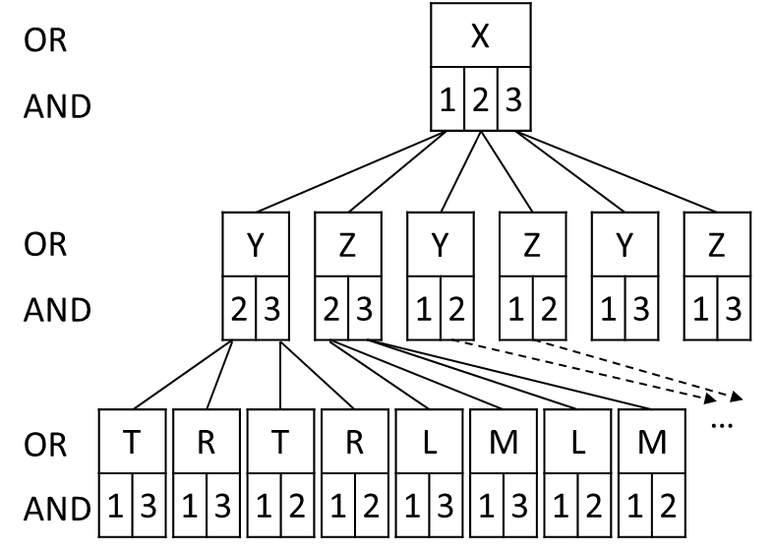
AND/OR Search Space
Is a 4-tuple (S,O,S_{g},s₀)
S: Set of state
OR state: alternative ways for solving the problem
AND state: problem decomposition into subproblems
O: Set of operators
OR operator transforms an OR state into a disjunction of other states
AND operator transforms an AND state into a conjunction of other states
S_{g} ⊆ S: Set of goal states
s₀: Start node
AND/OR State Graph
Each node is a state
children are those obtained by AND/OR operators
Terminal nodes (no children nodes) labeled Solved or Unsolved

Slide 7
AND/OR Search Tree
Given a CSP & a DFS spanning tree T of its graph
Nodes are either
OR nodes = variables
AND nodes = variable-value pairs (assignments)
Successor nodes
of an OR node X: are all consistent value assignments 〈X,v〉
of an AND node 〈X,v〉: are all children nodes of X in T
OR nodes do not count in depth of tree
Think of AND/OR nodes as a meta-node:
X
0
1
X
X
0
1
0
1
Notes:
The DFS spanning tree corresponds to a static variable ordering; dynamic variable ordering is addressed later

Slide 8
Example
Constraint Graph Graph Coloring
Domains {1,2,3}
OR Search Tree
AND/OR Search Tree
X
1
2
3
X
1 | 2 | 3
OR
X
Y
2
3
…
AND
Y
Z
T
1
3
OR
Y
2 | 3
Z
2 | 3
Y
1 | 2
Z
1 | 2
Y
1 | 3
Z
1 | 3
T
R
L
M
Also the DFS tree
R
1
3
AND
Z
2
3
…
Size of:
OR
T
1 | 3
R
1 | 3
T
1 | 2
R
1 | 2
L
1 | 3
M
1 | 3
L
1 | 2
M
1 | 2
OR tree: O(2⁷)
L
AND
1
3
AND/OR tree: O(2³)
M
1
3
1
3

Slide 9
Labeling AND/OR Search Tree Nodes
Terminal nodes
OR: “Unsolved”/0
AND: “Solved”/1
Internal nodes
OR: 1 iff one of its successor nodes is 1
AND: 1 iff all of its successor nodes are 1
Label 1
Label 1
Label 1

Slide 10
Labeling AND/OR Search Tree Nodes
Terminal nodes
OR: “Unsolved”/0
AND: “Solved”/1
Internal nodes
OR: 1 iff one of its successor nodes is 1
AND: 1 iff all of its successor nodes are 1
Label 4
Label 2
Label 1
Counting solutions
OR: sum of values in successors
AND: product of values in successors

Slide 11
Solution Subtree Example
Constraint Graph Graph Coloring
Domains {1,2,3}
AND/OR Search Tree
X
1
2
3
X
1 | 2 | 3
OR
X
Y
2
3
…
AND
Y
Z
T
1
3
OR
Y
2 | 3
Z
2 | 3
Y
1 | 2
Z
1 | 2
Y
1 | 3
Z
1 | 3
T
R
L
M
Also the DFS tree
R
1
3
AND
Z
2
3
…
OR
T
1 | 3
R
1 | 3
T
1 | 2
R
1 | 2
L
1 | 3
M
1 | 3
L
1 | 2
M
1 | 2
L
AND
1
3
M
1
3
1
3

Slide 12
Legal Tree of a Graph
X
Y
Z
Pseudo-tree [Freuder+ 85]
DFS of CSP graph is a legal tree
Constraint graph G = (V,E)
Legal tree is
Directed rooted tree 𝒯 = (V,E’)
∀edge ∈ G ∉ E’ is a back-arc (connects a node to an ancestor in 𝒯)
Arcs ∈ E’ may be ∉ E
T
R
L
M
Two Legal Trees:
X
X
Y
Y
Z
T
T
R
L
M
R
Any chain is a legal tree
Searching an OR space corresponds to searching a chain
Z
G^{𝒯}=(V,E∪E’): Extended graph of G relative to 𝒯
L
M

Slide 13
Dynamic Variable Ordering
A dynamic AND/OR tree
∀ subtree rooted at 〈X,v〉
there are no active constraints (arcs) in the subproblem
conditioned on the current path to 〈X,v〉 connecting different branches of the tree
X → A ∨ C
X → B ∨ C
Legal Tree
X
C
A
B
When X=0, no active constraints in the subproblem

Slide 14
Overview
Motivation
AND/OR
Search Space & Search Tree
Example
Finding Solution Subgraph
Legal Tree
Dynamic Variable Ordering
Minimal AND/OR Search Spaces [Day 2]
Merging Nodes & Example
Sketch of Proof
Complexity
Solution Counting
Algorithm & Empirical Evaluation
Conclusion

Slide 15
Minimal AND/OR Search Graphs (Idea)
X
Two partial paths over the same variables are unifiable iff the search subgraphs rooted at each path are identical
Closure under ‘merge’ yields a unique fixed point
⇒ minimal AND/OR search graph
1
2
Y
Y
3
3
T
R
T
R
1
2
1
2
1
2
1
2
X
1
2
Y
Y
3
T
R
1
2
1
2

Slide 16
How To Merge Nodes
X
X
Y
Z
Y
T
T
R
L
M
Requires comparing subtrees…
which requires generating the full tree…
But we can do better!
G^{𝒯}: Extended graph of G relative to 𝒯
G^{*𝒯}: Extended graph of G induced by marrying parents, relative to 𝒯
G
R
ps_{T} =
{Y,X}
Z
psa_{T} =
{Y,X,T}
L
ps_{R} =
{Y,T,X}
M
psa_{R} =
{X,R}
parents (ps_{X}): {Ancestors of X that have connections in G^{*𝒯}
to X or
to descendants of X in 𝒯}
G^{*𝒯}
𝒯
G^{𝒯}
ps_{R} is a clique in the graph
‘Latest’ variable in the clique
{R} ∪ ps_{R} ≠ psa_{R}
ps_{Z} =
{R,X}
psa_{Z} =
{Z}
parent-separator (psa_{X}): {X} ∪ {ancestors of X that have connections in G^{*𝒯} to descendants of X in 𝒯}
ps_{M} =
{L,Z}
psa_{M} =
{M}

Slide 17
Merging Nodes Example (I)
X
X
Y
Y
Z
Two partial paths of assignments
s₁ and s₂ ending at 〈X,v〉
Called the context
Merge when:
s₁[psa_{X}] = s₂[psa_{X}]
T
T
R
L
M
R
X
Z
1
2
3
…
L
Y
Y
2
3
2
3
M
ps_{R} =
{Y,T,X}
psa_{R} =
{X,R}
T
T
T
T
Can we merge these two paths?
1
3
1
2
1
3
1
2
R
R
R
R
R
R
R
R
NO! X values differ
1
3
1
3
1
3
1
3
1
3
1
3
1
3
1
3

Slide 18
Merging Nodes Example (II)
X
X
Y
Y
Z
Two partial paths of assignments
s₁ and s₂ ending at 〈X,v〉
Called the context
Merge when:
s₁[psa_{X}] = s₂[psa_{X}]
T
T
R
L
M
R
X
Z
1
2
3
…
L
Y
Y
2
3
2
3
M
ps_{R} =
{Y,T,X}
psa_{R} =
{X,R}
T
T
T
T
Can we merge these two paths?
1
3
1
2
1
3
1
2
R
R
R
R
R
R
R
R
Yes!
1
3
1
3
1
3
1
3
1
3
1
3
1
3
1
3

Slide 19
Sketch of Proof for Merging Nodes
Merge when: s₁[psa_{X}] = s₂[psa_{X}]
s₁ and s₂ are two conditioned subproblems are based on constraints that impacted the decisions
Scope of these constraints determine connections in the primal graph
Only relevant assignments on the conditioned subproblem are those in psa_{X}
psa_{X}
X
X
1
1
Notes:
Merge proof is given in the dissertation, Theorem 2.3.5 (context based merge)

Slide 20
Size of AND/OR
n: number of variables
k: domain size
w: induced width of G^{𝒯} along the ordering
m: depth of legal tree (m ≤ w log(n))
AND/OR tree: O(n k^{w log(n)})
Minimal AND/OR tree: O(n k^{w})

Slide 21
Overview
Motivation
AND/OR
Search Space & Search Tree
Example
Finding Solution Subgraph
Legal Tree
Dynamic Variable Ordering
Minimal AND/OR Search Spaces [Day 2]
Merging Nodes & Example
Sketch of Proof
Complexity
Solution Counting
Algorithm & Empirical Evaluation
Conclusion

Slide 22
Solution Counting Algorithm
X
1 | 2 | 3
Y
2 | 3
Z
2 | 3
Y
1 | 2
Z
1 | 2
Y
1 | 3
Z
1 | 3
…
T
1 | 3
R
1 | 3
T
1 | 2
R
1 | 2
L
1 | 3
M
1 | 3
L
1 | 2
M
1 | 2
OPEN
CLOSED
n
g(n): stores label of node
c(v): stores context of node
Notes:
[[cache-nogood adds constraints. If this is an OR node that has no consistent successors, it is identified as dead-end and assigned g = 0. A no-good is recorded and the set of constraints are modified to include this new constraint. This step will cause pruning of the search tree.
c() is the context of an AND node

Slide 23
Empirical Evaluations
Forward Checking (FC)
filters when constraint scope has one future variable
Relational Forward Checking (RFC)
Projects constraint onto future variables
Compare
AND/OR
OR search spaces,
Bucket Elimination (when space allows)
Also compare caching (learning clauses)

Slide 24
Empirical Evaluations
N=number variables K=domain size
C=number constraints w*=induced width
S=arity h=height of legal tree
i=Maximum caching size

Slide 25
Use of Caching

Slide 26
Conclusions
Impact of AND/OR search spaces can be great
Better than Bucket Elimination
Always better than traditional OR space
Saves time by merging nodes (minimal AND/OR Search tree)
Existing constraint propagation techniques can work for AND/OR search

Slide 27
Thank You!
Any Questions?

Slide 28
Bayes Networks
AIMA 3rd, page 529, Figure 14.12
Q (Daniel Geschwender): Are constraint networks a subset of reasoning graphical models or just an alternate name? In what ways do they differ? How do AND/OR graphs of constraint networks differ from AND/OR graphs of reasoning graphical models?
Cluster
A multiply connected network with conditional probability tables
A clustered equivalent of the multiply connected network
Notes:
After clustering, forms a polytree

Slide 29
Influence Diagrams
Generalization of Bayes Networks
Two types of nodes
Bayes Networks do not have decision nodes
Optimal policy:
Perform test
Drill only if open or closed
Utility: 22.5
chance
decision
[Marinescu, Razak, Wilson: Multi-objective Influence Diagrams. UAI 2012: 574-583]

