Slide 1
Probabilistic Networks
Chapter 14 of Dechter’s CP textbook
Speaker: Daniel Geschwender
April 1, 2013

Slide 2
Motivation
Hard & soft constraints are known with certainty
How to model uncertainty?
Probabilistic networks (also belief networks & Bayesian networks) handle uncertainty
Not a ‘pure’ CSP but techniques (bucket elimination) can be adapted to work

Slide 3
Overview
Background on probability
Probabilistic networks defined Section 14
Belief assessment with bucket elimination Section 14.1
Most probable explanation with Section 14.2
bucket elimination
Maximum a posteriori hypothesis [Dechter 96]
Complexity Section 14.3
Hybrids of elimination and conditioning Section 14.4
Summary

Slide 4
Probability: Background
Single variable probability: P(b) probability of b
Joint probability: P(a,b) probability of a and b
Conditional probability: P(a|b) probability of a given b

Slide 5

Chaining Conditional Probabilities
A joint probability of any size may be broken into conditional probabilities

Slide 6
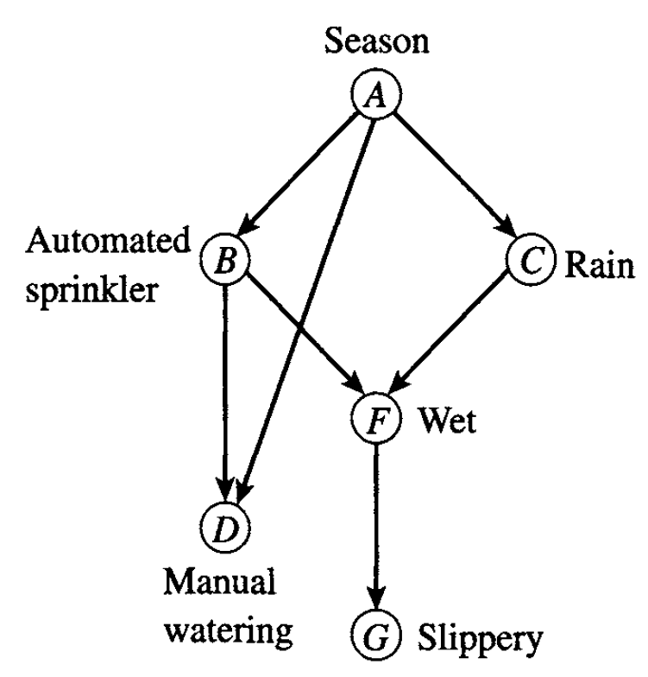
Graphical Representation
Section 14
Represented by a directed acyclic graph
Edges are causal influence of one variable to another
Direct influence: single edge
Indirect influence: path length ≥ 2

Slide 7
Example
Section 14
A:
P(A=w) | P(A=sp) | P(A=su) | P(A=f)
0.25 | 0.25 | 0.25 | 0.25
D:
A | B | P(D=0|A,B) | P(D=1|A,B)
w | 0 | 1.0 | 0.0
sp | 0 | 0.9 | 0.1
su | 0 | 0.8 | 0.2
f | 0 | 0.9 | 0.1
w | 1 | 1.0 | 0.0
sp | 1 | 1.0 | 0.0
su | 1 | 1.0 | 0.0
f | 1 | 1.0 | 0.0
F:
B | C | P(F=0|B,C) | P(F=1|B,C)
0 | 0 | 1.0 | 0.0
1 | 0 | 0.4 | 0.6
0 | 1 | 0.3 | 0.7
1 | 1 | 0.2 | 0.8
G:
F | P(G=0|F) | P(G=1|F)
0 | 1.0 | 0.0
1 | 0.5 | 0.5
B:
A | P(B=0|A) | P(B=1|A)
w | 1.0 | 0.0
sp | 0.9 | 0.1
su | 0.8 | 0.2
f | 0.9 | 0.1
C:
A | P(C=0|A) | P(C=1|A)
w | 1.0 | 0.0
sp | 0.7 | 0.3
su | 0.8 | 0.2
f | 0.9 | 0.1
Conditional
Probability Table (CPT)

Slide 8






Belief Network Defined
Section 14
Set of random variables:
Variables’ domains:
Belief network:
Directed acyclic graph:
Conditional prob. tables:
Evidence set: , subset of instantiated variables

Slide 9



Belief Network Defined
Section 14
A belief network gives a probability distribution over all variables in X
An assignment is abbreviated
is the restriction of to a subset of variables, S

Slide 10
Example
Section 14
A:
P(A=w) | P(A=sp) | P(A=su) | P(A=f)
0.25 | 0.25 | 0.25 | 0.25
D:
A | B | P(D=0|A,B) | P(D=1|A,B)
w | 0 | 1.0 | 0.0
sp | 0 | 0.9 | 0.1
su | 0 | 0.8 | 0.2
f | 0 | 0.9 | 0.1
w | 1 | 1.0 | 0.0
sp | 1 | 1.0 | 0.0
su | 1 | 1.0 | 0.0
f | 1 | 1.0 | 0.0
F:
B | C | P(F=0|B,C) | P(F=1|B,C)
0 | 0 | 1.0 | 0.0
1 | 0 | 0.4 | 0.6
0 | 1 | 0.3 | 0.7
1 | 1 | 0.2 | 0.8
G:
F | P(G=0|F) | P(G=1|F)
0 | 1.0 | 0.0
1 | 0.5 | 0.5
B:
A | P(B=0|A) | P(B=1|A)
w | 1.0 | 0.0
sp | 0.9 | 0.1
su | 0.8 | 0.2
f | 0.9 | 0.1
C:
A | P(C=0|A) | P(C=1|A)
w | 1.0 | 0.0
sp | 0.7 | 0.3
su | 0.8 | 0.2
f | 0.9 | 0.1
Conditional
Probability Table (CPT)

Slide 11
Example
Section 14
P(A=sp,B=1,C=0,D=0,F=0,G=0)
= P(A=sp) ∙
P(B=1|A=sp) ∙
P(C=0|A=sp) ∙
P(D=0|A=sp,B=1) ∙
P(F=0|B=1,C=0) ∙
P(G=0|F=0)
= 0.25 ∙ 0.1 ∙ 0.7 ∙ 1.0 ∙ 0.4 ∙ 1.0 = 0.007

Slide 12
Probabilistic Network: Queries
Section 14
Belief assessment
given a set of evidence, determine how probabilities of all other variables are affected
Most probable explanation (MPE)
given a set of evidence, find the most probable assignment to all other variables
Maximum a posteriori hypothesis (MAP)
assign a subset of unobserved hypothesis variables to maximize their conditional probability

Slide 13
Belief Assessment: Bucket Elimination
Section 14.1
Belief Assessment
Given a set of evidence, determine how probabilities of all other variables are affected
Evidence: Some possibilities are eliminated
Probabilities of unknowns can be updated
Known as belief updating
Solved by a modification of Bucket Elimination

Slide 14

Derivation
Section 14.1
Similar to ELIM-OPT
Summation replaced with product
Maximization replaced by summation
x=a is the proposition we are considering
E=e is our evidence
Compute

Slide 15
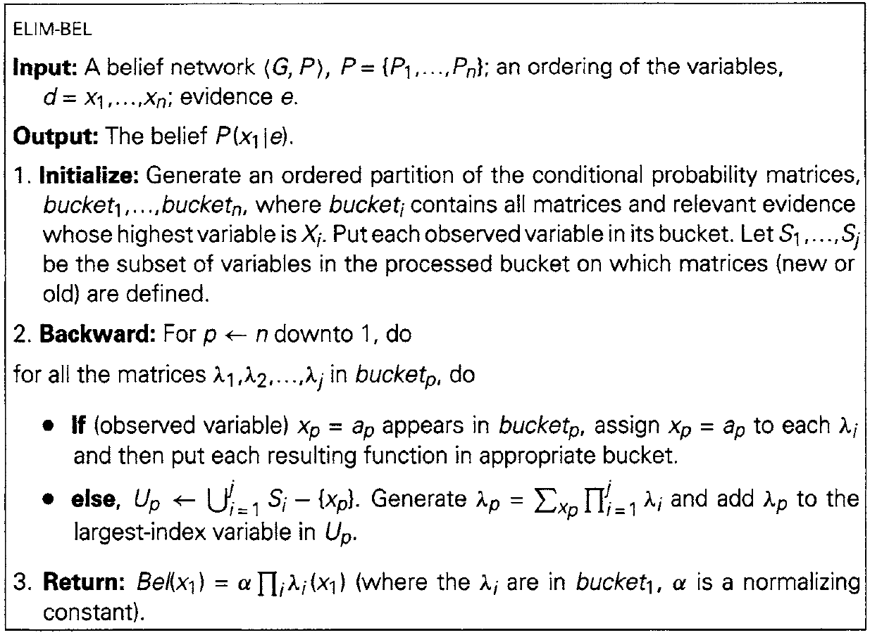
ELIM-BEL Algorithm
Section 14.1
Takes as input a belief network along with an ordering on the variables. All known variable values are also provided as “evidence”

Slide 16
ELIM-BEL Algorithm
Section 14.1
Will output a matrix with probabilities for all values of x1 (the first variable in the given ordering) given the evidence.

Slide 17
ELIM-BEL Algorithm
Section 14.1
Sets up the buckets, one for each variable. As with other bucket elimination algorithms, the matrices start in the last bucket and move up until they are “caught” by the first bucket which is a variable in its scope.

Slide 18
ELIM-BEL Algorithm
Section 14.1
Go through all the buckets, last to first.

Slide 19
ELIM-BEL Algorithm
Section 14.1
If a bucket contains a piece of the input evidence, ignore all probabilities not associated with that variable assignment

Slide 20
ELIM-BEL Algorithm
Section 14.1
The scope of the generated matrix is the union of the scopes of the contained matrices and without the bucket variable, as it is projected out
Consider all tuples of variables in the scopes and multiply their probabilities. When projecting out the bucket variable, sum the probabilities.

Slide 21
ELIM-BEL Algorithm
Section 14.1
To arrive at the output desired, a normalizing constant must be applied to make all probabilities of all values of x1 sum to 1.

Slide 22
Example
Section 14.1
A:
P(A=w) | P(A=sp) | P(A=su) | P(A=f)
0.25 | 0.25 | 0.25 | 0.25
D:
A | B | P(D=0|A,B) | P(D=1|A,B)
w | 0 | 1.0 | 0.0
sp | 0 | 0.9 | 0.1
su | 0 | 0.8 | 0.2
f | 0 | 0.9 | 0.1
w | 1 | 1.0 | 0.0
sp | 1 | 1.0 | 0.0
su | 1 | 1.0 | 0.0
f | 1 | 1.0 | 0.0
F:
B | C | P(F=0|B,C) | P(F=1|B,C)
0 | 0 | 1.0 | 0.0
1 | 0 | 0.4 | 0.6
0 | 1 | 0.3 | 0.7
1 | 1 | 0.2 | 0.8
G:
F | P(G=0|F) | P(G=1|F)
0 | 1.0 | 0.0
1 | 0.5 | 0.5
B:
A | P(B=0|A) | P(B=1|A)
w | 1.0 | 0.0
sp | 0.9 | 0.1
su | 0.8 | 0.2
f | 0.9 | 0.1
C:
A | P(C=0|A) | P(C=1|A)
w | 1.0 | 0.0
sp | 0.7 | 0.3
su | 0.8 | 0.2
f | 0.9 | 0.1
Conditional
Probability Table (CPT)

Slide 23
Example
Section 14.1
A
P(a)
λ_{C}(a)
C
P(c|a)
λ_{B}(a,c)
B
P(b|a)
λ_{D}(b,a)
λ_{F}(b,c)
F
P(f|b,c)
λ_{G}(f)
D
P(d|b,a)
d=1
G
P(g|f)
g=1

Slide 24
Example
Section 14.1
G
P(g|f)
g=1
λ_{G}(f)
P(g|f)
g=1
λ_{G}(f)
F | P(G=0|F) | P(G=1|F)
0 | 1.0 | 0.0
1 | 0.5 | 0.5
F | λ_{G}(f)
0 | 0.0
1 | 0.5

Slide 25
Example
Section 14.1
D
P(d|b,a)
d=1
λ_{D}(b,a)
P(d|b,a)
d=1
λ_{D}(b,a)
A | B | P(D=0|A,B) | P(D=1|A,B)
w | 0 | 1.0 | 0.0
sp | 0 | 0.9 | 0.1
su | 0 | 0.8 | 0.2
f | 0 | 0.9 | 0.1
w | 1 | 1.0 | 0.0
sp | 1 | 1.0 | 0.0
su | 1 | 1.0 | 0.0
f | 1 | 1.0 | 0.0
A | B | λ_{D}(b,a)
w | 0 | 0.0
sp | 0 | 0.1
su | 0 | 0.2
f | 0 | 0.1
w | 1 | 0.0
sp | 1 | 0.0
su | 1 | 0.0
f | 1 | 0.0

Slide 26
Example
Section 14.1
F
P(f|b,c)
λ_{G}(f)
λ_{F}(b,c)
P(f|b,c)
λ_{G}(f)
λ_{F}(b,c)
B | C | P(F=0|B,C) | P(F=1|B,C)
0 | 0 | 1.0 | 0.0
1 | 0 | 0.4 | 0.6
0 | 1 | 0.3 | 0.7
1 | 1 | 0.2 | 0.8
F | λ_{G}(f)
0 | 0.0
1 | 0.5
B | C | F=0 | F=1 | λ_{F}(b,c)
0 | 0 | 0.0 | 0.0 | 0.0
1 | 0 | 0.0 | 0.3 | 0.3
0 | 1 | 0.0 | 0.35 | 0.35
1 | 1 | 0.0 | 0.4 | 0.4

Slide 27
Example
Section 14.1
B
P(b|a)
λ_{D}(b,a)
λ_{F}(b,c)
λ_{B}(a,c)
P(b|a)
λ_{D}(b,a)
λ_{F}(b,c)
λ_{B}(a,c)
A | P(B=0|A) | P(B=1|A)
w | 1.0 | 0.0
sp | 0.9 | 0.1
su | 0.8 | 0.2
f | 0.9 | 0.1
A | B | λ_{D}(b,a)
w | 0 | 0.0
sp | 0 | 0.1
su | 0 | 0.2
f | 0 | 0.1
w | 1 | 0.0
sp | 1 | 0.0
su | 1 | 0.0
f | 1 | 0.0
B | C | λ_{F}(b,c)
0 | 0 | 0.0
1 | 0 | 0.3
0 | 1 | 0.35
1 | 1 | 0.4
A | C | B=0 | B=1 | λ_{B}(a,c)
w | 0 | 0.0 | 0.0 | 0.0
sp | 0 | 0.0 | 0.0 | 0.0
su | 0 | 0.0 | 0.0 | 0.0
f | 0 | 0.0 | 0.0 | 0.0
w | 1 | 0.0 | 0.0 | 0.0
sp | 1 | 0.0315 | 0.0 | 0.0315
su | 1 | 0.056 | 0.0 | 0.056
f | 1 | 0.0315 | 0.0 | 0.0315

Slide 28
Example
Section 14.1
C
P(c|a)
λ_{B}(a,c)
λ_{C}(a)
P(c|a)
λ_{B}(a,c)
λ_{C}(a)
A | P(C=0|A) | P(C=1|A)
w | 1.0 | 0.0
sp | 0.7 | 0.3
su | 0.8 | 0.2
f | 0.9 | 0.1
A | C | λ_{B}(a,c)
w | 0 | 0.0
sp | 0 | 0.0
su | 0 | 0.0
f | 0 | 0.0
w | 1 | 0.0
sp | 1 | 0.0315
su | 1 | 0.056
f | 1 | 0.0315
A | C=0 | C=1 | λ_{C}(a)
w | 0.0 | 0.0 | 0.0
sp | 0.0 | 0.00945 | 0.00945
su | 0.0 | 0.0112 | 0.0112
f | 0.0 | 0.00315 | 0.00315

Slide 29
Example
Section 14.1
A
P(a)
λ_{C}(a)
λ_{A}(a)
P(a)
λ_{C}(a)
λ_{A}(a)
P(A=w) | P(A=sp) | P(A=su) | P(A=f)
0.25 | 0.25 | 0.25 | 0.25
A | λ_{C}(a)
w | 0.0
sp | 0.00945
su | 0.0112
f | 0.00315
A | Π | λ_{A}(a)
w | 0.0 | 0.0
sp | 0.00236 | 0.397
su | 0.0028 | 0.471
f | 0.00079 | 0.132
Σ=0.00595

Slide 30

Derivation
Section 14.1
Evidence that g=1
Need to compute:
Generate a function over G,

Slide 31


Derivation
Section 14.1
Place as far left as possible:
Generate . Place as far left as possible.
Generate .

Slide 32



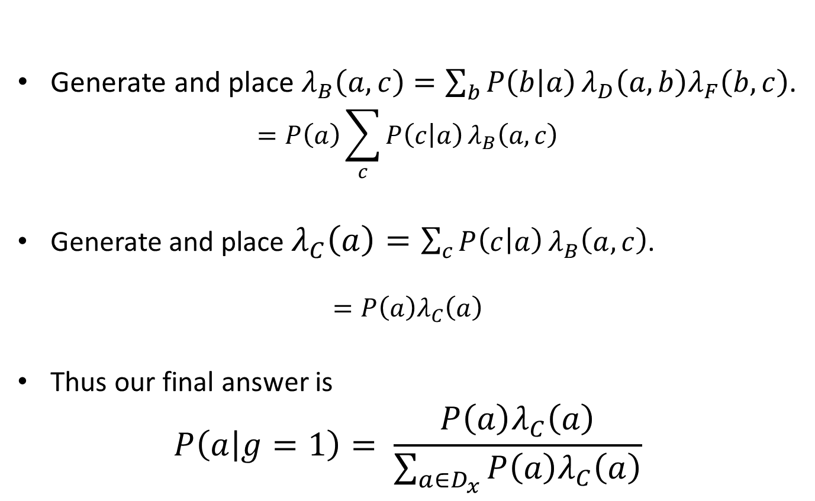
Derivation
Section 14.1
Generate and place .
Generate and place .
Thus our final answer is

Slide 33
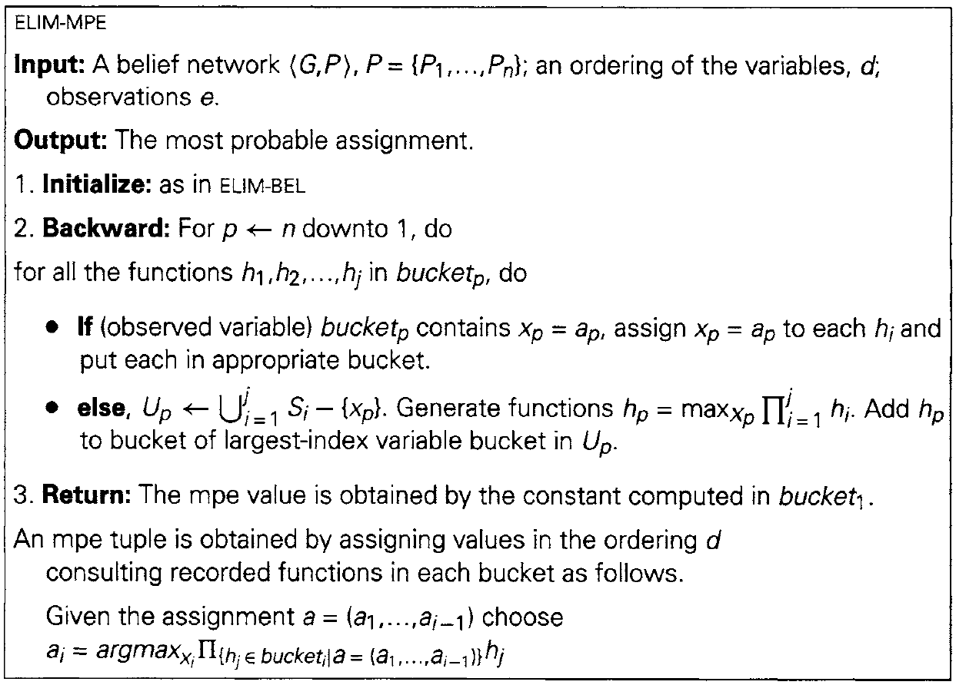
ELIM-MPE Algorithm
Section 14.2
As before, takes as input a belief network along with an ordering on the variables. All known variable values are also provided as “evidence”.

Slide 34
ELIM-MPE Algorithm
Section 14.2
The output will be the most probable configuration of the variables considering the given evidence. We will also have the probability of that configuration.

Slide 35
ELIM-MPE Algorithm
Section 14.2
Buckets are initialized as before.

Slide 36
ELIM-MPE Algorithm
Section 14.2
Iterate buckets from last to first. (Note that the functions are referred to by h rather than λ)

Slide 37
ELIM-MPE Algorithm
Section 14.2
If a bucket contains evidence, ignore all assignments that go against that evidence.

Slide 38
ELIM-MPE Algorithm
Section 14.2
The scope of the generated function is the union of the scopes of the contained functions but without the bucket variable.
The function is generated by multiplying corresponding entries in the contained matrices and then projecting out the bucket variable by taking the maximum probability.

Slide 39
ELIM-MPE Algorithm
Section 14.2
The probability of the MPE is returned when the final bucket is processed.

Slide 40
ELIM-MPE Algorithm
Section 14.2
Return to all the buckets in the order d and assign the value that maximizes the probability returned by the generated functions.

Slide 41
Example
Section 14.2
A:
P(A=w) | P(A=sp) | P(A=su) | P(A=f)
0.25 | 0.25 | 0.25 | 0.25
D:
A | B | P(D=0|A,B) | P(D=1|A,B)
w | 0 | 1.0 | 0.0
sp | 0 | 0.9 | 0.1
su | 0 | 0.8 | 0.2
f | 0 | 0.9 | 0.1
w | 1 | 1.0 | 0.0
sp | 1 | 1.0 | 0.0
su | 1 | 1.0 | 0.0
f | 1 | 1.0 | 0.0
F:
B | C | P(F=0|B,C) | P(F=1|B,C)
0 | 0 | 1.0 | 0.0
1 | 0 | 0.4 | 0.6
0 | 1 | 0.3 | 0.7
1 | 1 | 0.2 | 0.8
G:
F | P(G=0|F) | P(G=1|F)
0 | 1.0 | 0.0
1 | 0.5 | 0.5
B:
A | P(B=0|A) | P(B=1|A)
w | 1.0 | 0.0
sp | 0.9 | 0.1
su | 0.8 | 0.2
f | 0.9 | 0.1
C:
A | P(C=0|A) | P(C=1|A)
w | 1.0 | 0.0
sp | 0.7 | 0.3
su | 0.8 | 0.2
f | 0.9 | 0.1
Conditional
Probability Table (CPT)

Slide 42
Example
Section 14.2
A
P(a)
h_{C}(a)
C
P(c|a)
h_{B}(a,c)
B
P(b|a)
h_{D}(b,a)
h_{F}(b,c)
F
P(f|b,c)
f=1
h_{G}(f)
D
P(d|b,a)
G
P(g|f)

Slide 43
Example
Section 14.2
G
P(g|f)
h_{G}(f)
P(g|f)
h_{G}(f)
F | P(G=0|F) | P(G=1|F)
0 | 1.0 | 0.0
1 | 0.5 | 0.5
F | G=0 | G=1 | h_{G}(f)
0 | 1.0 | 0.0 | 1.0
1 | 0.5 | 0.5 | 0.5

Slide 44
Example
Section 14.2
D
P(d|b,a)
h_{D}(b,a)
P(d|b,a)
h_{D}(b,a)
A | B | P(D=0|A,B) | P(D=1|A,B)
w | 0 | 1.0 | 0.0
sp | 0 | 0.9 | 0.1
su | 0 | 0.8 | 0.2
f | 0 | 0.9 | 0.1
w | 1 | 1.0 | 0.0
sp | 1 | 1.0 | 0.0
su | 1 | 1.0 | 0.0
f | 1 | 1.0 | 0.0
A | B | D=0 | D=1 | h_{D}(b,a)
w | 0 | 1.0 | 0.0 | 1.0
sp | 0 | 0.9 | 0.1 | 0.9
su | 0 | 0.8 | 0.2 | 0.8
f | 0 | 0.9 | 0.1 | 0.9
w | 1 | 1.0 | 0.0 | 1.0
sp | 1 | 1.0 | 0.0 | 1.0
su | 1 | 1.0 | 0.0 | 1.0
f | 1 | 1.0 | 0.0 | 1.0

Slide 45
Example
Section 14.2
F
P(f|b,c)
f=1
h_{G}(f)
h_{F}(b,c)
P(f|b,c)
f=1
h_{G}(f)
h_{F}(b,c)
B | C | P(F=0|B,C) | P(F=1|B,C)
0 | 0 | 1.0 | 0.0
1 | 0 | 0.4 | 0.6
0 | 1 | 0.3 | 0.7
1 | 1 | 0.2 | 0.8
F | h_{G}(f)
0 | 1.0
1 | 0.5
B | C | F=0 | F=1 | h_{F}(b,c)
0 | 0 | 0.0 | 0.0 | 0.0
1 | 0 | 0.0 | 0.3 | 0.3
0 | 1 | 0.0 | 0.35 | 0.35
1 | 1 | 0.0 | 0.4 | 0.4

Slide 46
Example
Section 14.2
B
P(b|a)
h_{D}(b,a)
h_{F}(b,c)
h_{B}(a,c)
P(b|a)
h_{D}(b,a)
h_{F}(b,c)
h_{B}(a,c)
A | P(B=0|A) | P(B=1|A)
w | 1.0 | 0.0
sp | 0.9 | 0.1
su | 0.8 | 0.2
f | 0.9 | 0.1
A | B | h_{D}(b,a)
w | 0 | 1.0
sp | 0 | 0.9
su | 0 | 0.8
f | 0 | 0.9
w | 1 | 1.0
sp | 1 | 1.0
su | 1 | 1.0
f | 1 | 1.0
B | C | h_{F}(b,c)
0 | 0 | 0.0
1 | 0 | 0.3
0 | 1 | 0.35
1 | 1 | 0.4
A | C | B=0 | B=1 | h_{B}(a,c)
w | 0 | 0.0 | 0.0 | 0.0
sp | 0 | 0.0 | 0.03 | 0.03
su | 0 | 0.0 | 0.06 | 0.06
f | 0 | 0.0 | 0.03 | 0.03
w | 1 | 0.35 | 0.0 | 0.35
sp | 1 | 0.2835 | 0.04 | 0.2835
su | 1 | 0.224 | 0.08 | 0.224
f | 1 | 0.2835 | 0.04 | 0.2835

Slide 47
Example
Section 14.2
C
P(c|a)
h_{B}(a,c)
h_{C}(a)
P(c|a)
h_{B}(a,c)
h_{C}(a)
A | P(C=0|A) | P(C=1|A)
w | 1.0 | 0.0
sp | 0.7 | 0.3
su | 0.8 | 0.2
f | 0.9 | 0.1
A | C | h_{B}(a,c)
w | 0 | 0.0
sp | 0 | 0.03
su | 0 | 0.06
f | 0 | 0.03
w | 1 | 0.35
sp | 1 | 0.2835
su | 1 | 0.224
f | 1 | 0.2835
A | C=0 | C=1 | h_{C}(a)
w | 0.0 | 0.0 | 0.0
sp | 0.021 | 0.08505 | 0.08505
su | 0.048 | 0.0448 | 0.048
f | 0.027 | 0.02835 | 0.02835

Slide 48
Example
Section 14.2
A
P(a)
h_{C}(a)
h_{A}(a)
P(a)
h_{C}(a)
h_{A}(a)
P(A=w) | P(A=sp) | P(A=su) | P(A=f)
0.25 | 0.25 | 0.25 | 0.25
A | h_{C}(a)
w | 0.0
sp | 0.08505
su | 0.048
f | 0.02835
A | h_{A}(a)
w | 0.0
sp | 0.02126
su | 0.012
f | 0.00709
max=0.02126

Slide 49
Example
Section 14.2
h_{A}(a)
h_{C}(a)
h_{B}(a,c)
h_{F}(b,c)
A | h_{A}(a)
w | 0.0
sp | 0.02126
su | 0.012
f | 0.00709
A | C=0 | C=1 | h_{C}(a)
w | 0.0 | 0.0 | 0.0
sp | 0.021 | 0.08505 | 0.08505
su | 0.048 | 0.0448 | 0.048
f | 0.027 | 0.02835 | 0.02835
A | C | B=0 | B=1 | h_{B}(a,c)
w | 0 | 0.0 | 0.0 | 0.0
sp | 0 | 0.0 | 0.03 | 0.03
su | 0 | 0.0 | 0.06 | 0.06
f | 0 | 0.0 | 0.03 | 0.03
w | 1 | 0.35 | 0.0 | 0.35
sp | 1 | 0.2835 | 0.04 | 0.2835
su | 1 | 0.224 | 0.08 | 0.224
f | 1 | 0.2835 | 0.04 | 0.2835
B | C | F=0 | F=1 | h_{F}(b,c)
0 | 0 | 0.0 | 0.0 | 0.0
1 | 0 | 0.0 | 0.3 | 0.3
0 | 1 | 0.0 | 0.35 | 0.35
1 | 1 | 0.0 | 0.4 | 0.4
h_{D}(b,a)
A | B | D=0 | D=1 | h_{D}(b,a)
w | 0 | 1.0 | 0.0 | 1.0
sp | 0 | 0.9 | 0.1 | 0.9
su | 0 | 0.8 | 0.2 | 0.8
f | 0 | 0.9 | 0.1 | 0.9
w | 1 | 1.0 | 0.0 | 1.0
sp | 1 | 1.0 | 0.0 | 1.0
su | 1 | 1.0 | 0.0 | 1.0
f | 1 | 1.0 | 0.0 | 1.0
h_{G}(f)
F | G=0 | G=1 | h_{G}(f)
0 | 1.0 | 0.0 | 1.0
1 | 0.5 | 0.5 | 0.5
MPE probability: 0.02126

Slide 50
Example
Section 14.2
h_{A}(a)
h_{C}(a)
h_{B}(a,c)
h_{F}(b,c)
A | h_{A}(a)
w | 0.0
sp | 0.02126
su | 0.012
f | 0.00709
A | C=0 | C=1 | h_{C}(a)
w | 0.0 | 0.0 | 0.0
sp | 0.021 | 0.08505 | 0.08505
su | 0.048 | 0.0448 | 0.048
f | 0.027 | 0.02835 | 0.02835
A | C | B=0 | B=1 | h_{B}(a,c)
w | 0 | 0.0 | 0.0 | 0.0
sp | 0 | 0.0 | 0.03 | 0.03
su | 0 | 0.0 | 0.06 | 0.06
f | 0 | 0.0 | 0.03 | 0.03
w | 1 | 0.35 | 0.0 | 0.35
sp | 1 | 0.2835 | 0.04 | 0.2835
su | 1 | 0.224 | 0.08 | 0.224
f | 1 | 0.2835 | 0.04 | 0.2835
B | C | F=0 | F=1 | h_{F}(b,c)
0 | 0 | 0.0 | 0.0 | 0.0
1 | 0 | 0.0 | 0.3 | 0.3
0 | 1 | 0.0 | 0.35 | 0.35
1 | 1 | 0.0 | 0.4 | 0.4
h_{D}(b,a)
A | B | D=0 | D=1 | h_{D}(b,a)
w | 0 | 1.0 | 0.0 | 1.0
sp | 0 | 0.9 | 0.1 | 0.9
su | 0 | 0.8 | 0.2 | 0.8
f | 0 | 0.9 | 0.1 | 0.9
w | 1 | 1.0 | 0.0 | 1.0
sp | 1 | 1.0 | 0.0 | 1.0
su | 1 | 1.0 | 0.0 | 1.0
f | 1 | 1.0 | 0.0 | 1.0
h_{G}(f)
F | G=0 | G=1 | h_{G}(f)
0 | 1.0 | 0.0 | 1.0
1 | 0.5 | 0.5 | 0.5
MPE probability: 0.02126
A=sp

Slide 51
Example
Section 14.2
h_{A}(a)
h_{C}(a)
h_{B}(a,c)
h_{F}(b,c)
A | h_{A}(a)
w | 0.0
sp | 0.02126
su | 0.012
f | 0.00709
A | C=0 | C=1 | h_{C}(a)
w | 0.0 | 0.0 | 0.0
sp | 0.021 | 0.08505 | 0.08505
su | 0.048 | 0.0448 | 0.048
f | 0.027 | 0.02835 | 0.02835
A | C | B=0 | B=1 | h_{B}(a,c)
w | 0 | 0.0 | 0.0 | 0.0
sp | 0 | 0.0 | 0.03 | 0.03
su | 0 | 0.0 | 0.06 | 0.06
f | 0 | 0.0 | 0.03 | 0.03
w | 1 | 0.35 | 0.0 | 0.35
sp | 1 | 0.2835 | 0.04 | 0.2835
su | 1 | 0.224 | 0.08 | 0.224
f | 1 | 0.2835 | 0.04 | 0.2835
B | C | F=0 | F=1 | h_{F}(b,c)
0 | 0 | 0.0 | 0.0 | 0.0
1 | 0 | 0.0 | 0.3 | 0.3
0 | 1 | 0.0 | 0.35 | 0.35
1 | 1 | 0.0 | 0.4 | 0.4
h_{D}(b,a)
A | B | D=0 | D=1 | h_{D}(b,a)
w | 0 | 1.0 | 0.0 | 1.0
sp | 0 | 0.9 | 0.1 | 0.9
su | 0 | 0.8 | 0.2 | 0.8
f | 0 | 0.9 | 0.1 | 0.9
w | 1 | 1.0 | 0.0 | 1.0
sp | 1 | 1.0 | 0.0 | 1.0
su | 1 | 1.0 | 0.0 | 1.0
f | 1 | 1.0 | 0.0 | 1.0
h_{G}(f)
F | G=0 | G=1 | h_{G}(f)
0 | 1.0 | 0.0 | 1.0
1 | 0.5 | 0.5 | 0.5
MPE probability: 0.02126
A=sp, C=1

Slide 52
Example
Section 14.2
h_{A}(a)
h_{C}(a)
h_{B}(a,c)
h_{F}(b,c)
A | h_{A}(a)
w | 0.0
sp | 0.02126
su | 0.012
f | 0.00709
A | C=0 | C=1 | h_{C}(a)
w | 0.0 | 0.0 | 0.0
sp | 0.021 | 0.08505 | 0.08505
su | 0.048 | 0.0448 | 0.048
f | 0.027 | 0.02835 | 0.02835
A | C | B=0 | B=1 | h_{B}(a,c)
w | 0 | 0.0 | 0.0 | 0.0
sp | 0 | 0.0 | 0.03 | 0.03
su | 0 | 0.0 | 0.06 | 0.06
f | 0 | 0.0 | 0.03 | 0.03
w | 1 | 0.35 | 0.0 | 0.35
sp | 1 | 0.2835 | 0.04 | 0.2835
su | 1 | 0.224 | 0.08 | 0.224
f | 1 | 0.2835 | 0.04 | 0.2835
B | C | F=0 | F=1 | h_{F}(b,c)
0 | 0 | 0.0 | 0.0 | 0.0
1 | 0 | 0.0 | 0.3 | 0.3
0 | 1 | 0.0 | 0.35 | 0.35
1 | 1 | 0.0 | 0.4 | 0.4
h_{D}(b,a)
A | B | D=0 | D=1 | h_{D}(b,a)
w | 0 | 1.0 | 0.0 | 1.0
sp | 0 | 0.9 | 0.1 | 0.9
su | 0 | 0.8 | 0.2 | 0.8
f | 0 | 0.9 | 0.1 | 0.9
w | 1 | 1.0 | 0.0 | 1.0
sp | 1 | 1.0 | 0.0 | 1.0
su | 1 | 1.0 | 0.0 | 1.0
f | 1 | 1.0 | 0.0 | 1.0
h_{G}(f)
F | G=0 | G=1 | h_{G}(f)
0 | 1.0 | 0.0 | 1.0
1 | 0.5 | 0.5 | 0.5
MPE probability: 0.02126
A=sp, C=1, B=0

Slide 53
Example
Section 14.2
h_{A}(a)
h_{C}(a)
h_{B}(a,c)
h_{F}(b,c)
A | h_{A}(a)
w | 0.0
sp | 0.02126
su | 0.012
f | 0.00709
A | C=0 | C=1 | h_{C}(a)
w | 0.0 | 0.0 | 0.0
sp | 0.021 | 0.08505 | 0.08505
su | 0.048 | 0.0448 | 0.048
f | 0.027 | 0.02835 | 0.02835
A | C | B=0 | B=1 | h_{B}(a,c)
w | 0 | 0.0 | 0.0 | 0.0
sp | 0 | 0.0 | 0.03 | 0.03
su | 0 | 0.0 | 0.06 | 0.06
f | 0 | 0.0 | 0.03 | 0.03
w | 1 | 0.35 | 0.0 | 0.35
sp | 1 | 0.2835 | 0.04 | 0.2835
su | 1 | 0.224 | 0.08 | 0.224
f | 1 | 0.2835 | 0.04 | 0.2835
B | C | F=0 | F=1 | h_{F}(b,c)
0 | 0 | 0.0 | 0.0 | 0.0
1 | 0 | 0.0 | 0.3 | 0.3
0 | 1 | 0.0 | 0.35 | 0.35
1 | 1 | 0.0 | 0.4 | 0.4
h_{D}(b,a)
A | B | D=0 | D=1 | h_{D}(b,a)
w | 0 | 1.0 | 0.0 | 1.0
sp | 0 | 0.9 | 0.1 | 0.9
su | 0 | 0.8 | 0.2 | 0.8
f | 0 | 0.9 | 0.1 | 0.9
w | 1 | 1.0 | 0.0 | 1.0
sp | 1 | 1.0 | 0.0 | 1.0
su | 1 | 1.0 | 0.0 | 1.0
f | 1 | 1.0 | 0.0 | 1.0
h_{G}(f)
F | G=0 | G=1 | h_{G}(f)
0 | 1.0 | 0.0 | 1.0
1 | 0.5 | 0.5 | 0.5
MPE probability: 0.02126
A=sp, C=1, B=0, F=1

Slide 54
Example
Section 14.2
h_{A}(a)
h_{C}(a)
h_{B}(a,c)
h_{F}(b,c)
A | h_{A}(a)
w | 0.0
sp | 0.02126
su | 0.012
f | 0.00709
A | C=0 | C=1 | h_{C}(a)
w | 0.0 | 0.0 | 0.0
sp | 0.021 | 0.08505 | 0.08505
su | 0.048 | 0.0448 | 0.048
f | 0.027 | 0.02835 | 0.02835
A | C | B=0 | B=1 | h_{B}(a,c)
w | 0 | 0.0 | 0.0 | 0.0
sp | 0 | 0.0 | 0.03 | 0.03
su | 0 | 0.0 | 0.06 | 0.06
f | 0 | 0.0 | 0.03 | 0.03
w | 1 | 0.35 | 0.0 | 0.35
sp | 1 | 0.2835 | 0.04 | 0.2835
su | 1 | 0.224 | 0.08 | 0.224
f | 1 | 0.2835 | 0.04 | 0.2835
B | C | F=0 | F=1 | h_{F}(b,c)
0 | 0 | 0.0 | 0.0 | 0.0
1 | 0 | 0.0 | 0.3 | 0.3
0 | 1 | 0.0 | 0.35 | 0.35
1 | 1 | 0.0 | 0.4 | 0.4
h_{D}(b,a)
A | B | D=0 | D=1 | h_{D}(b,a)
w | 0 | 1.0 | 0.0 | 1.0
sp | 0 | 0.9 | 0.1 | 0.9
su | 0 | 0.8 | 0.2 | 0.8
f | 0 | 0.9 | 0.1 | 0.9
w | 1 | 1.0 | 0.0 | 1.0
sp | 1 | 1.0 | 0.0 | 1.0
su | 1 | 1.0 | 0.0 | 1.0
f | 1 | 1.0 | 0.0 | 1.0
h_{G}(f)
F | G=0 | G=1 | h_{G}(f)
0 | 1.0 | 0.0 | 1.0
1 | 0.5 | 0.5 | 0.5
MPE probability: 0.02126
A=sp, C=1, B=0, F=1, D=0

Slide 55
Example
Section 14.2
h_{A}(a)
h_{C}(a)
h_{B}(a,c)
h_{F}(b,c)
A | h_{A}(a)
w | 0.0
sp | 0.02126
su | 0.012
f | 0.00709
A | C=0 | C=1 | h_{C}(a)
w | 0.0 | 0.0 | 0.0
sp | 0.021 | 0.08505 | 0.08505
su | 0.048 | 0.0448 | 0.048
f | 0.027 | 0.02835 | 0.02835
A | C | B=0 | B=1 | h_{B}(a,c)
w | 0 | 0.0 | 0.0 | 0.0
sp | 0 | 0.0 | 0.03 | 0.03
su | 0 | 0.0 | 0.06 | 0.06
f | 0 | 0.0 | 0.03 | 0.03
w | 1 | 0.35 | 0.0 | 0.35
sp | 1 | 0.2835 | 0.04 | 0.2835
su | 1 | 0.224 | 0.08 | 0.224
f | 1 | 0.2835 | 0.04 | 0.2835
B | C | F=0 | F=1 | h_{F}(b,c)
0 | 0 | 0.0 | 0.0 | 0.0
1 | 0 | 0.0 | 0.3 | 0.3
0 | 1 | 0.0 | 0.35 | 0.35
1 | 1 | 0.0 | 0.4 | 0.4
h_{D}(b,a)
A | B | D=0 | D=1 | h_{D}(b,a)
w | 0 | 1.0 | 0.0 | 1.0
sp | 0 | 0.9 | 0.1 | 0.9
su | 0 | 0.8 | 0.2 | 0.8
f | 0 | 0.9 | 0.1 | 0.9
w | 1 | 1.0 | 0.0 | 1.0
sp | 1 | 1.0 | 0.0 | 1.0
su | 1 | 1.0 | 0.0 | 1.0
f | 1 | 1.0 | 0.0 | 1.0
h_{G}(f)
F | G=0 | G=1 | h_{G}(f)
0 | 1.0 | 0.0 | 1.0
1 | 0.5 | 0.5 | 0.5
MPE probability: 0.02126
A=sp, C=1, B=0, F=1, D=0, G=0/1

Slide 56
MPE vs MAP
[Dechter 96]
MPE gives the most probable assignment to the entire set of variables given evidence
MAP gives the most probable assignment to a subset of variables given evidence
The assignments may differ
Paper: “Bucket elimination: A unifying framework for probabilistic inference”
http://www.ics.uci.edu/~csp/bucket-elimination.pdf

Slide 57
MPE vs MAP
[Dechter 96]
W | X | Y | Z | P(w,x,y,z)
1 | 1 | 1 | 1 | 0.05
0 | 1 | 1 | 1 | 0.05
1 | 0 | 1 | 1 | 0.05
0 | 0 | 1 | 1 | 0.05
1 | 1 | 0 | 1 | 0.05
0 | 1 | 0 | 1 | 0.05
1 | 0 | 0 | 1 | 0.10
0 | 0 | 0 | 1 | 0.10
1 | 1 | 1 | 0 | 0.10
0 | 1 | 1 | 0 | 0.05
1 | 0 | 1 | 0 | 0.15
0 | 0 | 1 | 0 | 0.05
1 | 1 | 0 | 0 | 0.10
0 | 1 | 0 | 0 | 0.05
1 | 0 | 0 | 0 | 0.00
0 | 0 | 0 | 0 | 0.00
MPE: W=1, X=0, Y=1, Z=0
MAP for subset {W,X}: W=1, X=1
Evidence: Z=0
W | X | Y | Z | P(w,x,y,z)
1 | 1 | 1 | 0 | 0.10
0 | 1 | 1 | 0 | 0.05
1 | 0 | 1 | 0 | 0.15
0 | 0 | 1 | 0 | 0.05
1 | 1 | 0 | 0 | 0.10
0 | 1 | 0 | 0 | 0.05
1 | 0 | 0 | 0 | 0.00
0 | 0 | 0 | 0 | 0.00
W | X | P(w,x,y,z)
1 | 1 | 0.20
0 | 1 | 0.10
1 | 0 | 0.15
0 | 0 | 0.05

Slide 58
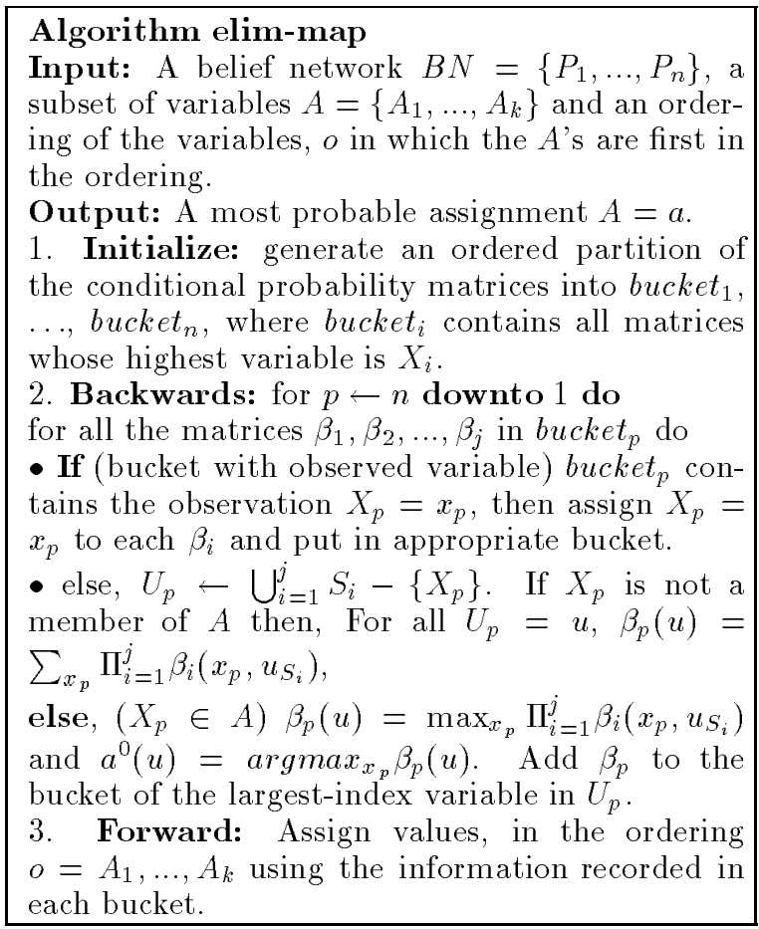
ELIM-MAP Algorithm
[Dechter 96]
Takes as input a probabilistic network, evidence (not mentioned), a subset of variables and an ordering in which those variables come first

Slide 59
ELIM-MAP Algorithm
[Dechter 96]
Outputs the assignment to the given variable subset that has the highest probability.

Slide 60
ELIM-MAP Algorithm
[Dechter 96]
Initialize buckets as normal.

Slide 61
ELIM-MAP Algorithm
[Dechter 96]
Process buckets from last to first as normal.

Slide 62
ELIM-MAP Algorithm
[Dechter 96]
If the bucket contains a variable assignment from evidence, apply that assignment and generate the corresponding function.

Slide 63
ELIM-MAP Algorithm
[Dechter 96]
Else if the bucket variable is not a member of the subset, take the product of all contained function, then project out the bucket variable by summing over it.

Slide 64
ELIM-MAP Algorithm
[Dechter 96]
Else if the bucket variable is a member of the subset, take the product of all contained function, then project out the bucket variable by maximizing over it.

Slide 65
ELIM-MAP Algorithm
[Dechter 96]
After all buckets have been processed, move in the forward direction and consult generated functions to obtain the most probable assignments to the subset.

Slide 66
Complexity
Section 14.3
With all bucket elimination, complexity dominated by time and space to process a bucket
Time and space exponential in the number of variables in a bucket
Induced width of the ordering bounds the scope of the generated functions

Slide 67
Complexity: adjusted induced width
Section 14.3
Adjusted induced width of G relative to E along d: w*(d,E) is the induced width along ordering d when nodes of variables in E are removed.
λ_{B}(a,c)
B
P(b|a)
λ_{D}(b,a)
λ_{F}(b,c)
B=1

Slide 68
Complexity: adjusted induced width
Section 14.3
Adjusted induced width of G relative to E along d: w*(d,E) is the induced width along ordering d when nodes of variables in E are removed.
λ_{B1}(a)
λ_{B2}(a)
λ_{B3}(c)
B
P(b|a)
B=1
λ_{D}(b,a)
B=1
λ_{F}(b,c)
B=1

Slide 69

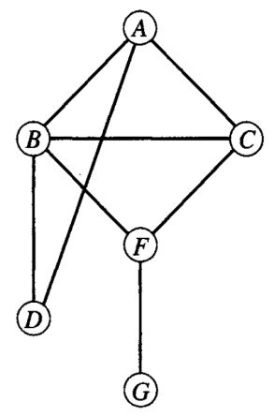
Complexity: orderings
Section 14.3
A
A
C
C
B
F
Belief network
F
D
D
G
G
B
w*(d₁ ,B=1)=2
w*(d₂ ,B=1)=3
Moral graph

Slide 70
Hybrids of Elimination and Conditioning
Section 14.4
Elimination algorithms require significant memory to store generated functions
Search only takes linear space
By combining these approaches the space complexity can be reduced and made manageable

Slide 71
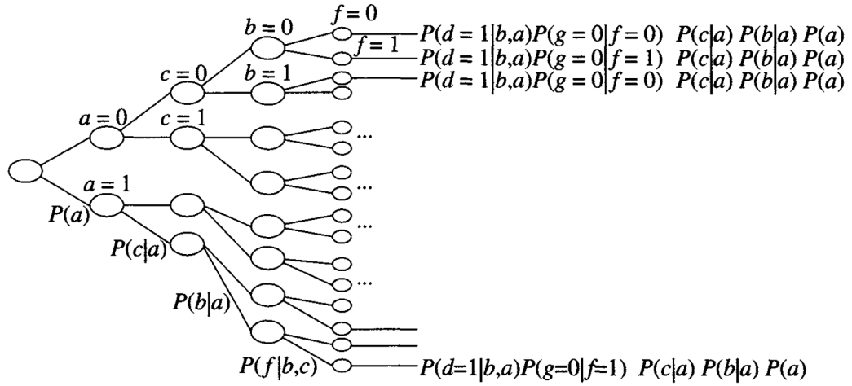
Full Search in Probabilistic Networks
Section 14.4
Traverse a search tree of variable assignments
When a leaf is reached, calculate the joint probability of that combination of values
Sum over values that are not of interest
Using search to find P(a, G=0, D=1)

Slide 72
Hybrid Search
Section 14.4
Take a subset of variables, Y, which we will search over
All other variables will be handled with elimination
First search for an assignment to variables in Y
Treat these as evidence and then perform elimination as usual

Slide 73
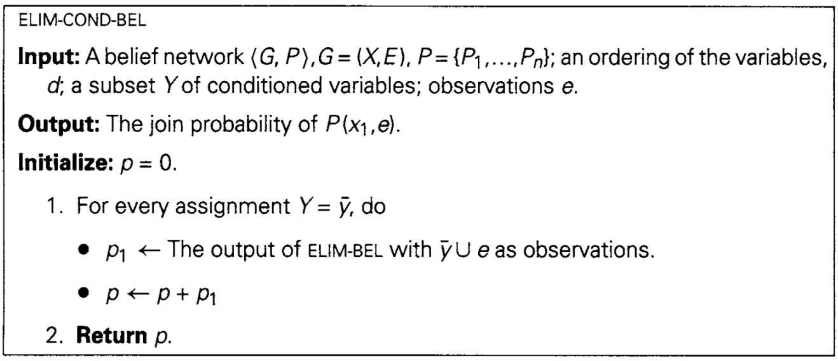
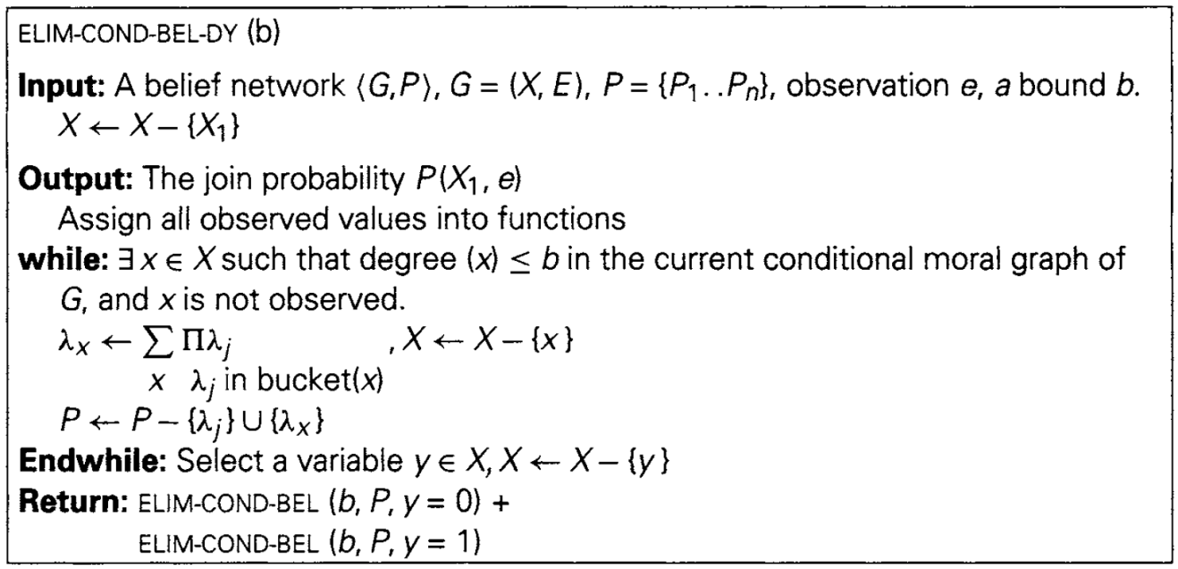
Hybrid Search
Section 14.4
Hybrid search with static selection of set Y
Hybrid search with dynamic selection of set Y

Slide 74
Hybrid Complexity
Section 14.4
Space: O(n∙exp(w* (d, Y U E)))
Time: O(n∙exp(w* (d, Y U E)+|Y|))
If E U Y is a cycle-cutset of the moral graph, graph breaks into trees and the adjusted induced width may become 1

Slide 75
Summary
Probabilistic networks are used to express problems with uncertainty
Most common queries:
belief assessment
most probable explanation
maximum a posteriori hypothesis
Bucket elimination can handle all three queries
Hybrid of search and elimination can cut down on space requirement

Slide 76
Questions?

