Slide 1
Constraint Satisfaction Problems (CSPs)
CSCE476/876, Fall 2023
www.cse.unl.edu/~choueiry/F23-476-876
Questions: Piazza
Berthe Y. Choueiry (Shu-we-ri)
AvH 259

Slide 2
Outline
CSP Definition
Graphical representation
Domain types
Constraint definition
Query
Examples
Consistency and constraint propagation
AC, PC, k-consisntency
Solving CSPs
Backtrack search: Var/val ordering, lookahead, intelligent backtracing
Local search
Exploiting structure
Tree structures, symmetry

Slide 3
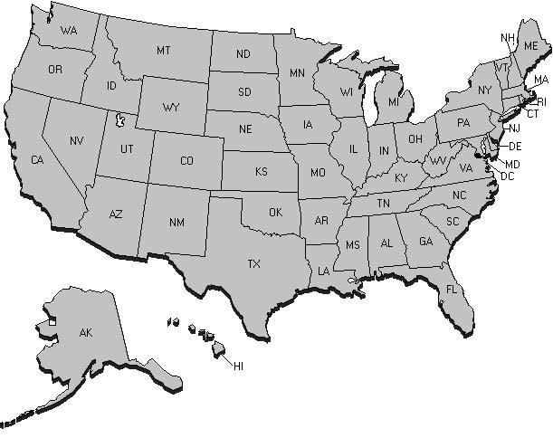
Example I: Map coloring
Using 3 colors (R, G, & B), color the US map such that no two adjacent states have the same color
Variables?
Domains?
Constraints?
3

Slide 4
Example I: Map coloring (cont’d)
Using 3 colors (R, G, & B), color the US map such that no two adjacent states have the same color
4

Slide 5
Definition of a CSP
Given
A set of variables
A set of variable domains (values)
A set of constraints
A solution where all constraints are satisfied
Query:
Does a solution exist?
What is the number of solutions?
Etc.
5
Notes:
C_i: \langle \mathit{scope},\mathit{rel}\rangle
\mathit{scope}(C_i) =\{{V_i}, {V_j},\ldots, V_k\} \subseteq \mathcal{V}
\mathit{rel}(C_i) =\{(x,y,\ldots,z\} \subseteq D_{V_i}\times D_{V_k}\times \ldots\times D_{V_k}
\mathit{rel}(C_i) =\{(x,y,\ldots,z\} \subseteq D_{V_i}\times D_{V_j}\times \ldots\times D_{V_k}
\mathit{scope}(C_i) =\{{V_i}\times {V_j}\times \ldots\times {V_k}\} \subseteq \mathcal{V}
\forall\; V_i \in \mathcal{V}, V_i \gets a_i \in D_{V_i}
C_i: \langle \mathit{scope},\mathit{rel}\rangle
\forall\; V_i \in \mathcal{V}, V_i \gets a_i \in D_{V_i}

Slide 6
CSP Definition: Terminology
Variable
Value
Domain of a variable, values of a domain
Variable assignment, variable instantiation, variable-value pair (vvp)
Constraint: scope, relation, arity
Supports, allowed
Nogoods, forbidden, conflicts
Nogood, minimal nogood
Partial assignment, partial solution
Complete assignment, solution
Consistent assignment, consistent solution
Universal constraint: binary constraint that allows all pairs of values between variables. It is the absence of any explicit (binary or non-binary) constraint between two given variables

Slide 7
Example II: Resource Allocation
What is the CSP formulation?
{ a, b, c }
{ a, b } { a, c, d }
{ b, c, d }
7

Slide 8
Example II: RA (cont’d)
{ a, b, c }
{ a, b } { a, c, d }
{ b, c, d }
Constraint Graph
T1
Interval Order
{ R1, R3 }
≠
T4
≠
≠
{ R1, R2, R3 }
≠
T6
T1
{ R1, R3 }
{ R2, R4 }
T2
{ R1, R3 }
{ R1, R3 }
≠
≠
≠
≠
T3
{ R1, R3 }
{ R1, R3, R4 }
T4
T2
{ R1, R2, R3 }
≠
≠
{ R1, R2, R3 }
≠
{ R2, R4 }
T5
{ R2, R4 }
T6
T3
{ R1, R3 }
T5
T7
T7
{ R2, R4 }
8

Slide 9
Graphical Representation
Graph
Vertices: variables
Edges: binary constraints
V₁
V₁ < V₂
{1,2,3,4}
{3,6,7}
V₂
V₁+V₃ < 9
V₂ < V₃
V₂ > V₄
V₃
{3,4,9}
{3,5,7}
V₄
Hypergraph
Vertices: variables
Hyperedges: constraints

Slide 10
Domain Types
x
Domains
Boolean CSPs: Restricted to {0,1}
Finite (discrete), enumeration works
Continuous, sophisticated algebraic techniques are needed
Consistency techniques on domain bounds
10

Slide 11
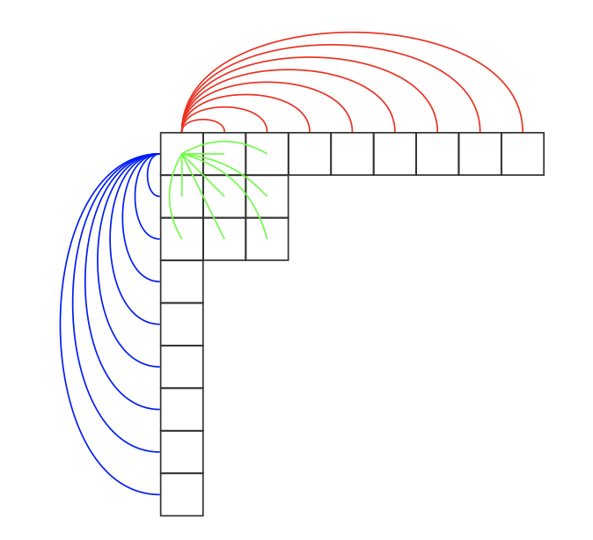
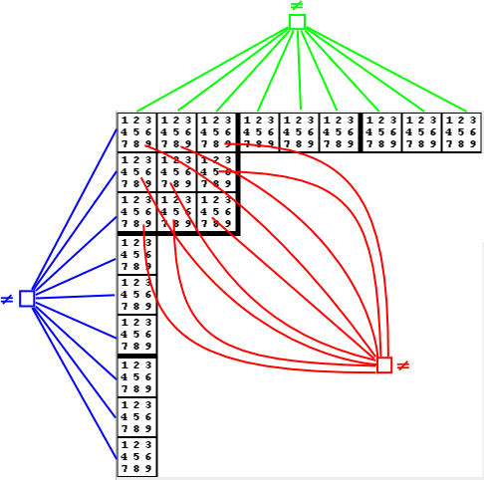
Example IV: Sudoku
Binary constraint model
Non-binary constraint model

Slide 12
Constraint Definition
A constraint C is defined by a
Scope, the set of variables on which the constraint applies
Notation: Scope(C), scope(C), scp(C)
Relation, a subset of the Cartesian product of the domains of the variables in the scope of the constraint
Notation: Relation(C), rel(C)
Arity of constraint: cardinality of the constraint’s scope
Unary, binary, ternary, …, non-binary
Global constraints: rel(C) is defined, scp(C) is a parameter
Example: AllDiff (Sudoku), Balance, Atmost
See: Global Constraints Catalog (https://sofdem.github.io/gccat/)
Universal constraint

Slide 13
Example III: Temporal reasoning
A < B
A
B
[1,10]
[5,18]
2 < C – A < 5
[4,15]
B < C
C
Give one solution: …….
Satisfaction, yes/no: decision problem
Note: bounded differences, gap constraints
13

Slide 14
Example V: Cryptarithmetic puzzles
D_{X1} = D_{X2} = D_{X3} = {0,1}
D_{F}=D_{T}=D_{U}=D_{W}=D_{R}=D_{O}=[0,9]
O+O = R+10X1
X1+W+W = U+10X2
X2+ T+T = O + 10X3
X3=F
AllDiff({F,T,U,W,R,O})
Note: Algebraic equality constraints, AllDiff
14

Slide 15
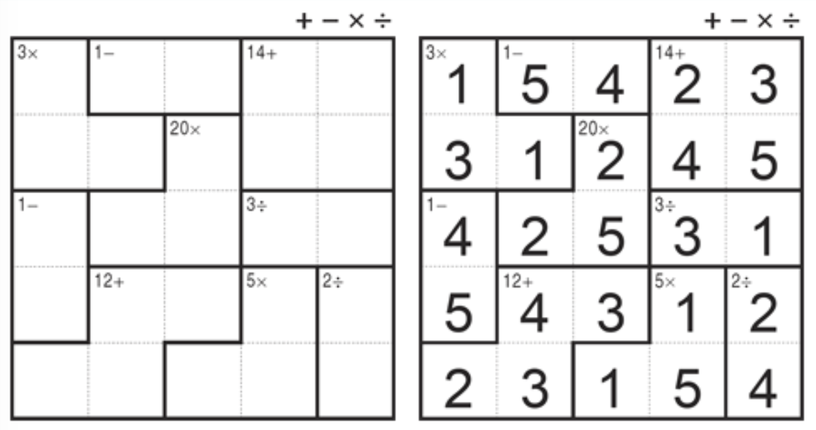
Example VI: Kendoku

Slide 16
Relation Definition
Extension, all tuples are enumerated
As a list of allowed tuples (supports, positive table)
As a list of forbidden tuples (conflicts, no-goods)
Intension, given by a set builder
When it is not practical or possible to list all tuples
Define types/templates of common constraints to be used repeatedly
Example: Global constraints
rel(C) is defined
scp(C) is a parameter
Examples: linear constraints, AllDiff (mutex), Atmost, TSP-constraint, cycle-constraint, etc.

Slide 17
Constraint Types
Algebraic constraints
Linear, nonlinear inequalities
Example: constraints
of bounded difference
Coloring (mutual exclusion, difference constraints)
AllDiff constraints, arbitrary constraints
V1
{1, 2, 3, 4}
v1 < v2
{ 3, 6, 7 }
V2
v1+v3 < 9
v2 < v3
v2 > v4
V3
{ 3, 4, 9 }
{ 3, 5, 7 }
V4
T1
Constraint Graph
{ R1, R3 }
≠
T4
≠
≠
{ R1, R2, R3 }
≠
T6
≠
≠
{ R2, R4 }
{ R1, R3 }
≠
≠
≠
≠
≠
≠
{ R1, R2, R3 }
≠
{ R2, R4 }
T3
{ R1, R3 }
T5
T7
17

Slide 18
Query
Different queries yield different problems
Decide if a solution exists decision problem
Find a solution exemplification problem
Find a minimum set of constraints that can be removed so that a solution exists optimization (min/max) problem
Find number of/all solutions counting problem
Etc.
18

Slide 19
Outline
CSP Definition
Graphical representation
Domain types
Constraint definition
Query
Examples
Consistency and constraint propagation
AC, PC, k-consistency
Solving CSPs
Backtrack search: Var/val ordering, lookahead, intelligent backtracing
Local search
Exploiting structure
Tree structures, symmetry

Slide 20
Enforcing Consistency
Goal Reduce
domain size
relation size
Operation
Checking consistency
Propagating constraints
Examples
Node consistency
Arc consistency (AC)
Path consistency
k-consistency, Higher-order consistency
A < B
A
B
[1,10]
[5,18]
2 < C–A < 5
B < C
[4,15]
C

Slide 21
AC Algorithm: AC-3
Two components
Enforcing consistency
Check((V_{i},x),(V_{j},y))
Revise(V_{i},V_{j})
Propagating constraints
Loop and update the propagation queue
A < B
A
B
[1,10]
[5,8]
2 < C–A < 5
[4,15]
B < C
C
Check((C,4),(B,5))? Check((C,15),((B,5))?
Revise(C,B)? Revise(B,C)?

Slide 22
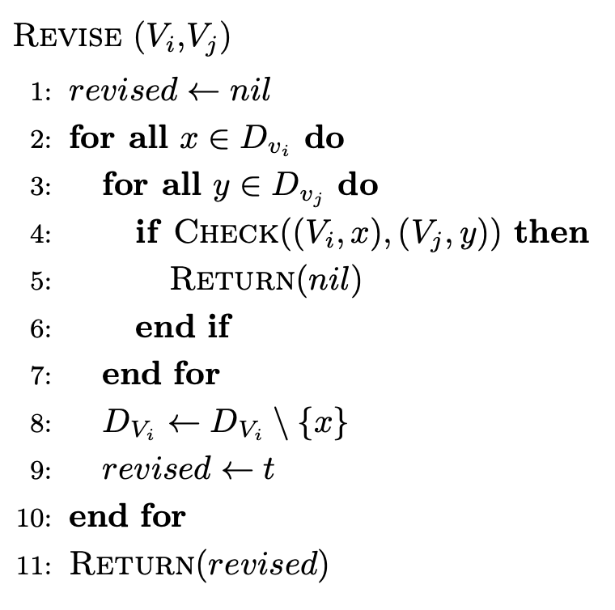
Revise
A < B
A
B
[1,10]
[5,8]
2 < C–A < 5
[4,15]
B < C
C
Consider
Revise(C,B)
Revise(B,C)

Slide 23
About Revise
After Revise(V_{i}, V_{j}) all the values in dom(V_{i}) are supported in dom(V_{j})
Revise(V_{i}, V_{j})
Updates the domain of V_{i}
Enforces of the consistency of V_{i} WRT V_{j}
Revise(V_{i}, V_{j}) and Revise(V_{j}, V_{i}) differ
Complexity of Revise(V_{i}, V_{j}) is O(d²)
where d is the maximum domain size

Slide 24
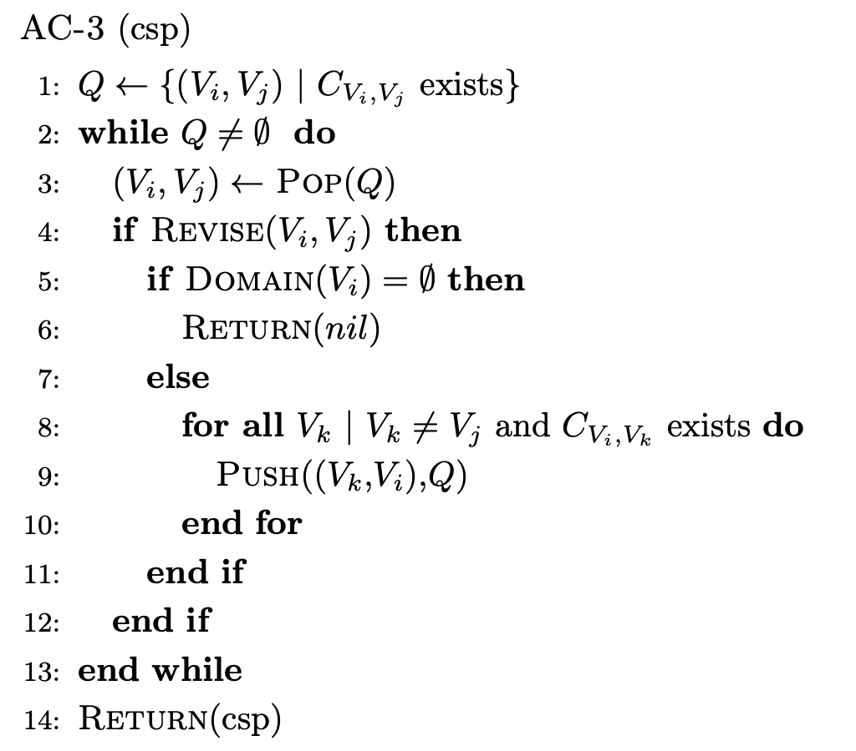
AC-3
V_{i}
V_{j}
V_{k}

Slide 25
About AC-3
Revise(V_{i}, V_{j}) enforces the consistency of V_{i} WRT V_{j}
AC-3 propagates constraints
A CSP is AC iff all variables are consistent WRT to all incident constraints (formal definition exists)
Complexity of AC-3 is O(ed³) = O(n²d³)
d is the maximum domain size
e is the number of constraints
n is the number of variables
New versions of AC-3 exist
AC-3 filters domains of the variables
Latest algorithms filter the binary constraint (tables)

Slide 26
AC, PC, k-consistency
Arc consistency
2-consistency
vvp
Path consistency
3-consistency
tuple
{r,g}
≠
{r,g}
<
{1,2,3}
<
<
{1,2}
<
≠
≠
≠
{r,g}
{r,g}
{r,g}
{rg,}
{1,2,3}
{1,2,3}
{1}
{3}
=
<
Strong 3-consistency
k-consistency
any consistent assignment of length k-1
k^{th} variables
Strong k-consistency: k-consistent for all 1 < i ≤ k

Slide 27
Beyond Arc Consistency
Generalized AC (GAC)
Example: AllDiff
See Global Constraints Catalog (https://sofdem.github.io/gccat/)
Bound Consistency
{1,2,3}
{3}
{1,2}
{1,2}
{1,2}
{1,2}
[0,165]
[0,385]
X+Y=420
[35,165]
[255,385]
X+Y=420

Slide 28
Outline
CSP Definition
Graphical representation
Domain types
Constraint definition
Query
Examples
Consistency and constraint propagation
AC, PC, k-consisntency
Solving CSPs
Backtrack search: Var/val ordering, lookahead, intelligent backtracing
Local search
Exploiting structure
Tree structures, symmetry

Slide 29
Systematic Search
Starting from a root node
Consider all values for a variable V₁
For every value for V₁, consider all values for V₂
etc..
For n variables, each of domain size d
Maximum depth fixed!
Maximum number of paths? size of search space
root
V₁
V₂
V_{n}

Slide 30
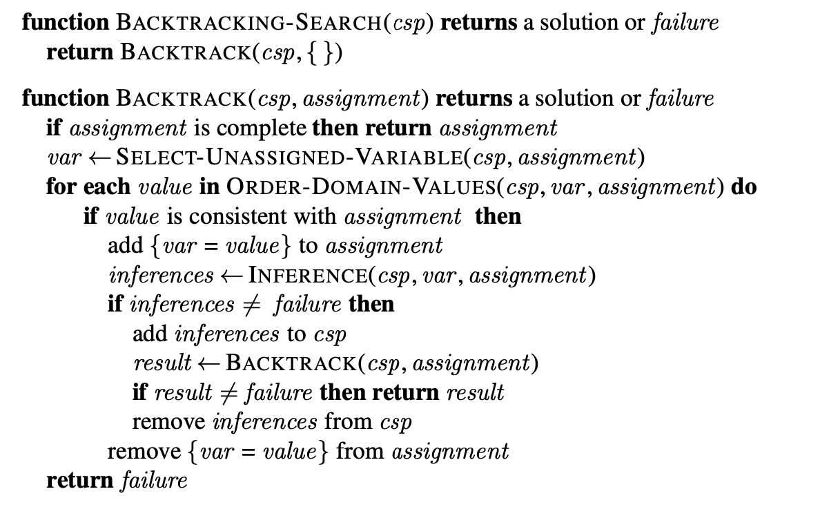
Backtrack Search
Variable ordering
Value ordering
Back checking
Lookahead
Intelligent backtracking

Slide 31
Variable Ordering Heuristic
Rationale
Choose the most constrained variable first
Intuitively, to reduce the branching factor
Examples
Least domain (LD), aka MRV
Largest degree (deg)
dom/deg
Etc.

Slide 32
Value Ordering Heuristic
Rationale
Choose the most promising value first
Intuitively, so we don’t have to undo decision
Example
Min-conflict: choose the values appearing in the least number of conflicts/no-goods/ forbidden tuples
3
3
0

Slide 33
Backtrack Search
Variable ordering
Variable ordering
Back checking
Lookahead
Intelligent backtracking

Slide 34
Back-checking
Rationale
Maintain the consistency of current path
Mechanism
When instantiating V_{i}, (back)check consistency with each previous assignment
If consistent, move to V_{i+1}
If inconsistent, try another value
If no other value exists, backtrack chronologically
root
V₁
V₂
V_{i}

Slide 35
Lookahead (inference)
Rationale
Maintain the consistency of future subproblem after each assignment
Mechanism
When instantiating V_{i}, enforce consistency of future subproblem
Forward checking revises the domain of the future variables that are adjacent to current variable V_{c}
Maintaining Arc Consistency enforces AC on the current assignment and the entire future subproblem
Advantage: domain-wipe out in the future
Question
Is back-checking needed with lookahead?
root
root
V_{c}
V_{c}
Maintaining Arc Consistency enforces AC on the current assignment and the entire future subproblem
FC
Real-Full Lookahead
MAC

Slide 36
Intelligent backtracking
Dead-end is encountered when
No more values for current variable
Backtracking
Chronological: undo previous assignment
Backtrack to source of conflict
Backjumping
Conflict-directed backjumping
Graph-based backjumping, etc.
Opportunity to learn no-goods
root
V₁
V₂
V_{i}

Slide 37
BT Search: Improving Performance
Three general mechanisms to improve performance of search
Variable, value ordering heuristics
Intelligent backtracking avoids repeating failure
Look-ahead: enforcing consistency as instantiations are made

Slide 38
BT Search: Terminology
Constructive, systematic, exhaustive
In general sound and complete
Back-checking: expands nodes consistent with past
Backtracking: Chronological vs. intelligent
Ordering heuristics:
Most constrained variable
Most promising value
Looking ahead:
Weak: Forward checking (FC)
Full Real Lookahead (aka Maintaining Arc-consistency or MAC)

Slide 39
Local Search for CSPs
Methodology: Iterative repair
Modifies a complete but inconsistent assignment to decrease the number of violated constraints
Example: Min-Conflicts algorithm Fig 6.8, page 198
Choose (randomly) a variable in a broken constraint
Change its value using the min-conflict heuristic (which is a value ordering heuristic)
Other examples: Hill climbing, taboo search, simulated annealing, etc.
→ Anytime algorithm → Strategies to avoid getting trapped: RandomWalk → Strategies to recover: Break-Out, Random restart, etc.
→ Incomplete & not sound

Slide 40
Break-Out Strategy
Initialization: All constraints are assigned weight = 1
The evaluation of a state includes the sum of the weights of the broken constraints
In each state, when a constraint is broken, we increment its weight
Eventually, frequently broken constraints become “important” allowing us to artificially break out of a local minimum

Slide 41
Outline
CSP Definition
Graphical representation
Domain types
Constraint definition
Query
Examples
Consistency and constraint propagation
AC, PC, k-consisntency
Solving CSPs
Backtrack search: Var/val ordering, lookahead, intelligent backtracing
Local search
Exploiting structure
Tree structures, symmetry

Slide 42
Exploiting Structure
Independent subproblems
Biconnected components
Tree-structured CSPs
Cutset conditioning (aka cycle cutset method)
Tree decomposition
Value symmetry

Slide 43
Tree-structured CSP
Consistency, bottom up
Starting from the leaves
Revise a parent given the domain of a child (directional arc consistency)
Keep going up to the root
Instantiations, top down
Instantiate variables from the root to the leaves
Runs in O(nd²), n is #variables and d domain size

Slide 44
Tree-Structured CSP
Any tree-structured CSP can be solved in time linear in the number of variables
Consistency, bottom up
Instantiations, top down
The assignment can be done backtrack-free
Idea exploited in
Cutset method
Tree decompositions

Slide 45
Cutset Conditionning
Identify a cycle cutset S in the CSP (nodes that when removed yield a tree), the remaining variables form the set T
Find a solution to the variables in S (S is smaller than initial problem)
For every consistent solution for variables in S :
Apply DAC from S to T. If domain wipeout, find another solution to T
Apply DAC bottom-up in S . If domain wipeout, find another solution to T
Solve T (top-down). Now, you have a solution to the CSP
Note:
If |S| = c, time is O(d^{c} (n−c) d²)
If graph is nearly a tree, c is small, and savings are large.
In the worst-case, c = n − 2 ☹
Finding the smallest cutset is NP-hard ☹ ☹

Slide 46
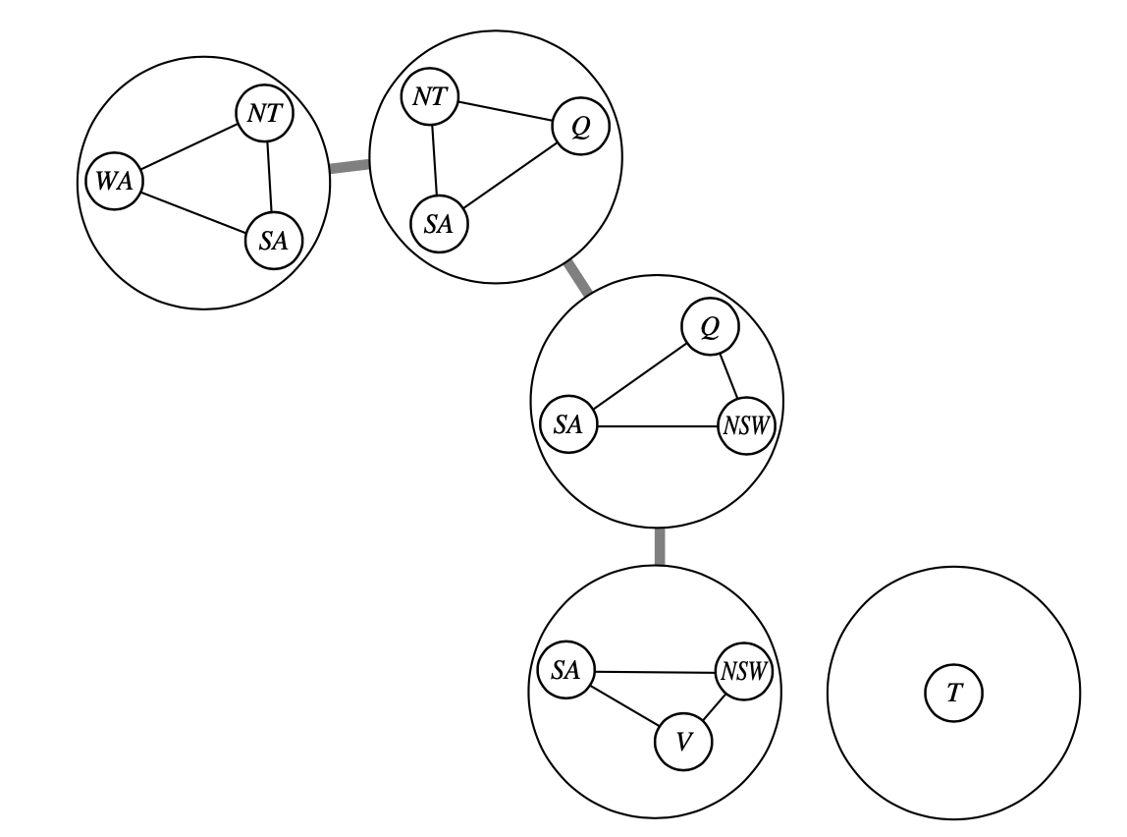
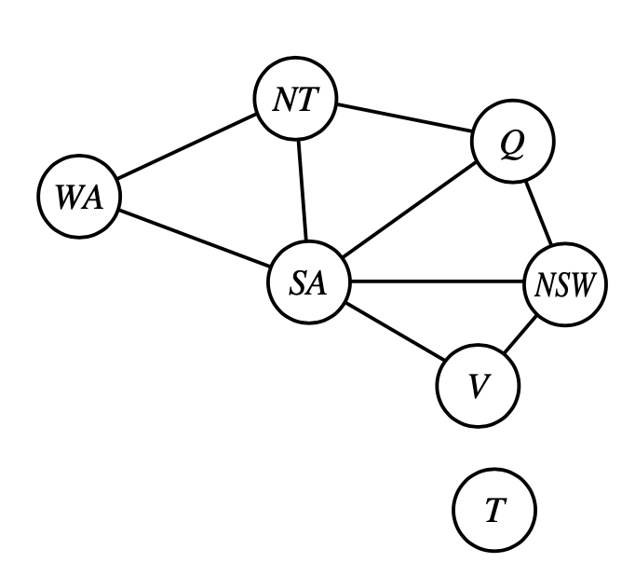
Tree Decomposition
Cluster the nodes of the CSP into subproblems organized in a tree structure
Every variable appears in at least one subproblem
If 2 variables are connected by a constraint, they must appear together (along with the constraint) in at least one subproblem
If a variable appears in 2 subproblems, it must appear in every suproblem along the path between the 2 subproblems

Slide 47
Solving a Tree Decomposition
Solving
Each subproblem is a meta-variable, whose domain is the set of all solutions to the subproblem
Starting from leaves, proceed bottom up
Ensure that solutions of parent agree w/ solution of children (common variables must agree)
Build solution top-down, backtrack free
Complexity
Complexity depends on w, the treewidth of the decomposition (number of nodes in largest subproblem – 1): O(n d ^{w+1})
Thus, CSPs with a bounded w can be solved in polynomial time
Finding the decomposition with minimal treewidth in NP-hard ☹

Slide 48
Value Symmetry
Known symmetry
In map coloring, new solutions can be generated by permuting the colors
Add symmetry-break constraints to disallow permutations of solutions
Example: Adding “CO < NE < IA”
Allows CO←col1, NE←col2, IA←col3
Prevents (CO←col2, NE←col1), (CO←col3, NE←col2), etc.
Discovering symmetry
Equivalent to graph isomorphism (open questions: P or NPC?)
Efficient methods for value interchangeability exist
Example: values that have the same supports are interchangeable

Slide 49
Take Away Message
Constraint Programming (CP)
CP = Modeling + Inference + Search
Variables
Domains
Constraints
Query
AC, PC, HLC
Enforce consistency (filtering)
Propagate constraint
Systematic (w/ backtracking) or
Non-systematic (hill climbing, taboo, etc.)

